Slide 1
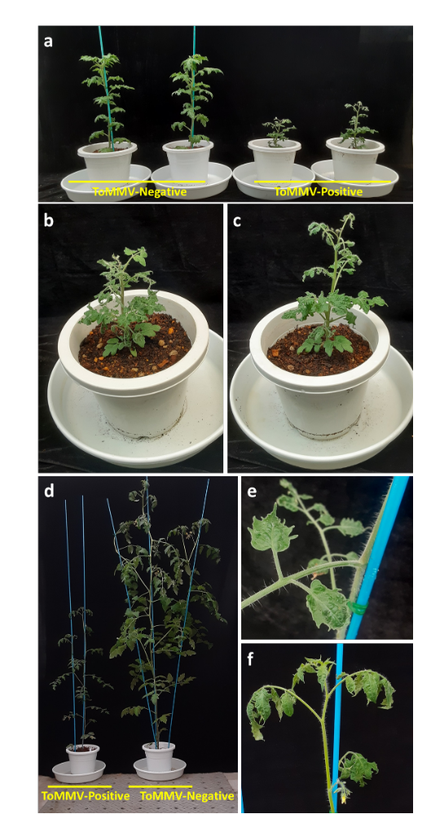
Supplementary Fig. S1 Symptoms of seed-transmitted tomato seedlings infected with ToMMV through the tomato seeds on eight weeks after transplanting. (a) Inhibited growth of ToMMV-positive tomato (cv. Rejina) seedlings. (b) Leaf distortion (left) ToMMV-positive seedling in (a). (c) Leaf distortion (right) in ToMMV-positive seedling shown in (a). (d) Inhibited growth on ToMMV-positive tomato (cv. Carol Passion) seedling. (e) Mottling in the leaf on ToMMV-positive seedling shown in (d). (e) leaf distortion on ToMMV-positive seedling shown in (d).

