Slide 1
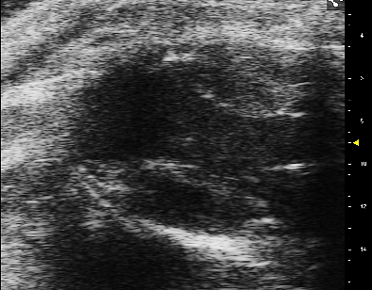
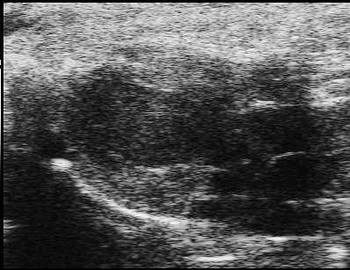
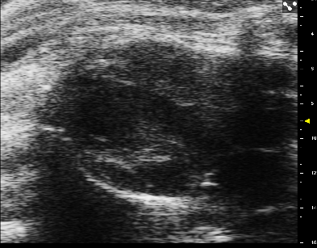
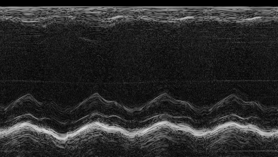
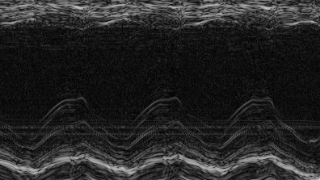
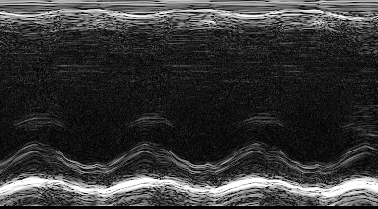
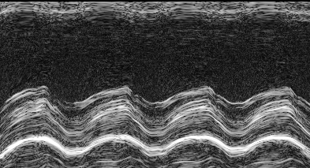
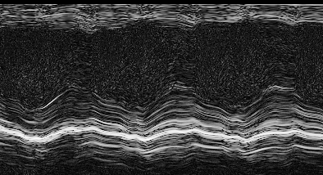
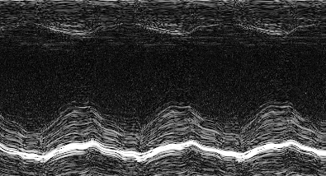
Supplementary Figure I
Vehicle MSCs CMCs CPCs
B-mode
Post-Rx Pre-Rx
M-mode
Post-Rx Pre-Rx
Supplementary Figure I: Representative B-mode long axis images during systole from a vehicle-, MSC-, CMC-, and CPC-treated rat obtained before treatment (Pre-Rx, 1st row) and at 35 d after treatment (Post-Rx, 2nd row) and M-mode images before treatment (Pre-Rx, 3rd row) and at 35 d after treatment (Post-Rx, 4th row).
Supplementary Figure II

Slide 2
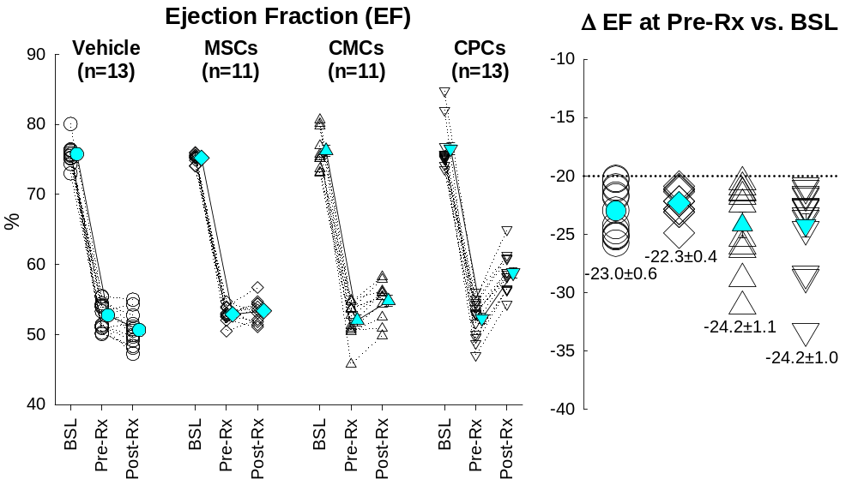
Supplementary Figure II
A
B
Vehicle (n=13)
CMCs (n=11)
MSCs (n=11)
CPCs (n=13)
Supplementary Figure II. Echocardiographic assessment of LV ejection fraction (EF). A. Line plots showing the time-course of EF in individual animals (open symbols with dotted lines) and average values (solid symbols with solid lines) at baseline (BSL), before treatment (30 d after MI, Pre-Rx), and 35 d after treatment (Post-Rx) in the vehicle, MSCs, CMCs, and CPCs groups; B. EF drop before treatment (30 d after MI, Pre-Rx) from baseline value. Open symbols represent individual animals and solid symbols stand for average. Data are means ± SEM.

