Slide 1
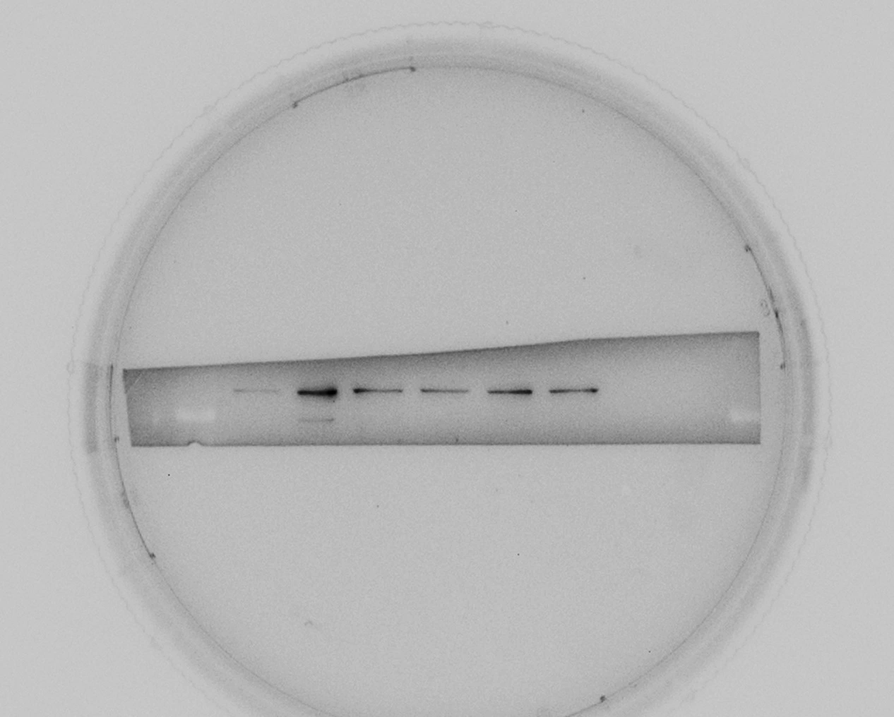
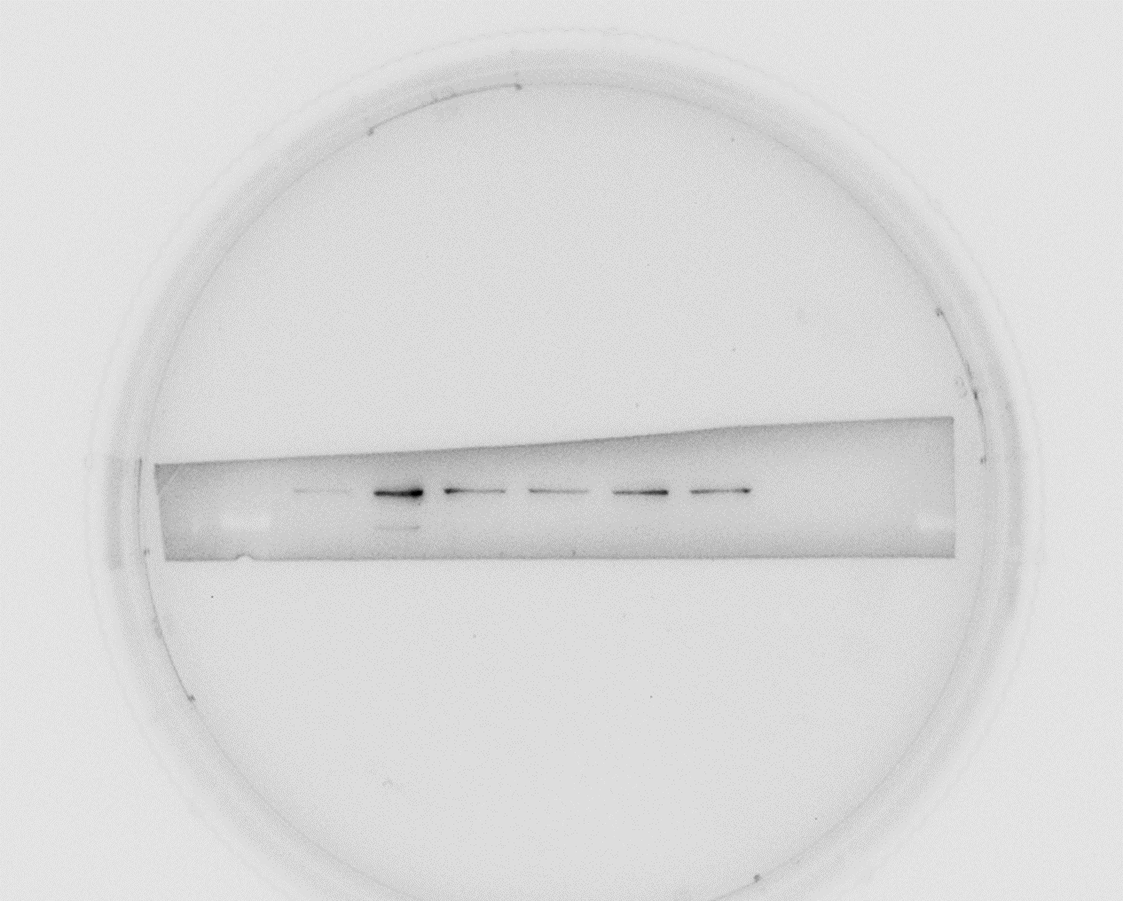
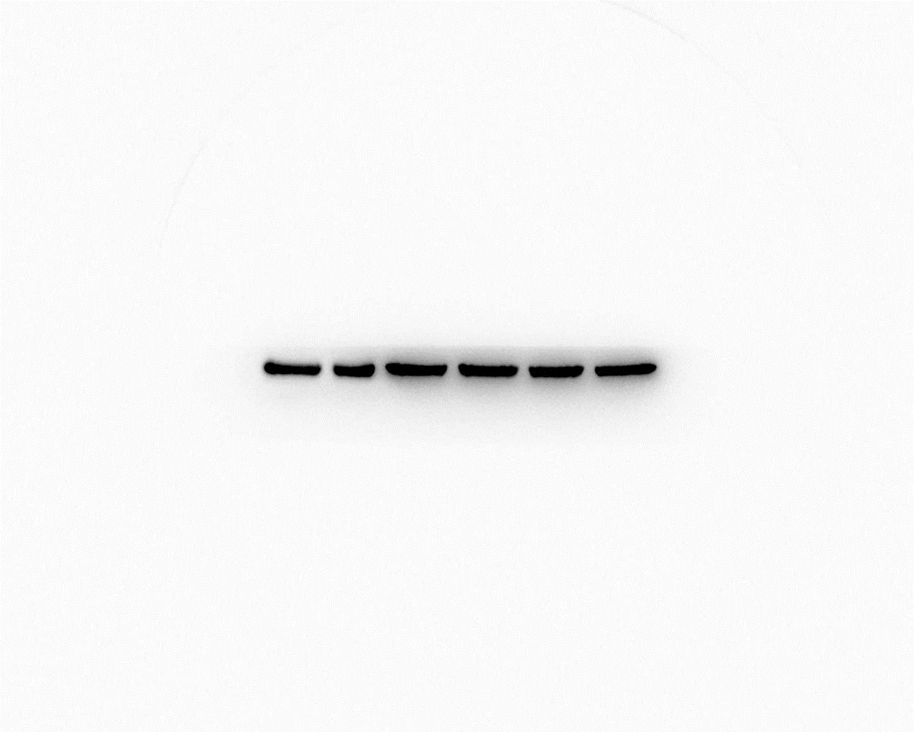
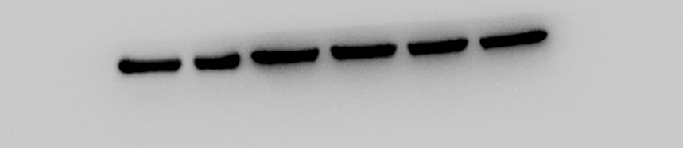
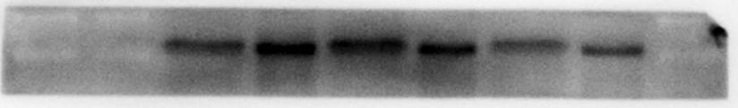
Figure 1C
raw membrane
In article
The data was from Experiment 1
+CD3/CD28
Unstimulation
Unstimulation
+CD3/CD28
kDa
SATB1
SATB1(86)
100
β-actin
70
β-actin (42)
40
Experiment 1
Unstimulation
Unstimulation
Unstimulation
kDa
+CD3/CD28
+CD3/CD28
+CD3/CD28
100
SATB1(86)
70
55
β-actin(42)
40
Experiment 2
Experiment 3
Experiment 4

Slide 2
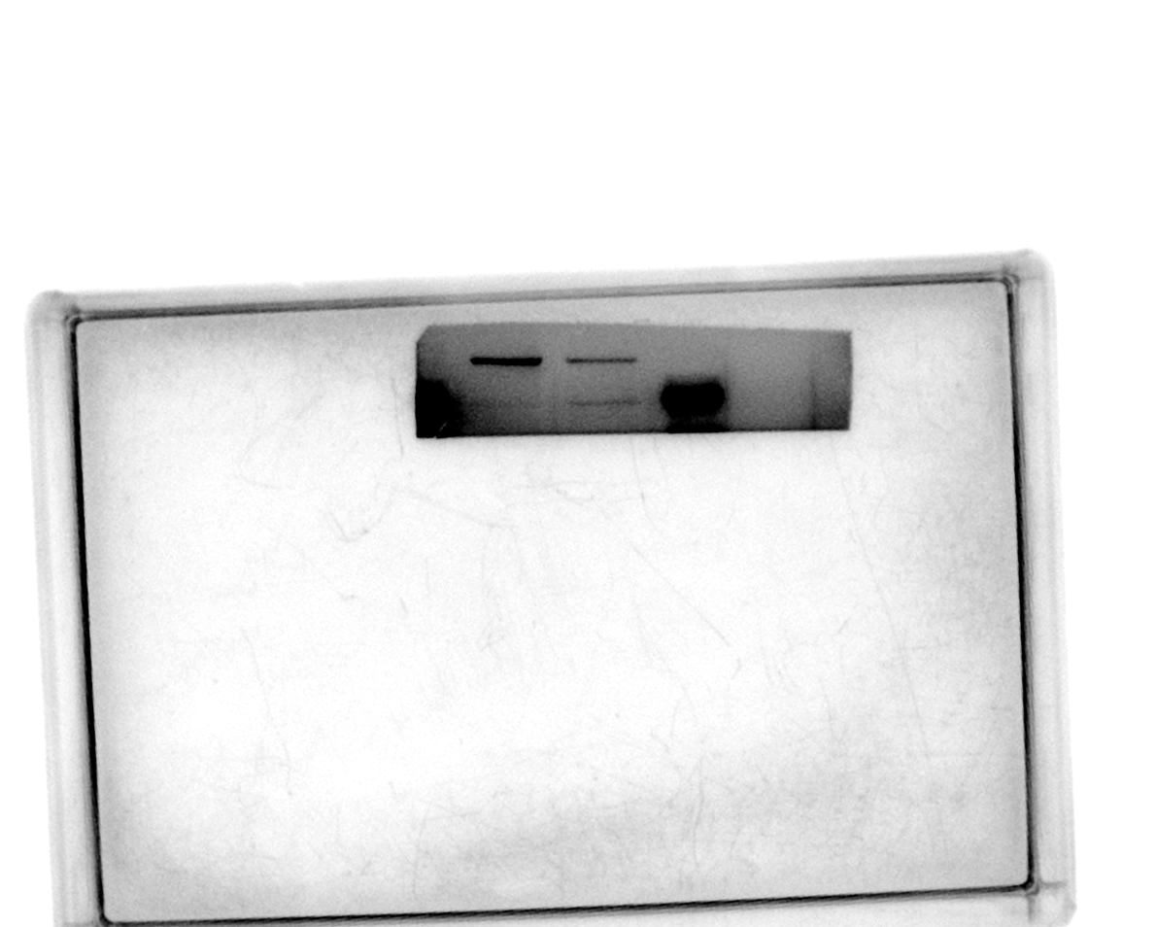
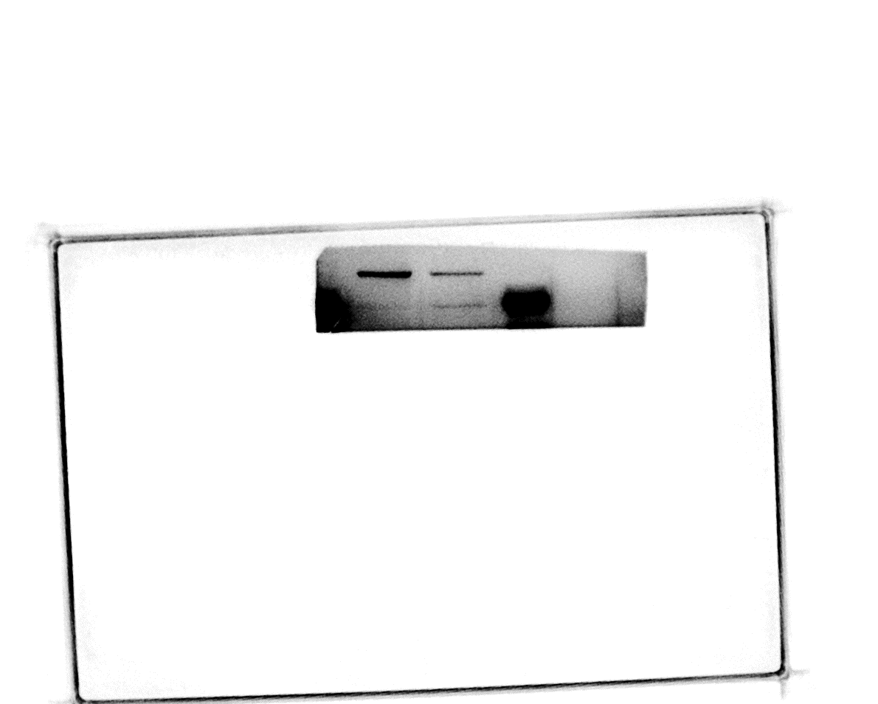
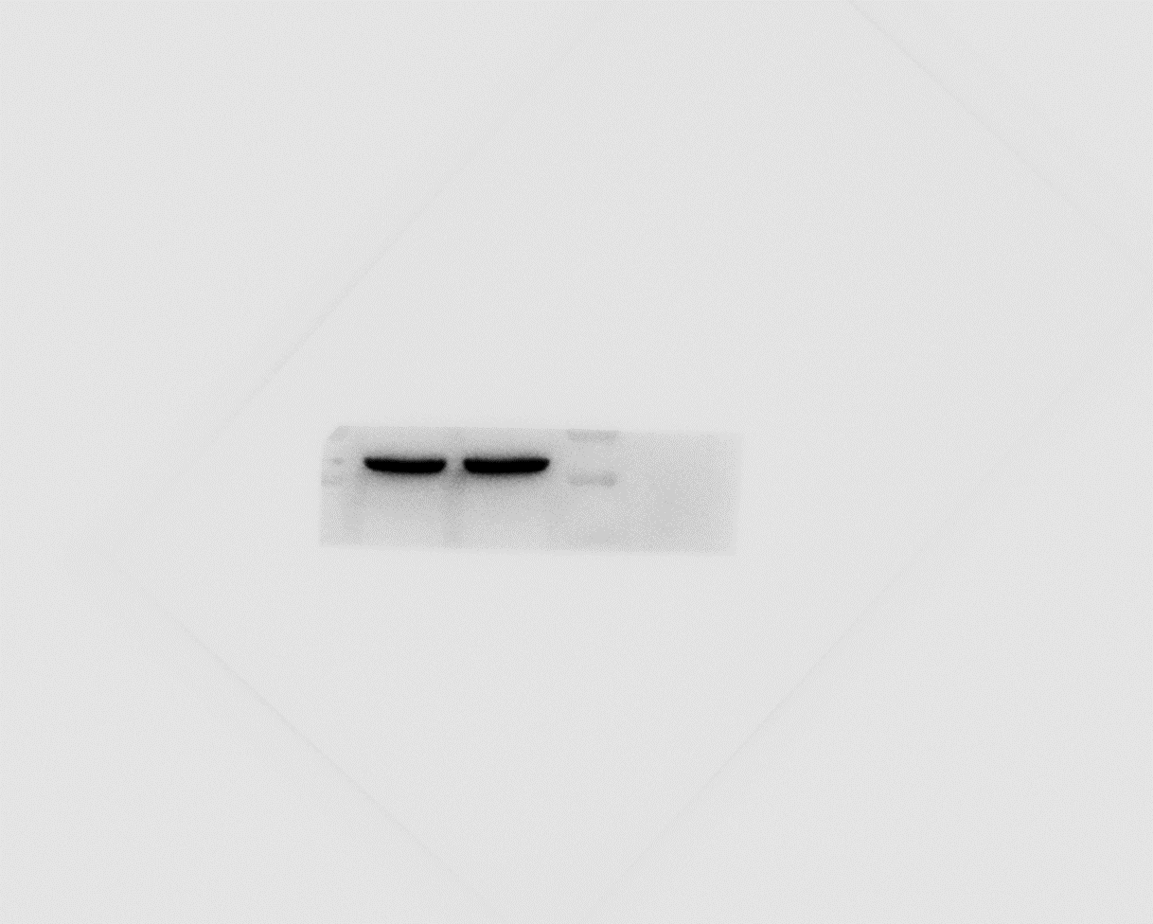
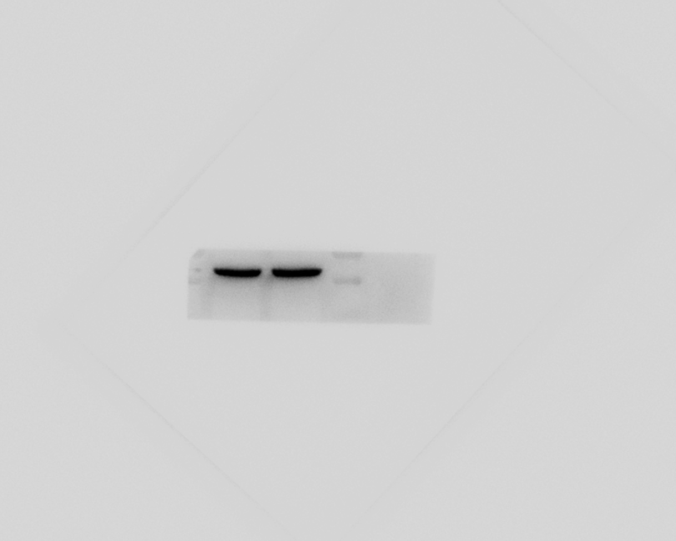
Figure 2B
raw membrane
In article
The data was from Experiment 1
SATB1-CAR-T
kDa
CAR-T
CAR-T
SATB1-CAR-T
SATB1(86)
70
SATB1
β-actin
55
β-actin (42)
40
Experiment 1
SATB1-CAR-T
SATB1-CAR-T
CAR-T
CAR-T
kDa
SATB1(86)
100
70
β-actin (42)
40
Experiment 2
Experiment 3

