Slide 1
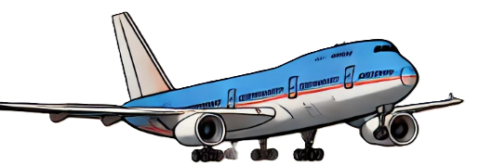
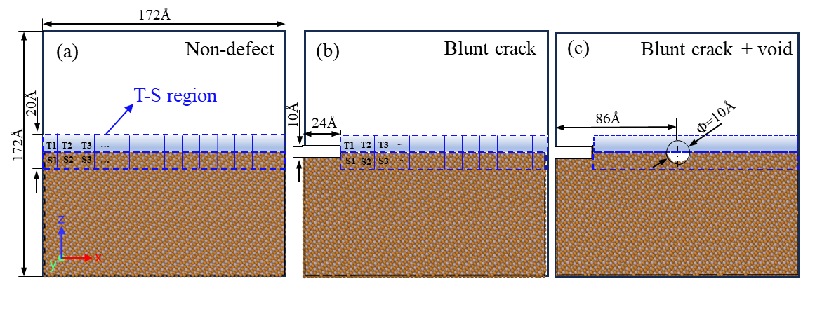

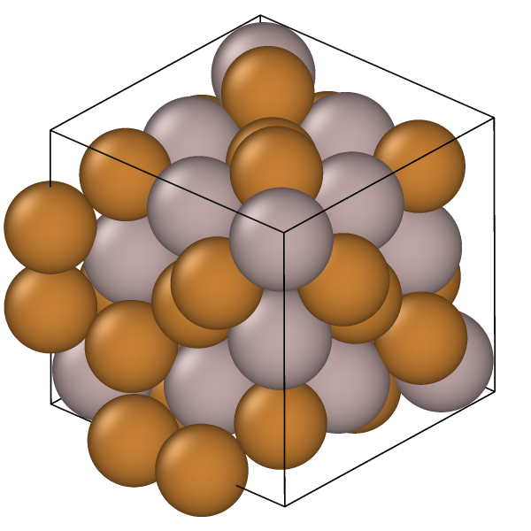

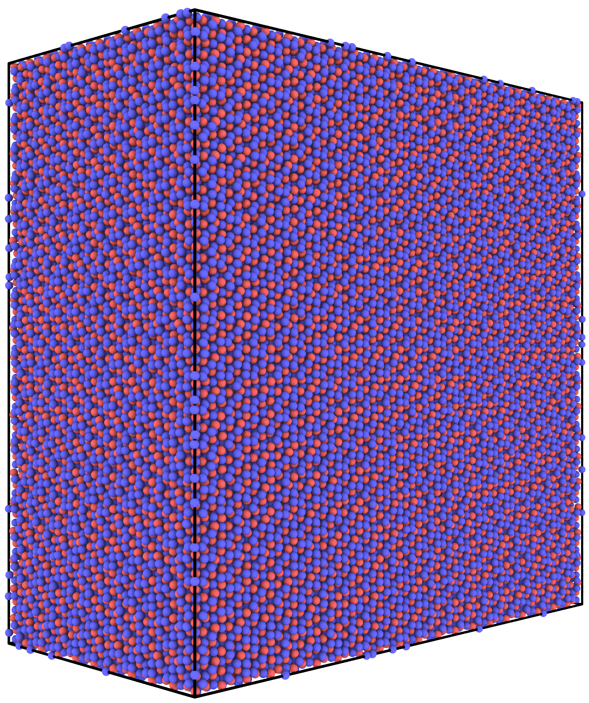
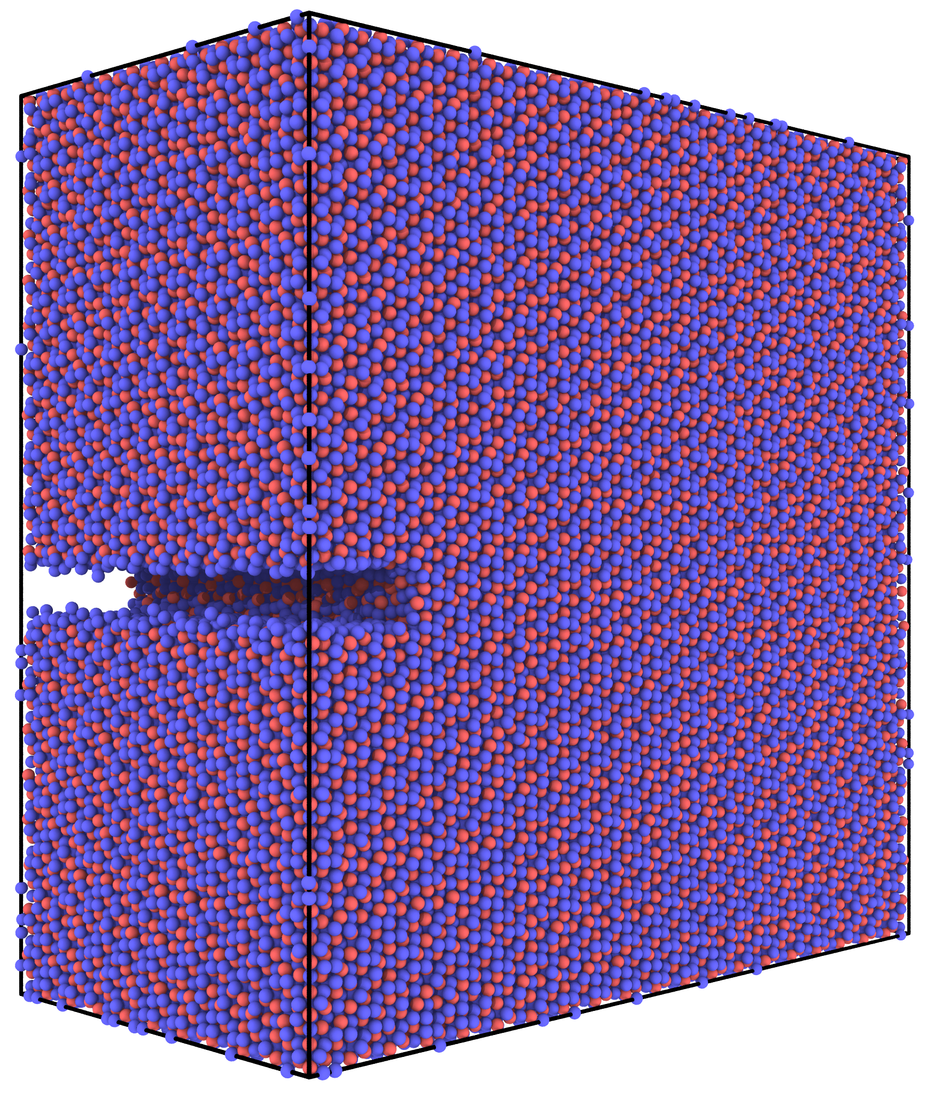
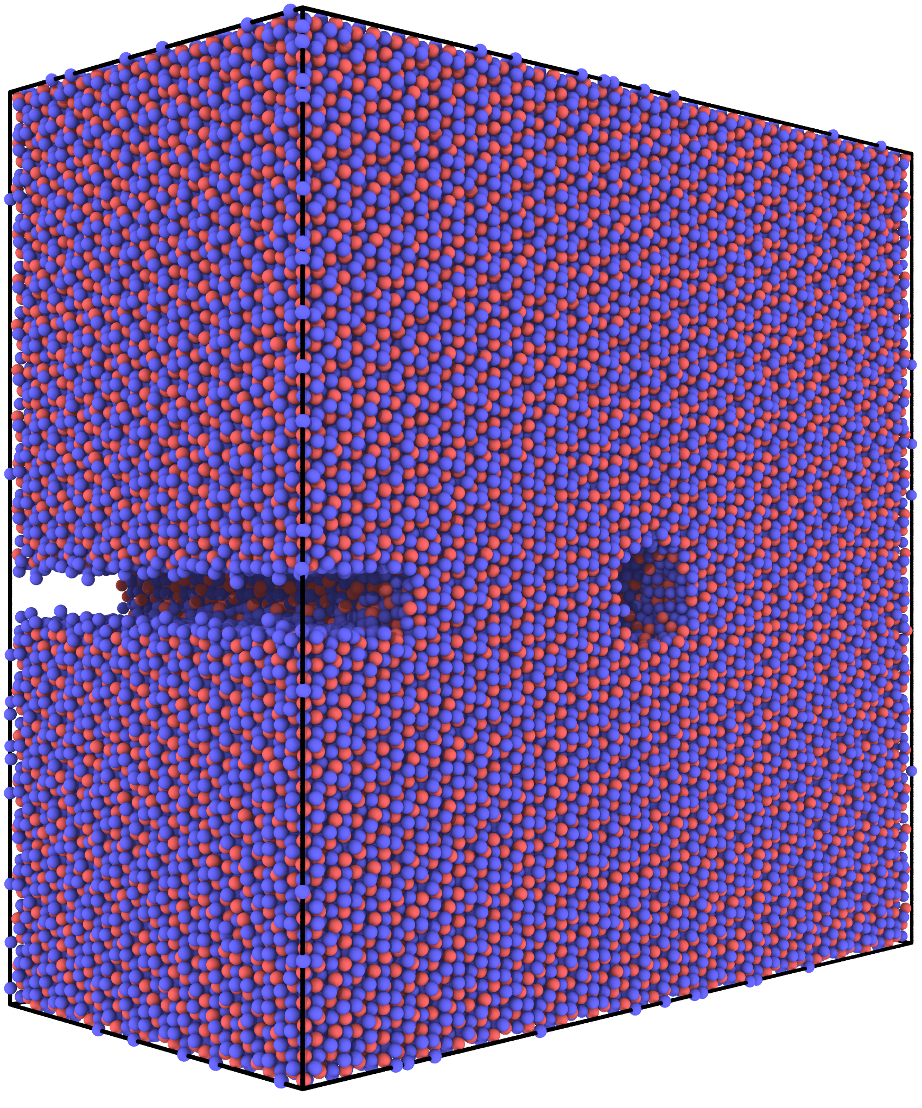
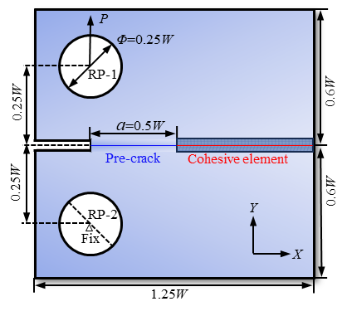
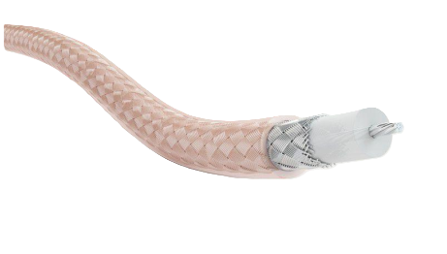


Multiscale Crack Modeling and Methodology Flowchart for Al₄Cu₉ Impact-Welded Alloy
Background
Methodology
Al₄Cu₉
Uniaxial stretching
Distributed in small spaces
Different defect types
The strain rate 0.005
Good electrical conductivity
LAMMPS
The working conditions are relatively harsh
ABAQUS
CZM parameter
Cu-Al conductive cables for aerospace
Non-defect
Blunt crack
Blunt crack + void
Results
Discussion
Traction-separation curve
Different Temperatures
Damage stress
Fracture energy
Stiffness
Relationship between reaction force and displacement
ASTM E399-2024
stress cloud diagram
Conclusion
Defect type dominates fracture toughness fluctuations in Al₄Cu₉ (100-500 K) more significantly than temperature variations.

