Slide 1
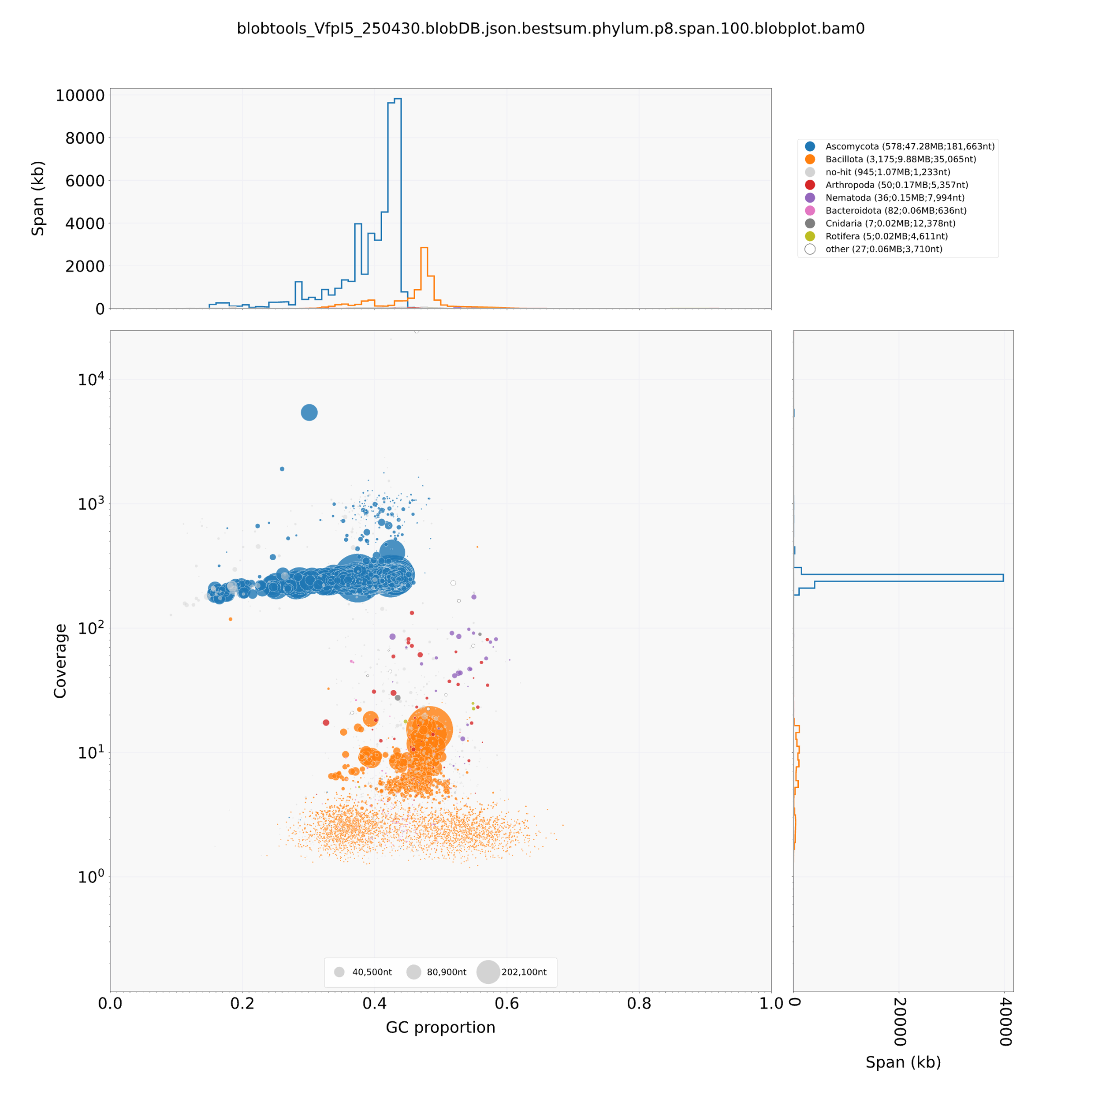
Supplementary Fig. S1 BlobTools plot of genome contamination. Points represent contigs, positioned by GC content (x-axis) and read coverage (y-axis). Colours show taxonomic assignment from DIAMOND BLAST. Outliers mark putative contaminants.

