Slide 1
After transfer, the PDF membrane could cut according to molecular weight of specific proteins. See the following image. If the whole membrane to incubate the primary and secondary antibody we need spend a large amount and we large amount substrate, so we want to minimize the antibody and substrate usage we cut the membrane.

Slide 2
Figure 3
SIRT1

Slide 3
Figure 3
NLRP3

Slide 4
Figure 3

Slide 5
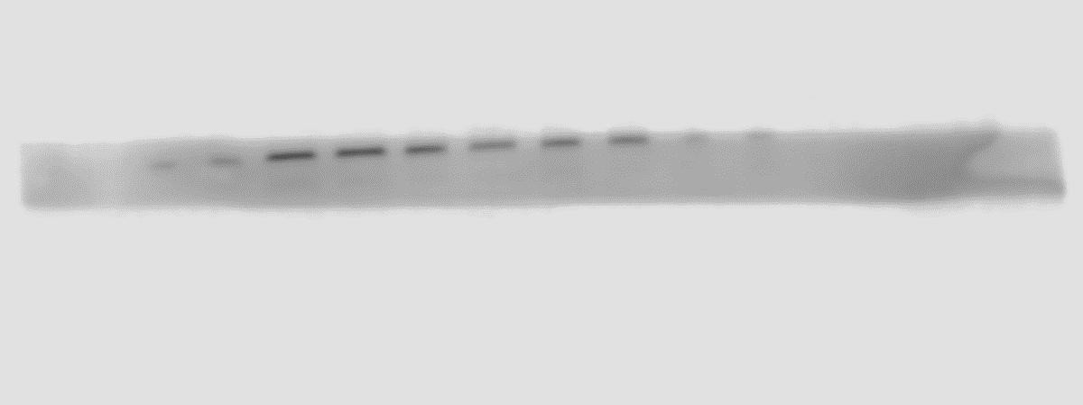
Figure 3
CLEAVED CASPASE-1

Slide 6
Figure 3

Slide 7
Figure 3

Slide 8
Figure 3

Slide 9
Figure 6
NRF2

Slide 10
Figure 6
HO-1

Slide 11
Figure 6
BDNF

Slide 12
Figure 6
β- Actin

