Slide 1
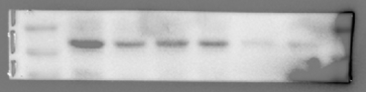
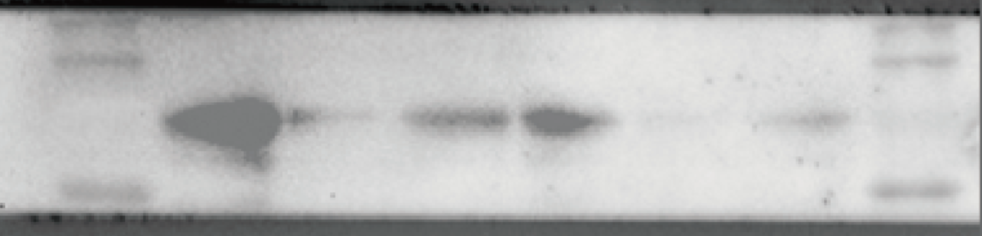
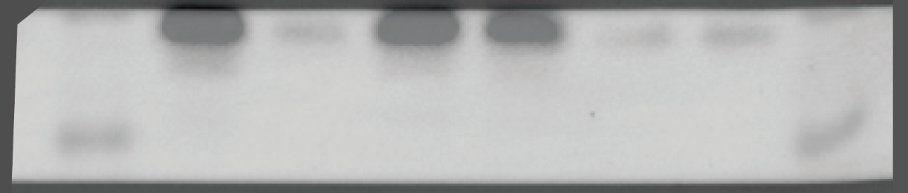
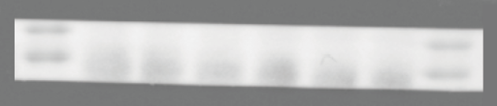
Original image：Fig 2D
Erastin
Erastin
Sham
LPS
NE
Sham
LPS
NE
Sham
LPS
NE
Sham
LPS
NE
20 KD
67 KD
GPX4
17 KD
SLC7A11
55 KD
15 KD
48 KD
Erastin
Erastin
Sham
LPS
NE
Sham
LPS
NE
Sham
LPS
NE
Sham
LPS
NE
20 KD
21 KD
40 KD
FTH1
GAPDH
35 KD
36 KD

Slide 2
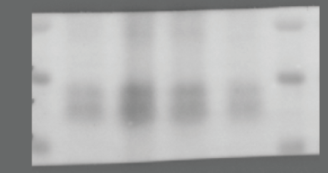
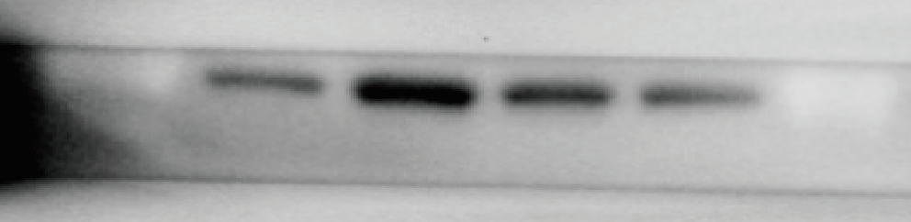
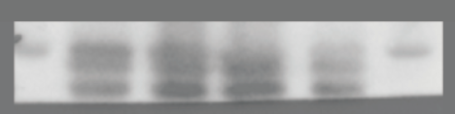
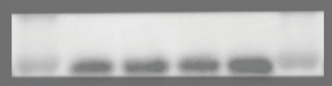
Original image：Fig 3D
LPS
LPS
PBS
SAL
NE+BUT
PBS
SAL
NE+BUT
NE
NE
20 KD
FTH1
20 KD
21 KD
GPX4
17 KD
15 KD
LPS
LPS
PBS
SAL
NE+BUT
SAL
NE+BUT
NE
PBS
NE
55 KD
40 KD
SLC7A11
55 KD
GAPDH
35 KD
36 KD

Slide 3
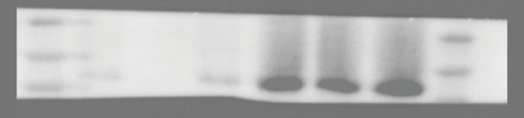

Original image：Fig 4H
NE
NE+BUT
HDC
95 KD
67 KD
74 KD
NE
NE+BUT
GAPDH
40 KD
35 KD
36 KD

Slide 4

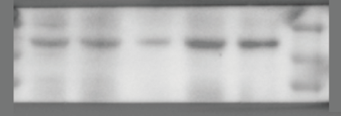
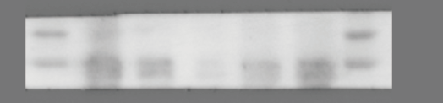
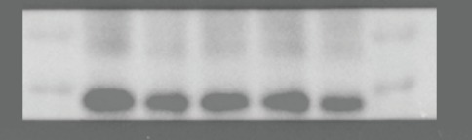
Original image：Fig 5I
LPS+NE+H1R antag
LPS+NE+H1R antag
LPS+H1R antag
LPS+H1R antag
Sham
LPS+NE
Sham
LPS+NE
LPS
LPS
100 KD
100 KD
92 KD
STAT3
92 KD
P-STAT3
70 KD
70 KD
LPS+NE+H1R antag
LPS+NE+H1R antag
LPS+H1R antag
LPS+H1R antag
Sham
LPS+NE
Sham
LPS+NE
LPS
LPS
40 KD
SLC7A11
55 KD
55 KD
GAPDH
35 KD
36 KD

Slide 5
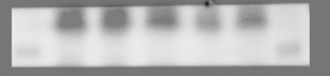
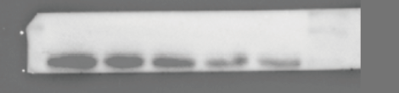
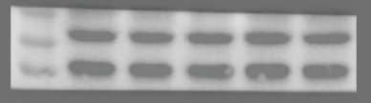
Original image：Fig 6H
Erastin
+LPS
LPS
Sham
PBS
SAL
PBS
SAL
17 KD
GPX4
15 KD
Erastin
+LPS
LPS
Sham
PBS
SAL
PBS
SAL
70 KD
SLC7A11
55 KD
55 KD
Erastin
+LPS
LPS
Sham
PBS
SAL
PBS
SAL
40 KD
36 KD
GAPDH
35 KD

Slide 6
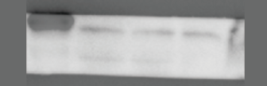
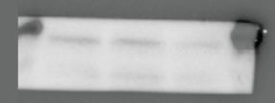
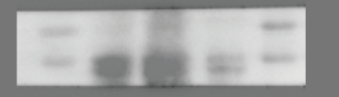
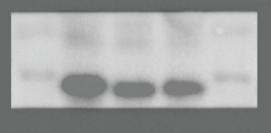
Original image：Fig S3C
LPS+NE+colivelin
LPS+NE+colivelin
LPS+NE+c188-9
LPS+NE+c188-9
LPS
LPS
100 KD
100 KD
STAT3
92 KD
P-STAT3
92 KD
LPS+NE+colivelin
LPS+NE+colivelin
LPS+NE+c188-9
LPS+NE+c188-9
LPS
LPS
70 KD
40 KD
SLC7A11
55 KD
55 KD
GAPDH
35 KD
36 KD

