Slide 1
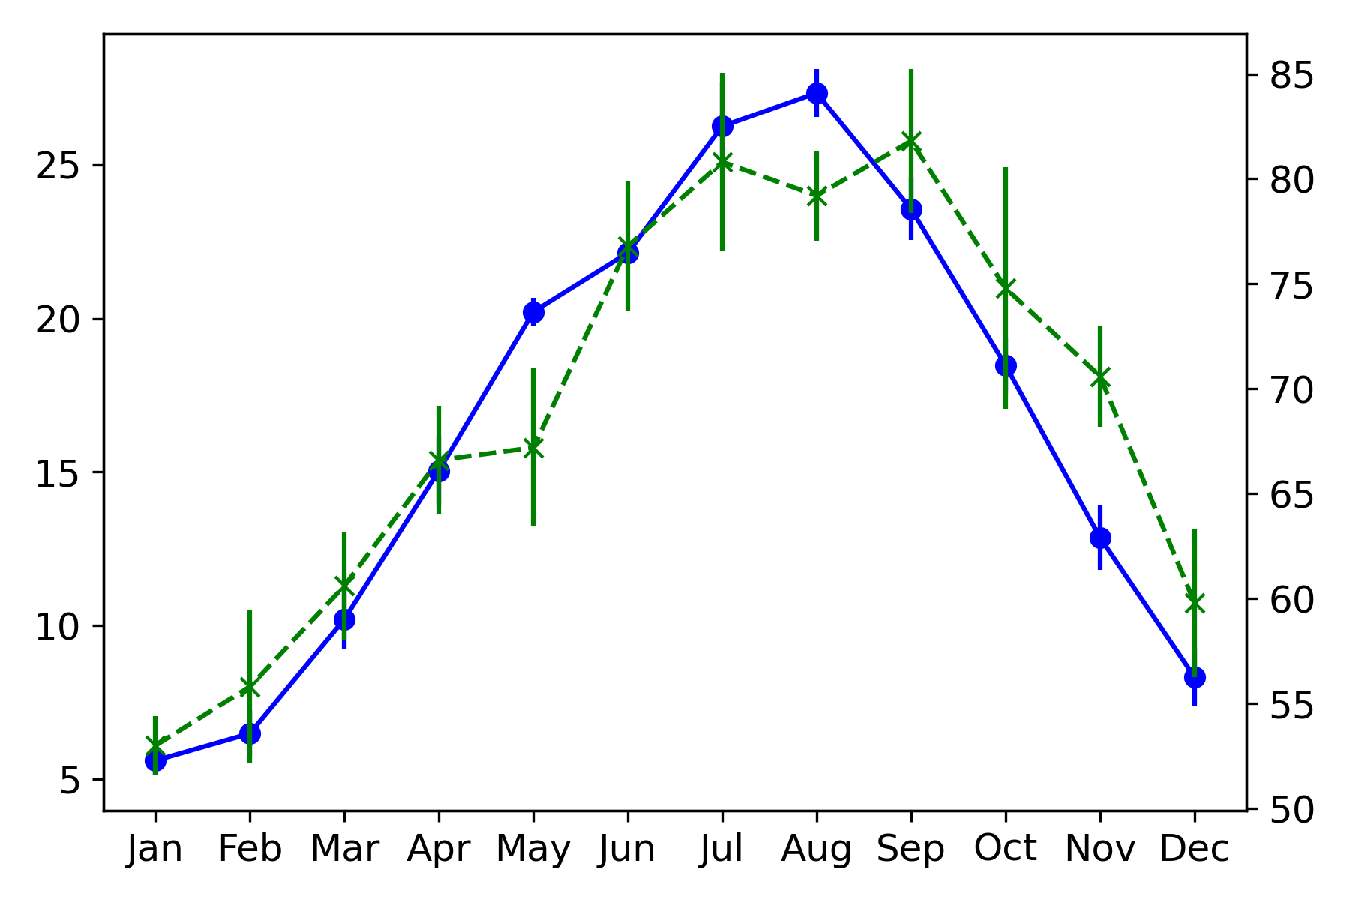
Temperature
C)
Relative humidity
Monthly average temperature (°
Monthly average relative humidity (%)
Supplementary Figure S1
Average monthly temperature and relative humidity from 2015 to 2019.

