Slide 1
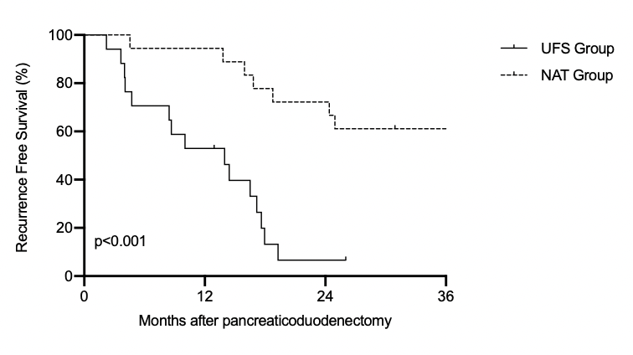
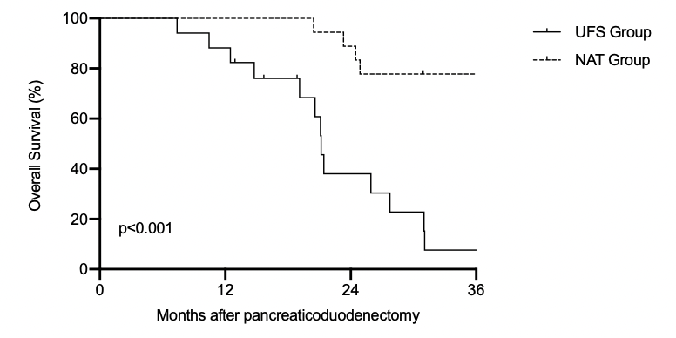
A
N at risk
NAT Group | 18 | 17 | 14 | 11
UFS Group | 17 | 10 | 1 | 0
B
N at risk
NAT Group | 18 | 17 | 14 | 11
UFS Group | 17 | 15 | 6 | 1
Supplemental Figure 1

