Slide 1
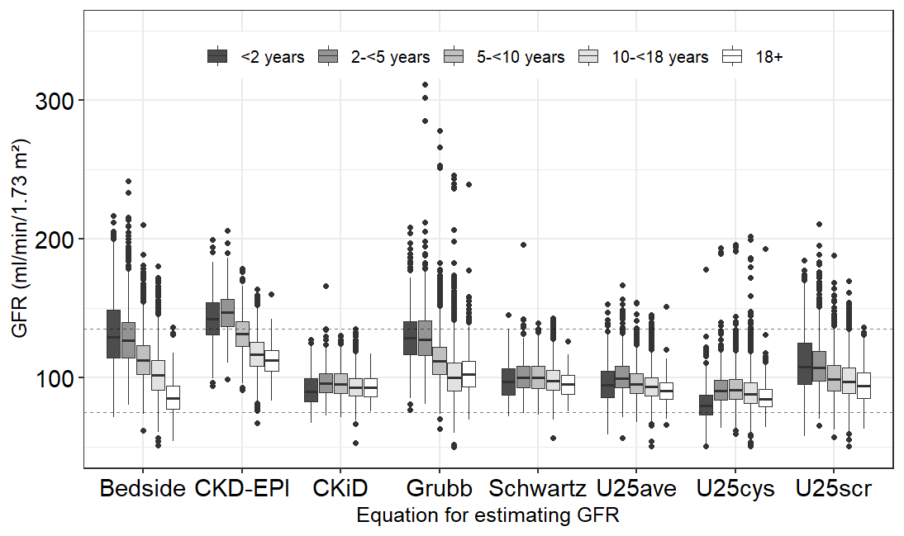






Examining commonly used equations for estimating the glomerular filtration rate (GFR) in a healthy cohort of children and adolescents
AIM: Evaluate eGFR-equations by assessing plausibility and consistency across sexes, age and weight groups
DESIGN & OUTCOMES:
Study population
Age-dependent estimates for the different equations
Results
4776 healthy participants
(0.25–21 years)
Inconsistent across age groups
Higher bias level
Lower eGFR accuracy
Consistent across age groups
Lower bias level
Higher eGFR accuracy
CKiD, Schwartz, U25ave
Grubb, Bedside, CKD-EPI
CONCLUSION: CKiD, Schwartz and combined U25 resulted in the most plausible eGFR distributions for a healthy pediatric cohort. Estimates from simpler equations like Bedside and Grubb are less plausible.
-----
Trenkmann et al. 2025

