Slide 1
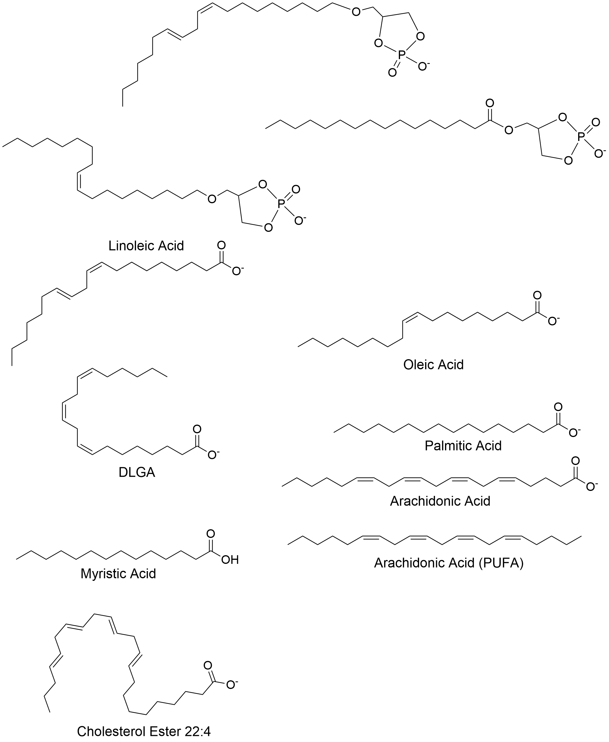
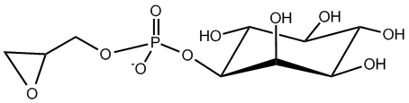
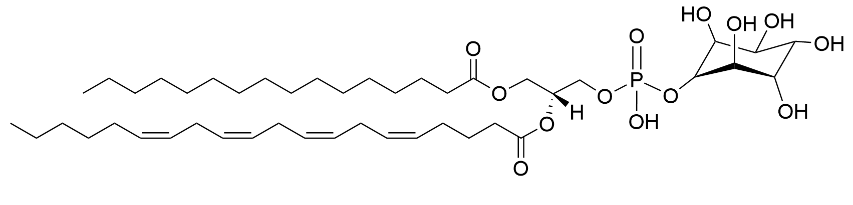
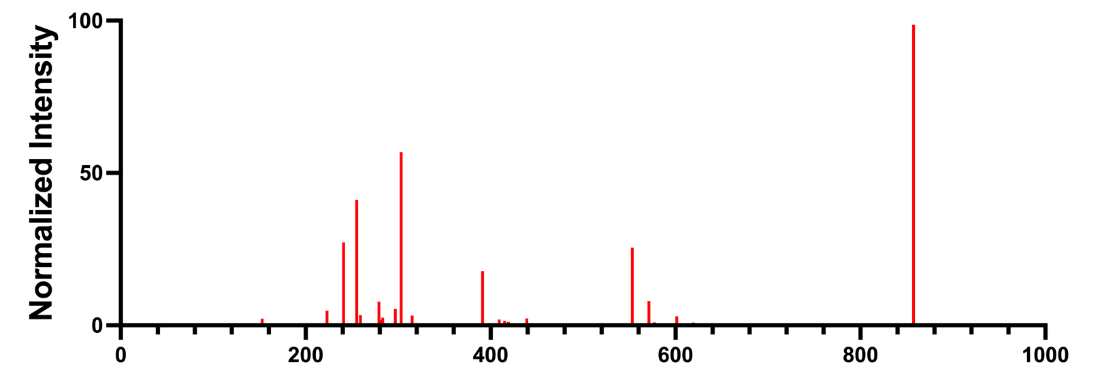
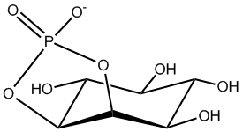
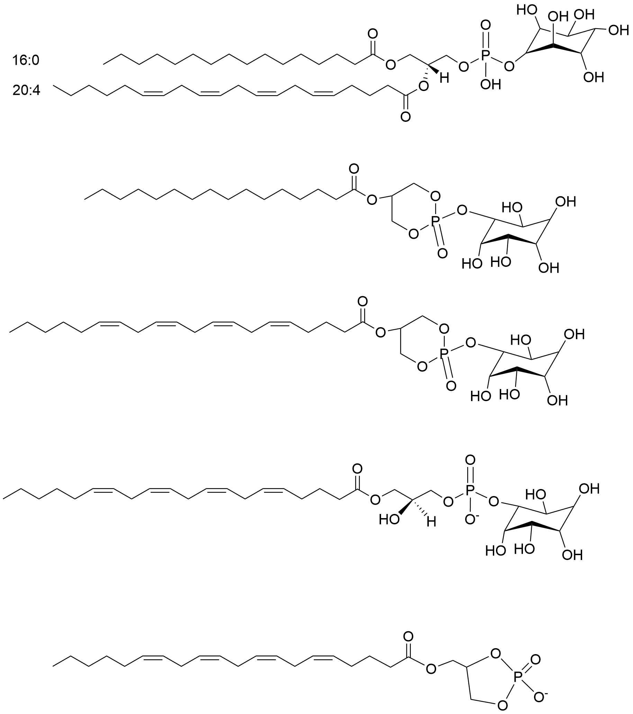
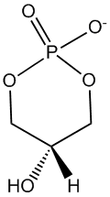
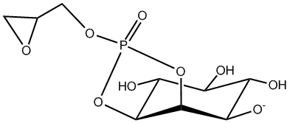

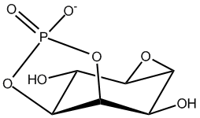
Supplemental Figure 2: Detected fragment ions from the precursor ion isolated at m/z 857.52 and 1/K₀ 1.4308 ± 0.0093 Vs/cm². Annotation of the detected ions to known fragment ion m/z from the species PI 36:4(16:0/20:4) confirmed the lipid identity based on characteristic fragments for R-groups Palmitic Acid (m/z 255.23) and Arachidonic Acid (m/z 303.23). Multiple head group fragments, including a prominent ion at m/z 241.01 representing an inositol phosphate ion minus H₂O, confirmed the lipid class identity. Pseudo MS/MS spectrum for the isolated species was assembled from detected fragment ions extracted from the iprm mobilogram.
Pseudo MS/MS for PI 36:4(16:0/20:4)
20:4 acyl chain (Arachidonic Acid)
16:0 acyl chain (Palmitic Acid)
Glycerophosphoinositol - H₂O
Precursor ion
PI 36:4(16:0/20:4)
Neutral loss of 20:4-COOH group and inositol from Precursor [M-H]-
857.52
Inositol Phosphate Ion - H₂O
303.23
Neutral loss of 20:4 RCOOH
group from [M-H]-
255.23
241.01
553.28
391.23
153.00
223.00
315.05
439.23
571.29
553.28
m/z
Neutral loss of 16:0 RCOOH group from [M-H]-
297.04 –Glycerophosphoinositol - 2x H₂O
Glycerol-3-phosphate - H₂O
259.03 – Inositol phosphate ion
Loss of 16:0 acyl chain as ketene(RCH=C=O) from [M-H]-
Inositol phosphate ion
- 2x H₂O
259.24 – Loss of CO₂ from 20:4-COO- ion
(Poly-Unsaturated Fatty Acid - PUFA)
Neutral loss of 16:0-COOH group and inositol from Precursor [M-H]-

