Slide 1
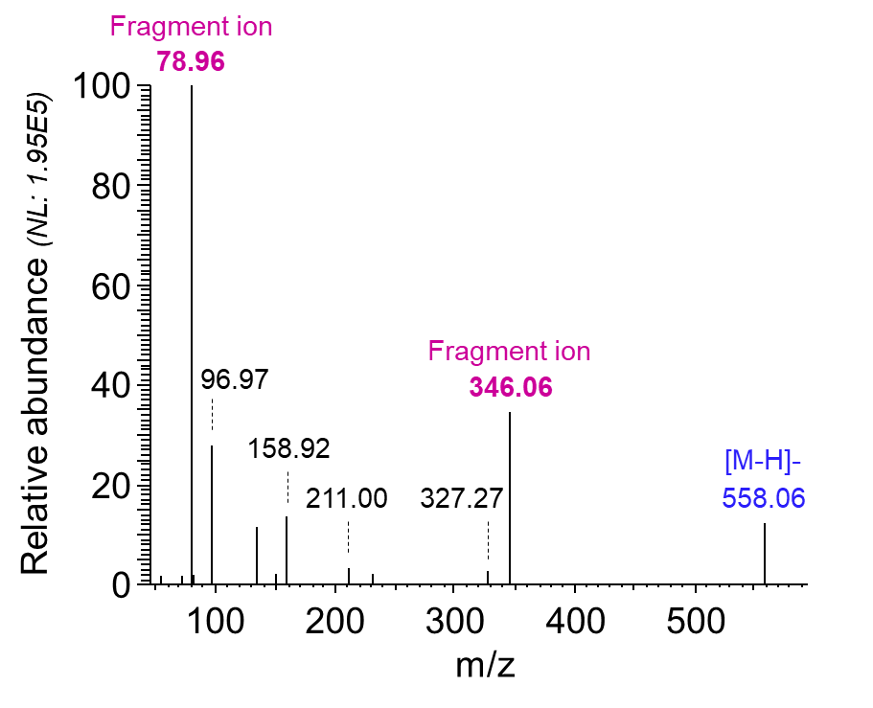
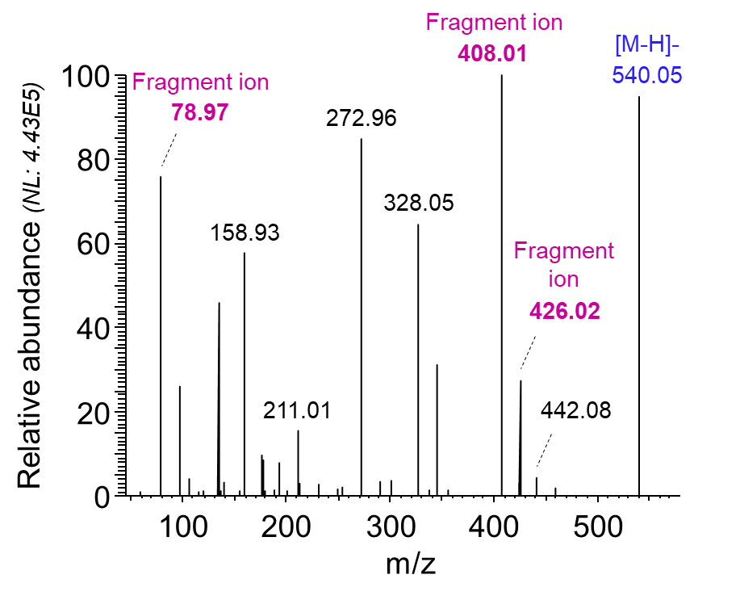
A. ADPR, LC-MS/MS in negative mode
B. cADPR, LC-MS/MS in negative mode
Supplemental Figure 4: LC-ESI-MS/MS spectra of ADPR and cADPR standards. A. Analysis by LC-ESI-MS/MS of pure ADPR synthetic standard on the Thermo Q Exactive Orbitrap mass spectrometer enabled the detection of several characteristic fragment ions of ADPR, that matched fragment m/z features detected by iprm-PASEF for both the pure standard and the endogenous metabolite in fresh-frozen liver tissues. B. LC-ESI-MS/MS of pure cADPR synthetic standard also led to the identification of characteristic fragment ions that matched those detected by iprm-PASEF.

