Slide 1
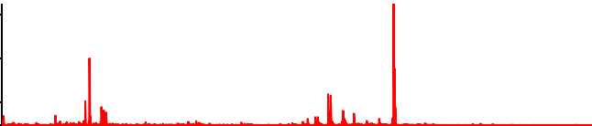
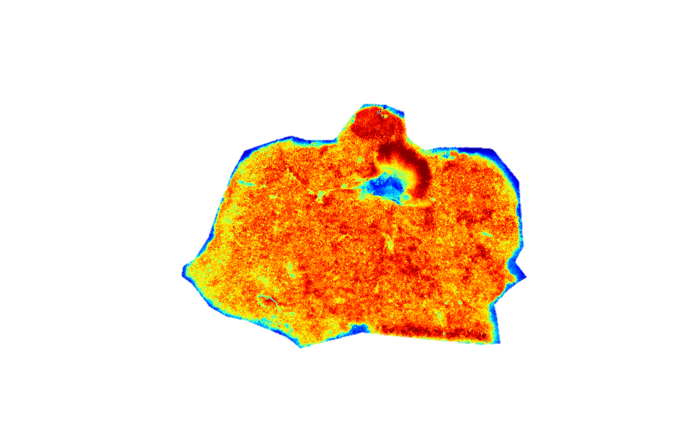
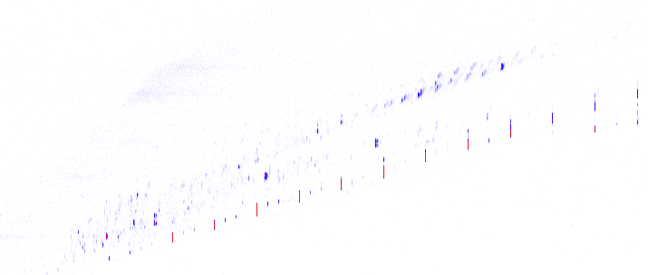

A. Untargeted MS1 MALDI composite spectrum
10
m/z 885.55
6
Intensity (x10⁵)
2
0
200
400
600
m/z
800
1000
1200
B. Untargeted MS1 MALDI composite mobilogram
4
1.60
m/z 885.55 & 1/K₀ 1.47
Int.
x10
1/K₀
1.30
2.5
1.00
1.5
200
400
600
800
1000
1200
0.5
m/z
C. MS/MS isolation of precursor ion by 1/K₀ and m/z
Int.
1.54
1800
1/K₀
1.50
m/z 885.55 & 1/K₀ 1.47
1400
1.46
1000
1.42
200
400
600
800
1000
1200
m/z
D. MS/MS isolation of precursor ion by 1/K₀ and m/z and fragmentation
1.54
Int.
1800
1.50
m/z 885.55 & 1/K₀ 1.47
1400
1/K₀
1.46
1.42
1000
200
400
600
m/z
800
1000
1200
Supplemental Figure 1: iprm-PASEF isolation and fragmentation. A. Features were first identified in the MS1 MALDI composite spectrum and spatial heatmaps were investigated. B. Mobility (CCS or 1/K₀) values for the feature of interest at m/z 855.55 was extracted from the mobilogram from the full untargeted MS1 acquisition. C. Using both 1/K₀ and m/z, the precursor ion was isolated from surrounding molecular species. D. Fragmentation of the precursor ion generated fragment ions that shared the exact same ion mobility range.

