Slide 1
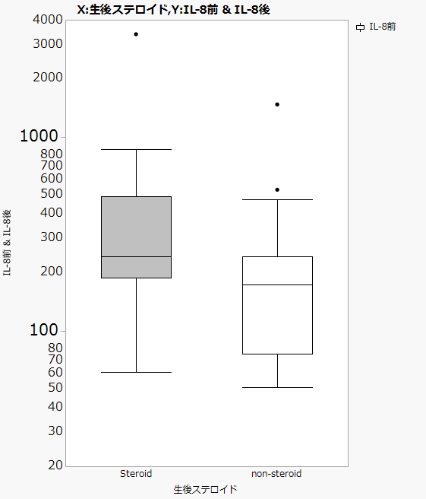
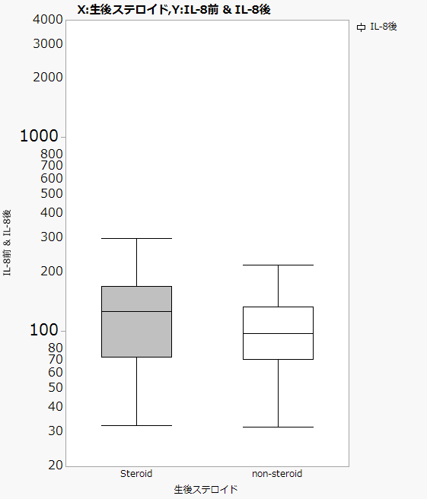
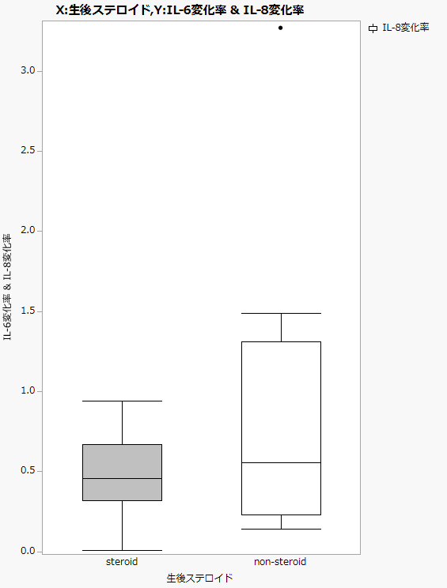
Supplementary Fig. 1
a
b
2000
steroid group
non-steroid group
3.0
1000
2.5
IL-8 log scale (pg/mL)
500
2.0
IL-8 late/early ratio
200
1.5
100
1.0
50
0.5
20
early phase
late phase
steroid
group
non-
steroid
group

