Slide 1
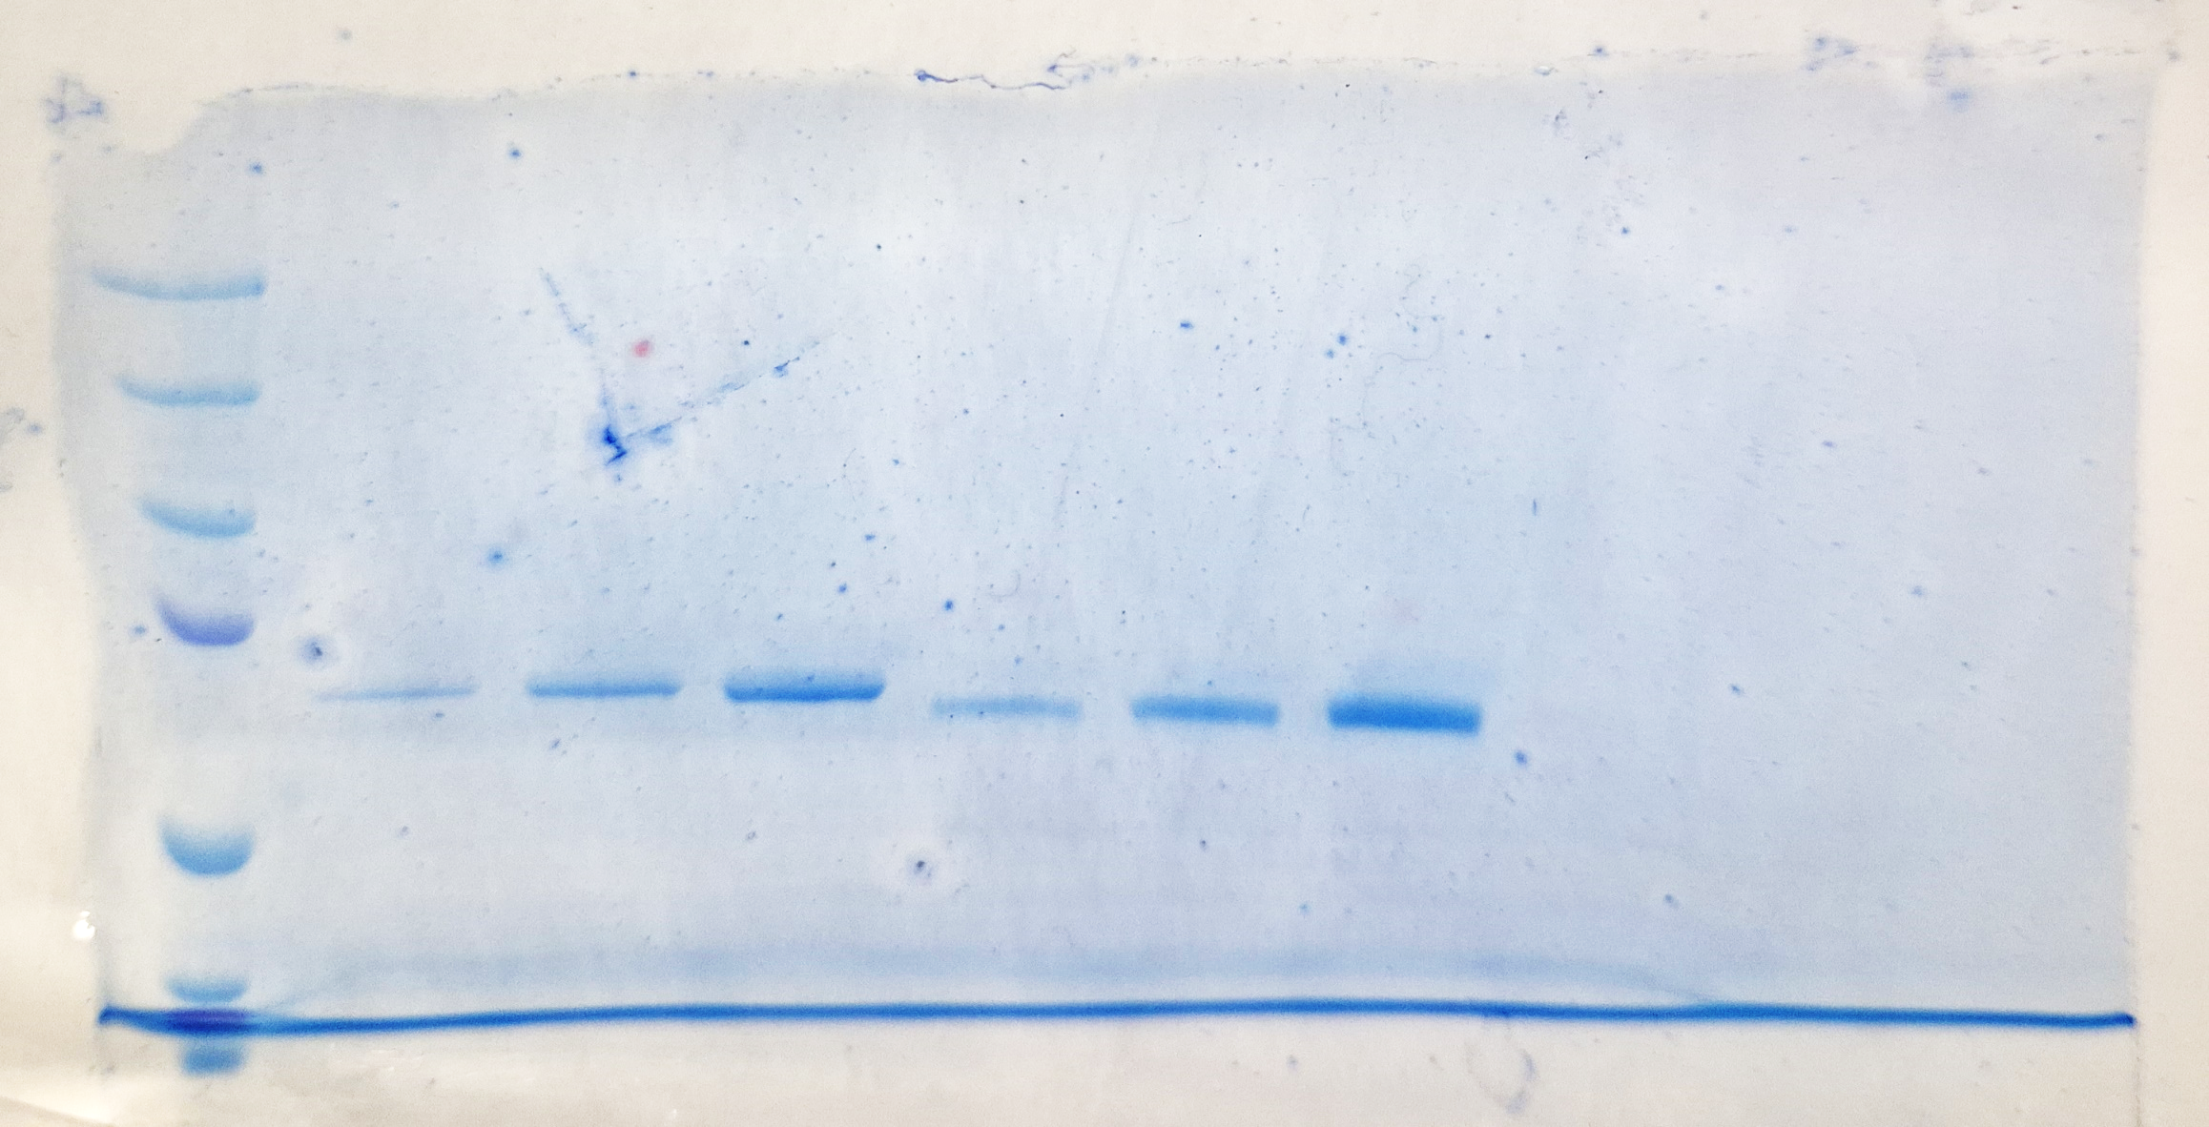
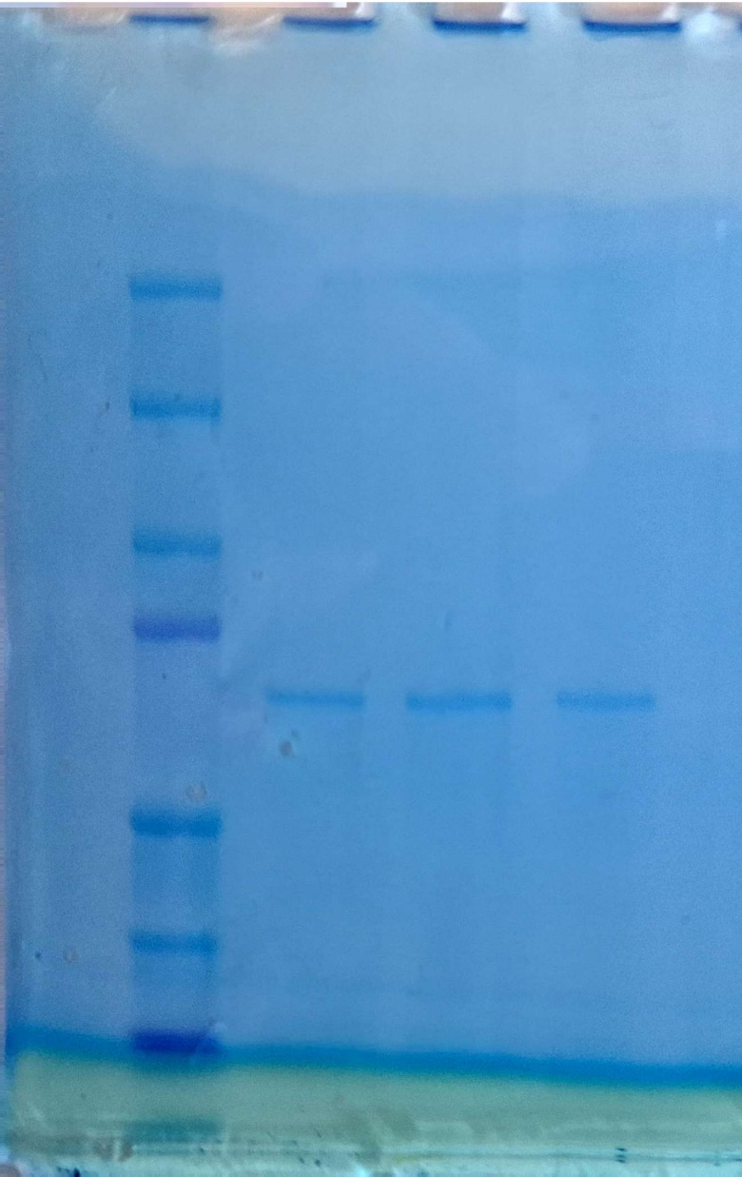
Supplementary Fig. 1
A
1 2 4 µl
100 200 400 ng
75KDa
50KDa
wt ERα – TWIN STREP TAG
BSA
B
Wilde Type
Y537S
L370F
75KDa
50KDa

Slide 2
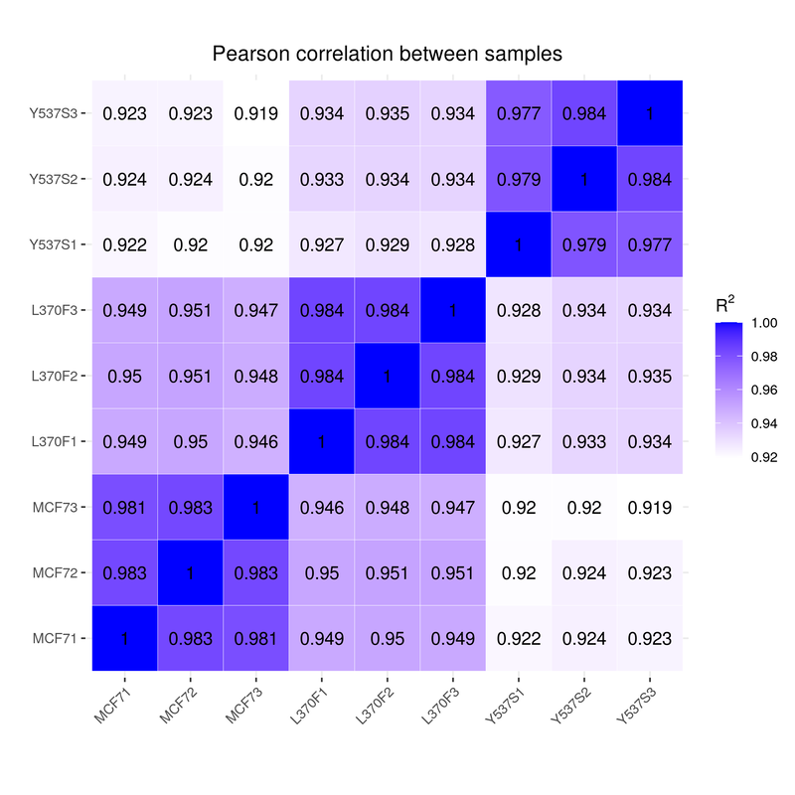
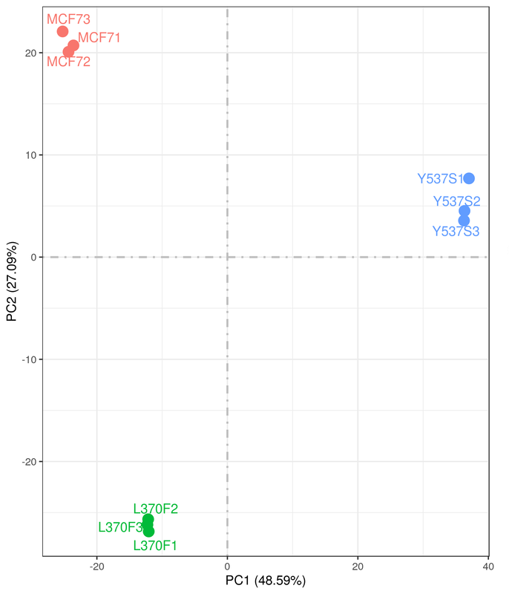
Supplementary Fig. 2
A
B

Slide 3
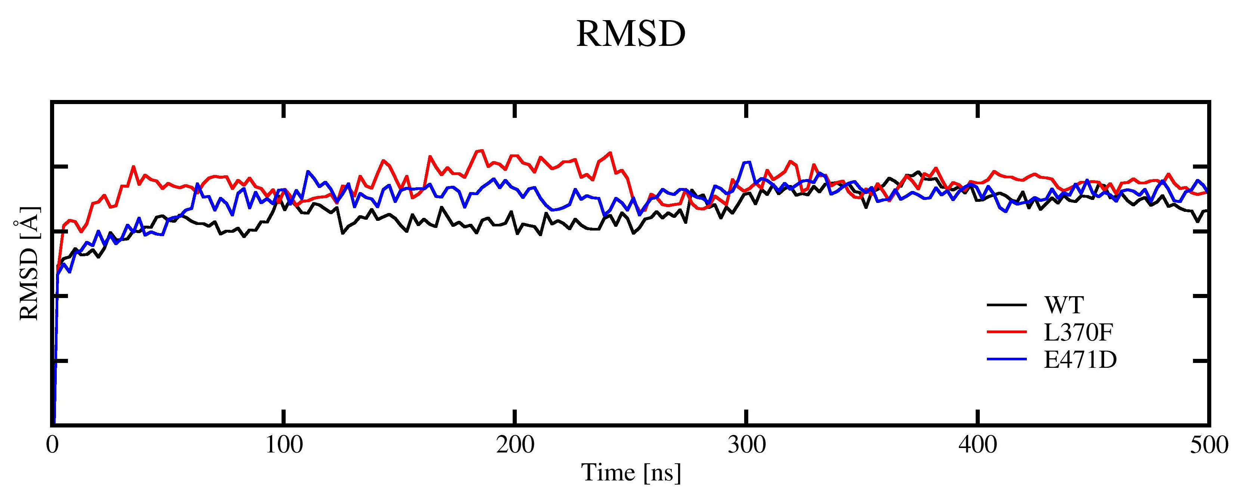
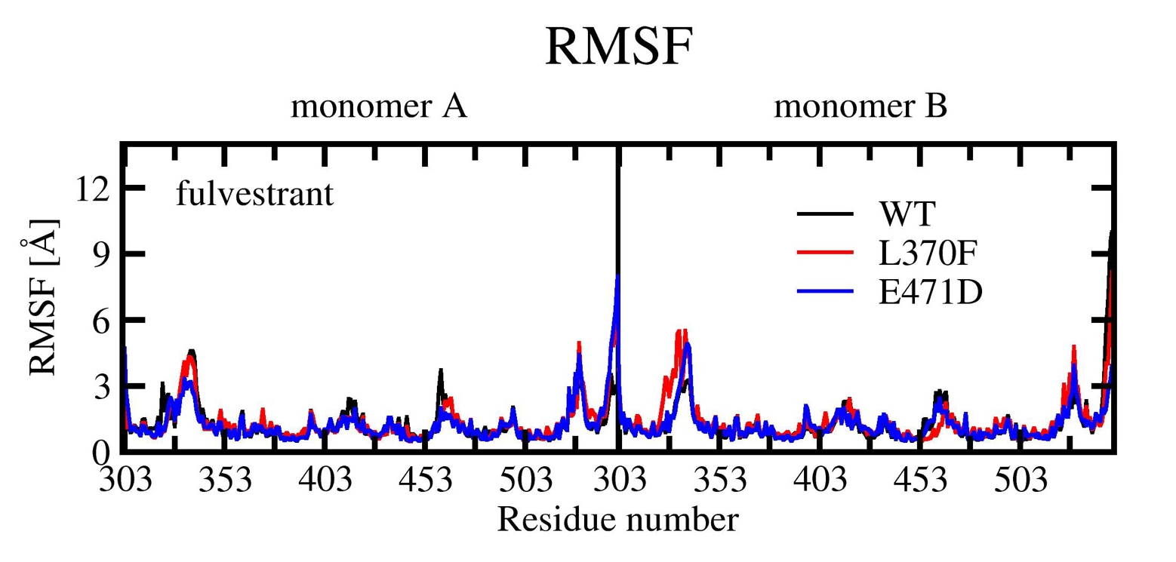
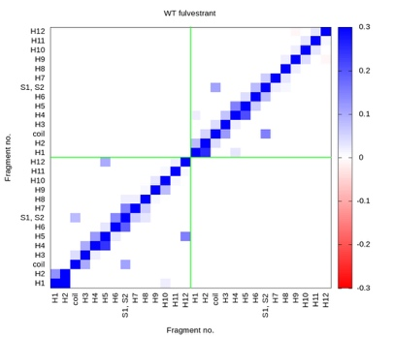
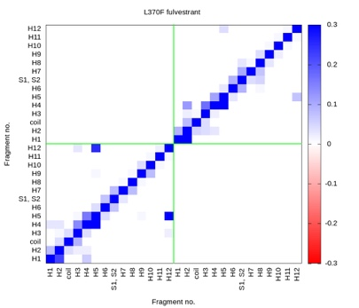
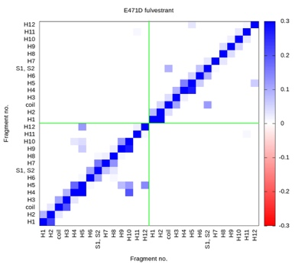
Supplementary Fig. 3
A
B
C
D
E

Slide 4
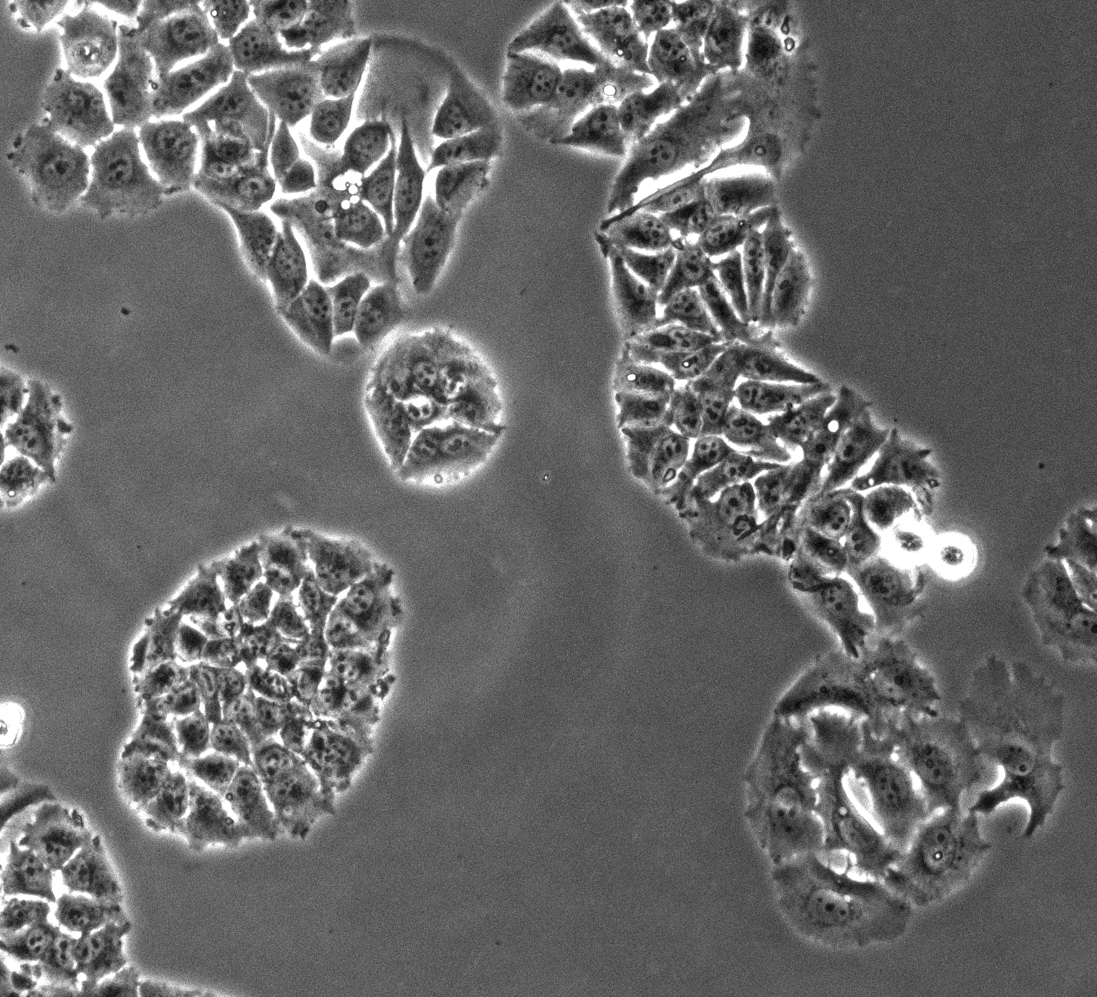
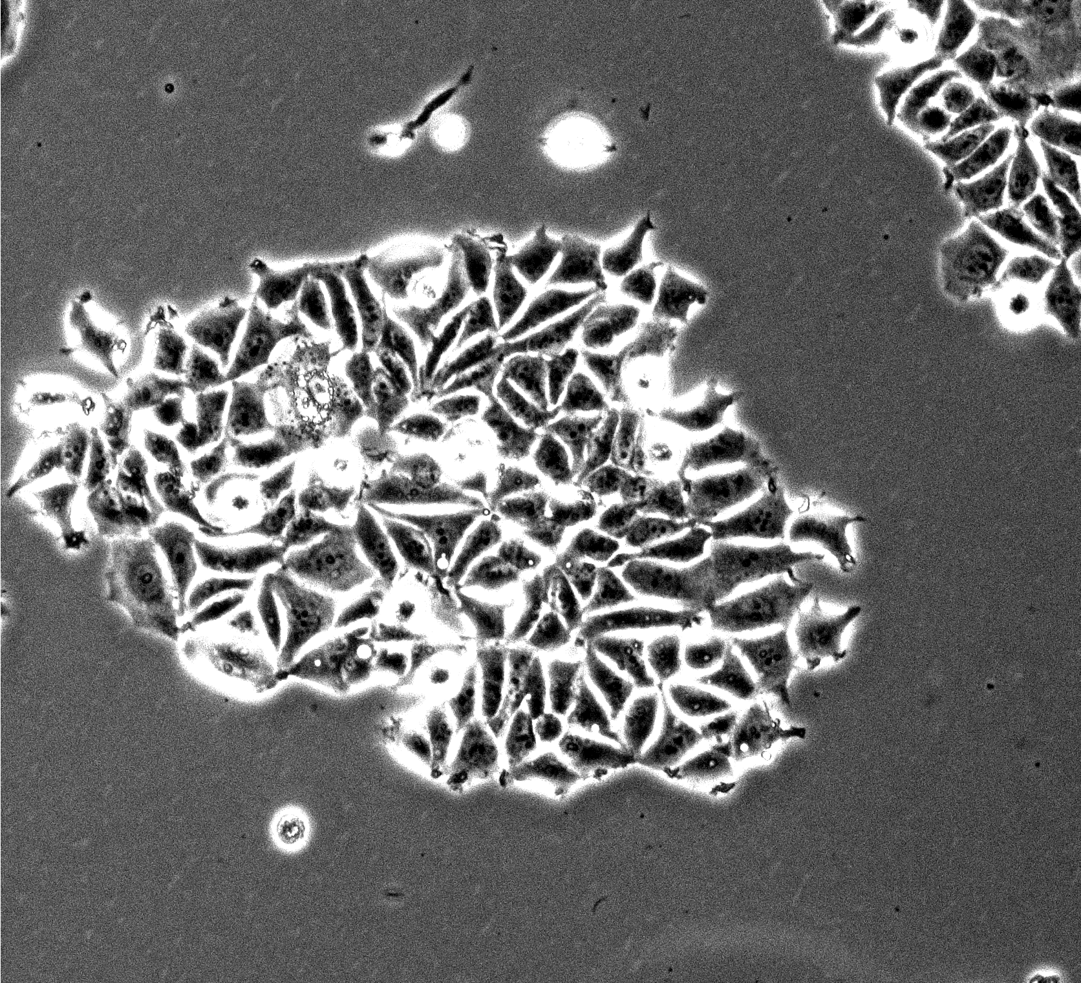
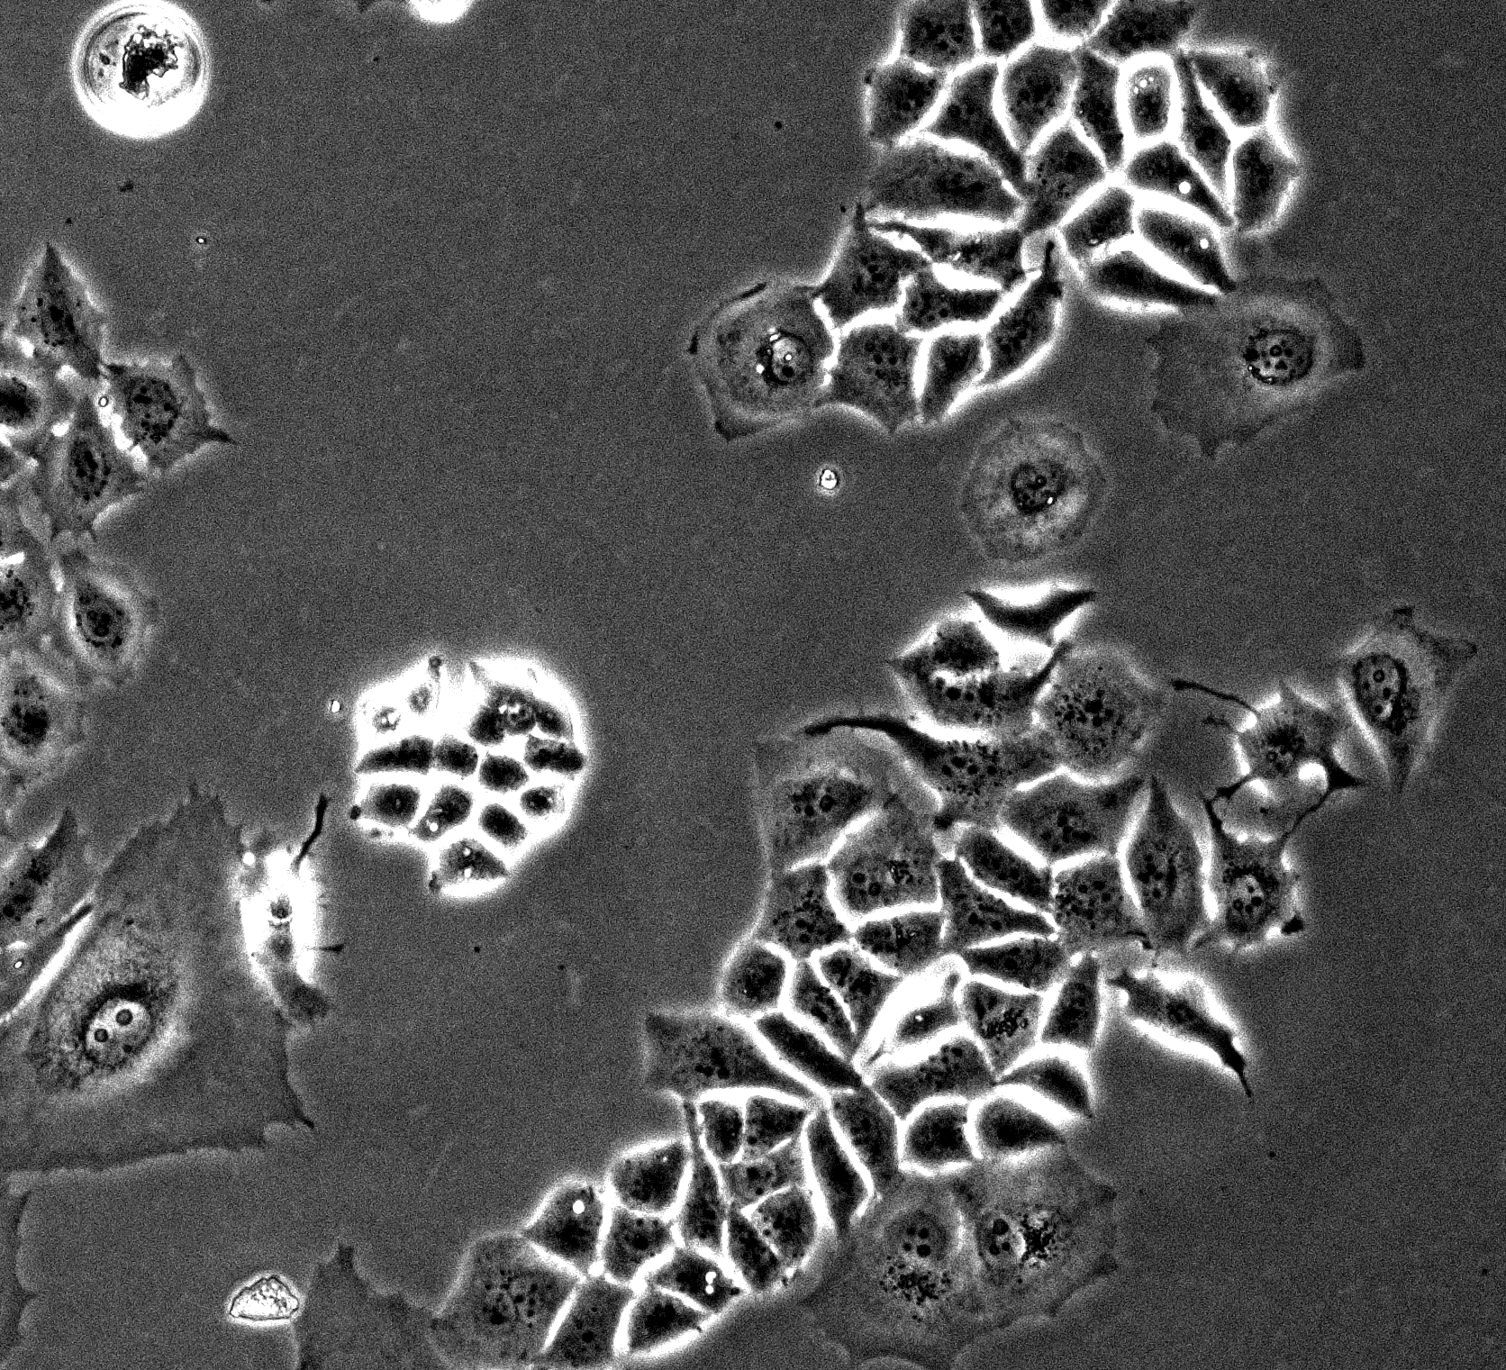
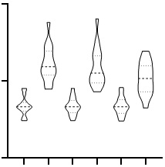
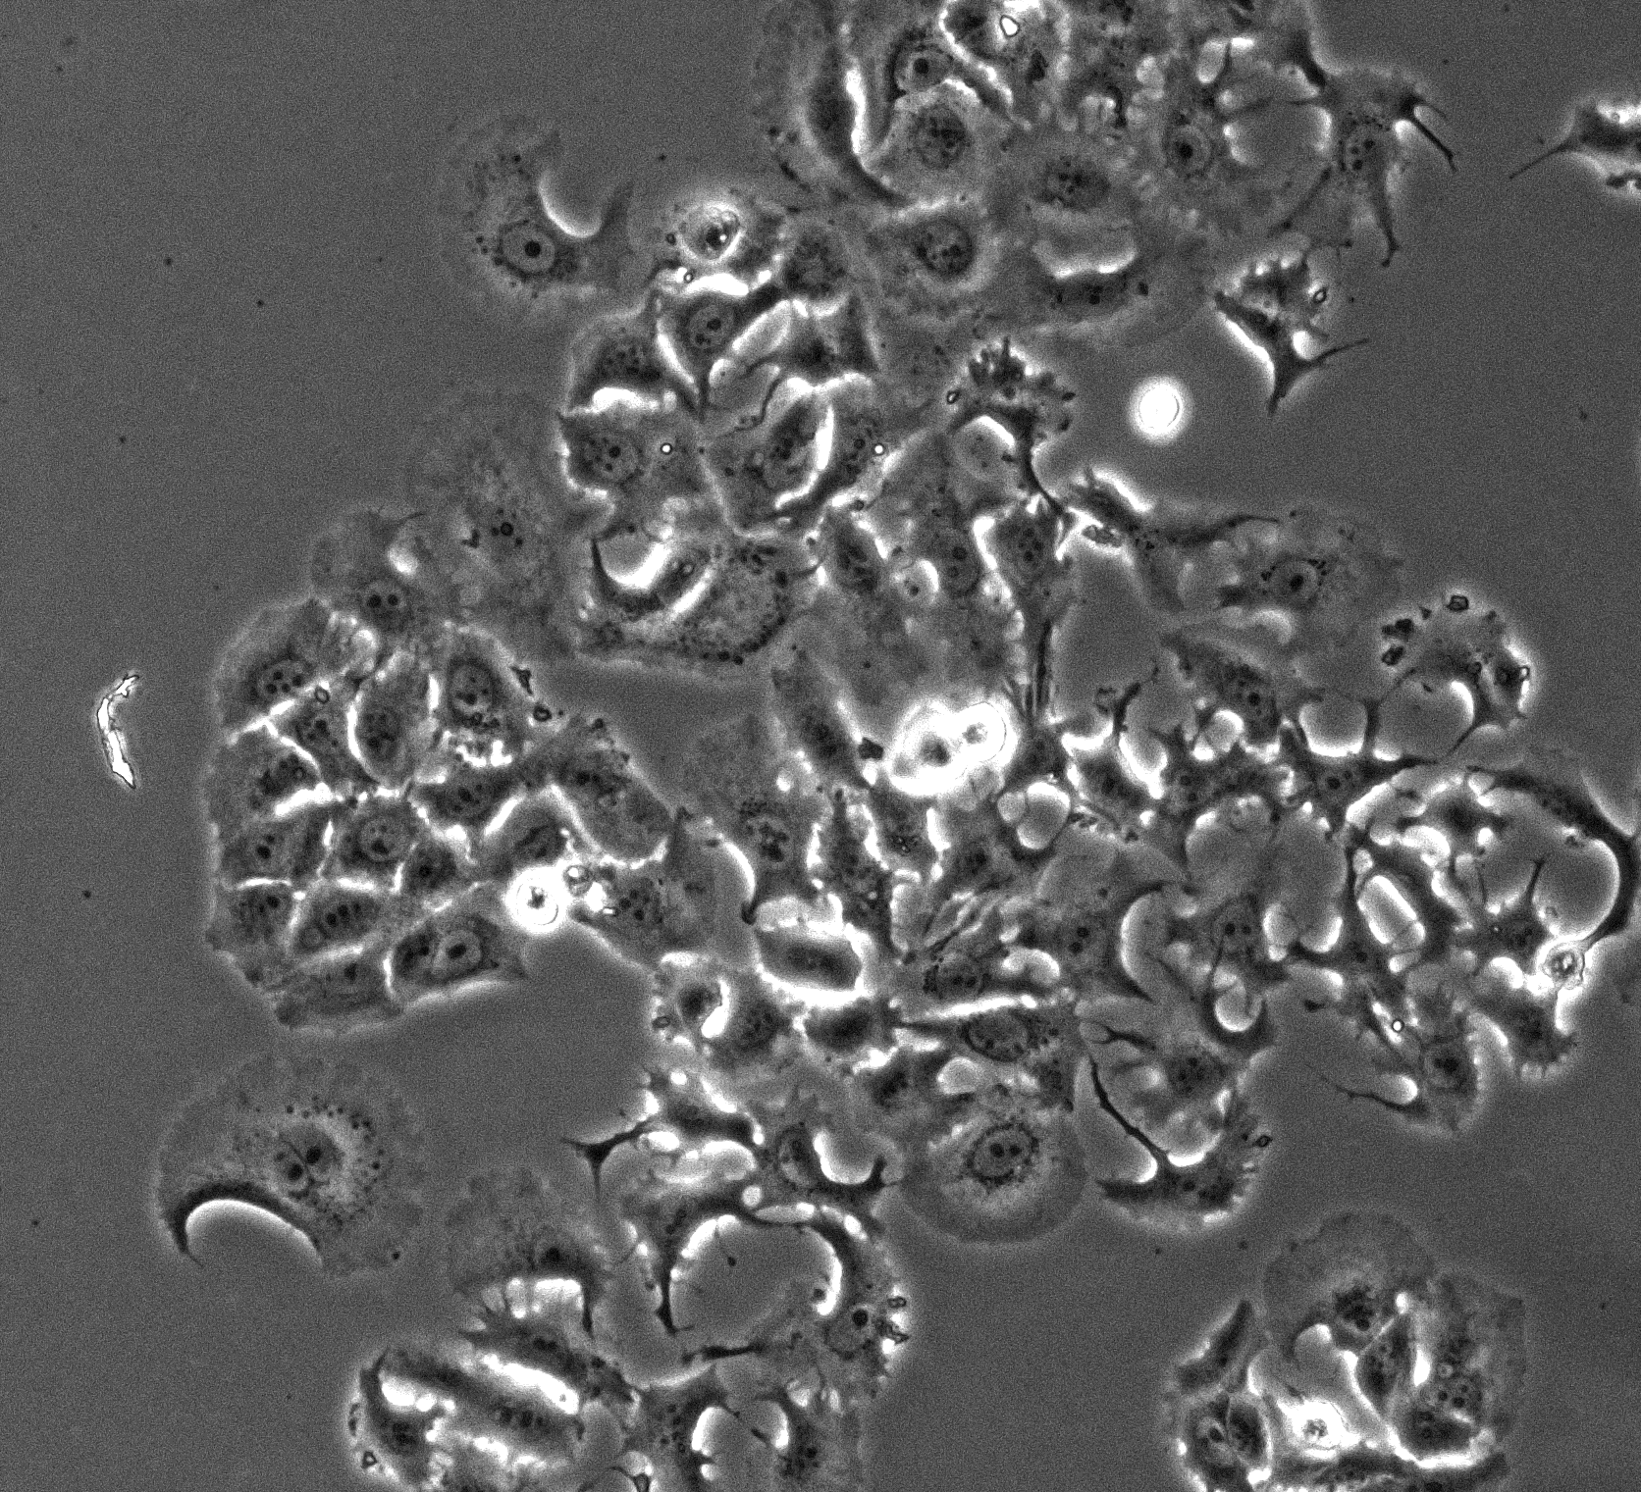
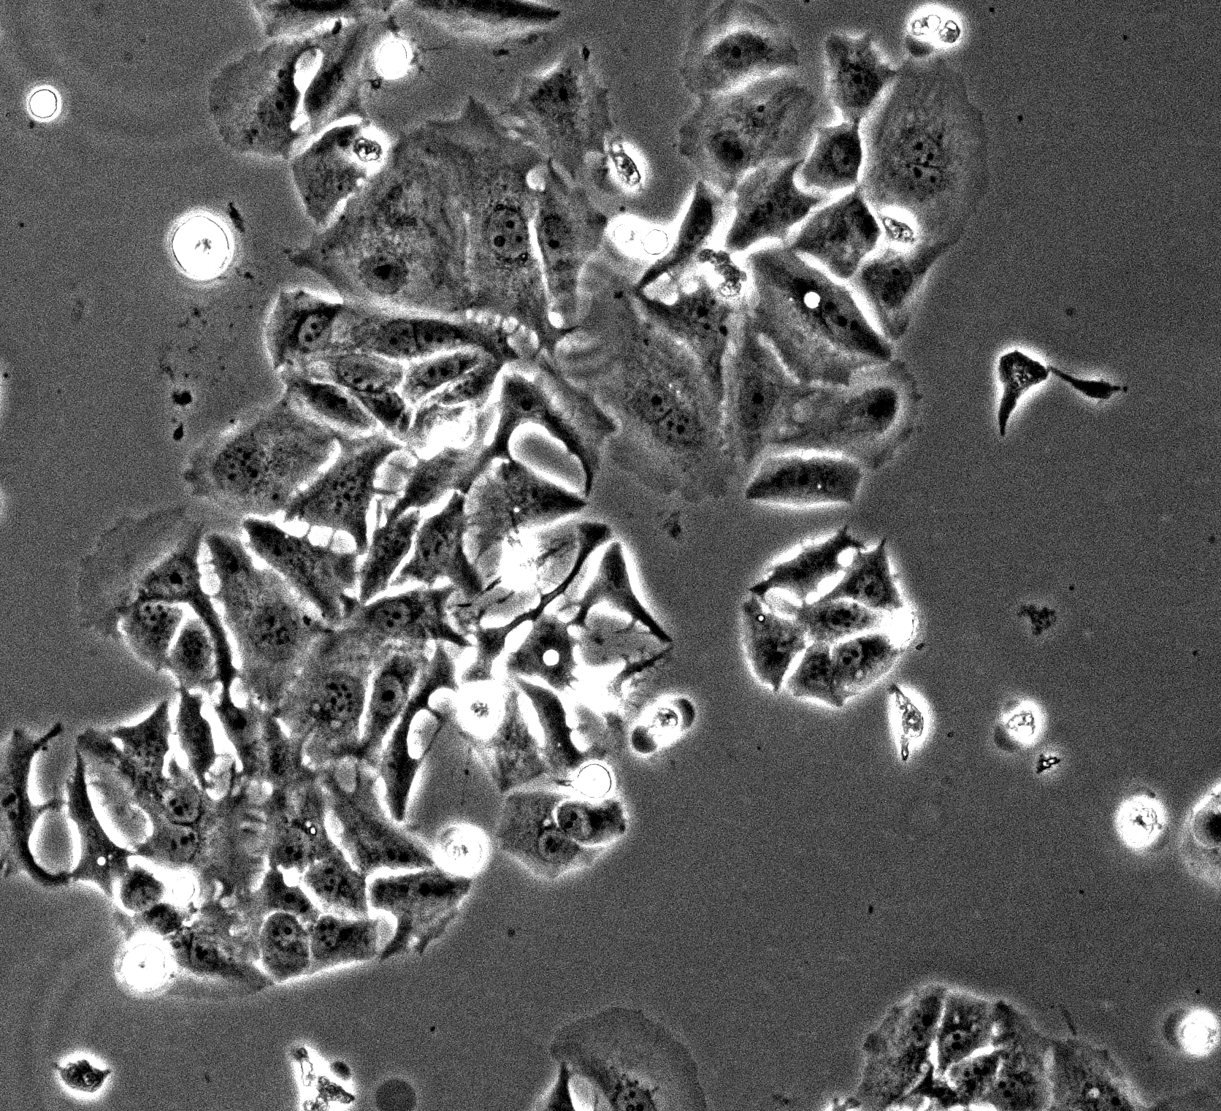
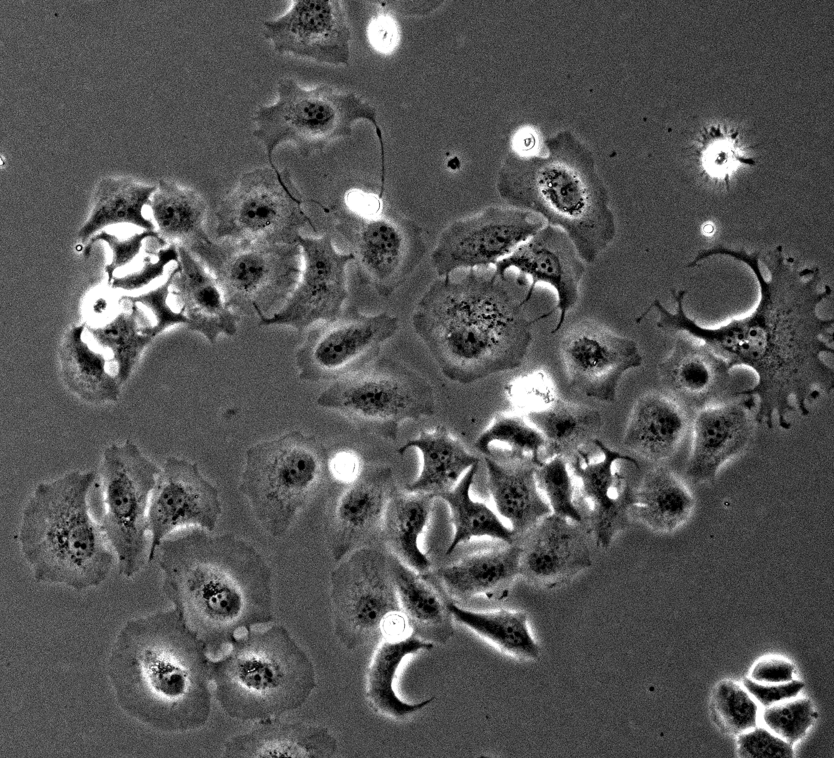
Supplementary Fig. 4
A
A’
MCF-7
L370F
Y537S
CTR
300
****
****
****
Cell Area
(% on -)
150
0
-
+
-
+
-
+
ATRA
ATRA
L370F
MCF-7
Y537S

Slide 5


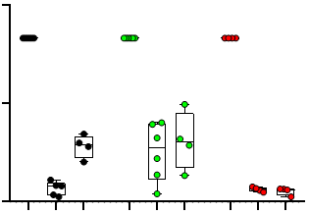
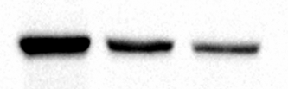


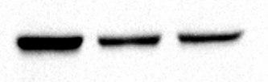

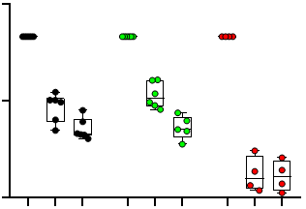

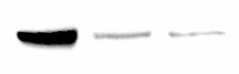

Supplementary Fig. 5
A
A’
MCF-7
-
+
-
siRARα
L370F
-
-
+
siERα
120
Y537S
RARα
MCF-7
ERα
RARα Levels
(% on CTR)
****
****
60
****
Vinculin
****
****
****
RARα
0
-
+
-
-
+
-
-
+
-
siRARα
L370F
ERα
A’’
-
-
+
-
-
+
-
-
+
siERα
MCF-7
L370F
Vinculin
120
Y537S
RARα
ERα Levels
(% on CTR)
****
****
60
****
****
Y537S
ERα
****
****
Vinculin
0
-
+
-
-
+
-
-
+
-
siRARα
-
-
+
-
-
+
-
-
+
siERα

