Slide 1
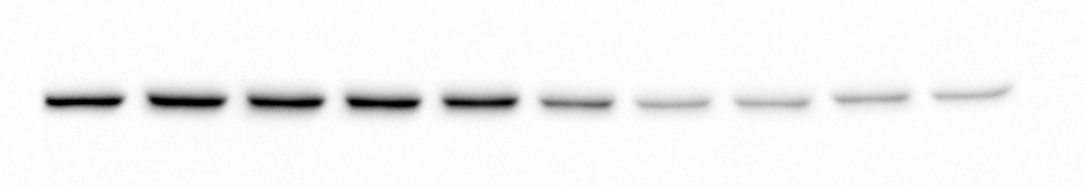
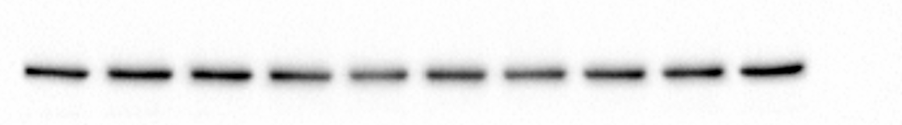
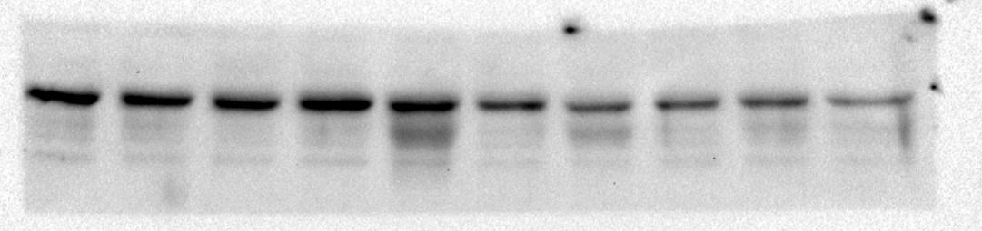
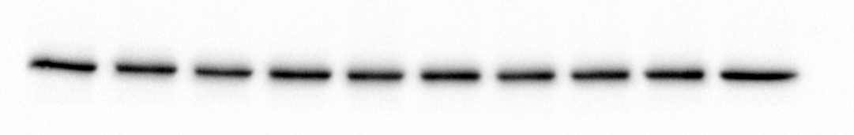
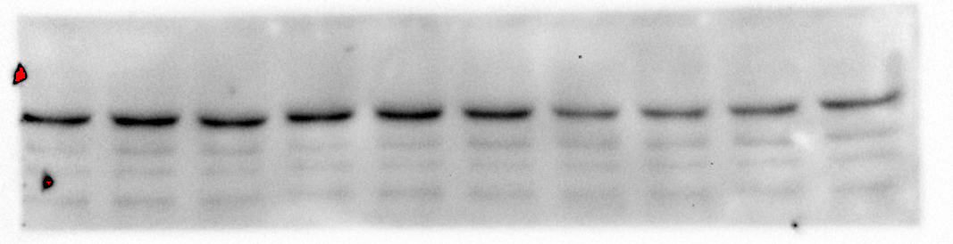
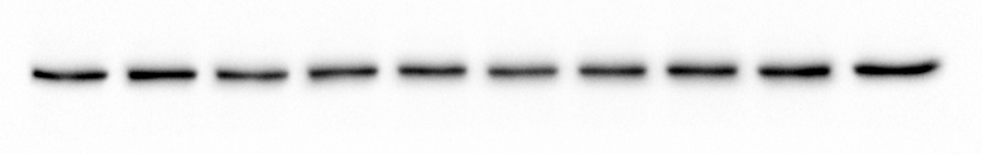
Figure 1E
Log[Ful]
75KDa
-
-14
-13
-12
-11
-10
-9
-8
-7
-6
-5
ERα
50KDa
MCF-7
100KDa
Vinculin
75KDa
50KDa
ERα
L370F
100KDa
Vinculin
75KDa
ERα
50KDa
Y537S
100KDa
Vinculin

Slide 2
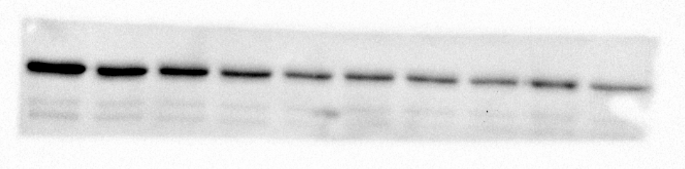
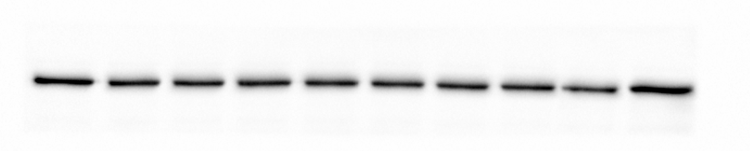
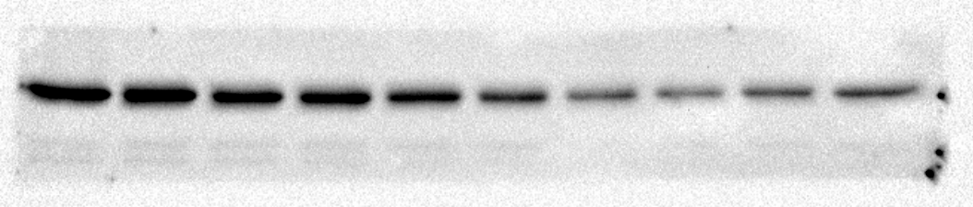
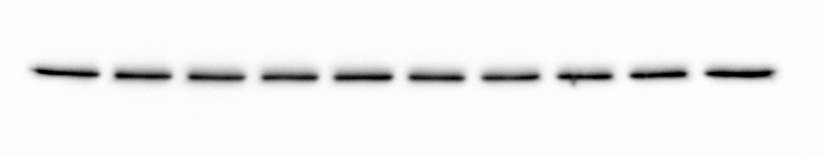
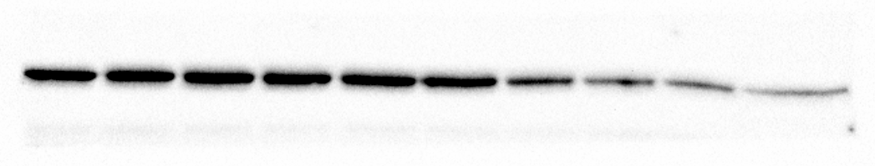
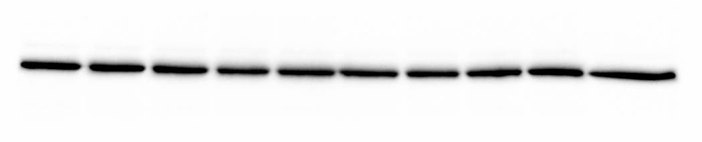
Figure 2A
MCF-7
Log[Ful]
-
-14
-13
-12
-11
-10
-9
-8
-7
-6
75KDa
50KDa
ERα
100KDa
Vinculin
L370F
Log[Ful]
-
-14
-13
-12
-11
-10
-9
-8
-7
-6
75KDa
50KDa
ERα
100KDa
Vinculin
Y537S
Log[Ful]
-
-14
-13
-12
-11
-10
-9
-8
-7
-6
75KDa
50KDa
ERα
100KDa
Vinculin

Slide 3
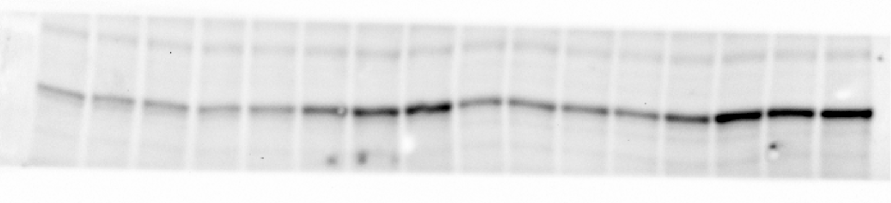
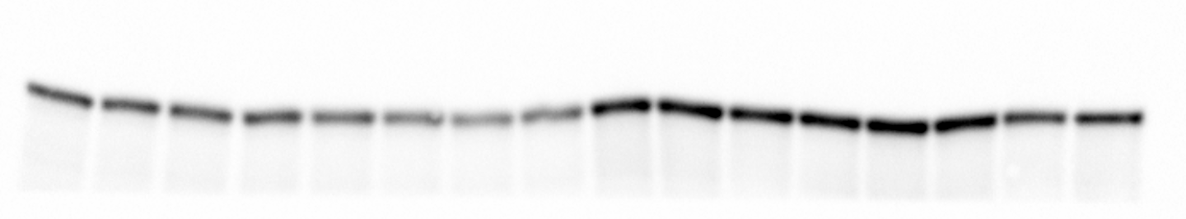
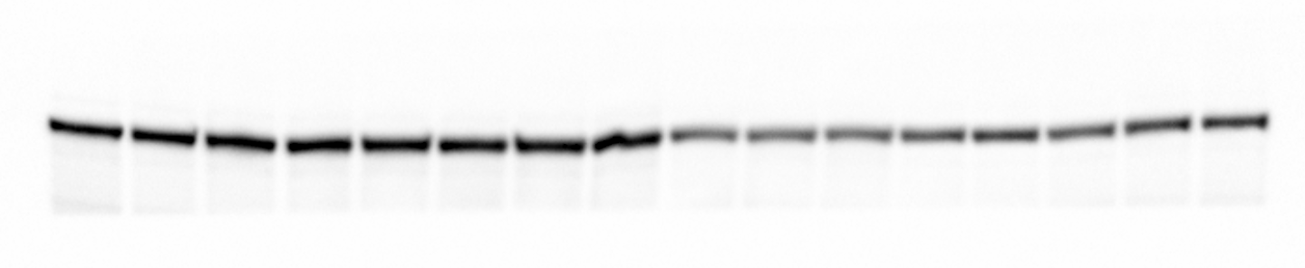
Figure 4A
Log[E2]
Log[E2]
0
-14
-13
-12
-11
-10
-9
-8
0
-14
-13
-12
-11
-10
-9
-8
75KDa
50KDa
pS118ERα
75KDa
50KDa
ERα
100KDa
Vinculin
MCF-7
LF

Slide 4
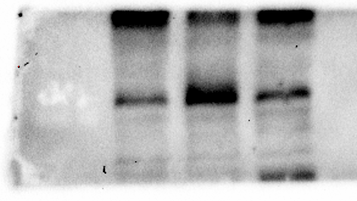
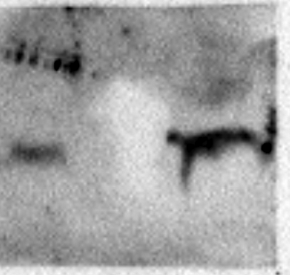
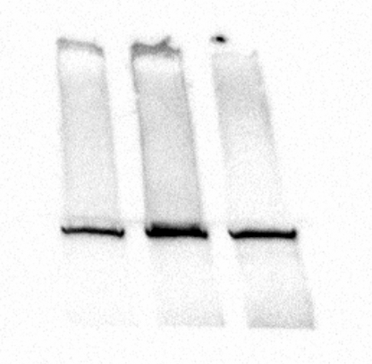
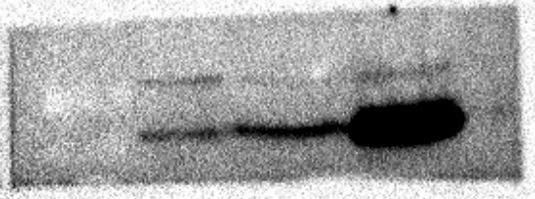
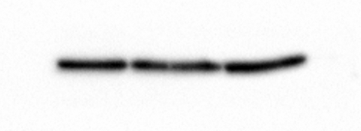
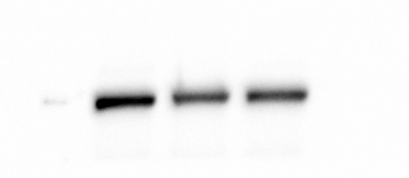
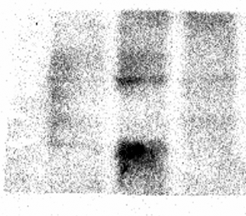
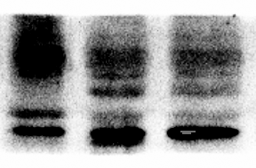
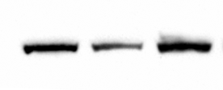
Figure 5F’
MCF-7
L370F
Y537S
MCF-7
Y537S
L370F
75KDa
50KDa
RARα
75KDa
FABP5
25KDa
CAV1
50KDa
Tubulin
250KDa
FASN
Vinculin
100KDa
MCF-7
L370F
Y537S
37KDa
ASCL1
50KDa
CALCR
100KDa
Vinculin

Slide 5
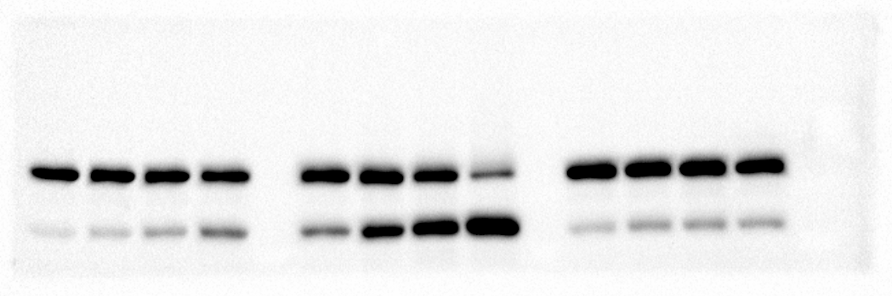
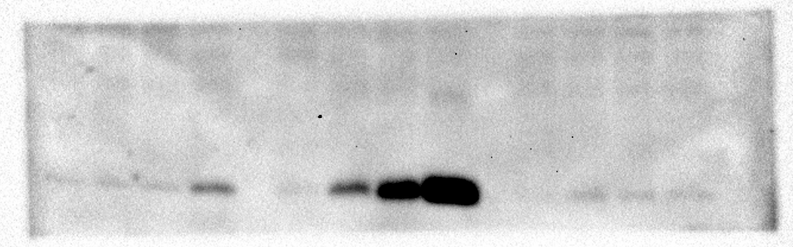
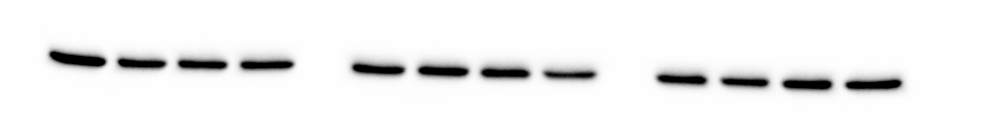
Figure 7H
Log[ATRA]
Log[ATRA]
Log[ATRA]
-
-7
-6
-5
-
-7
-6
-5
-
-7
-6
-5
3 Days
150KDa
100KDa
PARP
75KDa
15KDa
γH2AX
50KDa
Vinculin
MCF-7
L370F
Y537S

Slide 6
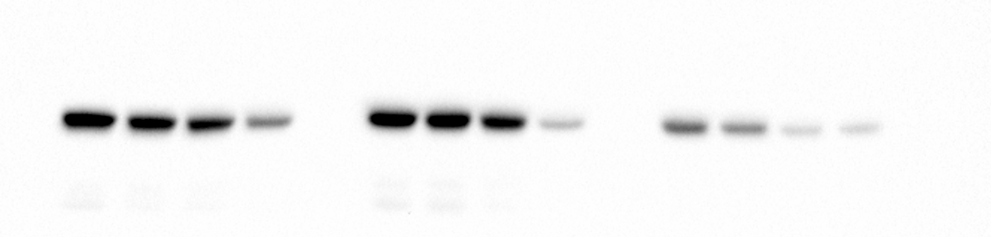
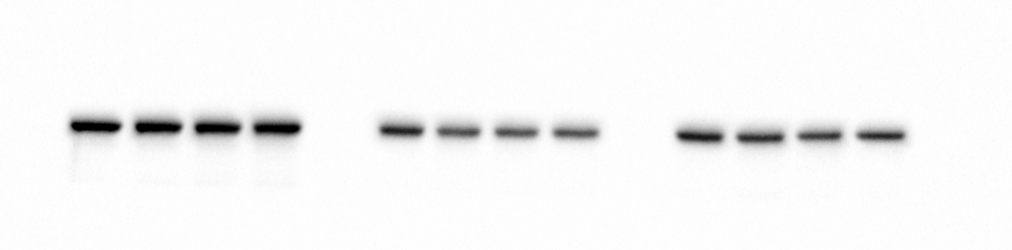
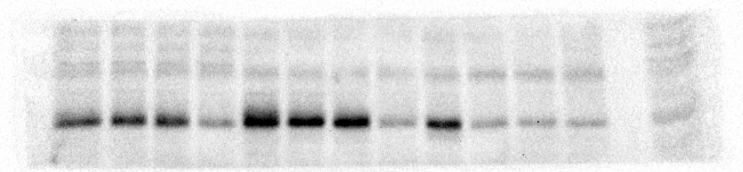
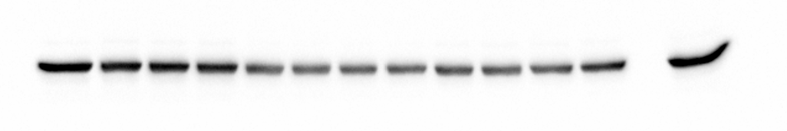
Figure 8A
Log[ATRA]
Log[ATRA]
Log[ATRA]
-
-7
-6
-5
-
-7
-6
-5
-
-7
-6
-5
75KDa
50KDa
ERα
100KDa
Vinculin
MCF-7
L370F
Y537S
Figure 8B
Log[ATRA]
Log[ATRA]
Log[ATRA]
siRNA RARa
-
-7
-6
-5
-
-7
-6
-5
-
-7
-6
-5
75KDa
RARα
50KDa
Vinculin
100KDa

Slide 7
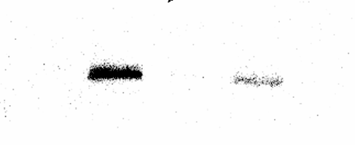
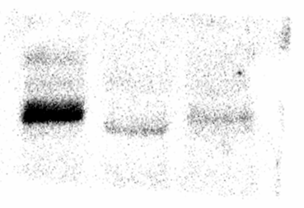
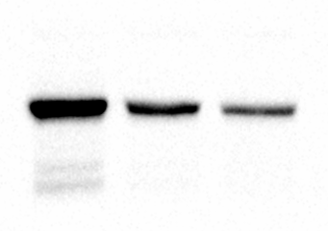
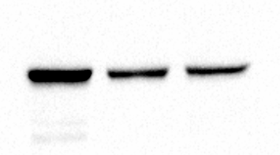
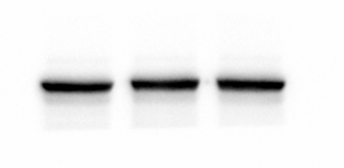
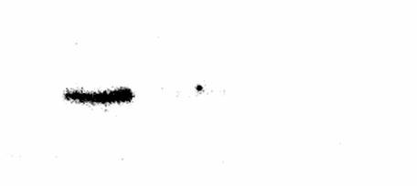
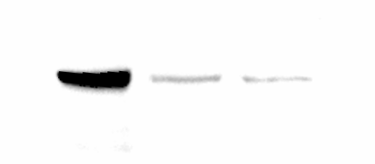
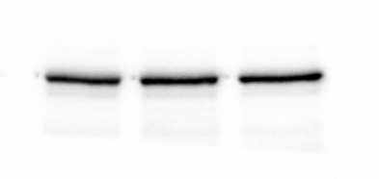
Supplementary Fig. XXX (RARa siRNA)
-
+
-
siRARα
-
+
-
siRARα
75KDa
-
-
+
siERα
-
-
+
siERα
50KDa
RARα
75KDa
50KDa
RARα
75KDa
ERα
50KDa
75KDa
50KDa
ERα
100KDa
Vinculin
100KDa
Vinculin
MCF-7
L370F
-
+
-
siRARα
-
-
+
siERα
75KDa
50KDa
RARα
75KDa
50KDa
ERα
100KDa
Vinculin
Y537S

