Slide 1
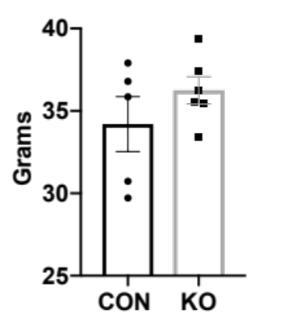
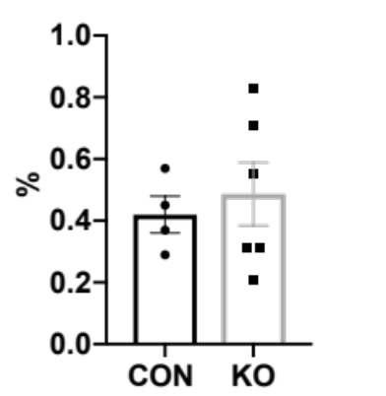
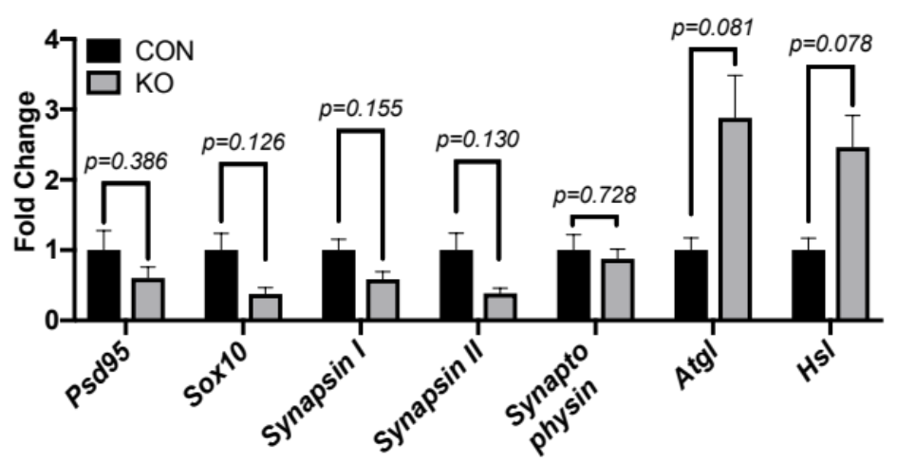
Supplementary Figure S1
A.
Genotyping LymCre^{-/-}:BDNF^{fl/fl} (CON) and LysMCre^{+/-}:BDNF^{-/-} (KO) mice
100 bp
ladder
BDNF^{fl/fl}
Base Pairs
100 bp
ladder
Cre
Base Pairs
1,517
1,200
1,000
900
800
700
600
1,517
1,200
1,000
900
800
700
600
Controls
Controls
fl/fl
fl/fl
fl/fl
fl/fl
fl/fl
fl/fl
+/+
fl/+
fl/fl
-/-
-/-
+/-
+/-
+/-
+/-
-/-
+/-
500/517
400
300
500/517
400
300
200
A B C D E F
A B C D E F
B.
Inguinal scWAT/Body Weight (basal)
Basal
Body Weight
p=0.2735
p=0.6364
C.
Gene Expression Inguinal scWAT Following Cold Exposure

Slide 2
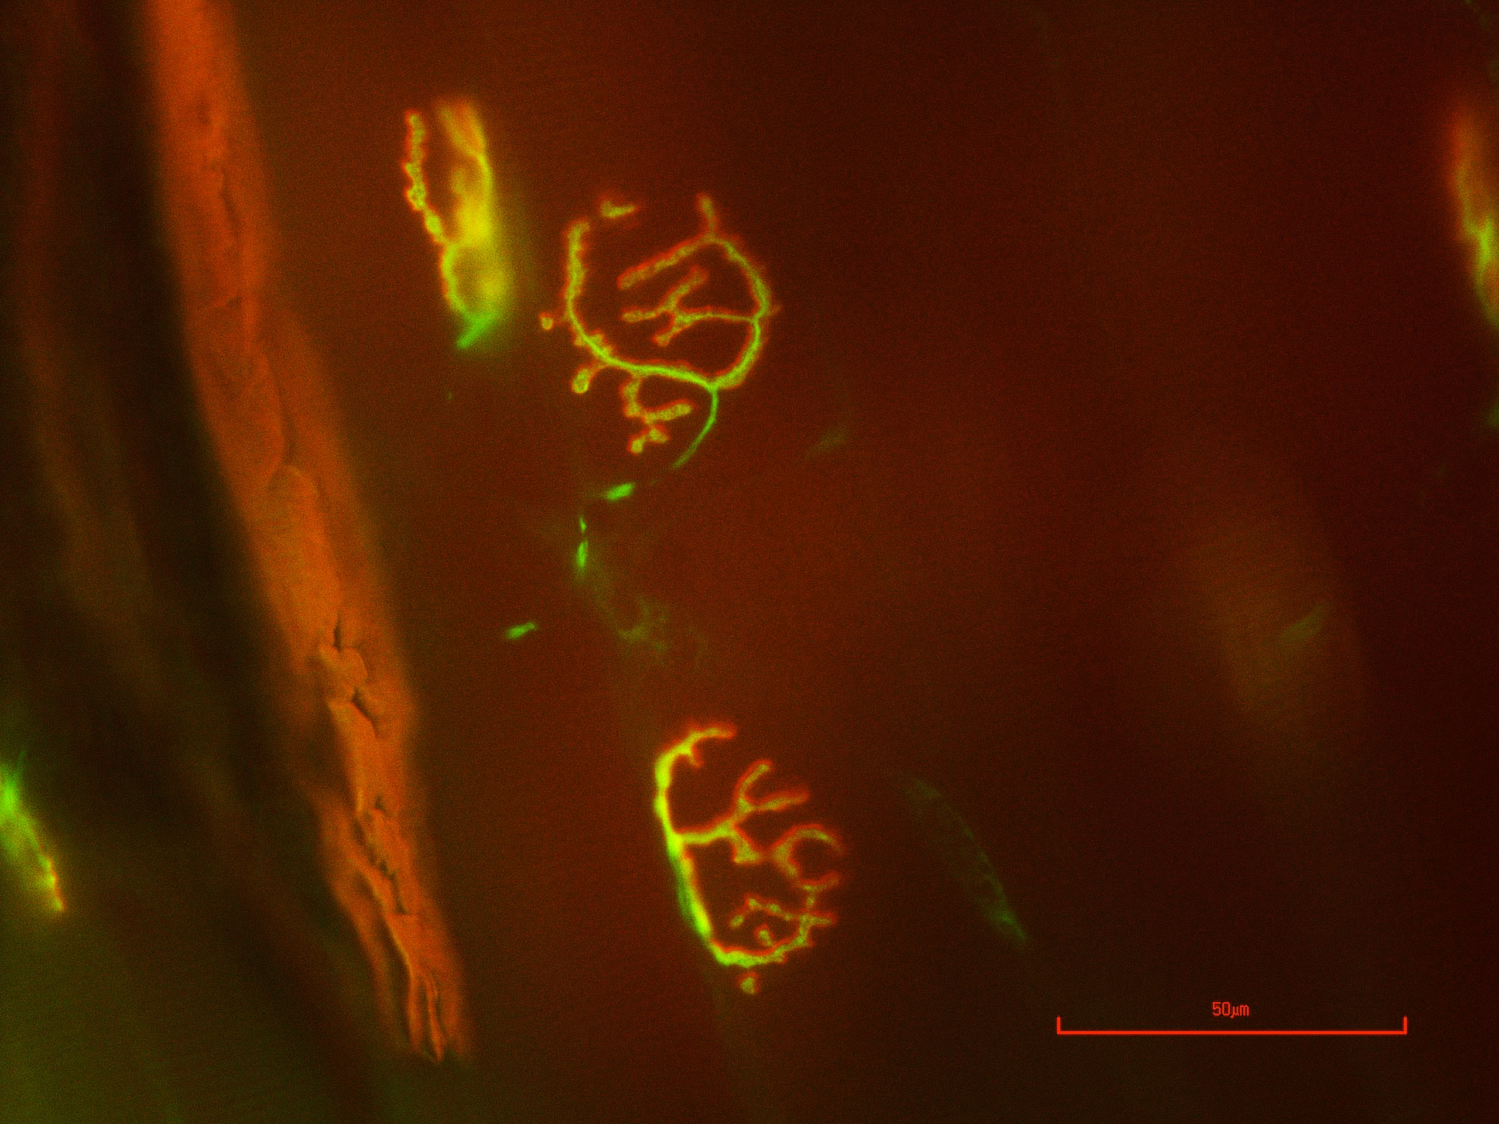
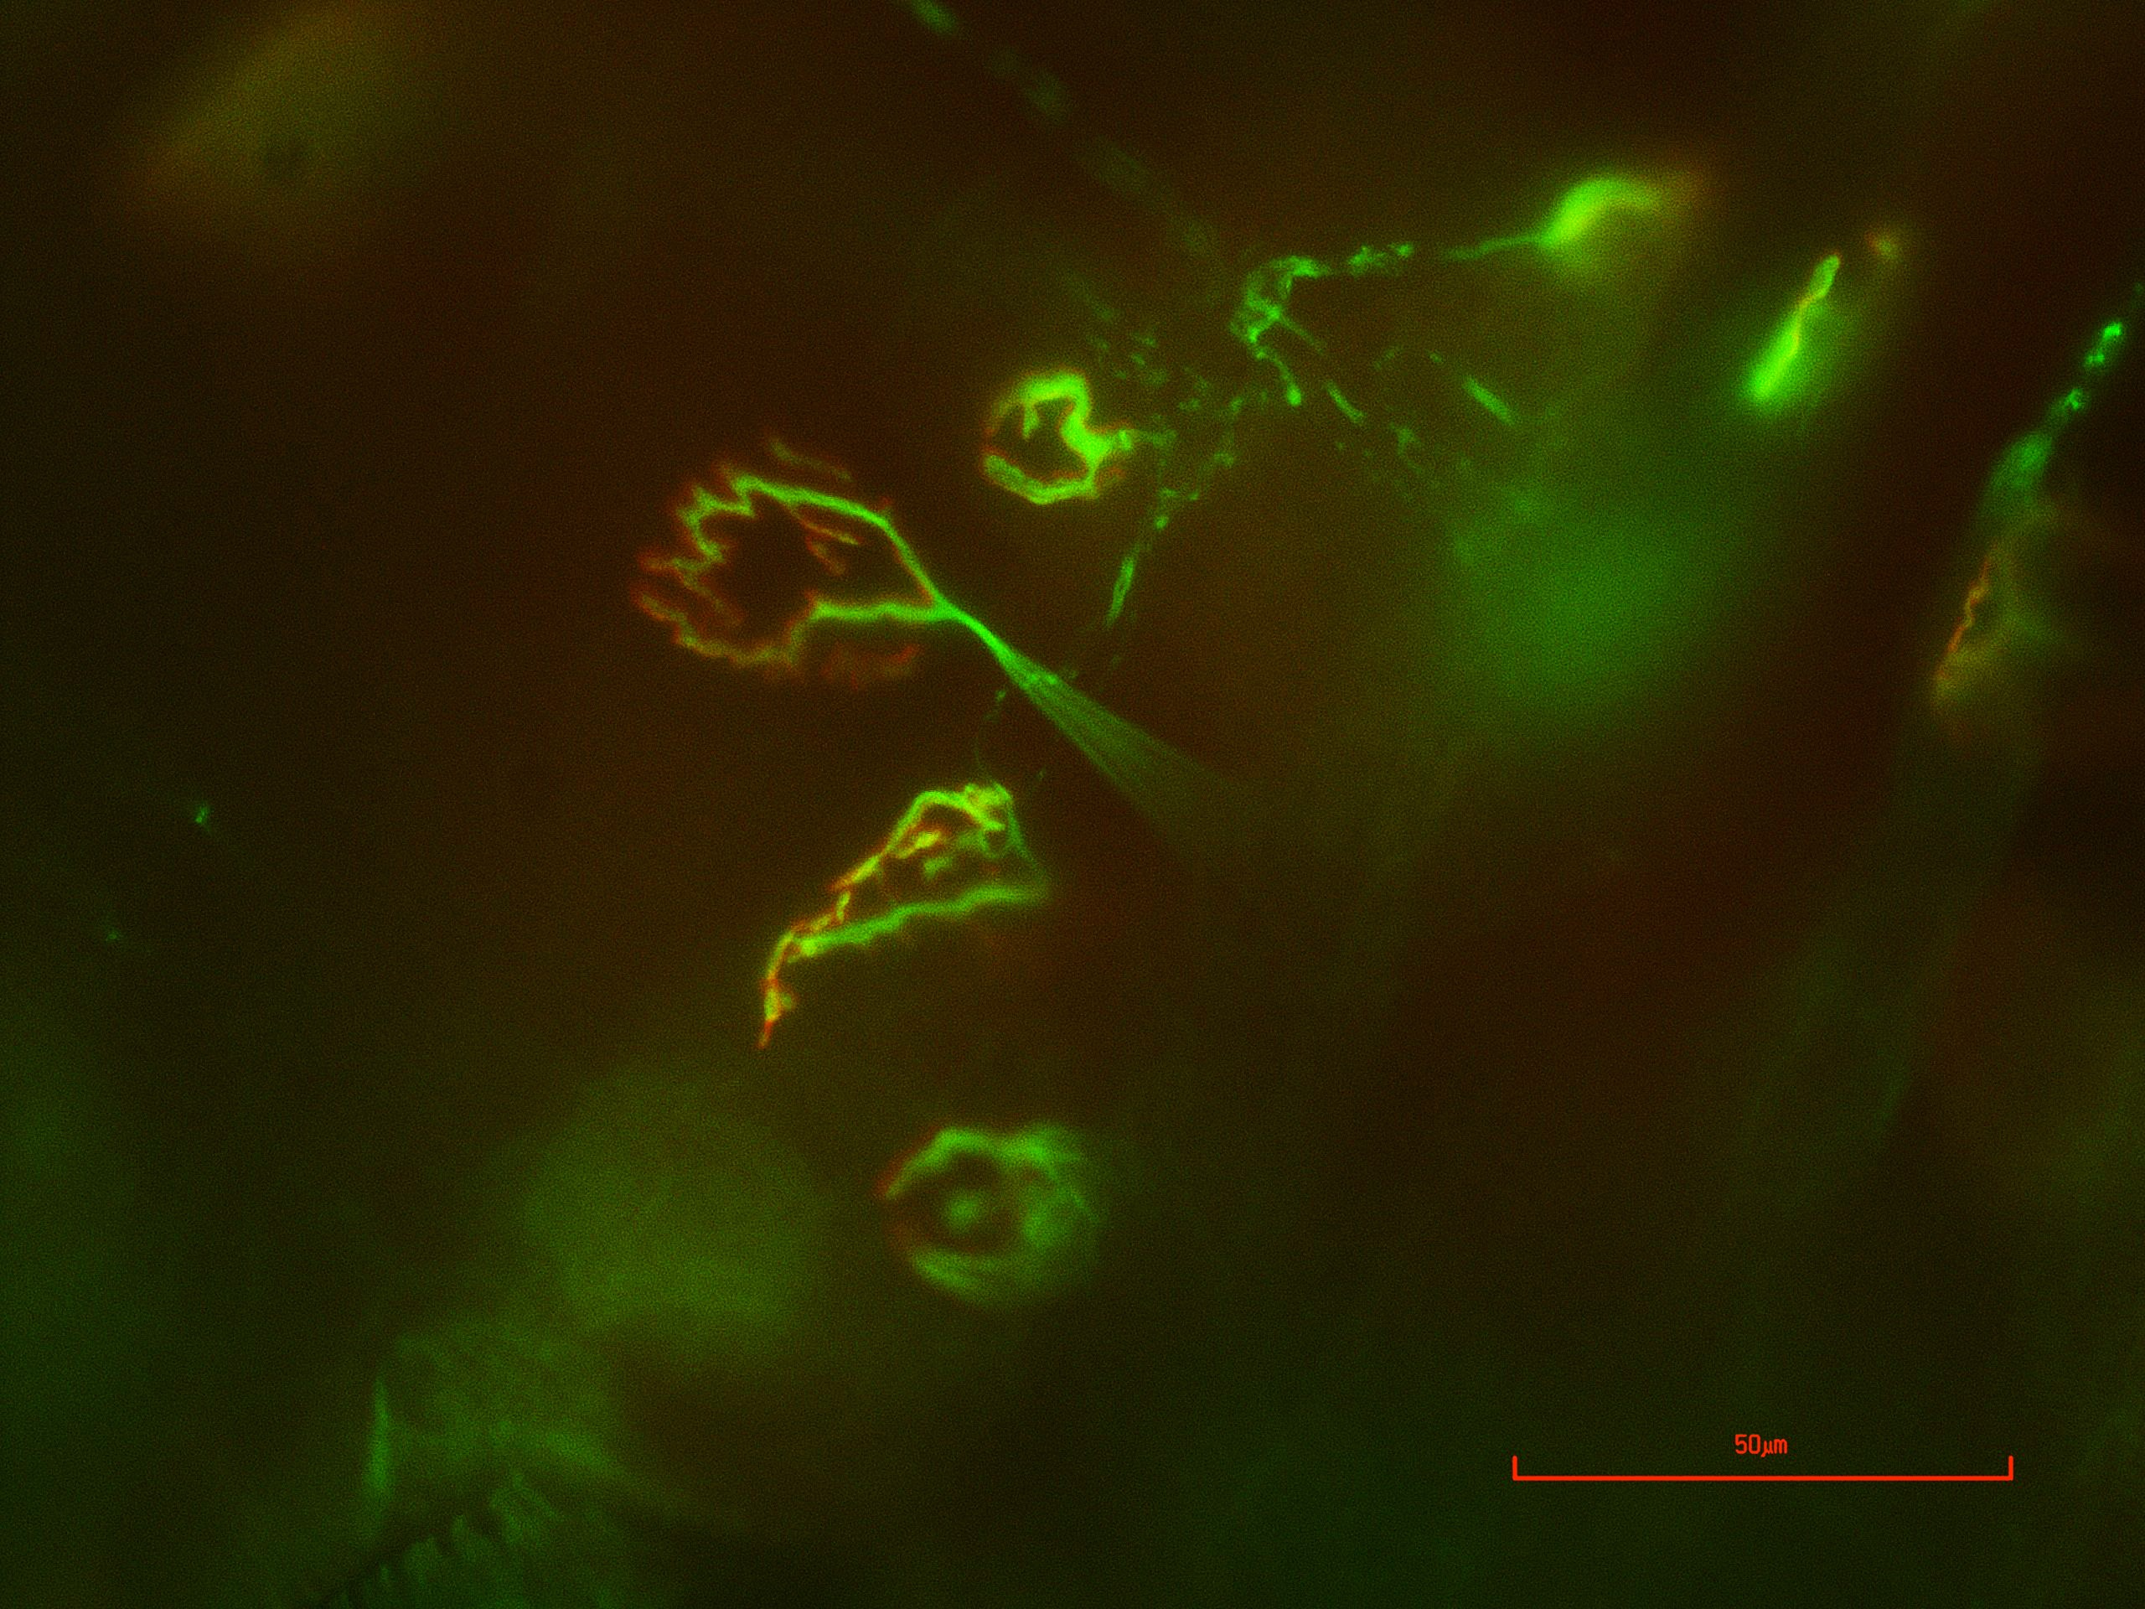
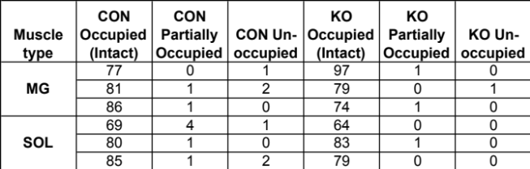
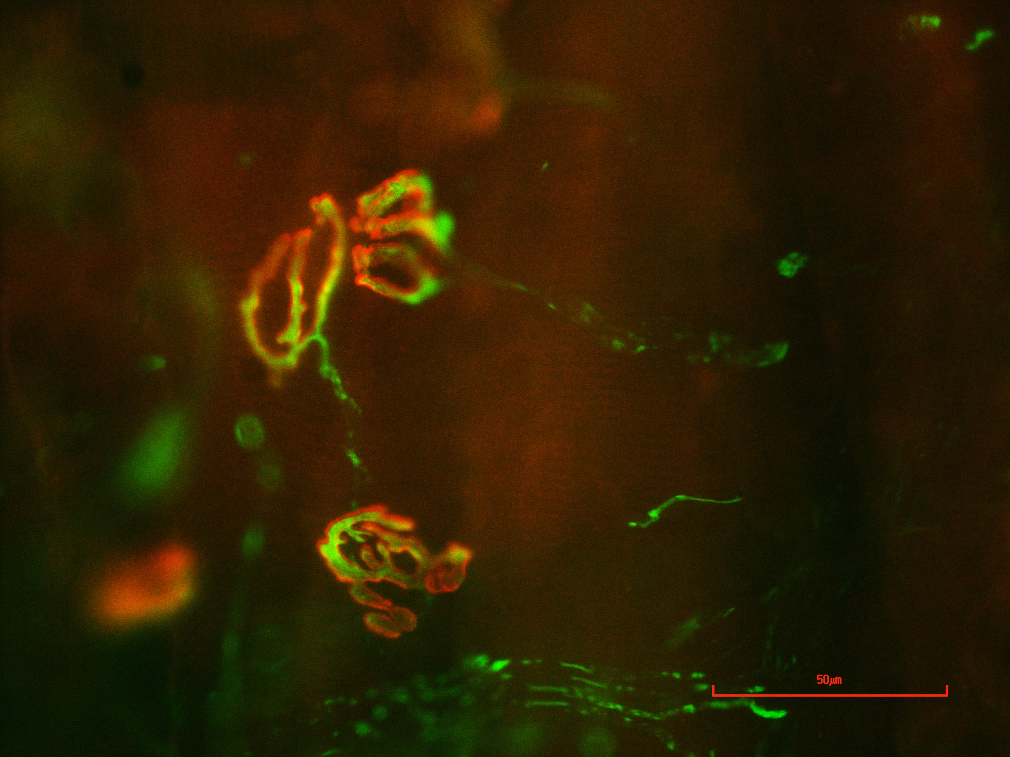
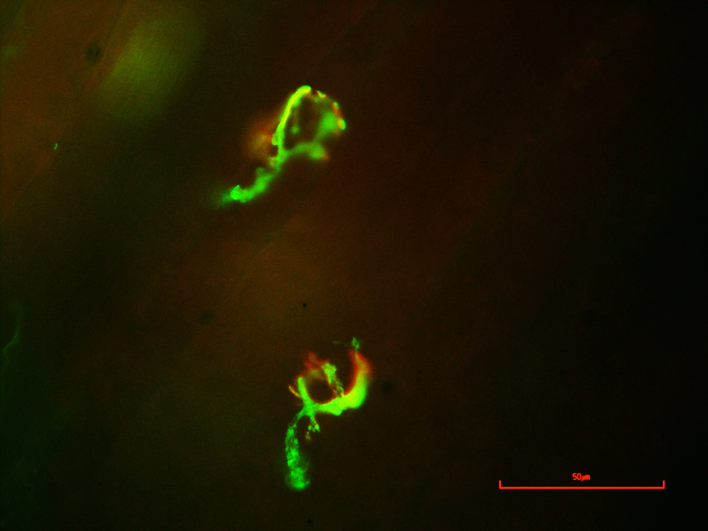
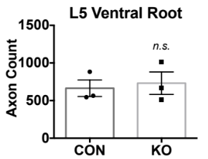
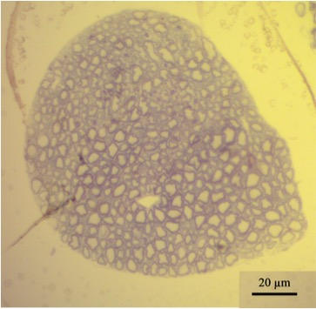
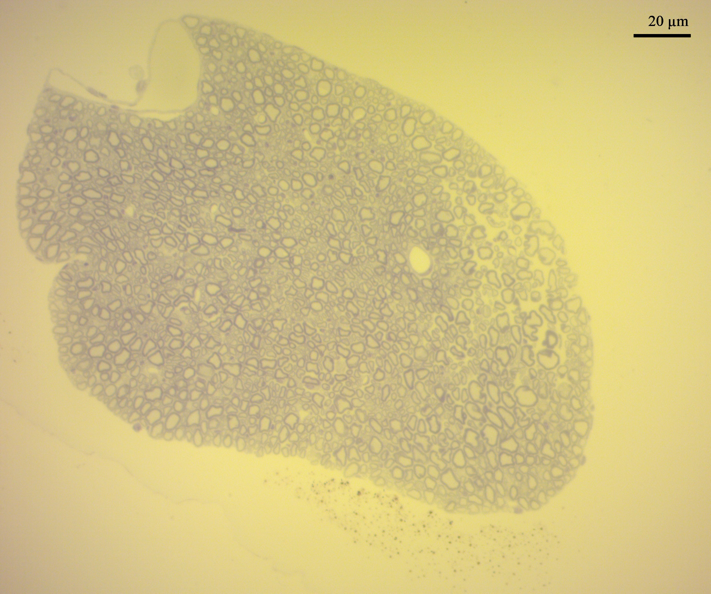
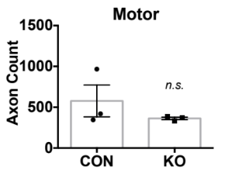
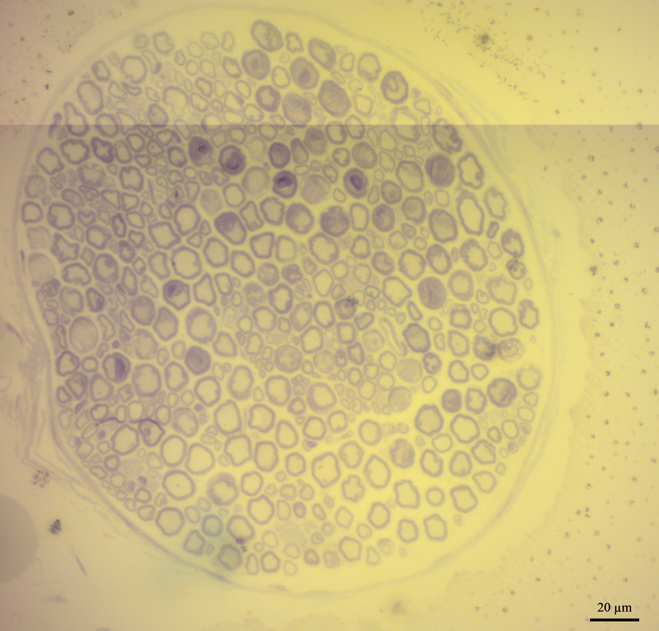
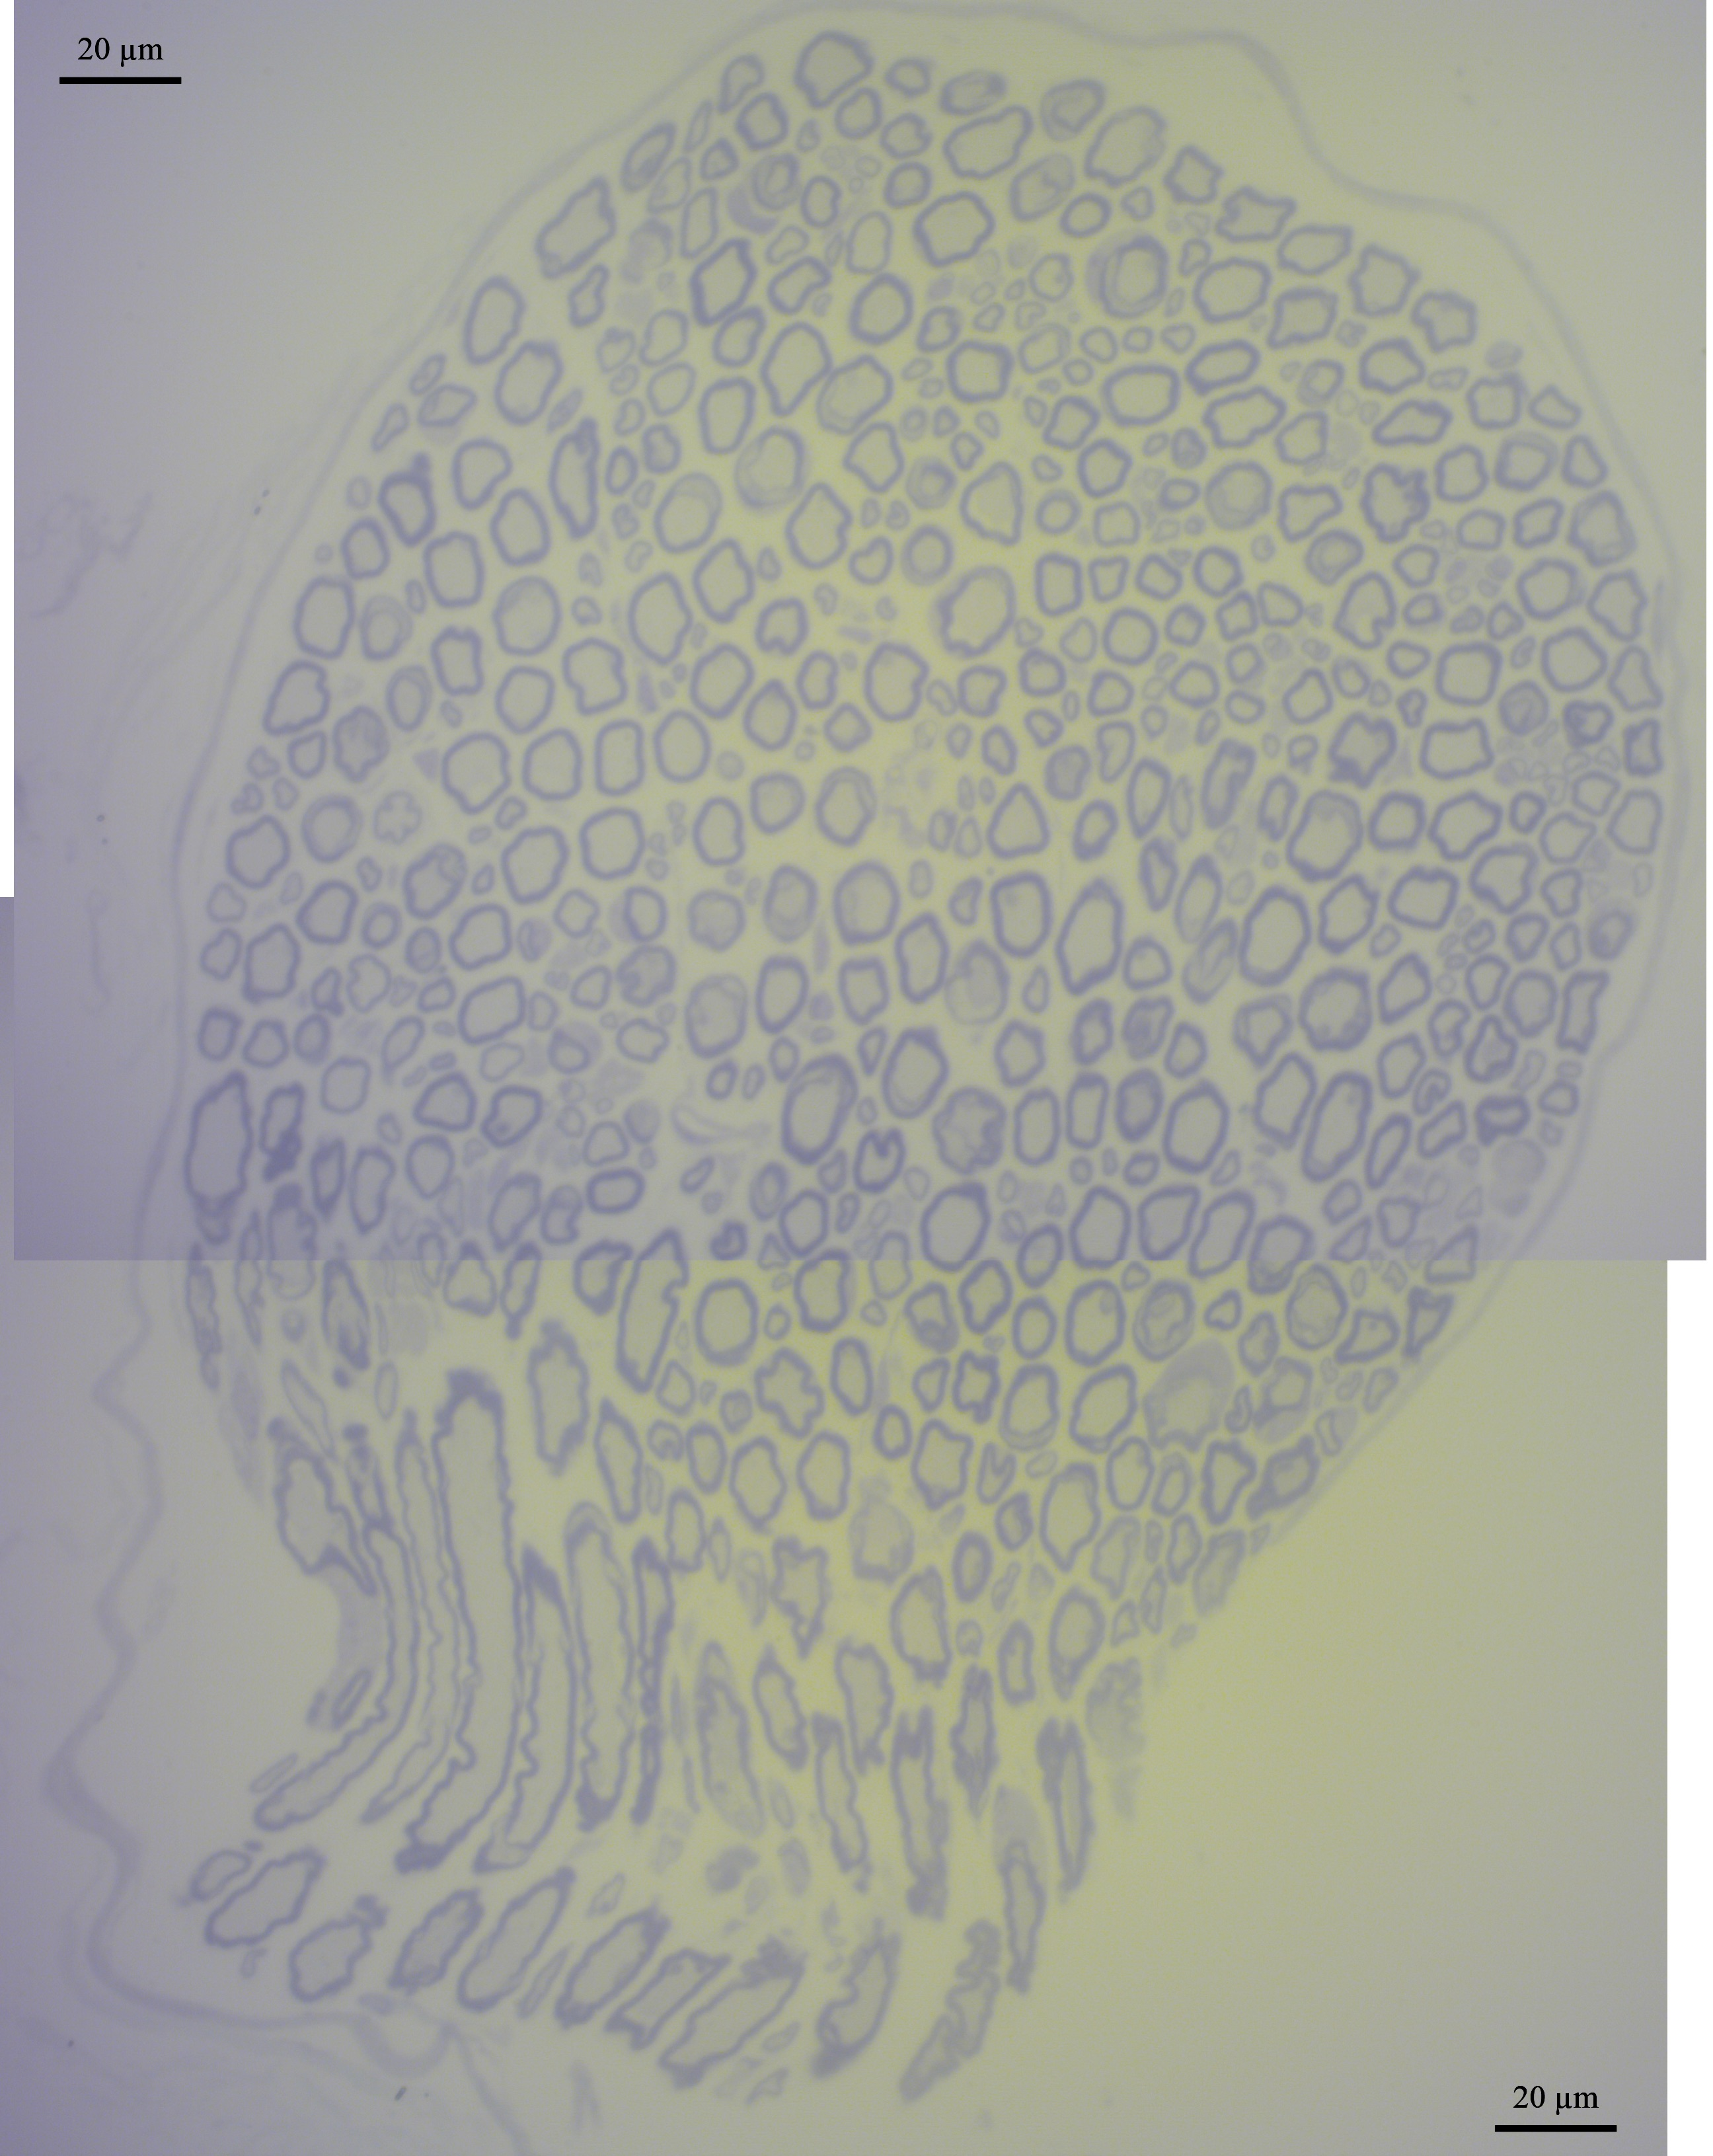
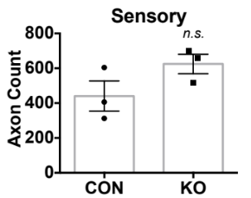
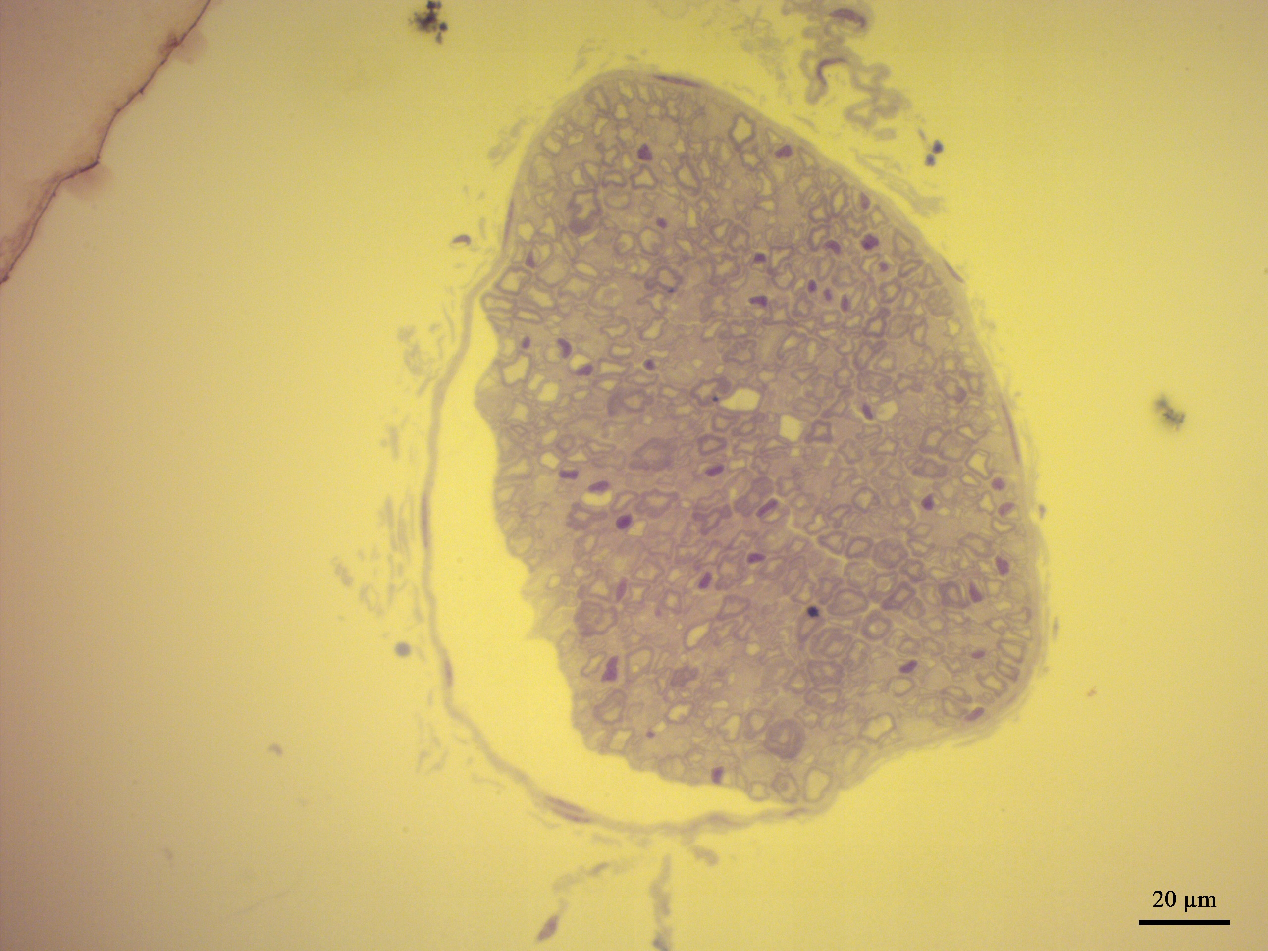
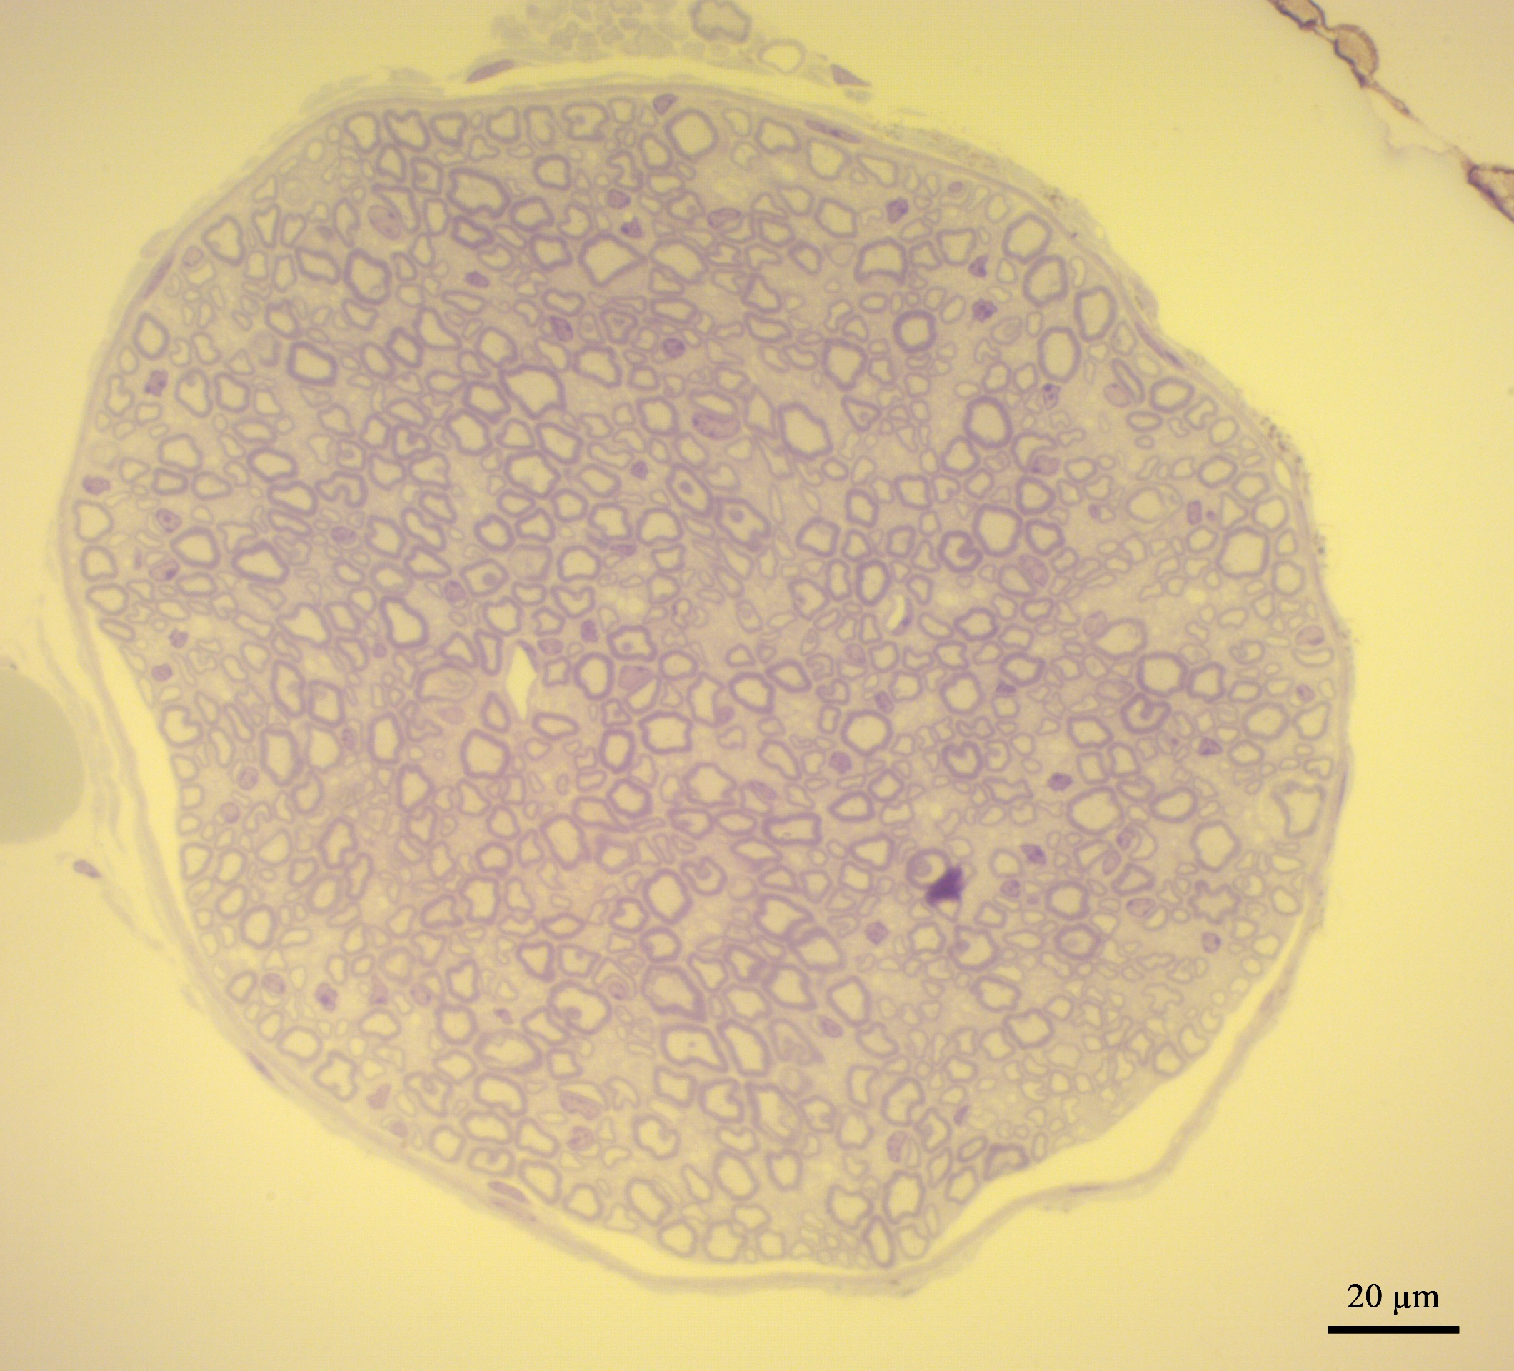
Supplementary Figure S2
A.
Neuromuscular Junction (NMJ) Assessment
CON
KO
Medial
Gastroc
(MG)
Soleus
(Sol)
B.
Spinal, Motor, Sensory Nerve Assessment
CON
KO
p=0.7344
p=0.3363
p=0.1469

Slide 3
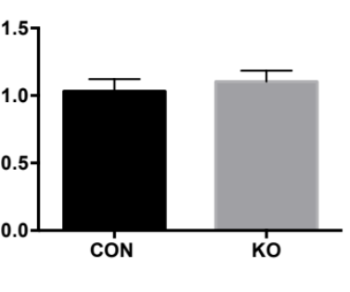
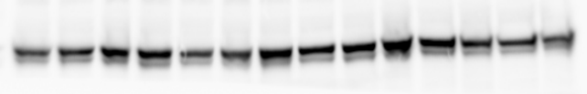
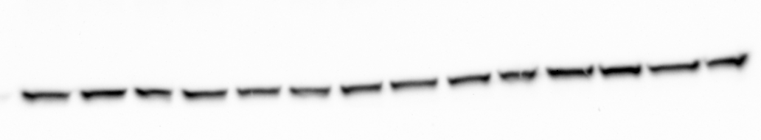
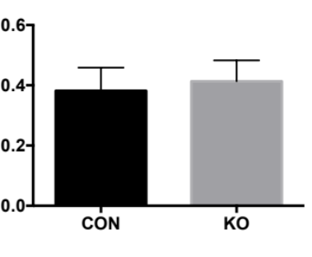


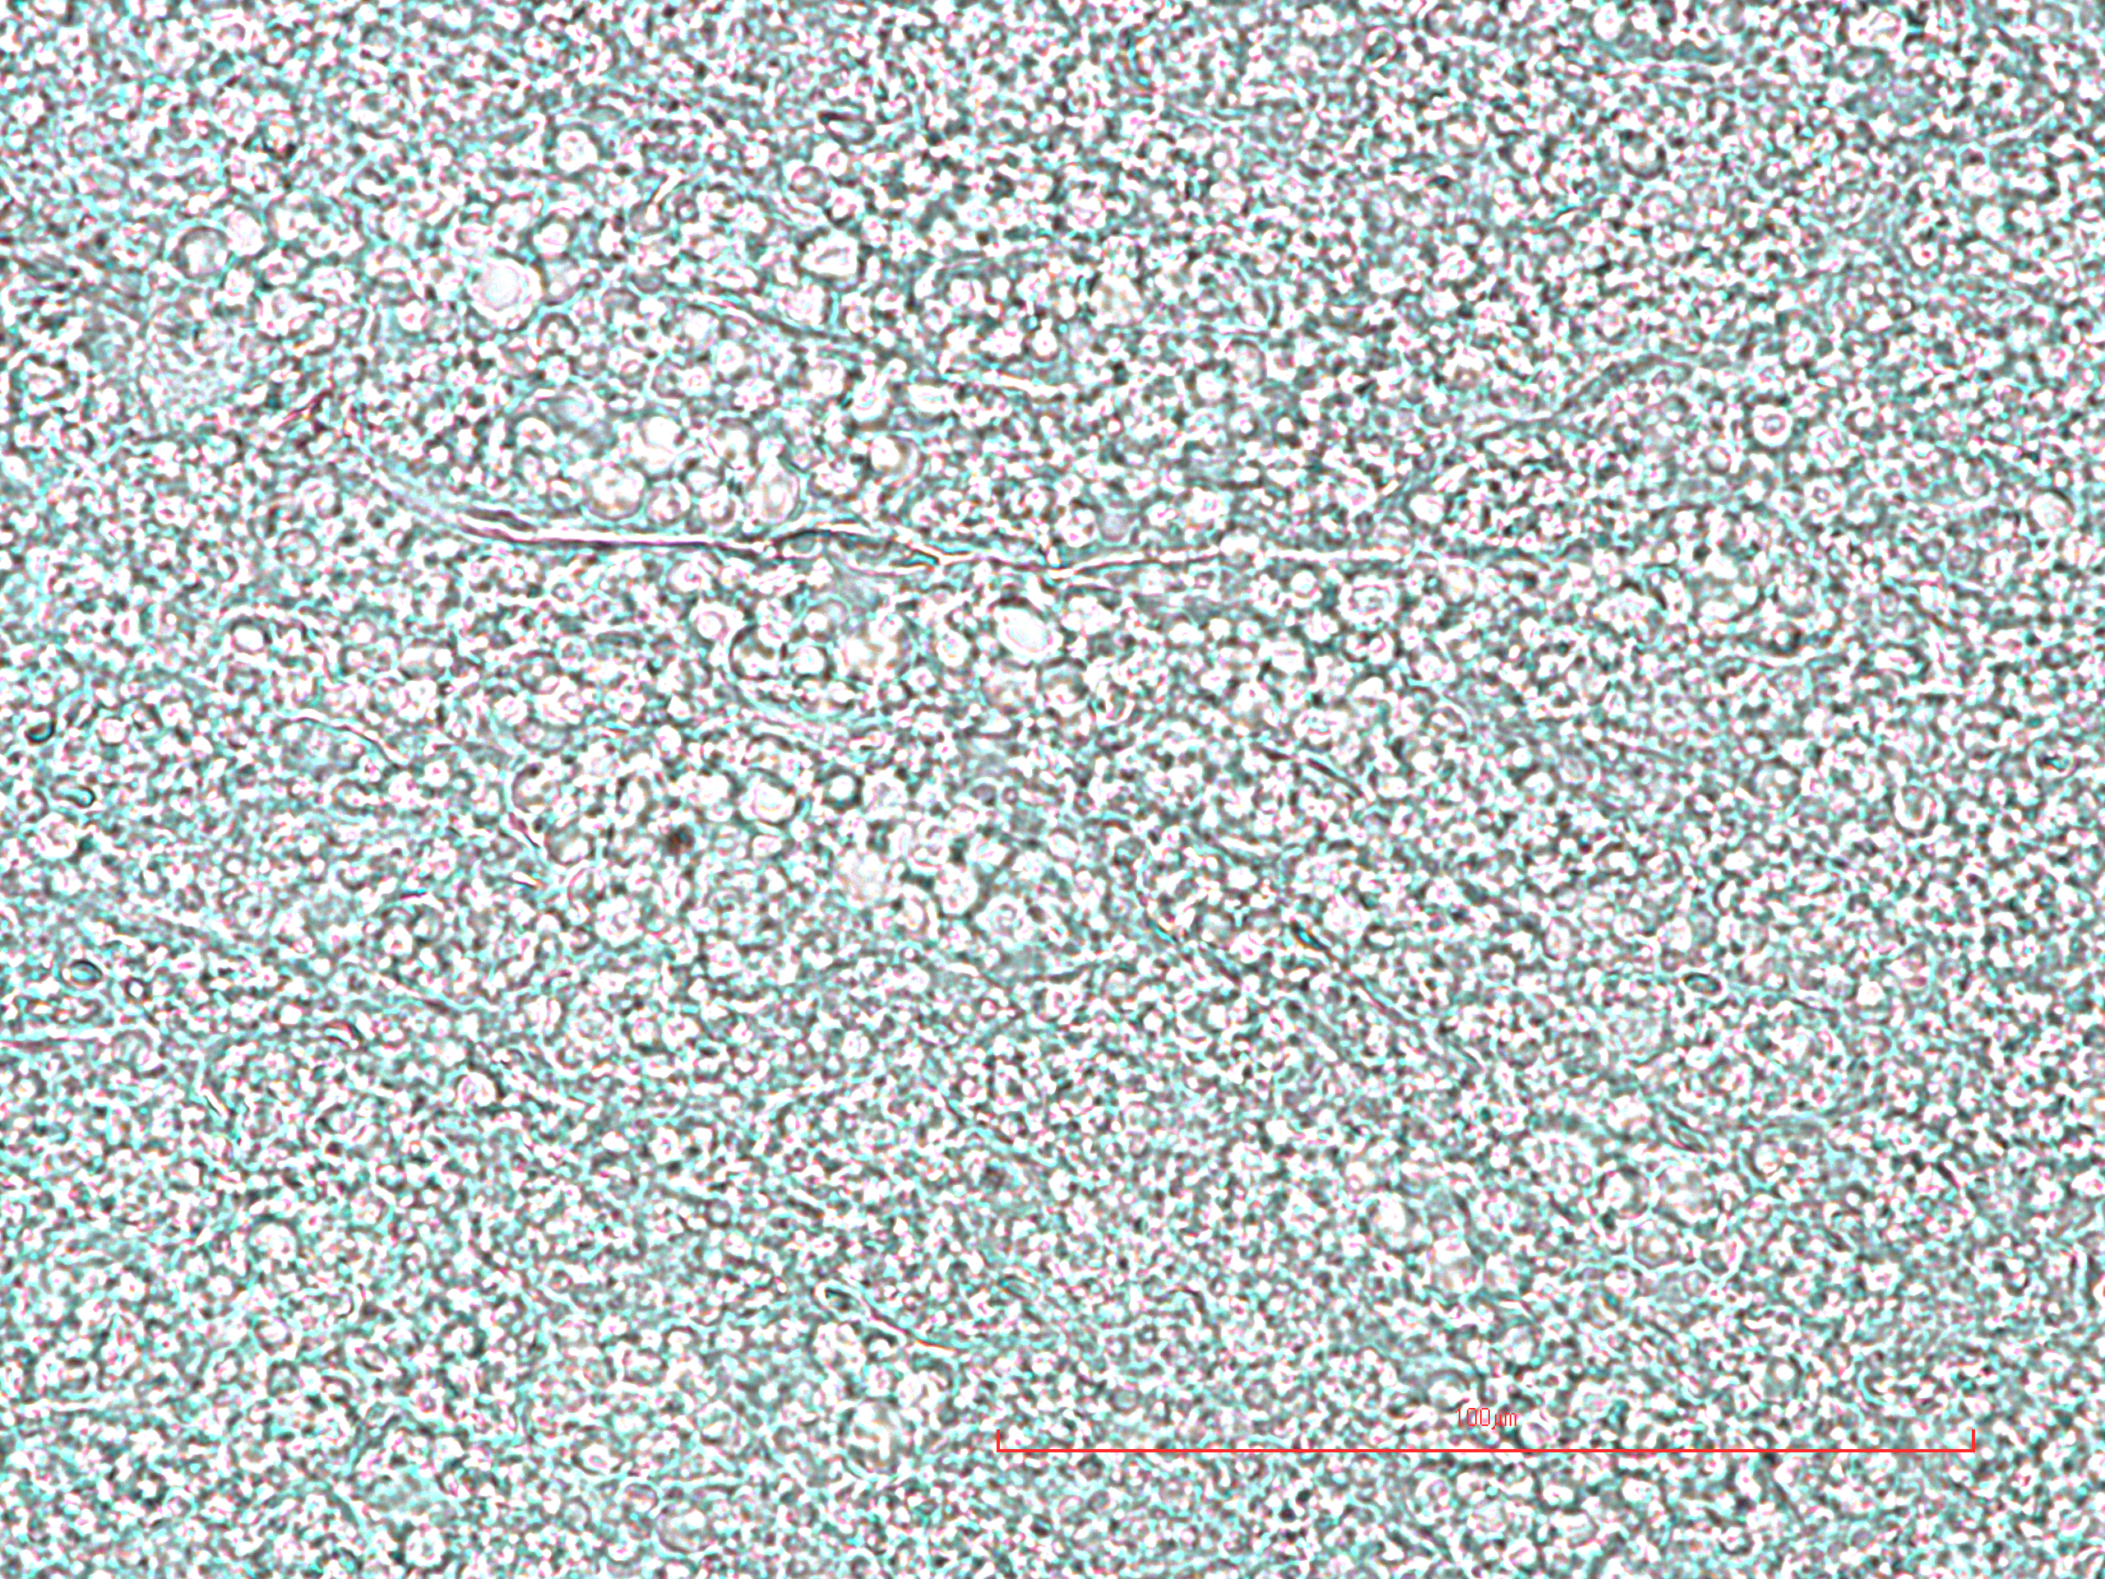
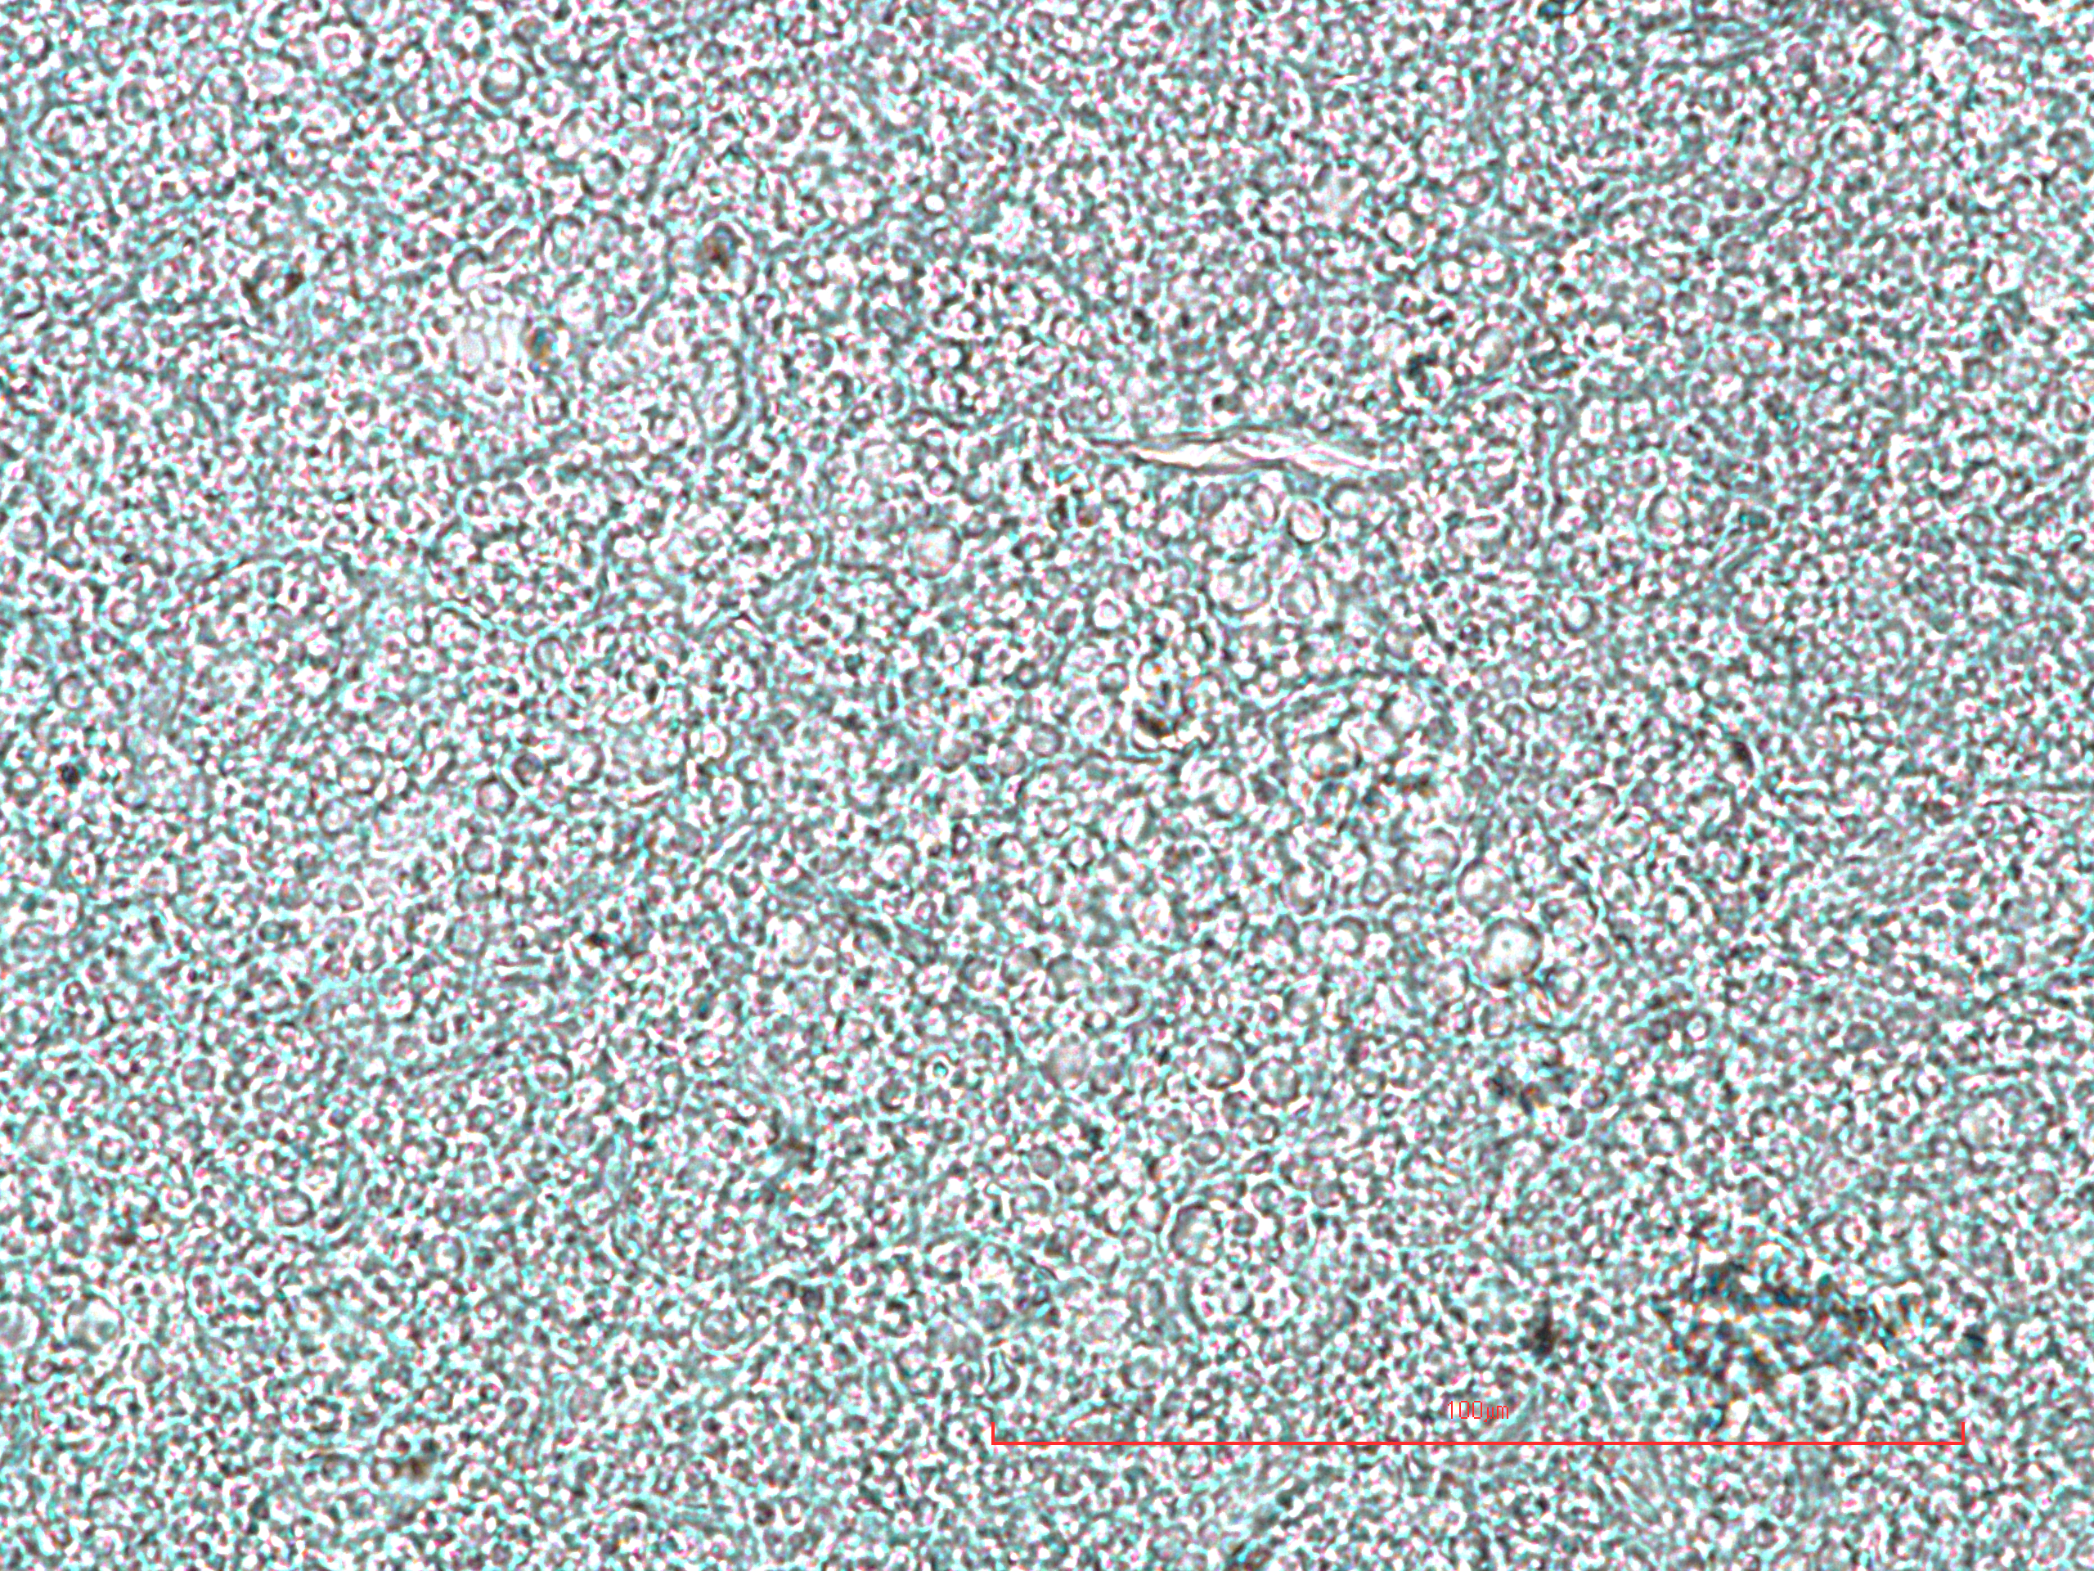
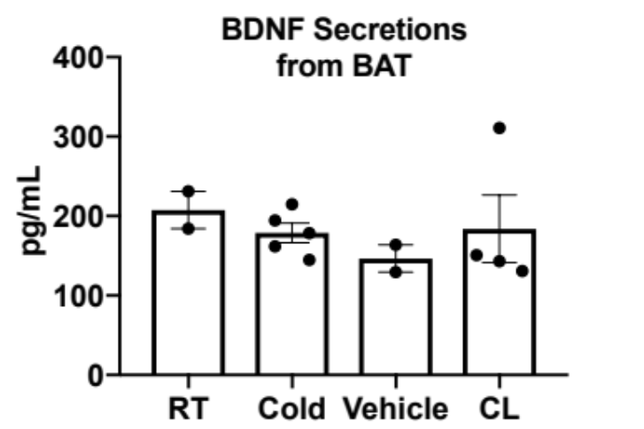
Supplementary Figure S3
A.
BAT 7-day cold (males)
Tyrosine Hydroxylase
p=0.7747
TH
TH/ β-Tubulin
β-Tubulin
CON
KO
BAT 7-day cold (males)
PGP9.5
p=0.7680
PGP9.5
PGP9.5/β-Tubulin
β-Tubulin
CON
KO
B.
BAT histology and UCP1 immunostaining 5-day cold (males)
C.
CON
KO
Typogen Black
UCP1 (green)

Slide 4
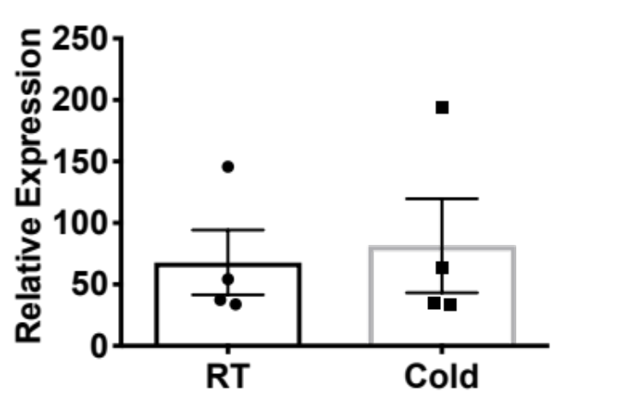
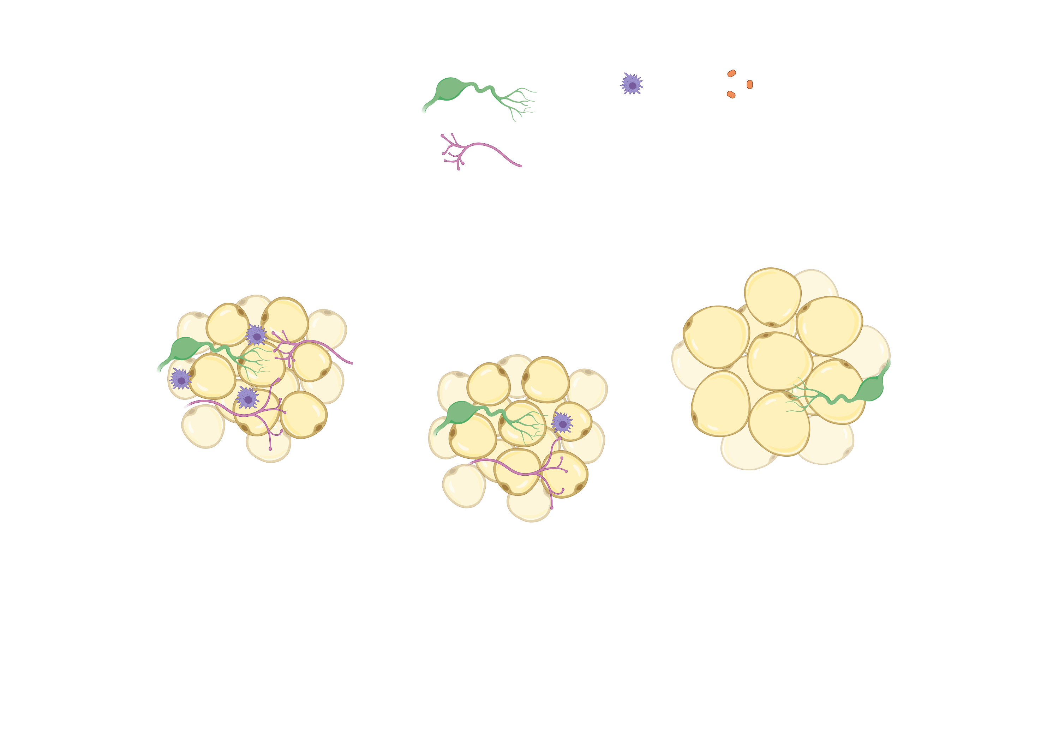

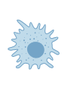
Supplementary Figure S4
A.
Adrβ3 Gene Expression
Ly6C⁺CCR2⁺Cx3CR1⁺ Macrophages
p=0.7788
Model: Cold Induced Neuroimmune Cells (CINCs) are Myeloid Lineage Monocyte/Macrophages that Home in to scWAT and Secrete BDNF to Maintain Nerve Integrity
B.
Deletion of BDNF from myeloid-lineage cells leads to adipose denervation and metabolic perturbations
Cold Induced Neuroimmune Cells (CINCs) home in to adipose via lymphatics and secrete BDNF
BASAL STATE
LysMCre^{+/-}:BDNF^{-/-}
Cold Exposure
Key:
Lymphatics
Nerves
Myeloid cells
BDNF
CINCs

