Slide 1

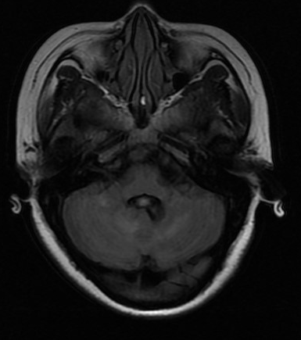
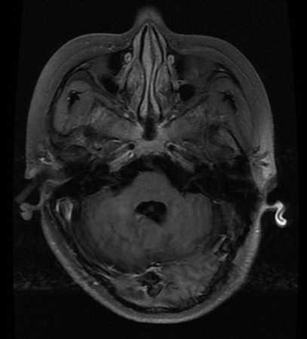
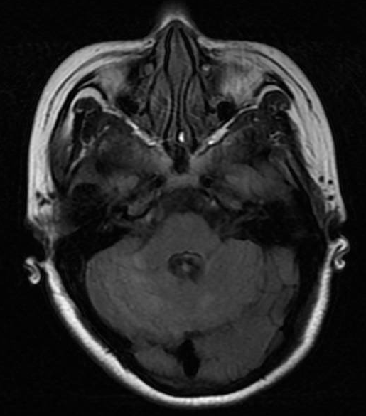
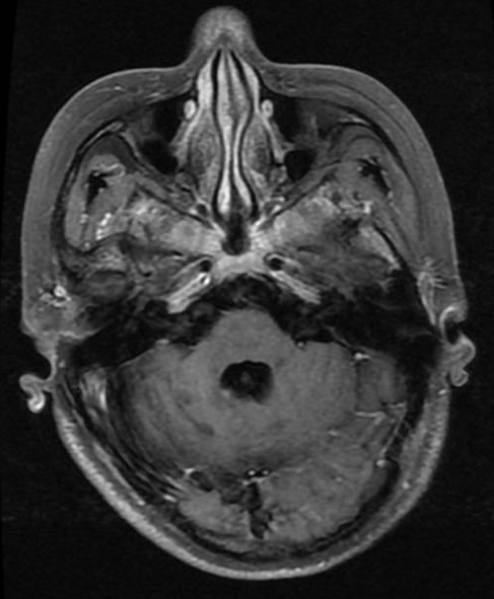
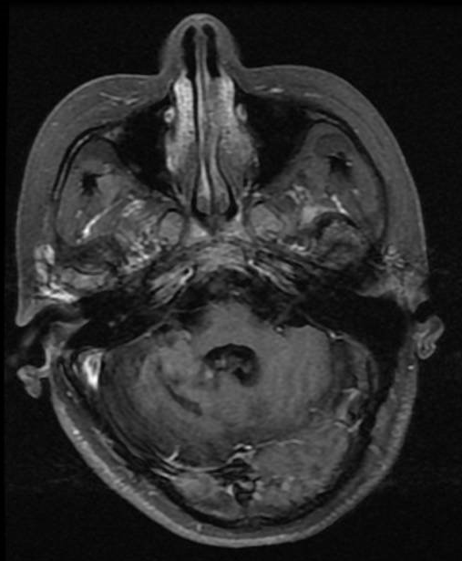
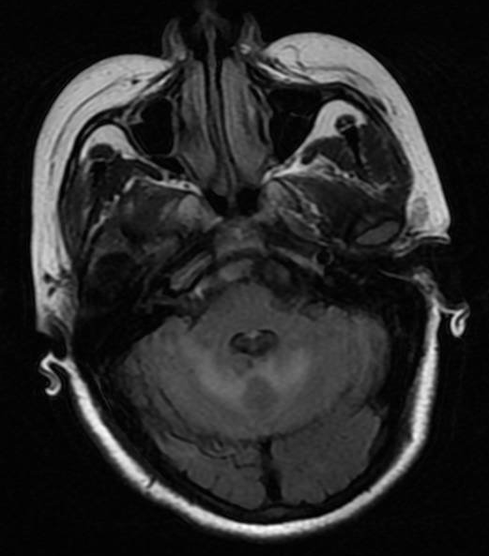
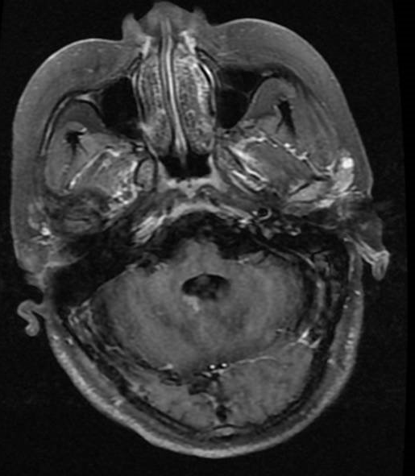
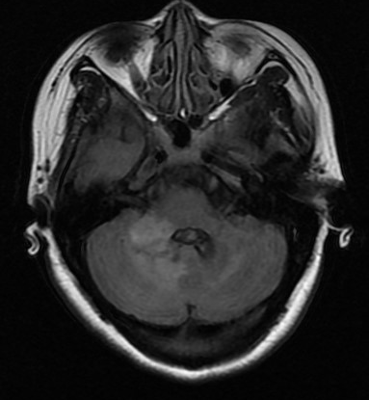
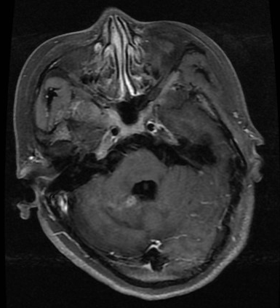
22-year-old female with dizziness and walking instability
Severe headache, nausea, vomiting and ataxia
Brain MRI:reduced of right temporo-occipital lobe lesions and bilateral cerebellar lesions;brainatrophy
Enhanced MRI：Reduced right cerebellar enhancement foci
Brain MRI:reduced of bilateral cerebellar lesions;brainatrophy
27days
4months
6months
15months
29months
Brain MRI:FLAIR hyperintensity and edema in right temporo-occipital lobe, bilateral cerebellar hemispheres;
Enhanced MRI：Cerebellar lesions and adjacent meninges were enhanced;
（(blood,CSF)）Positive Anti-CV2-Ab
showing chronic cervicitis with localized high-grade phosphoepithelial lesions (HSIL, CIN grade III)
Brain MRI：Enlargement of bilateral cerebellar lesions；Enhanced foci of cerebellar lesions increased；MRS：slightly reduced Cho and Cr and NAA peaks in the cerebellar strengthening nodules
Cone biopsy
Recurrence, prevention of recurrence with mycophenolate mofetil
Anti-CV2-Ab autoimmune encephalitis
corticoste-roid、cyclophosphamide infusion (2 times/month, 12 times in total)
Brain MRI：no changes

