Slide 1
Supplementary Figure S1
P = 0.5481
P = 0.1485
a
b
c
P = 0.3205
d
P = 0.9825
e
P = 0.7041
f
P = 0.8086

Slide 2
Supplementary Figure S1
P = 0.0585
P = 0.5211
g
h
i
P = 0.0721
j
P = 0.1521
k
P = 0.9886
l
P = 0.9852

Slide 3
Supplementary Figure S1
P = 0.9328
P = 0.9448
m
n
Supplemental Figure 1. Correlation analysis of antibody levels against glucose-dependent insulinotropic peptide and glucagon-like peptide-1 with data of participants in the diabetes cohort
The participants were divided as follows: sex (male and female); diabetes type (type 1 and type 2); absence (−) or presence (+) of complications of retinopathy, neuropathy, or dyslipidemia; and lifestyle factors (smoking and alcohol consumption habits). Antibody levels (Alpha counts) were compared using the Mann–Whitney U test. Sample numbers, averages, standard deviations of Alpha counts, and P values are shown.

Slide 4
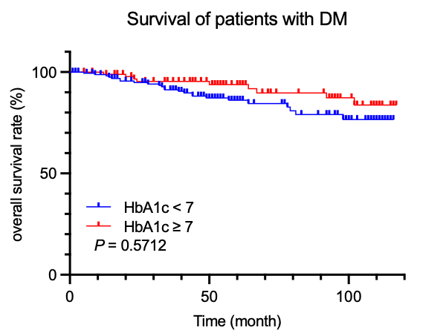
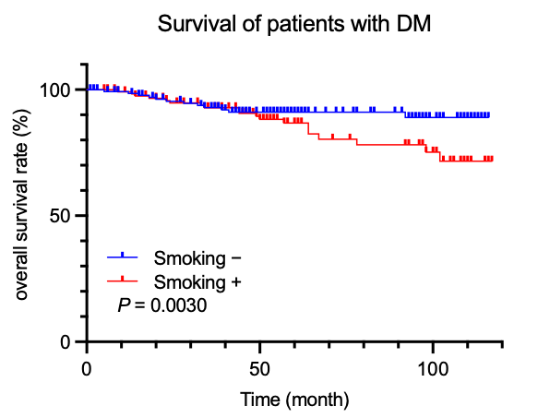
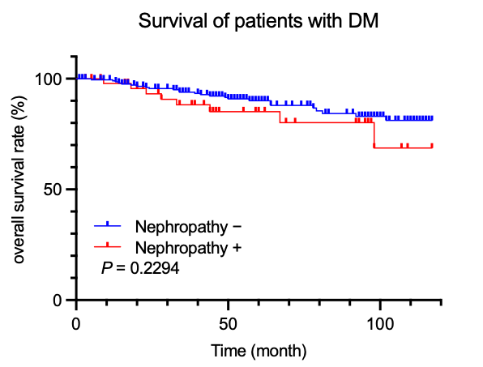
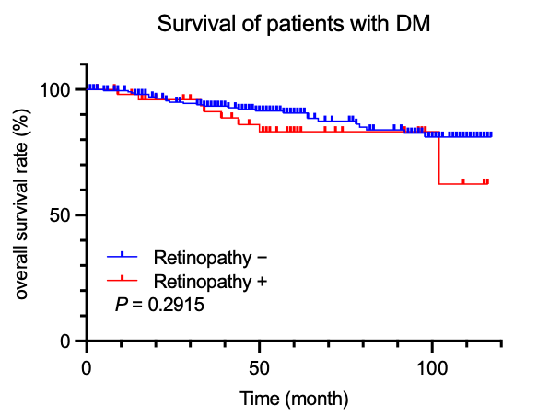
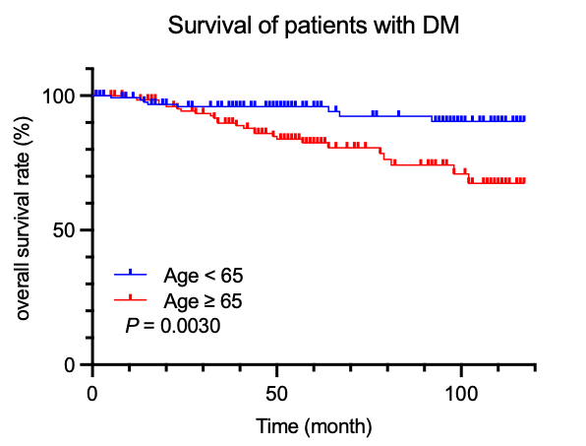
Supplementary Figure S2
a
b
c
d
e
Supplemental Figure 2. Survival analysis of patients with diabetes
Comparison of overall survival of the patients with diabetes according to HbA1c (a); with or without smoking (b), nephropathy (c), retinopathy (d) and age (e) are shown in Kaplan–Meier plots. Cutoff values were determined using X-tile software.
Statistical analyses were performed using the log-rank test. P values are shown.

