Slide 1
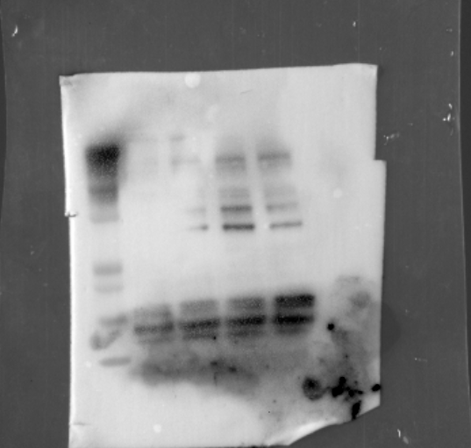
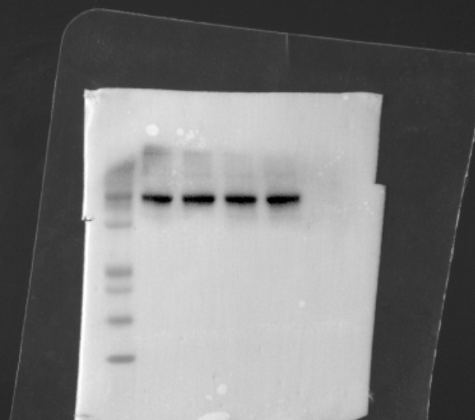
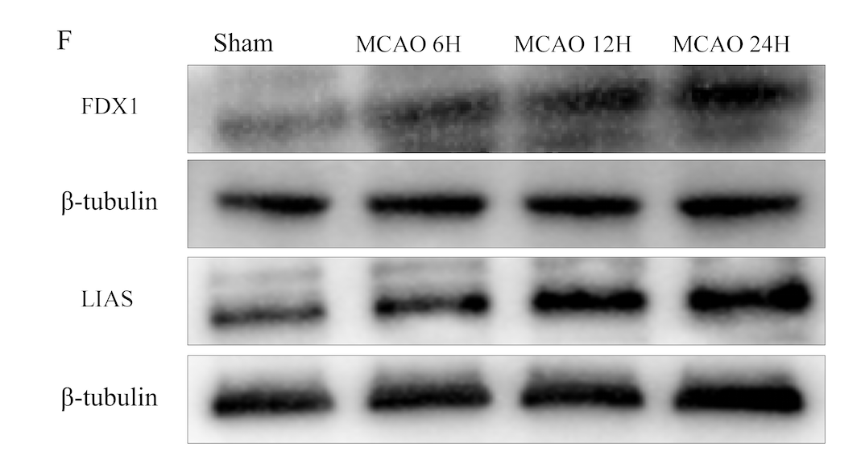
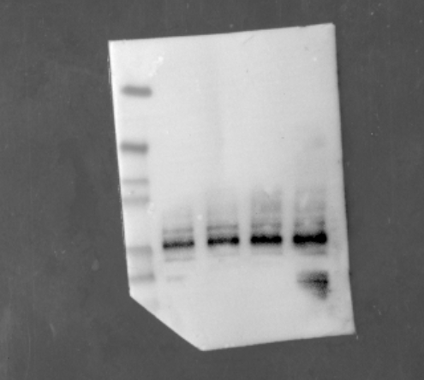
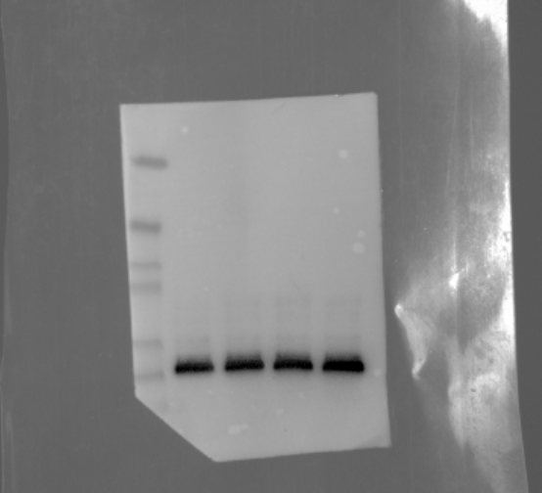
FIGURE 1
53kDa
40kDa
β-tubulin
18kDa
10kDa
FDX1
53kDa
40kDa
LIAS
53kDa
40kDa
β-tubulin

Slide 2
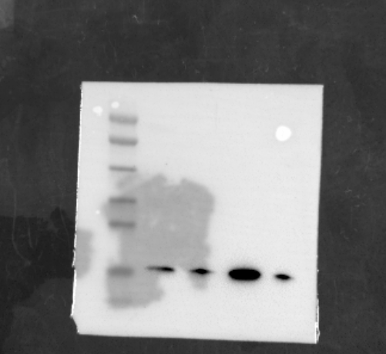
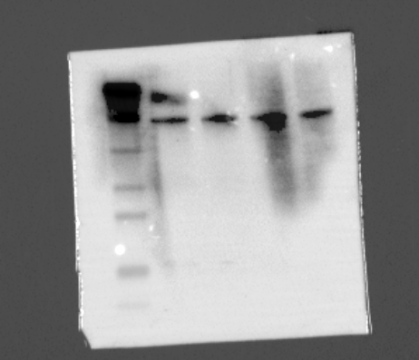
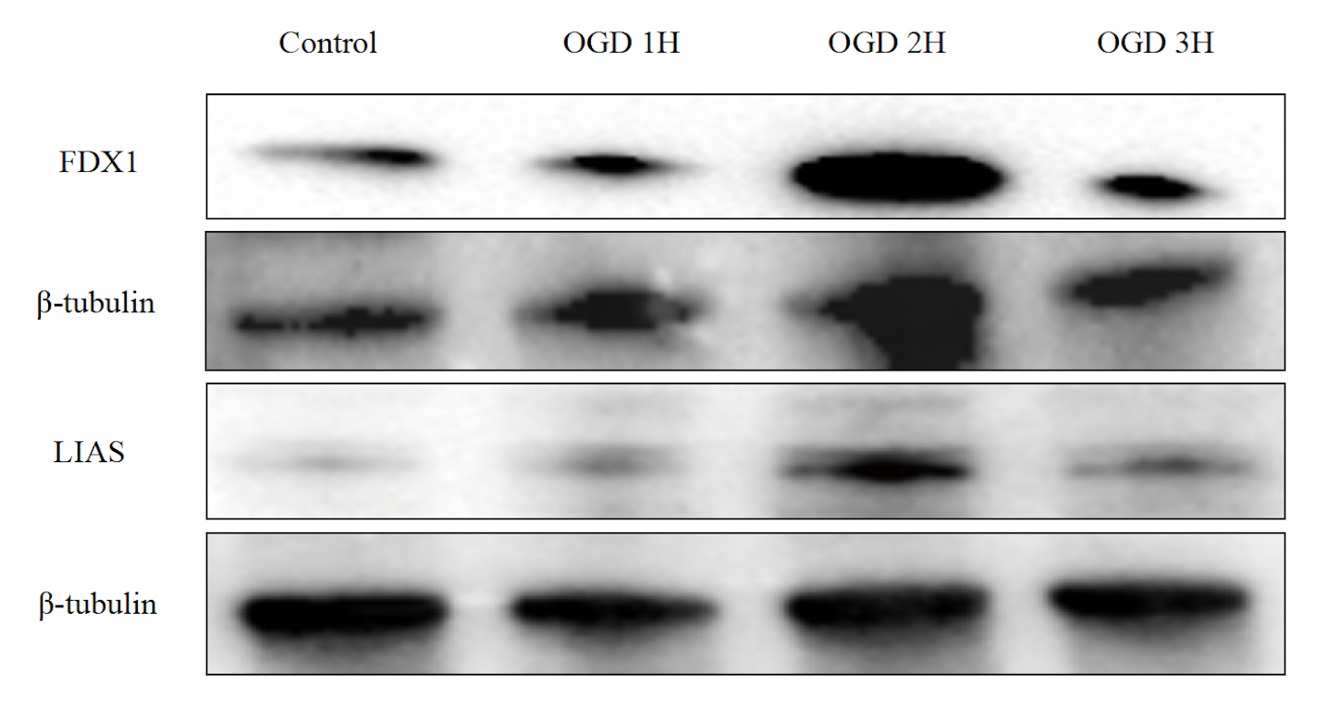
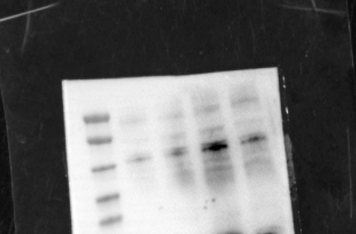
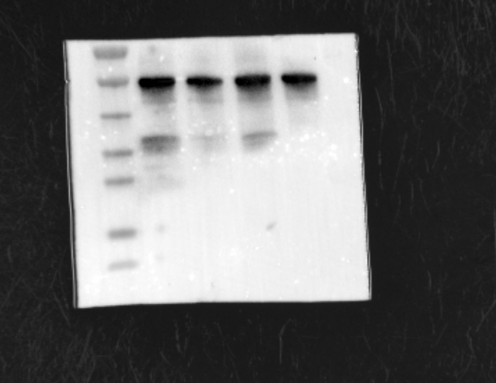
FIGURE 2
53kDa
40kDa
18kDa
10kDa
FDX1
53kDa
40kDa
β-tubulin
53kDa
40kDa
LIAS

Slide 3
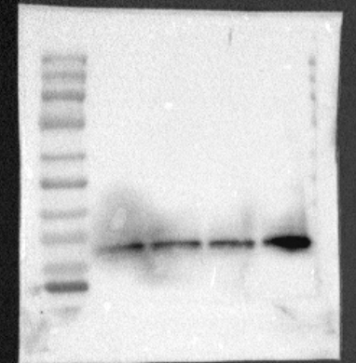
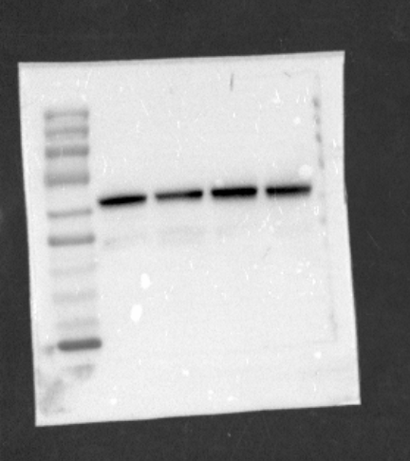
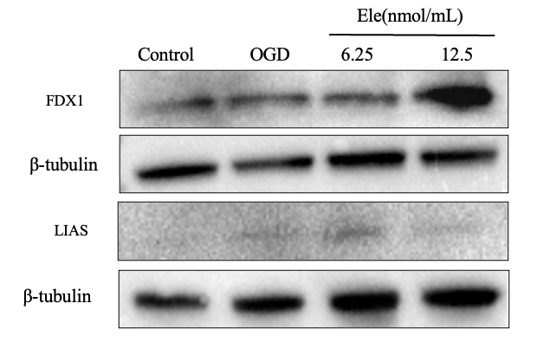
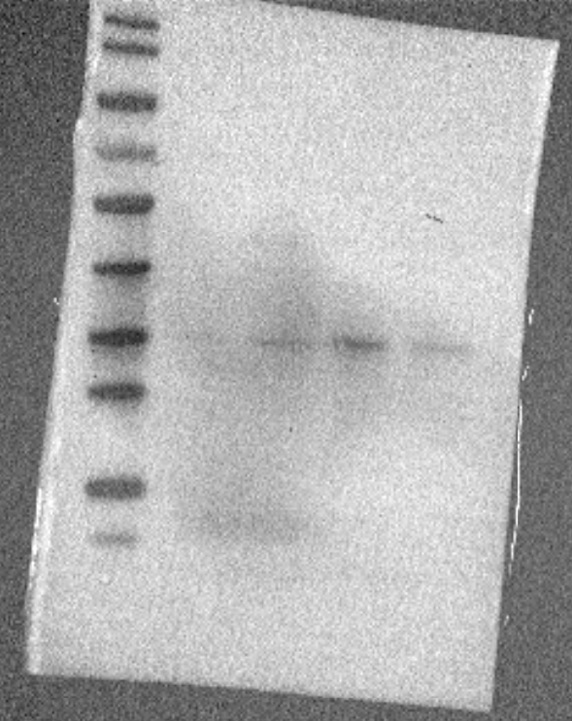
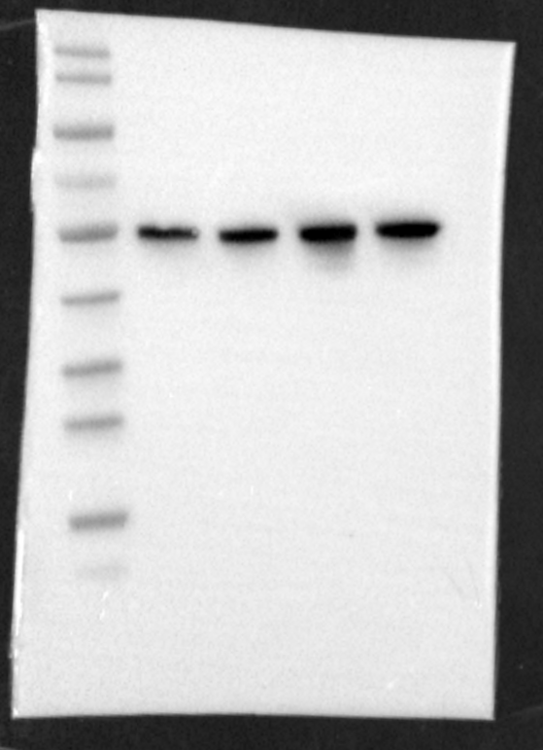
FIGURE 3
70kDa
55kDa
β-tubulin
25kDa
15kDa
FDX1
70kDa
55kDa
40kDa
β-tubulin
35kDa
LIAS

Slide 4
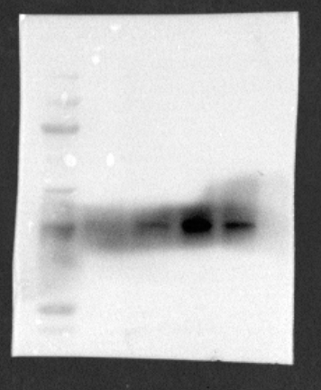
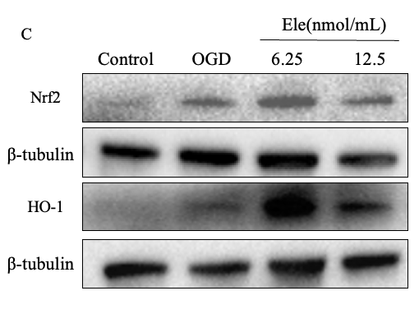
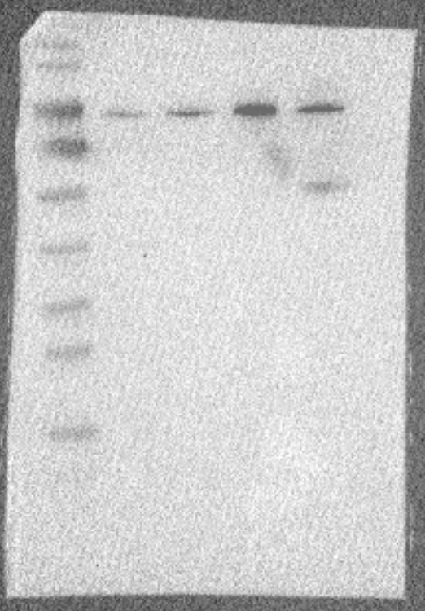
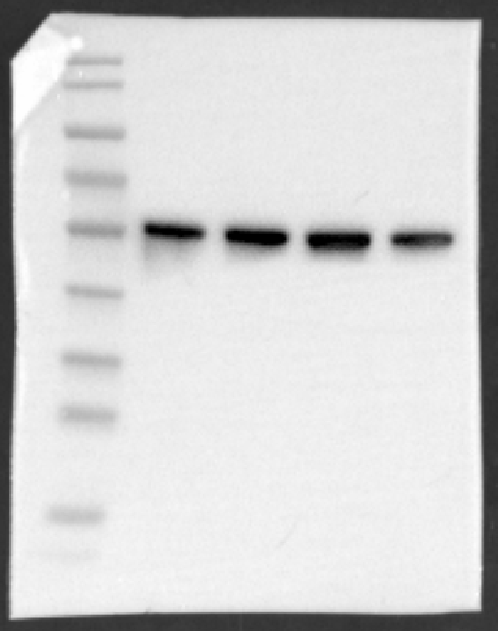
FIGURE 5
70kDa
40kDa
53kDa
β-tubulin
35kDa
HO-1
100kDa
70kDa
70kDa
Nrf2
53kDa
β-tubulin

Slide 5
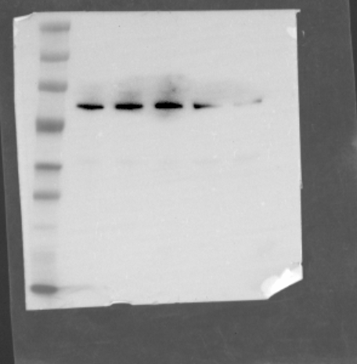
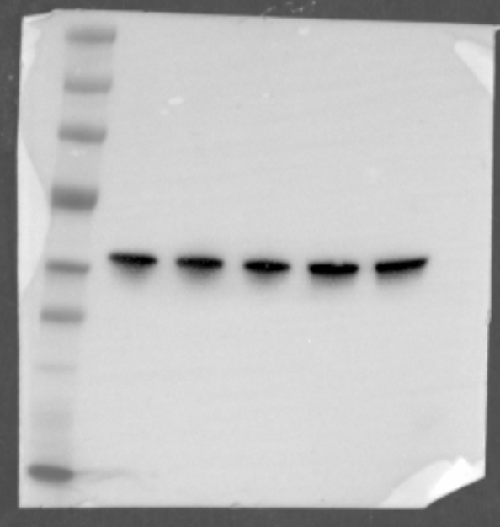
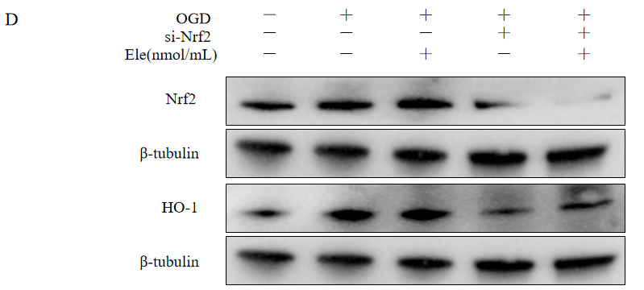
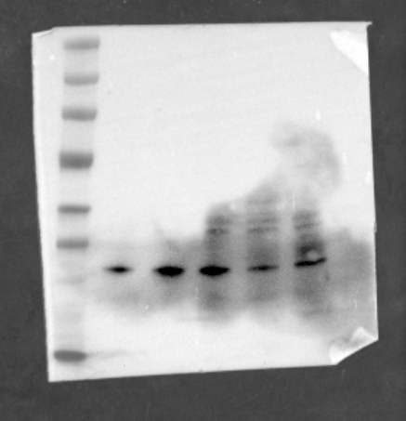
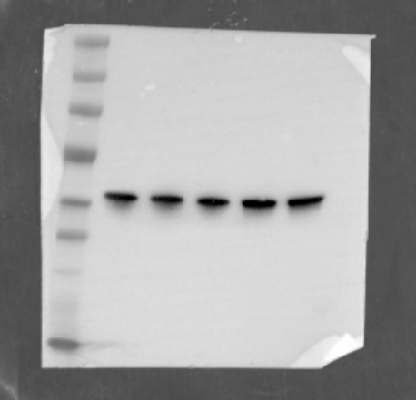
FIGURE 6
100kDa
70kDa
70kDa
Nrf2
53kDa
β-tubulin
70kDa
53kDa
40kDa
35kDa
β-tubulin
HO-1

Slide 6
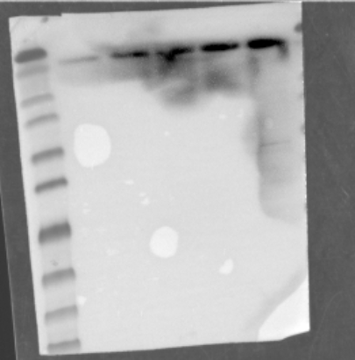
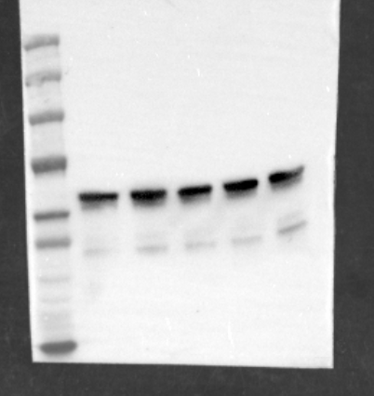
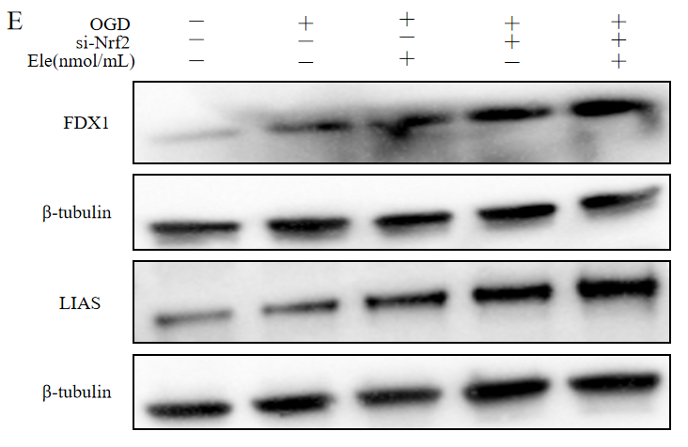
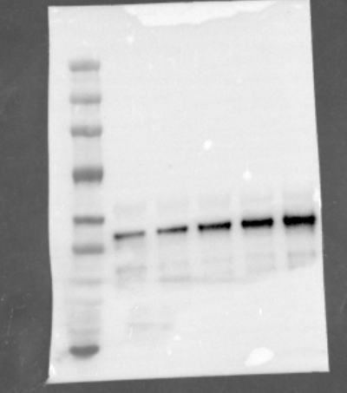
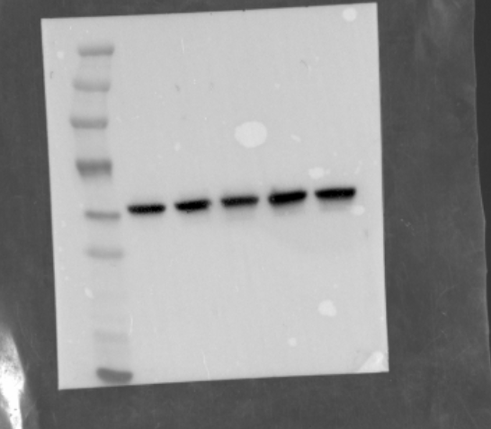
FIGURE 7
10kDa
18kDa
FDX1
70kDa
53kDa
β-tubulin
70kDa
53kDa
40kDa
53kDa
LIAS
β-tubulin

Slide 7
Equipment and Settings
Gel Imaging Systems BIO-RAD GelDoc XR Biorad
Default Settings Automatic Exposure

