Slide 1
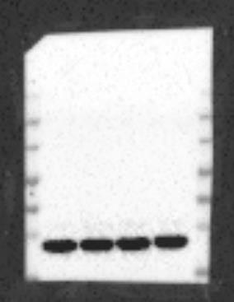
Supplementary
Fig.1
Full western blots related to
Fig 5A,B,C,D,E,F.
Control
Acute Rosuvastatin
Prophylaxis Rosuvastatin
Sham
β-Actin-45 kDa
270 kDa
175 kDa
130 kDa
95 kDa
66 kDa
52 kDa
175 kDa
37 kDa

Slide 2
Supplementary
Fig.2
Full western blots related to
Fig 5A.
Control
Acute Rosuvastatin
Prophylaxis Rosuvastatin
Sham
270 kDa
175 kDa
130 kDa
95 kDa
66 kDa
52 kDa
pAKT-60 kDa
175 kDa

Slide 3
Supplementary
Fig.3
Full western blots related to
Fig 5B.
Control
Acute Rosuvastatin
Prophylaxis Rosuvastatin
Sham
Bcl-xL-30 kDa
270 kDa
175 kDa
130 kDa
95 kDa
66 kDa
52 kDa
37 kDa
30 kDa
175 kDa

Slide 4
Supplementary
Fig.4
Full western blots related to
Fig 5C,D.
Control
Acute Rosuvastatin
Prophylaxis Rosuvastatin
Sham
P-ERK1/2-42/44 kDa
270 kDa
175 kDa
130 kDa
95 kDa
66 kDa
52 kDa
175 kDa
37 kDa

Slide 5
Supplementary
Fig.5
Full western blots related to
Fig 5E,F.
Control
Acute Rosuvastatin
Prophylaxis Rosuvastatin
Sham
p-JNK1/2-46/54 kDa
175 kDa
270 kDa
175 kDa
130 kDa
95 kDa
66 kDa
52 kDa
37 kDa

