Slide 1
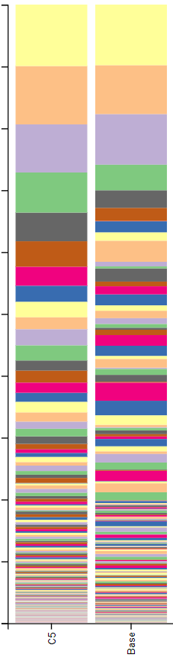
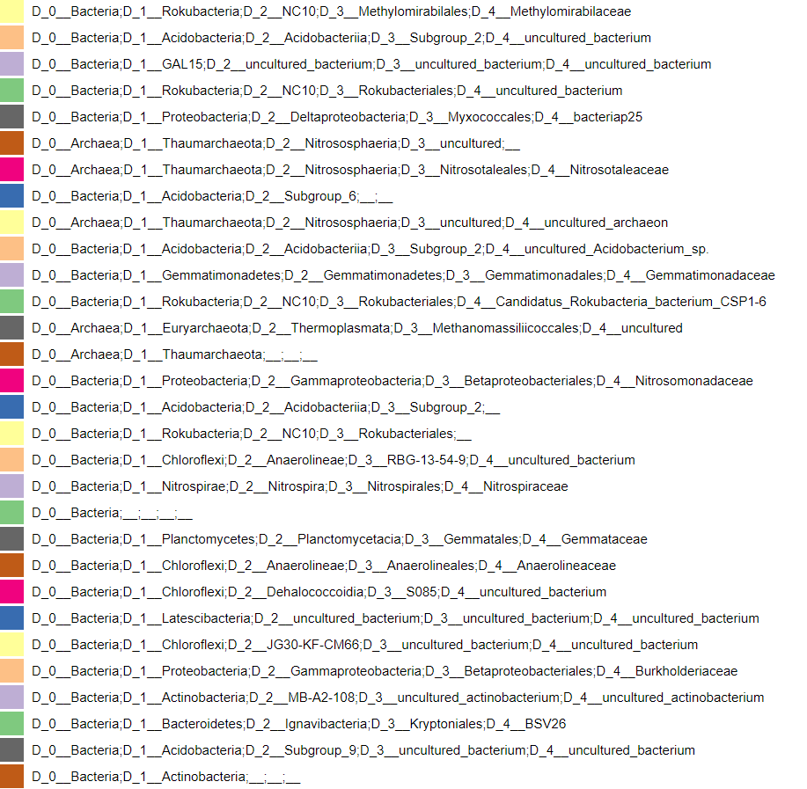
Relative Frequency
S
B
Figure S1. Microbial taxonomical distribution at family level of the S and B samples from Boguaçú Sambaqui, based on metagenome 16S rDNA amplicon sequencing. The figure was generated using QUIIME2.

Slide 2
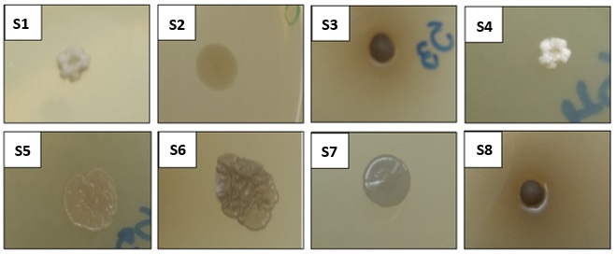
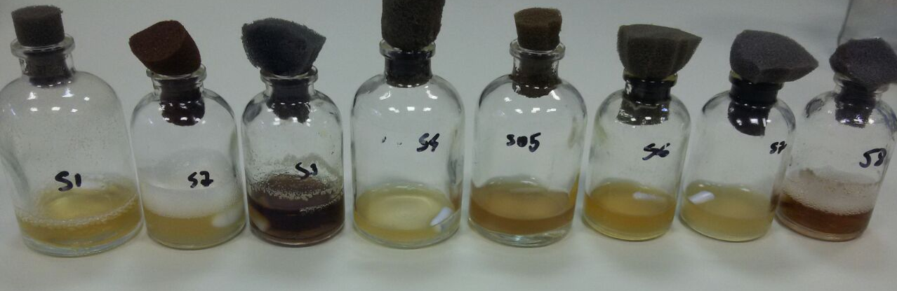
A
B
S1
S2
S3
S4
S5
S6
S7
S8
Figure S2. A) Colony morphology of the isolates S1 to S8 in LB solid medium. B) Growth of isolates S1 to S8 aerobically in LB liquid medium.

Slide 3
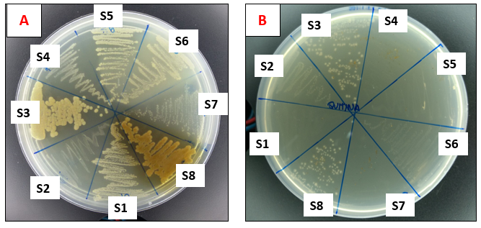
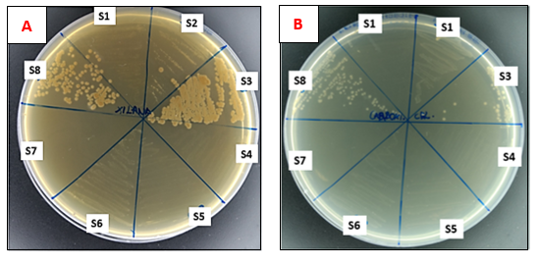
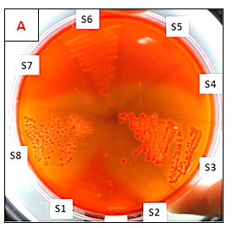
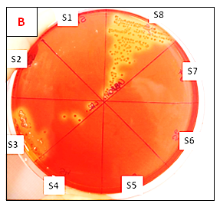
A
B
Glucose
Chitin
C
S1
S2
D
S1
S2
S8
S3
S8
S3
Xylan
CMC
S7
S4
S7
S4
S6
S5
S6
S5
E
S6
S5
F
S1
S8
S7
S2
S7
S4
Xylan
CMC
S8
S3
S3
S6
S1
S2
S4
S5
Figure S3. Growth of isolates S1 to S8 in M9 minimal medium containing different carbon sources. Cells were cultured on M9 minimal medium containing as carbon source: A) glucose; B) chitin; C) xylan; D) CMC. After cell growth, the plates from M9 xylan and CMC were stained with congo red. The substrate degradation halo can be observed in figures E and F, respectively.

Slide 4
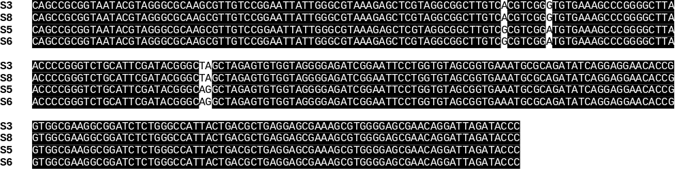
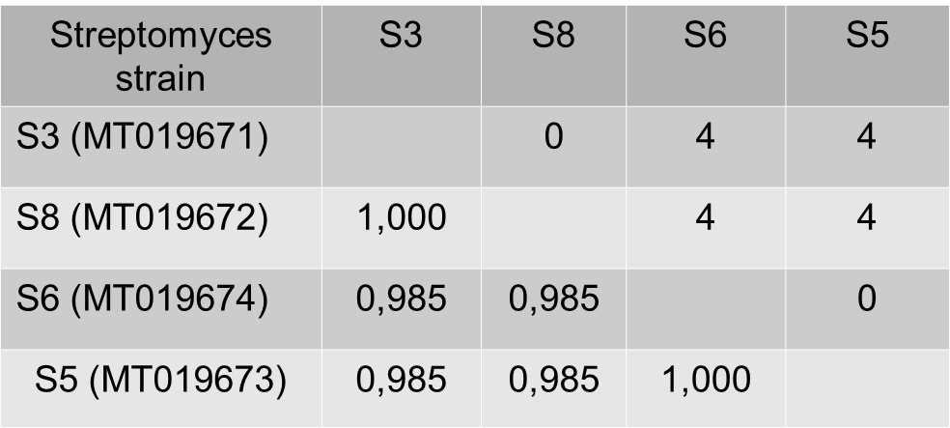
A
B
Figure S4. ClustalW alignment of the partial 16S rDNA sequences of the isolates S3, S8, S5 and S6.
Partial 16S rRNA gene sequence identity for Streptomyces spp. Isolated from Sambaqui sediment. A) DNA sequences were aligned using ClustalW 1.8 in BioEdit package; B) Lower triangle matrix values are percentage identities and upper triangle matrix values are number of nucleotide differences; GenBank accession number are shown in parenthesis; multiple sequence alignment contain 276 positions with 4 position including nucleotide differences.

Slide 5
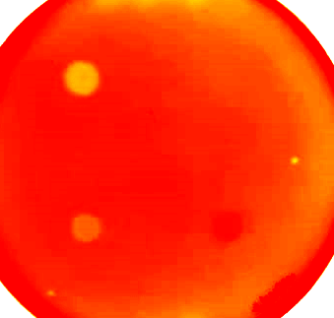
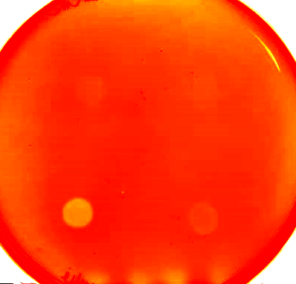
A
Xylan
B
CMC
1
2
1
2
3
4
3
4
Figure S5. Agar plate qualitative enzymatic assays of Streptomyces sp. S3 culture supernatant. The supernatant of cultures from M9 medium contain: 1) xylan; 2) filter paper; 3) microcrystalline cellulose; or 4) carboxymethyl cellulose; as sole carbon sources were spotted onto agar plates containing M9 minimum with 1% Xylan (A) or CMC (B) as substrates. After incubation at 30ºC for 30 min enzymatic activity was confirmed by the formation of degradation halo after staining the plates with congo red.

