Slide 1
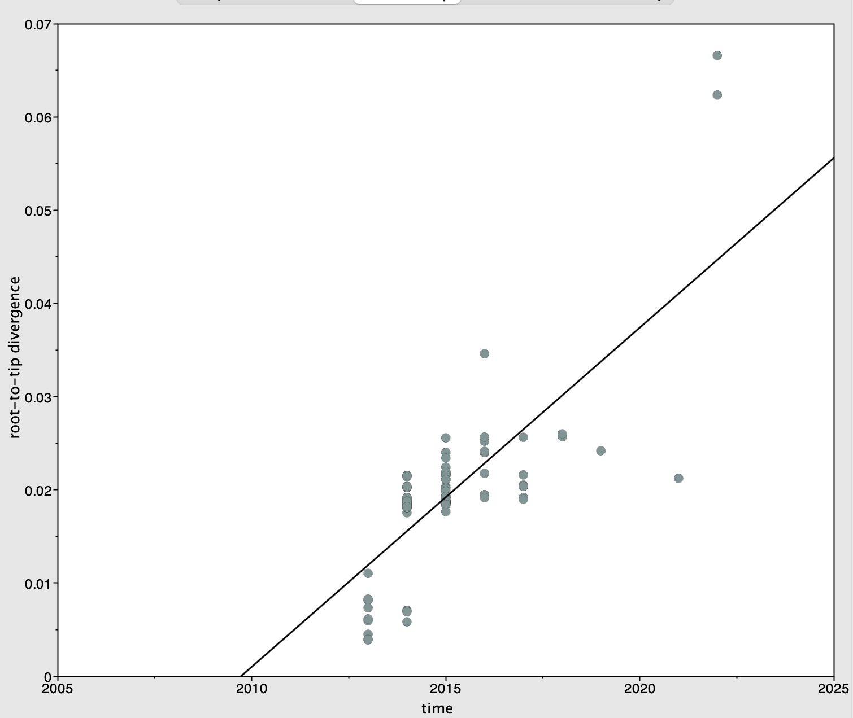
Date range | 9
Slope (rate) | 3.58E-03
X-Intercept (TMRCA) | 2009.8198
Correlation Coefficient | 0.7488
R squared | 0.5607
Residual Mean Squared | 3.05E-05
Figure 1 Regression of the root-to-tip genetic distance against year of sampling for GII.17 whole genome sequence

Slide 2
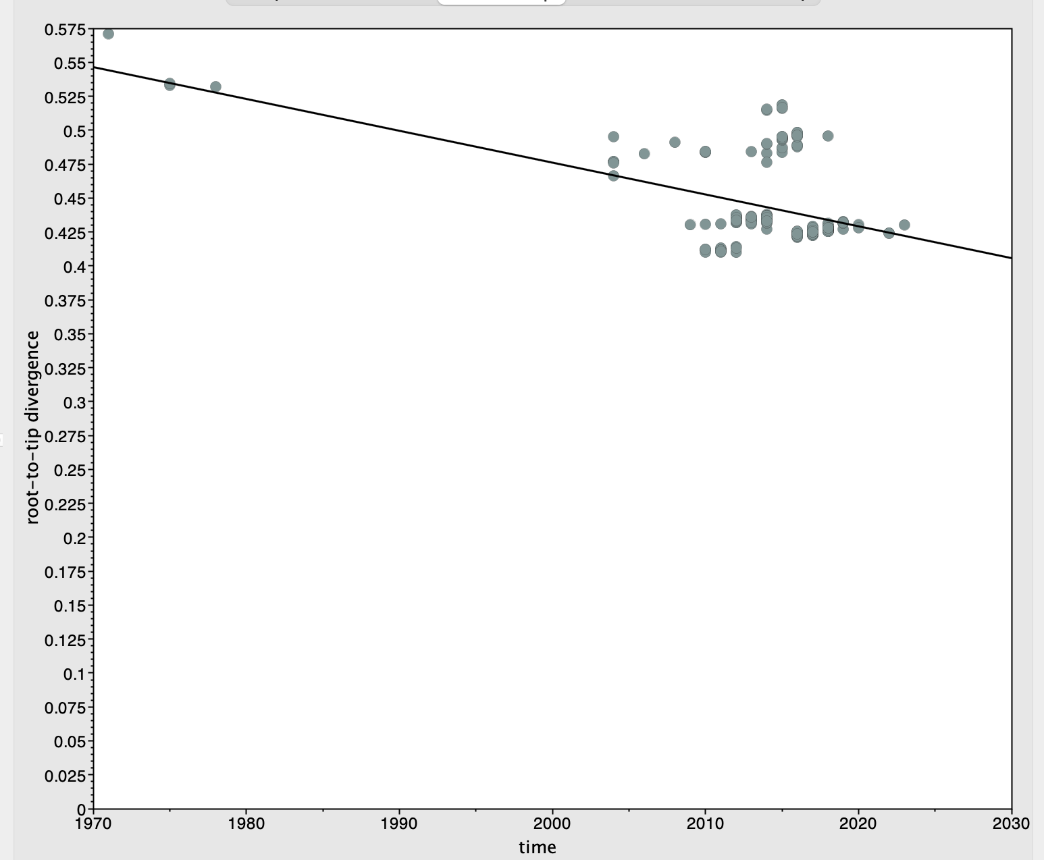
Date range | 50
Slope (rate) | -0.0026
X-Intercept (TMRCA) | 2203.8263
Correlation Coefficient | -0.4711
R squared | 0.2219
Residual Mean Squared | 9.8689E-04
Figure 2 Regression of the root-to-tip genetic distance against year of sampling for GII.2 whole genome sequence

Slide 3
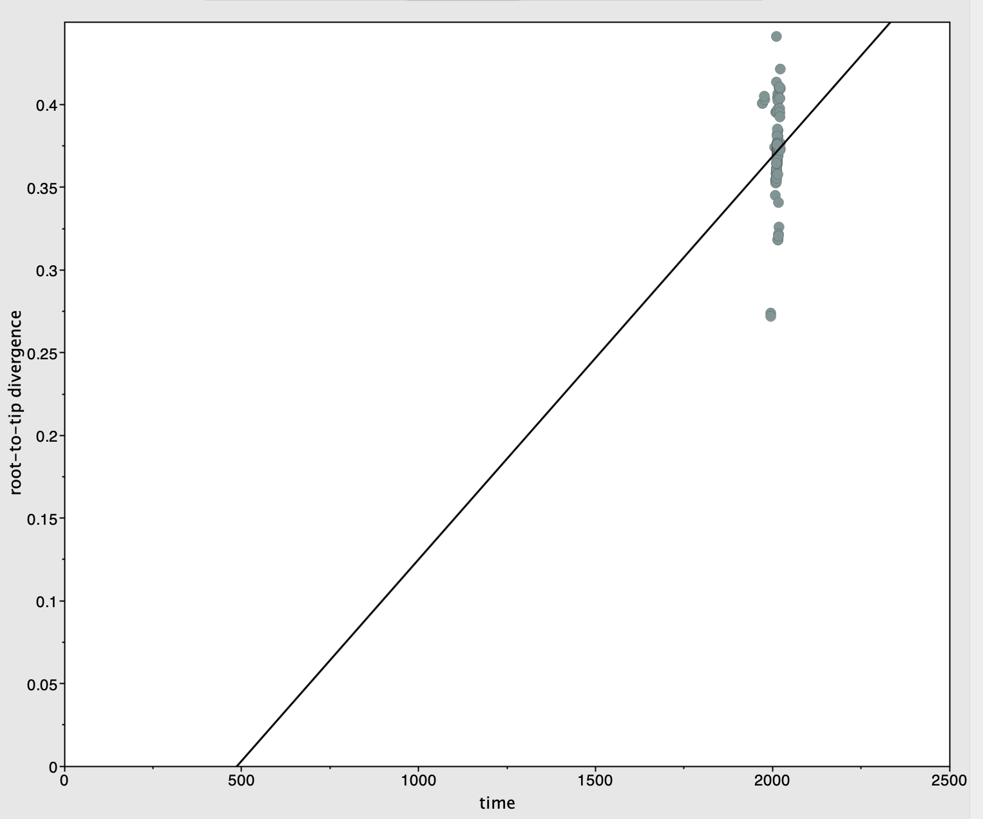
Date range | 50
Slope (rate) | 2.44E-04
X-Intercept (TMRCA) | 486.2677
Correlation Coefficient | 7.78E-02
R squared | 6.05E-03
Residual Mean Squared | 5.58E-04
Figure 3 Regression of the root-to-tip genetic distance against year of sampling for GII.3 whole genome sequence

Slide 4
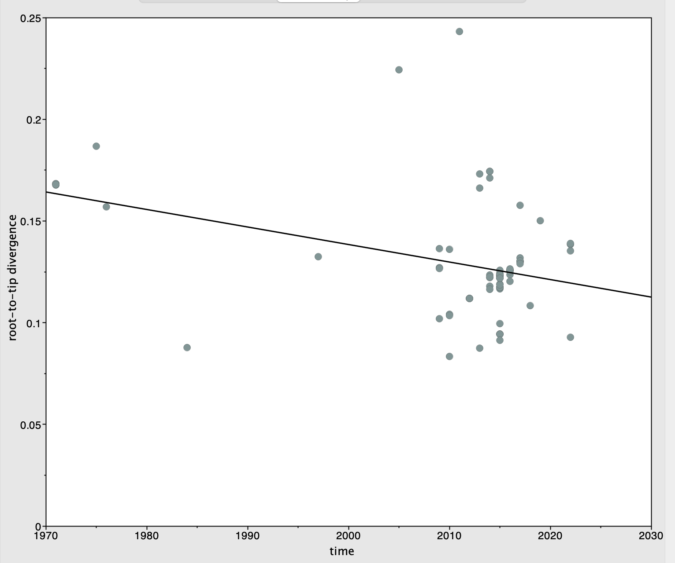
Date range | 51
Slope (rate) | -0.0009
X-Intercept (TMRCA) | 2160.7945
Correlation Coefficient | -0.3659
R squared | 0.1339
Residual Mean Squared | 7.71E-04
Figure 4 Regression of the root-to-tip genetic distance against year of sampling for GII.6 whole genome sequence

Slide 5
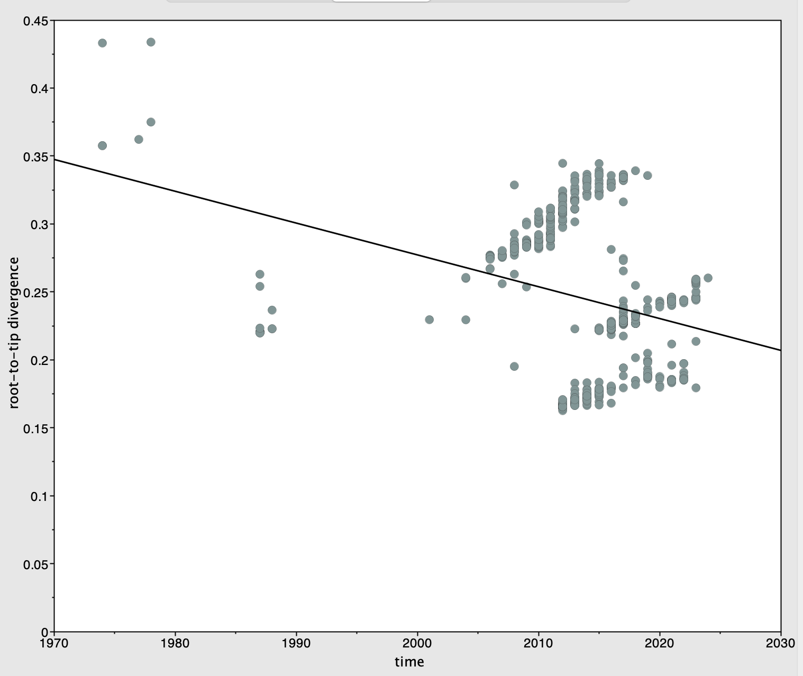
Date range | 50
Slope (rate) | -0.0023
X-Intercept (TMRCA) | 2118.3355
Correlation Coefficient | -0.2934
R squared | 8.6064E-2
Residual Mean Squared | 2.9175E-3
Figure 5 Regression of the root-to-tip genetic distance against year of sampling for GII.4 whole genome sequence

Slide 6
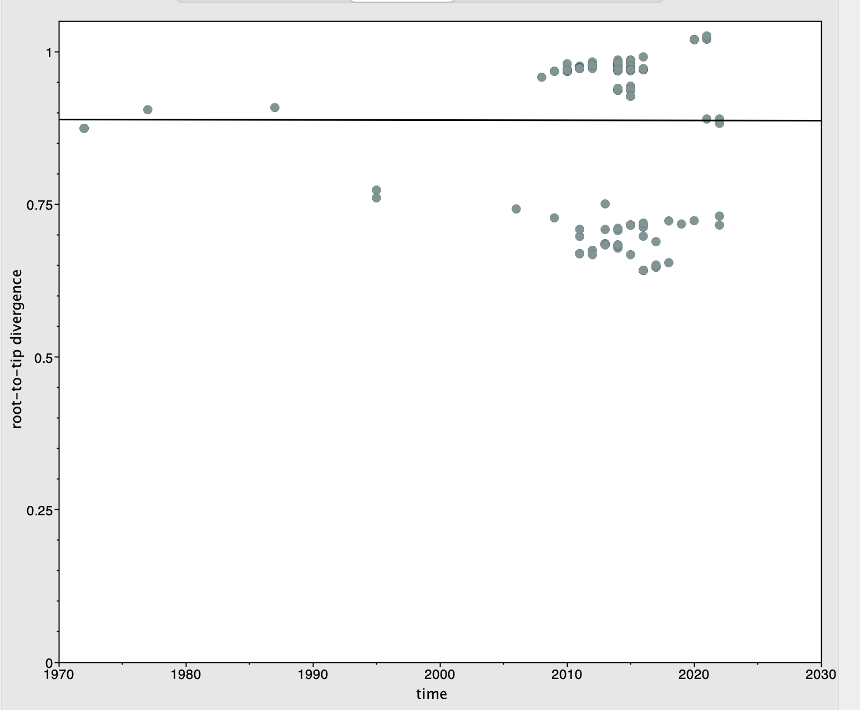
Date range | 50
Slope (rate) | 0
X-Intercept (TMRCA) | 36985.6894
Correlation Coefficient | -0.0014
R squared | 2.08E-06
Residual Mean Squared | 1.65E-02
Figure 6 Regression of root-to-tip genetic distance against the year of sampling for GII.3 in the 3CLpro region

Slide 7
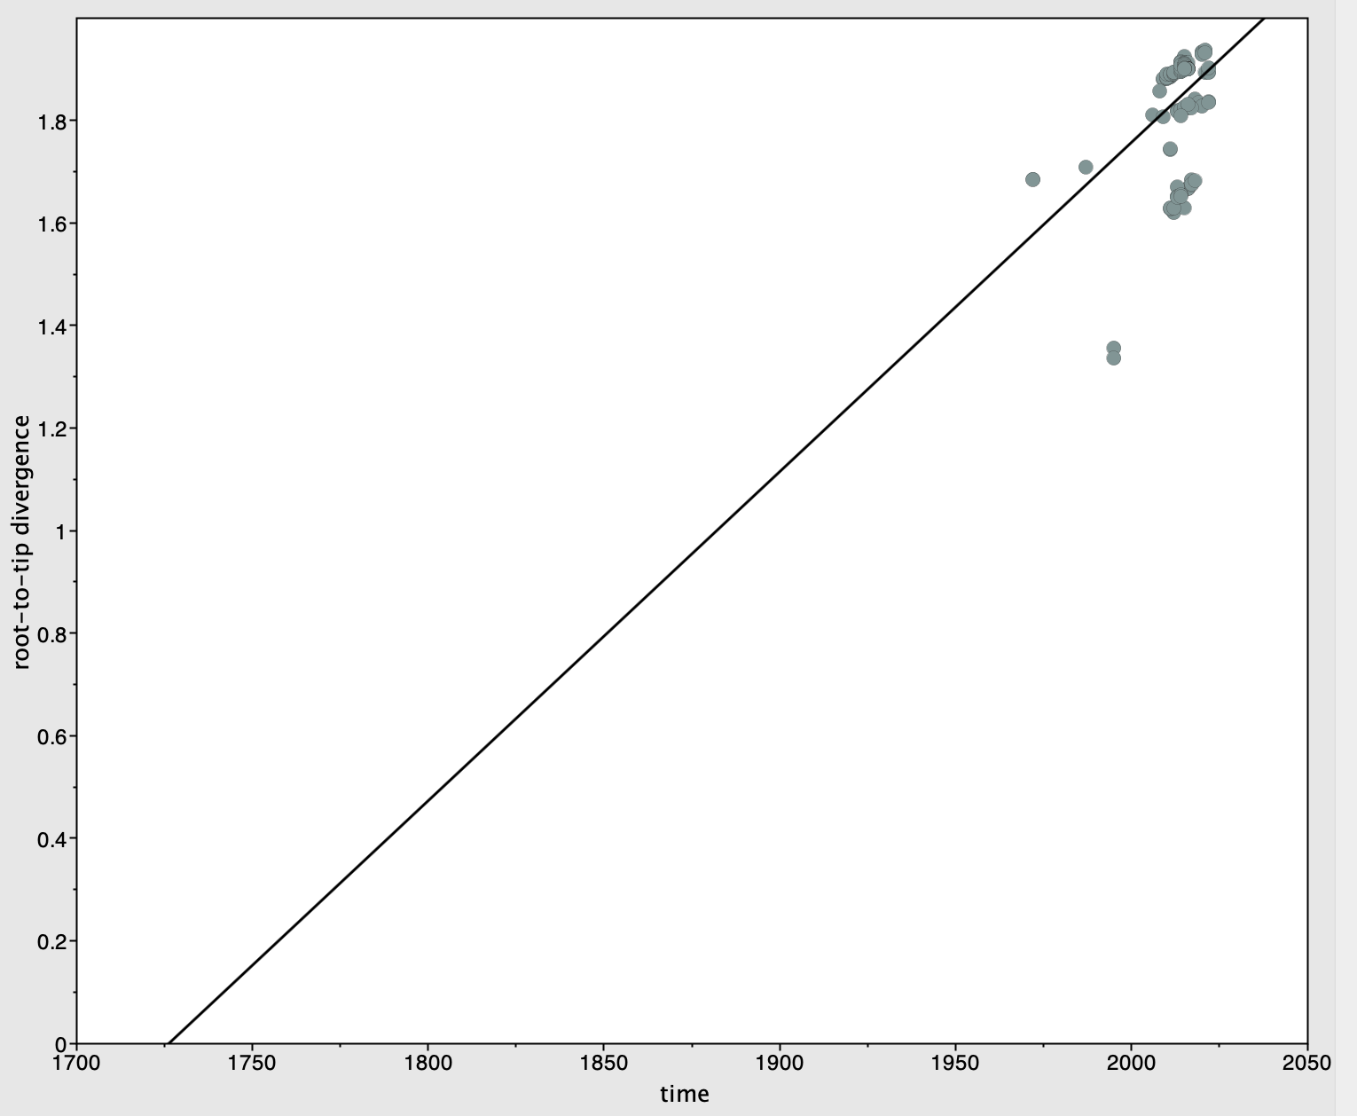
Date range | 50
Slope (rate) | 6.42E-03
X-Intercept (TMRCA) | 1726.3525
Correlation Coefficient | 0.3986
R squared | 0.1589
Residual Mean Squared | 9.67E-03
Figure 7 Regression of root-to-tip genetic distance against the year of sampling for GII.3 in the p22 region

Slide 8
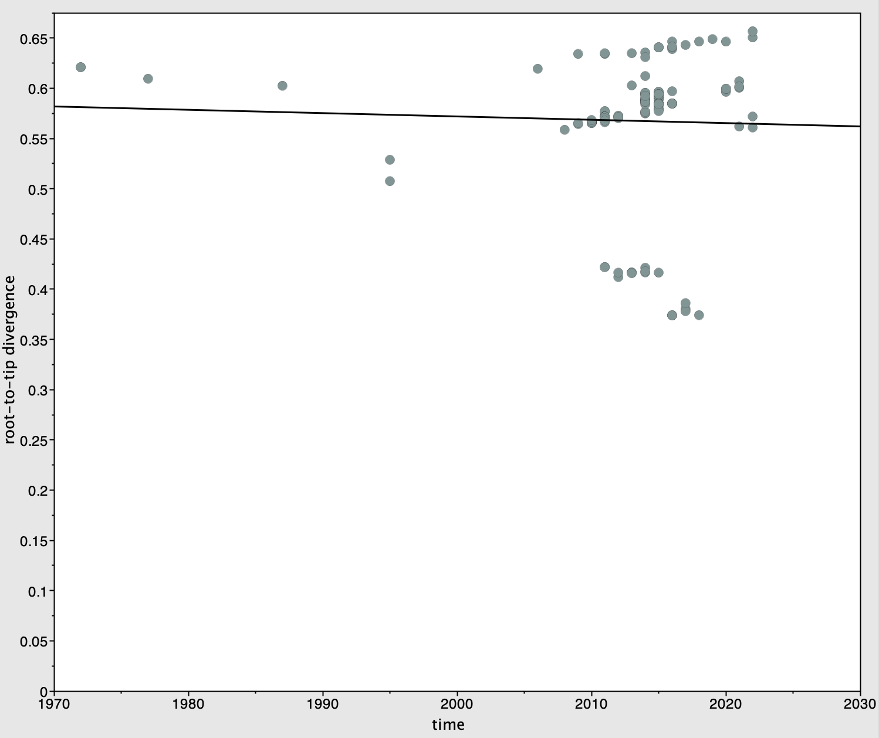
Date range | 50
Slope (rate) | -0.0003
X-Intercept (TMRCA) | 3738.2993
Correlation Coefficient | -0.0351
R squared | 1.23E-03
Residual Mean Squared | 4.72E-03
Figure 8 Regression of root-to-tip genetic distance against the year of sampling for GII.3 in the NTPase region

Slide 9
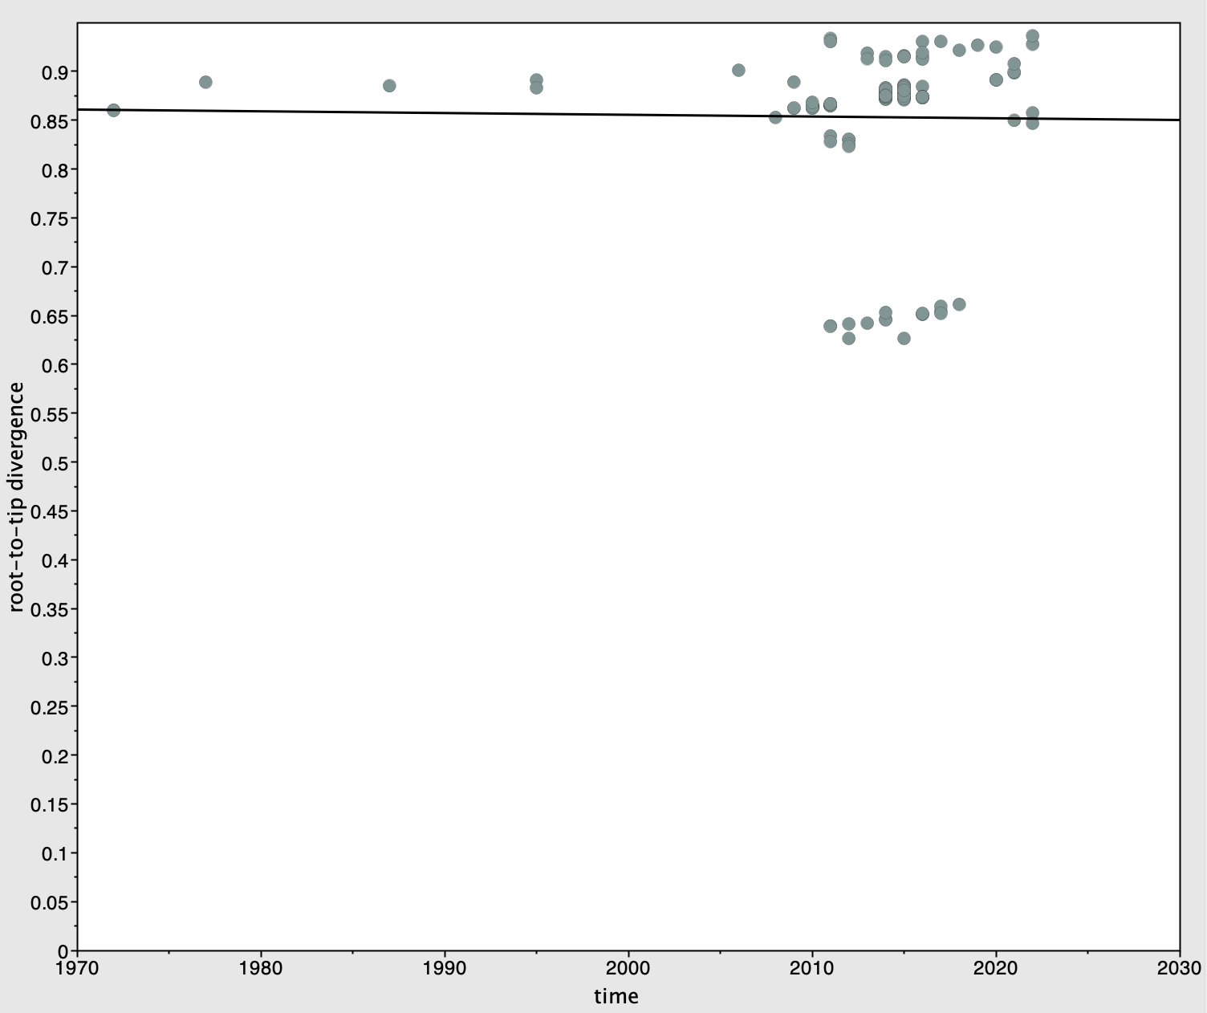
Date range | 50
Slope (rate) | -0.0002
X-Intercept (TMRCA) | 6746.6595
Correlation Coefficient | -0.017
R squared | 2.90E-04
Residual Mean Squared | 6.10E-03
Figure 9 Regression of root-to-tip genetic distance against the year of sampling for GII.3 in the p48 region

Slide 10
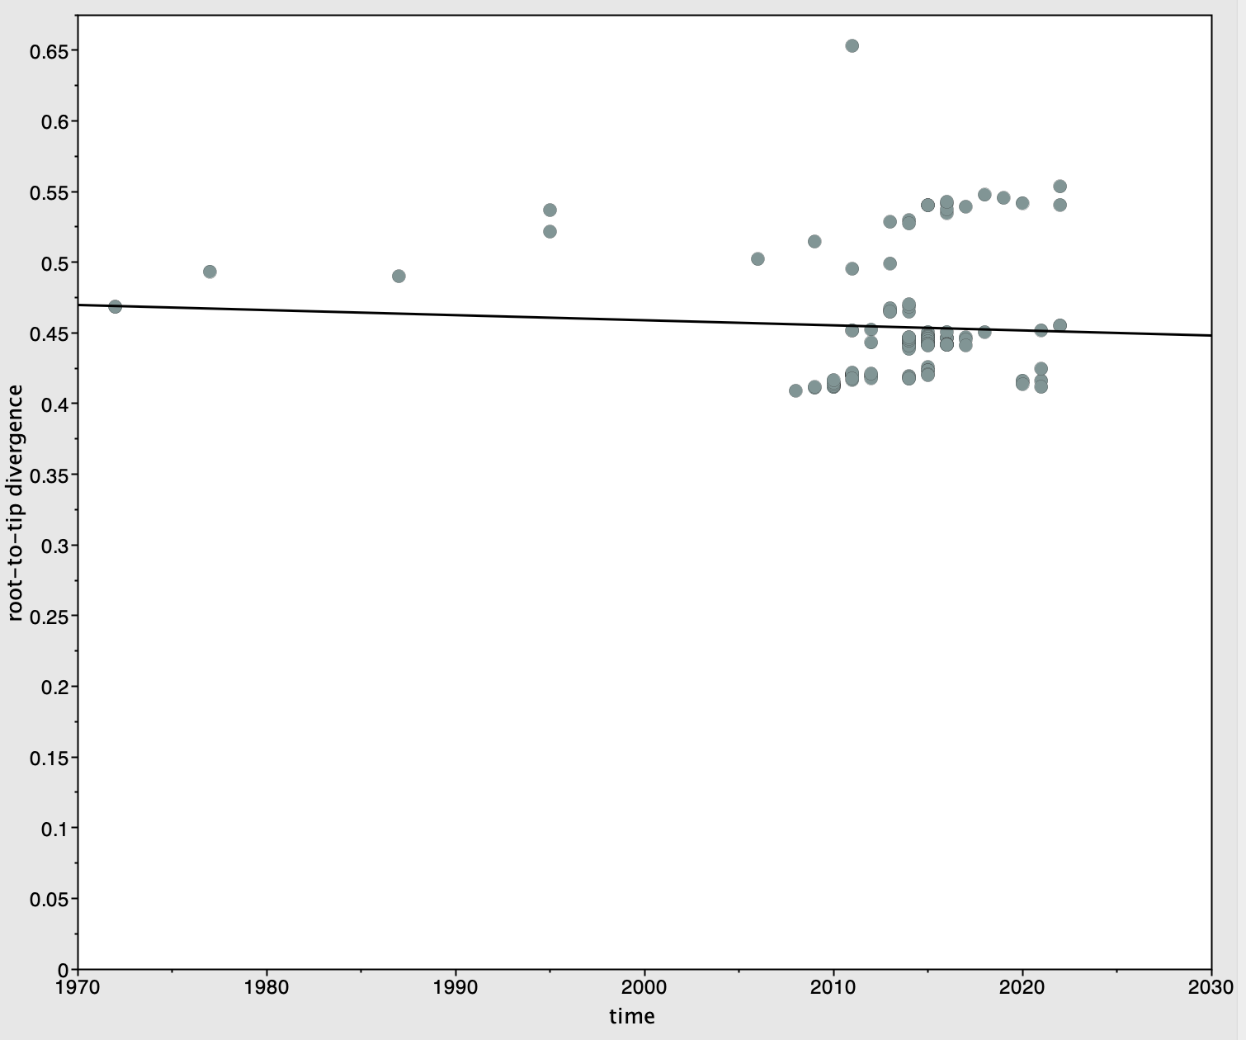
Date range | 50
Slope (rate) | -0.0004
X-Intercept (TMRCA) | 3274.1878
Correlation Coefficient | -0.0629
R squared | 3.96E-03
Residual Mean Squared | 1.74E-03
Figure 10 Regression of root-to-tip genetic distance against the year of sampling for GII.3 in the RdRp region

Slide 11
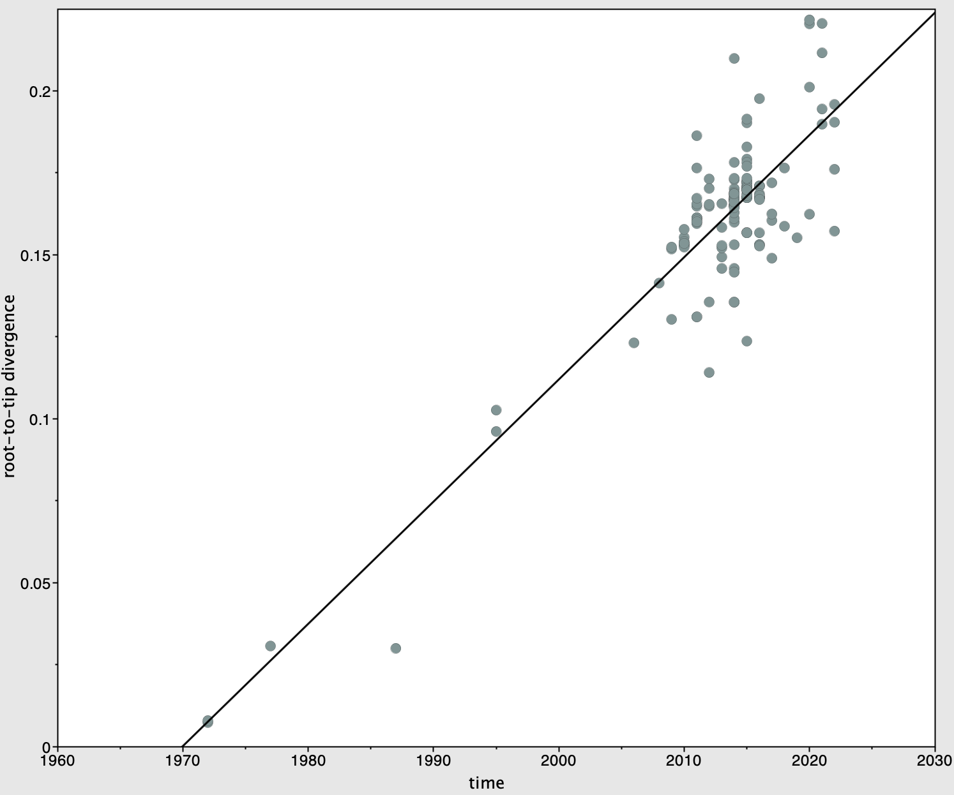
Date range | 50
Slope (rate) | 1.84E-03
X-Intercept (TMRCA) | 1951.4186
Correlation Coefficient | 0.6519
R squared | 0.425
Residual Mean Squared | 2.43E-04
Figure 11 Regression of root-to-tip genetic distance against the year of sampling for GII.3 in the VP1 region

Slide 12
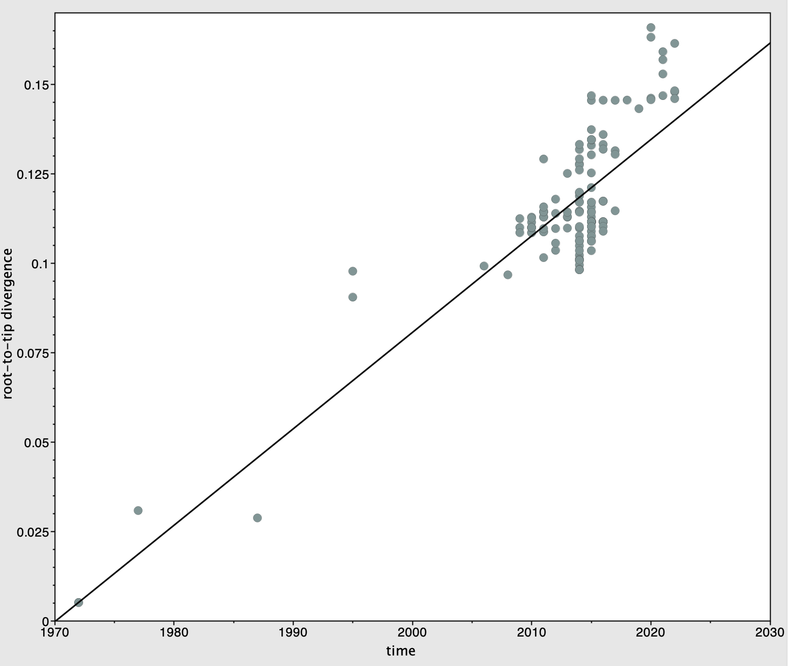
Date range | 50
Slope (rate) | 2.70E-03
X-Intercept (TMRCA) | 1970.0988
Correlation Coefficient | 0.8571
R squared | 0.7347
Residual Mean Squared | 1.45E-04
Figure 12 Regression of root-to-tip genetic distance against the year of sampling for GII.3 in the VP2 region

Slide 13
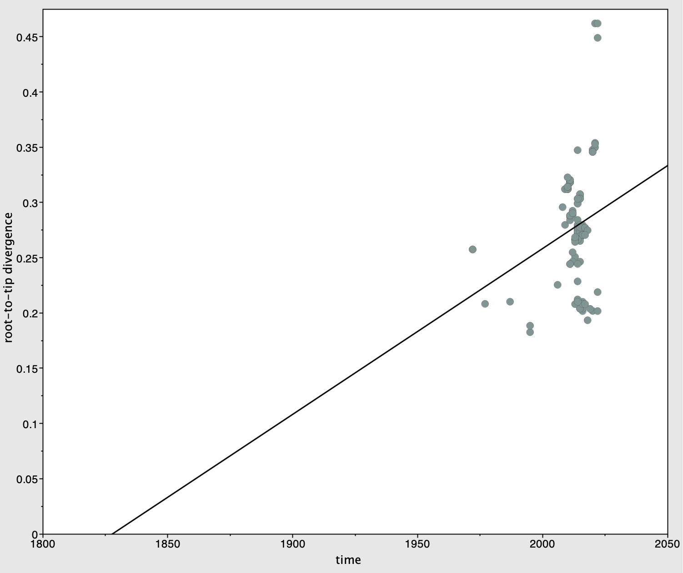
Date range | 50
Slope (rate) | 1.50E-03
X-Intercept (TMRCA) | 1827.7314
Correlation Coefficient | 0.24
R squared | 5.76E-02
Residual Mean Squared | 1.97E-03
Figure 13 Regression of root-to-tip genetic distance against the year of sampling for GII.3 in the VPg region

Slide 14
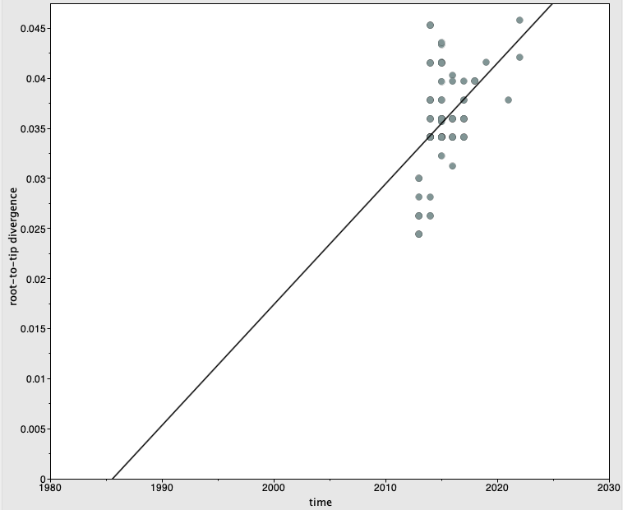
Date range | 9
Slope (rate) | 1.21E-03
X-Intercept (TMRCA) | 1985.561
Correlation Coefficient | 0.4464
R squared | 0.1992
Residual Mean Squared | 1.78E-05
Figure 14 Regression of root-to-tip genetic distance against the year of sampling for GII.17 in the 3CLpro region

Slide 15
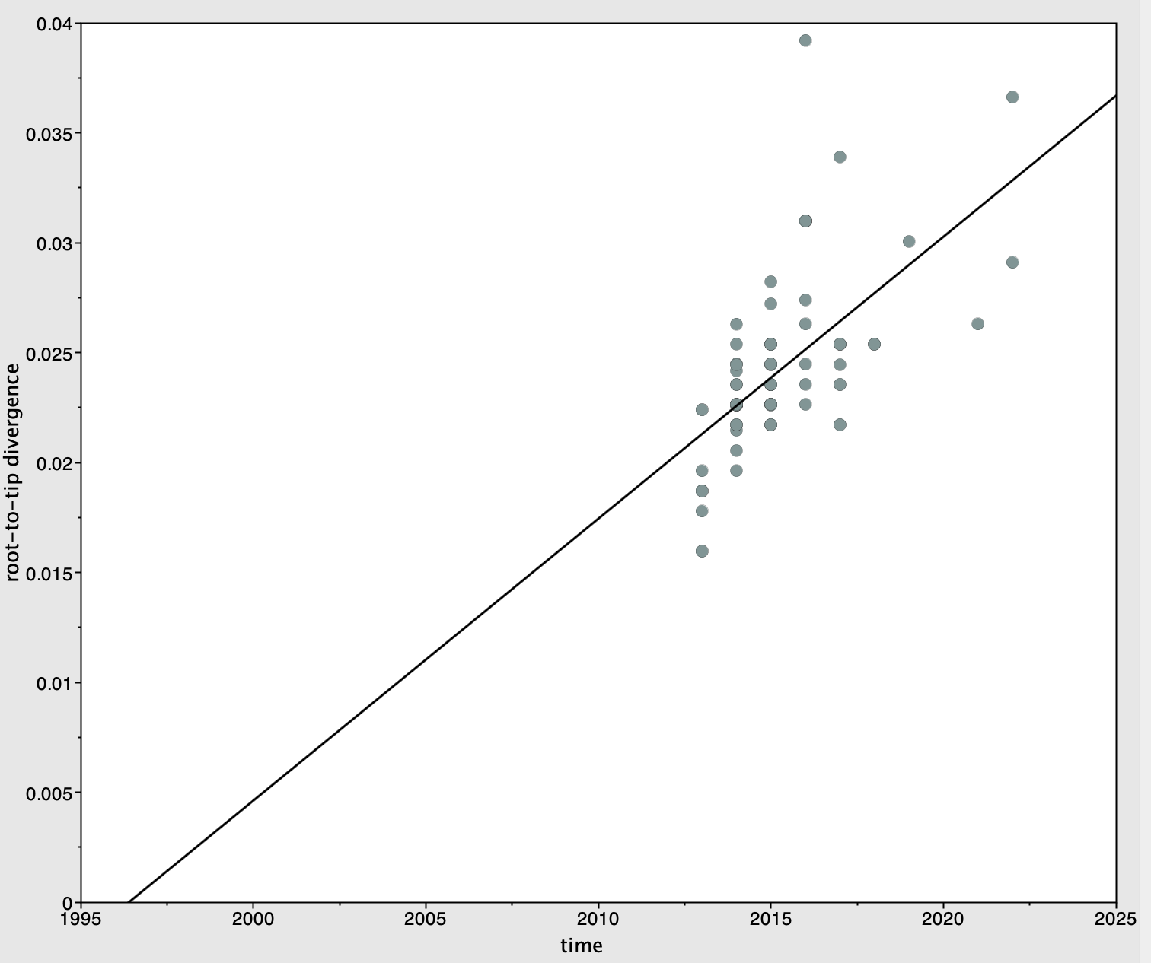
Date range | 9
Slope (rate) | 1.28E-03
X-Intercept (TMRCA) | 1996.3784
Correlation Coefficient | 0.6108
R squared | 0.3731
Residual Mean Squared | 8.39E-06
Figure 15 Regression of root-to-tip genetic distance against the year of sampling for GII.17 in the NTPase region

Slide 16
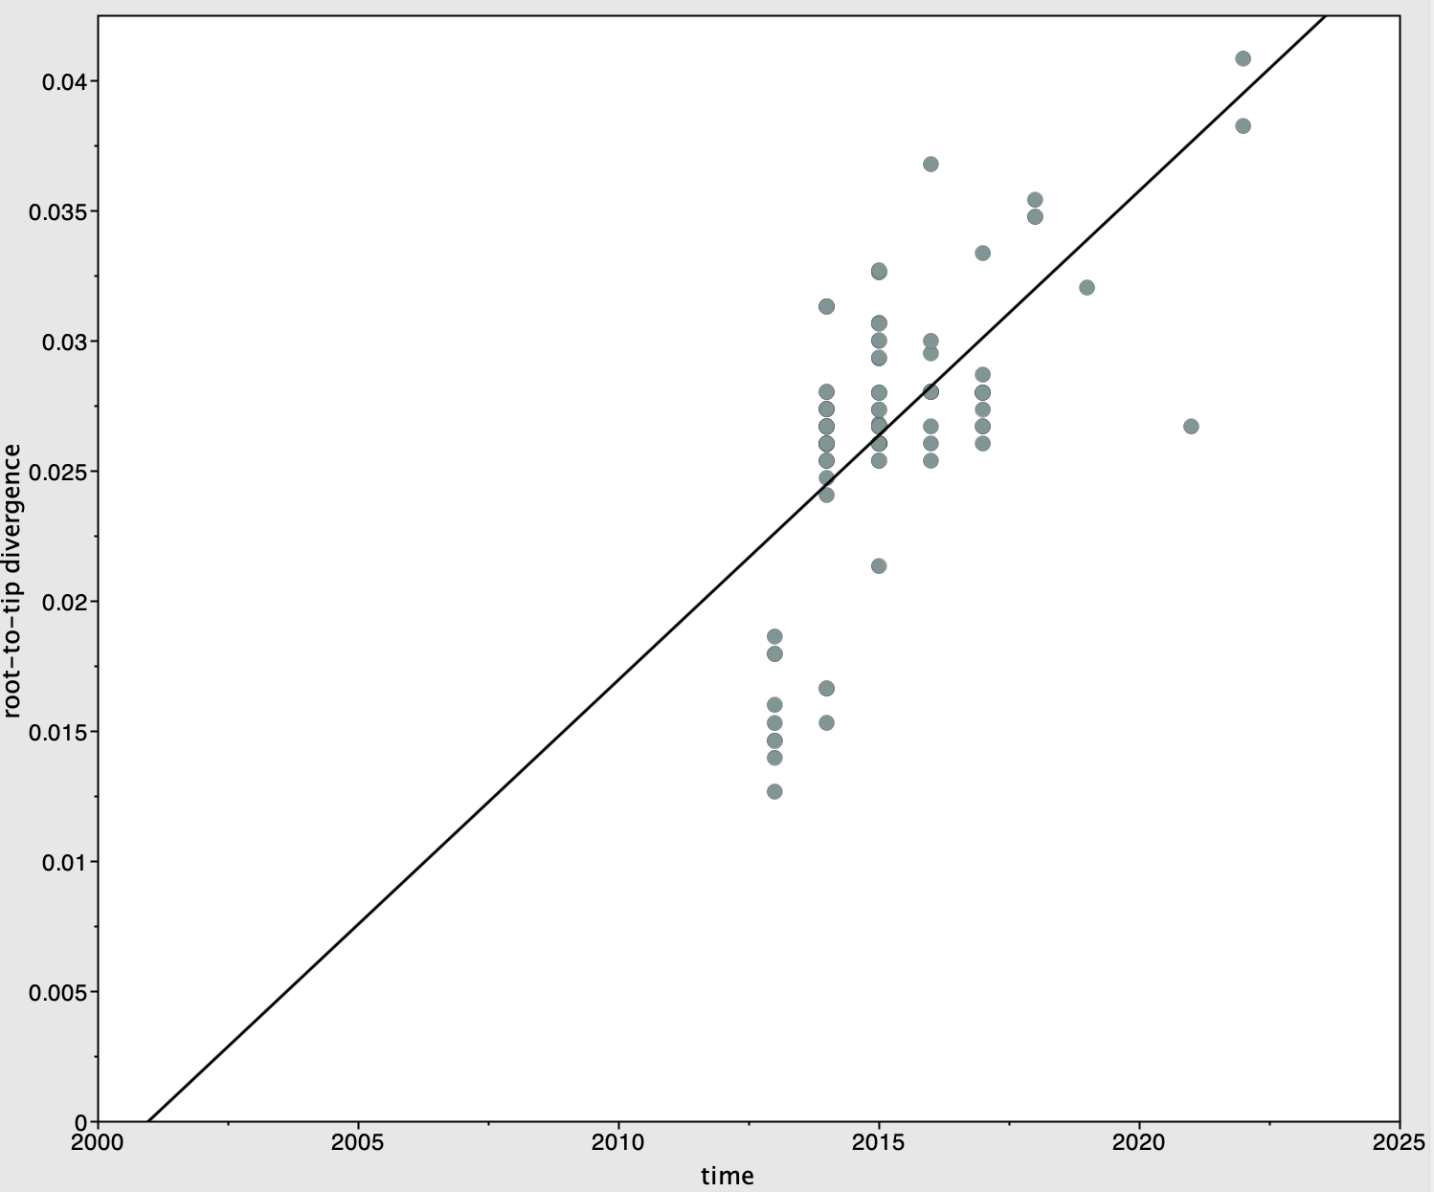
Date range | 9
Slope (rate) | 1.88E-03
X-Intercept (TMRCA) | 2000.9622
Correlation Coefficient | 0.6392
R squared | 0.4085
Residual Mean Squared | 1.55E-05
Figure 16 Regression of root-to-tip genetic distance against the year of sampling for GII.17 in the RdRp region

Slide 17
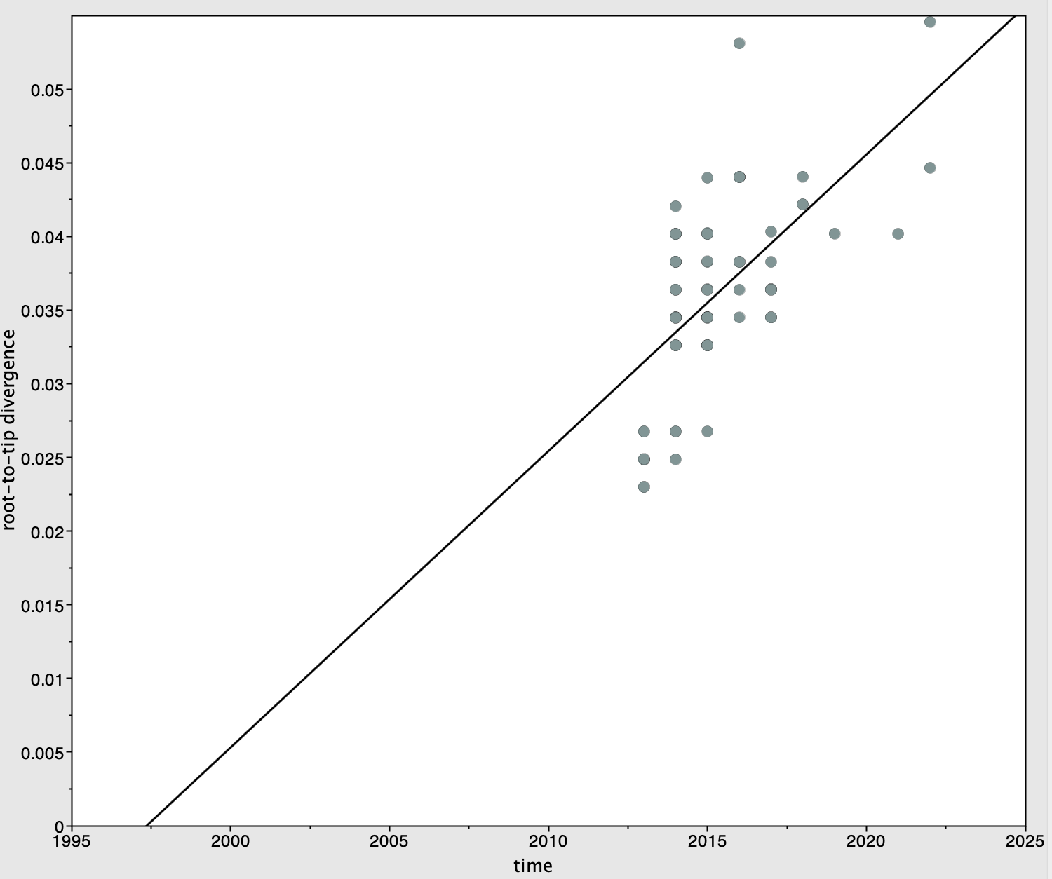
Date range | 9
Slope (rate) | 2.01E-03
X-Intercept (TMRCA) | 1997.3466
Correlation Coefficient | 0.602
R squared | 0.3624
Residual Mean Squared | 2.16E-05
Figure 17 Regression of root-to-tip genetic distance against the year of sampling for GII.17 in the p22 region

Slide 18
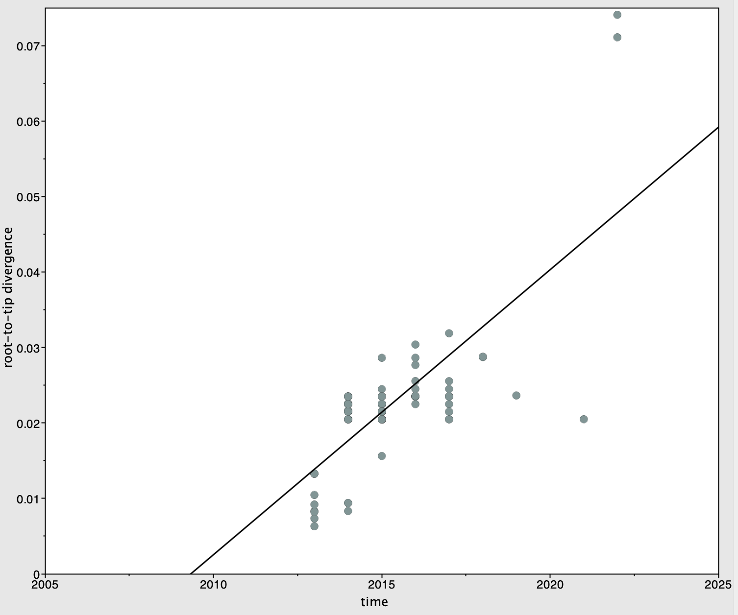
Date range | 9
Slope (rate) | 3.78E-03
X-Intercept (TMRCA) | 2009.3274
Correlation Coefficient | 0.7378
R squared | 0.5444
Residual Mean Squared | 3.64E-05
Figure 18 Regression of root-to-tip genetic distance against the year of sampling for GII.17 in the p48 region

Slide 19
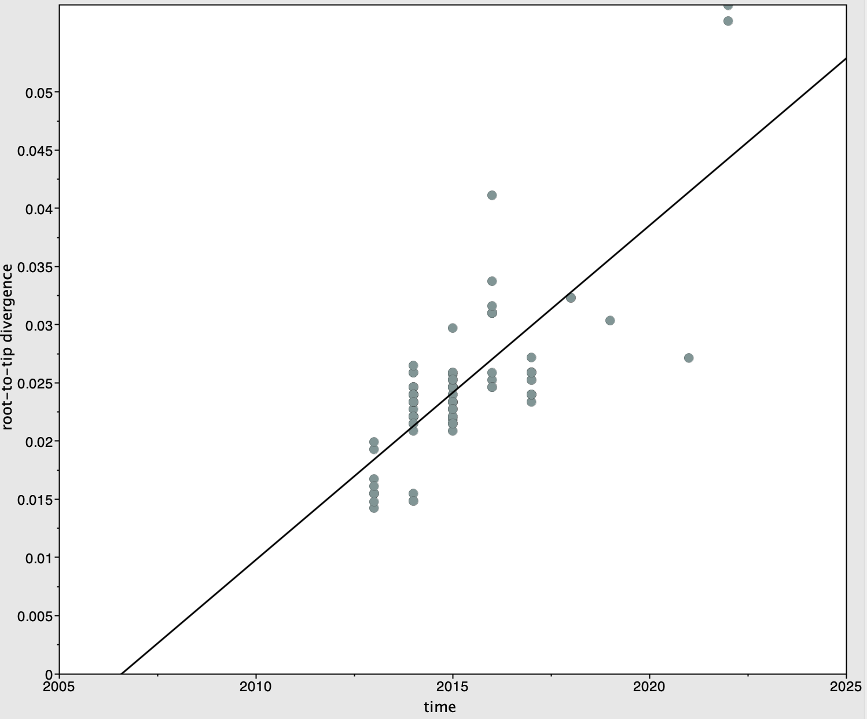
Date range | 9
Slope (rate) | 2.87E-03
X-Intercept (TMRCA) | 2006.5871
Correlation Coefficient | 0.7759
R squared | 0.602
Residual Mean Squared | 1.66E-05
Figure 19 Regression of root-to-tip genetic distance against the year of sampling for GII.17 in the VP1 region

Slide 20
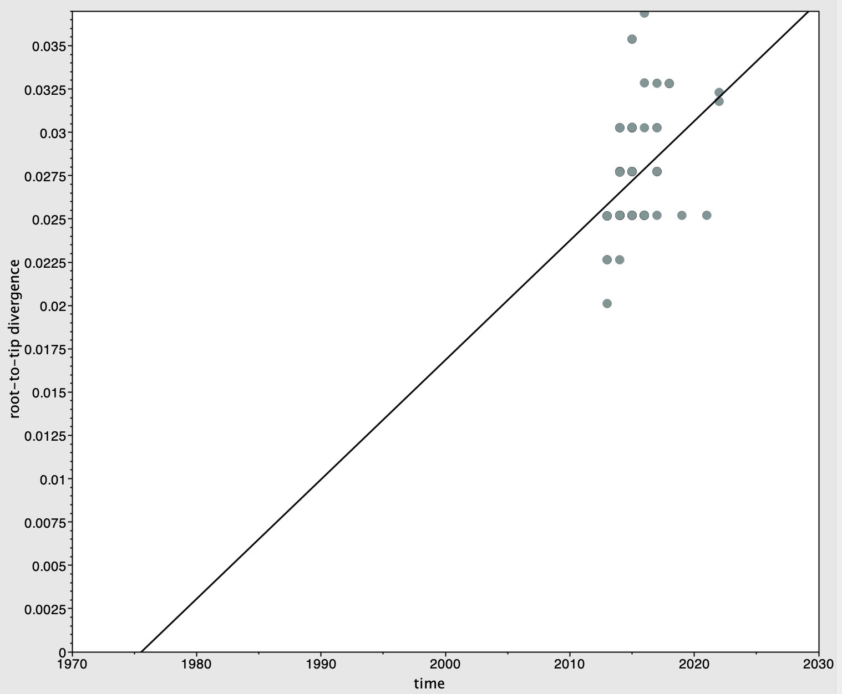
Date range | 9
Slope (rate) | 6.90E-04
X-Intercept (TMRCA) | 1975.5531
Correlation Coefficient | 0.402
R squared | 0.1616
Residual Mean Squared | 7.49E-06
Figure 20 Regression of root-to-tip genetic distance against the year of sampling for GII.17 in the VPg region

Slide 21
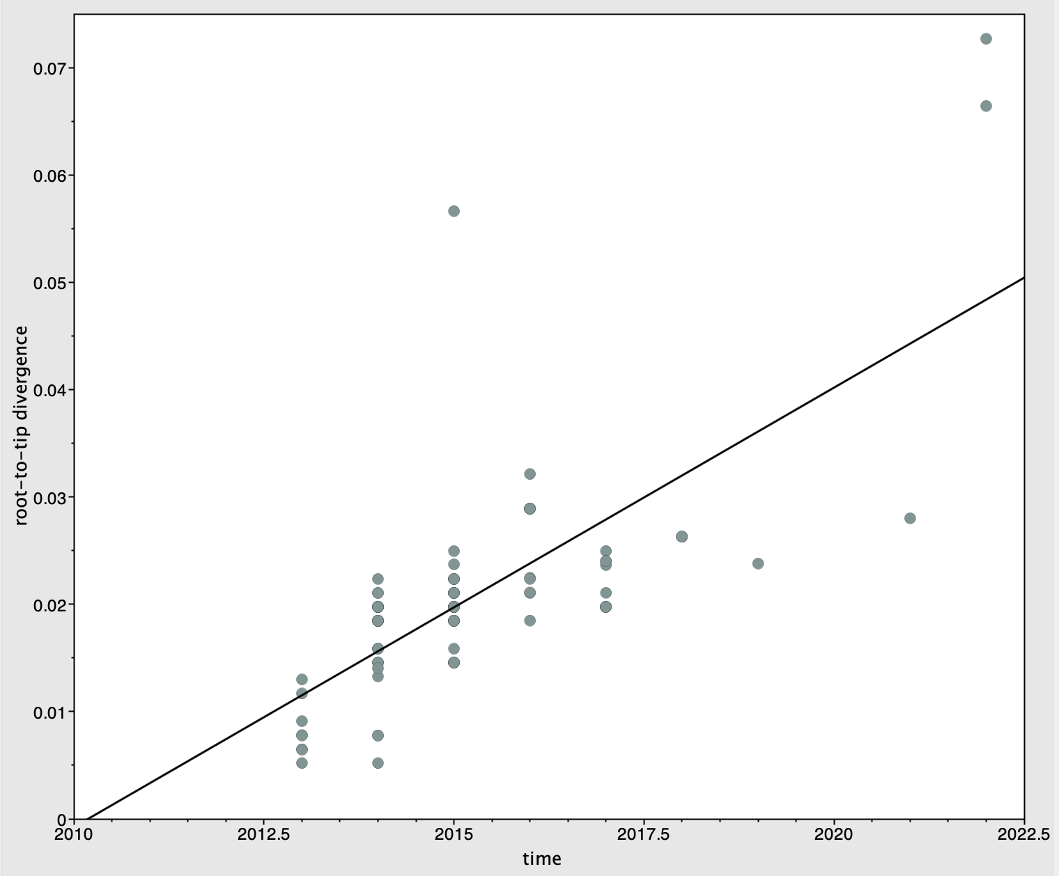
Date range | 9
Slope (rate) | 4.10E-03
X-Intercept (TMRCA) | 2010.1888
Correlation Coefficient | 0.7227
R squared | 0.5223
Residual Mean Squared | 4.63E-05
Figure 21 Regression of root-to-tip genetic distance against the year of sampling for GII.17 in the VP2 region

Slide 22
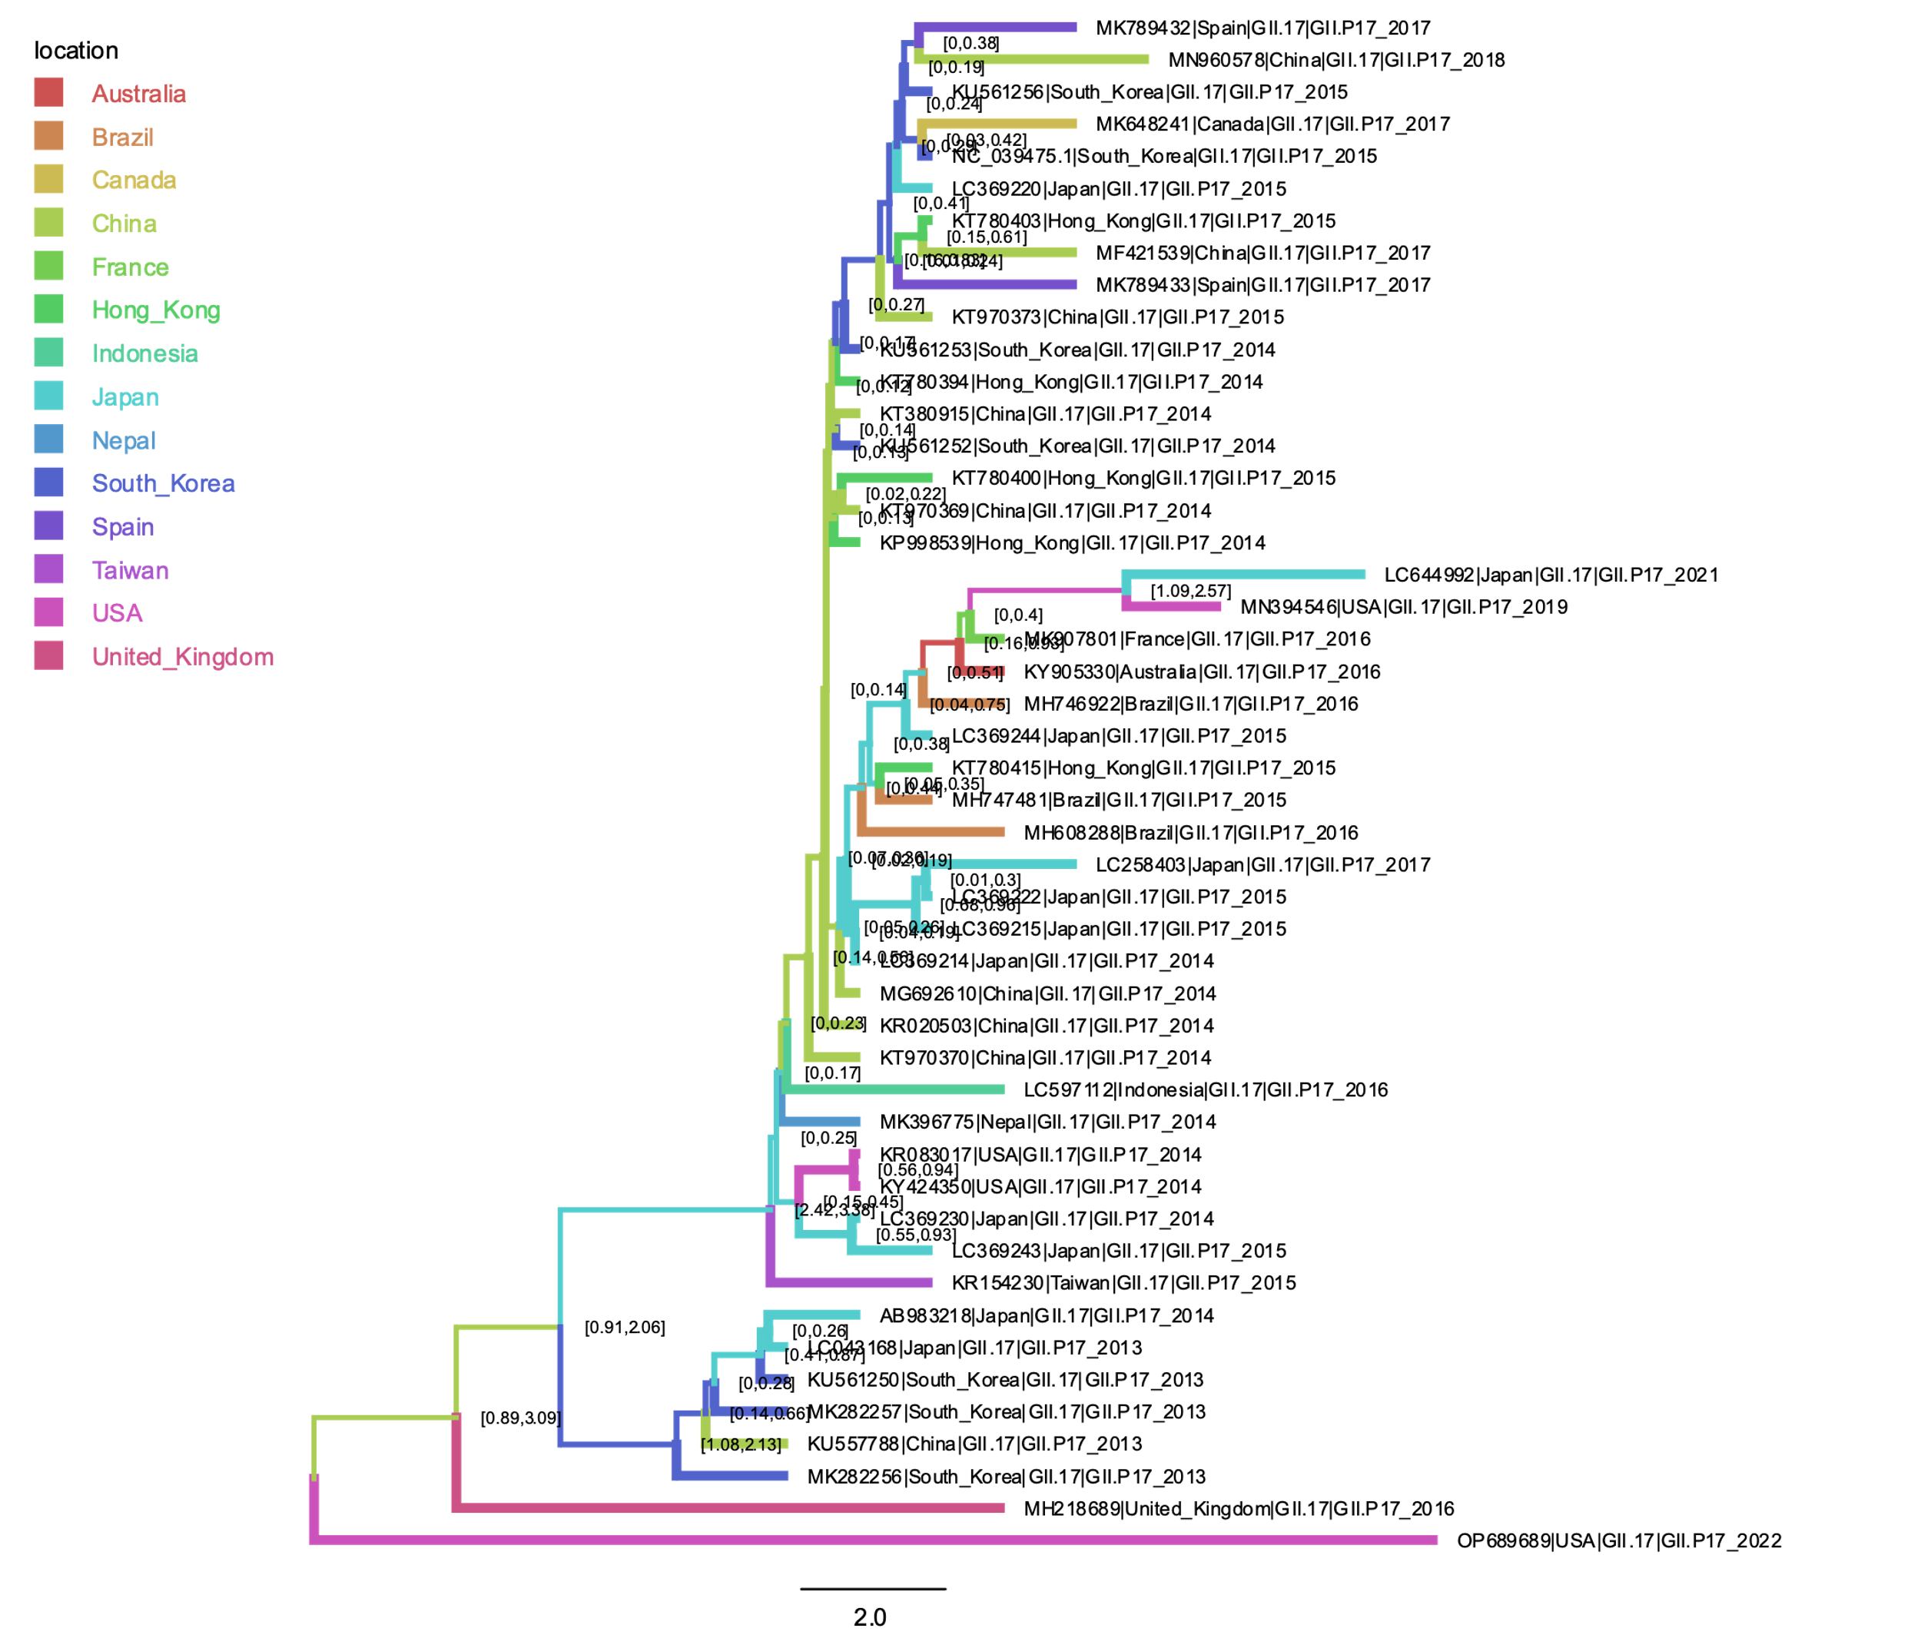

95% HPD interval
Location probability
Figure 22 MCC phylogenies of norovirus GII.17[P17]

