Slide 1
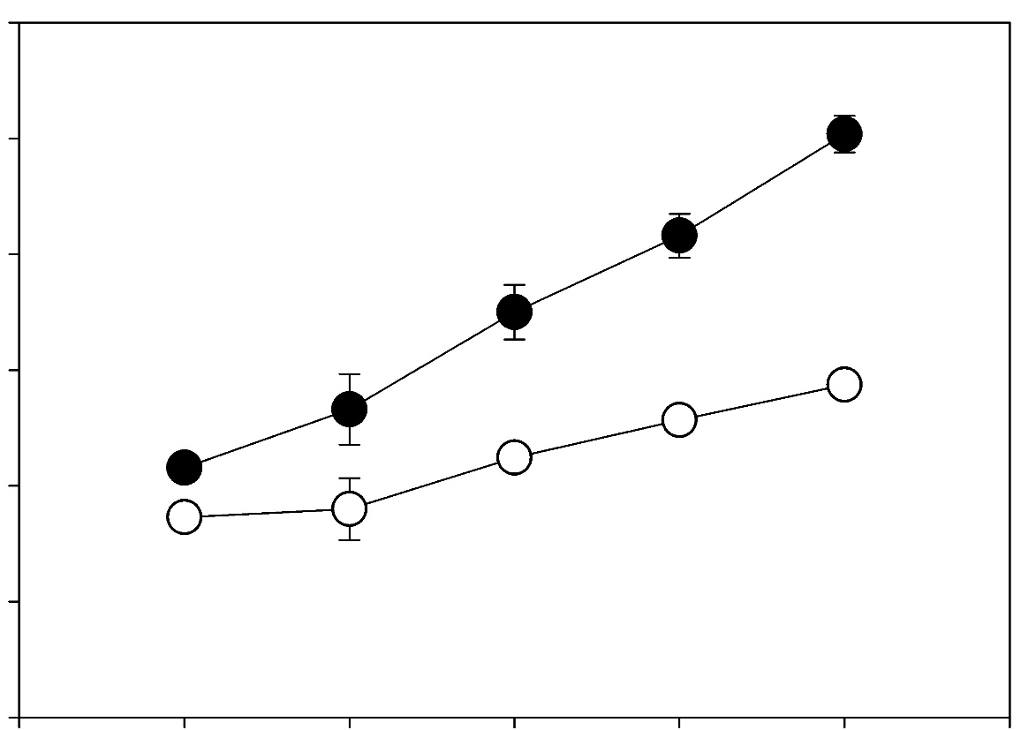
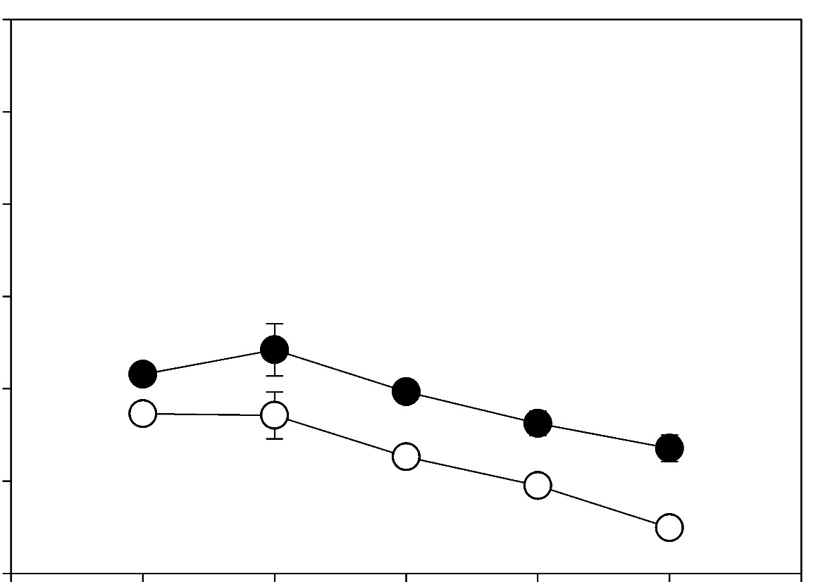



A.
B.
C.
T47D
T47D
1.2
1.2
T47D
BLVRB^{+/+}
****
BLVRB^{+/+}
BLVRB^{+/+}
BLVRB^{-/-}
****
BLVRB^{-/-}
BLVRB^{-/-}
#1 #2 #3
BLVRB
0.6
*
0.6
**
BLVRA
Optical density
**
Optical density
**
****
Actin
***
***
0
Serum
Serum-free
0
0
3
5
0
3
5
Time (days)
Time (days)
N. Marchenko et. al., Supplementary Fig. 3

