Slide 1
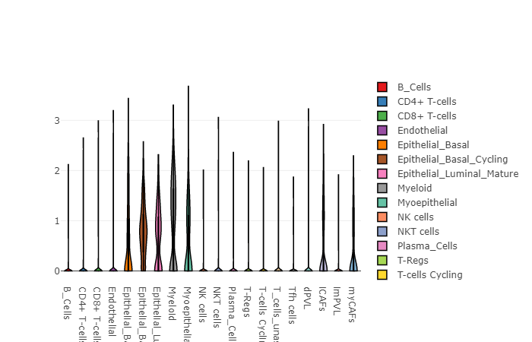
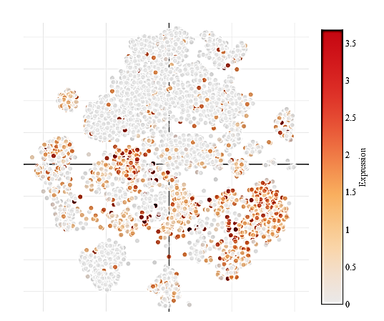
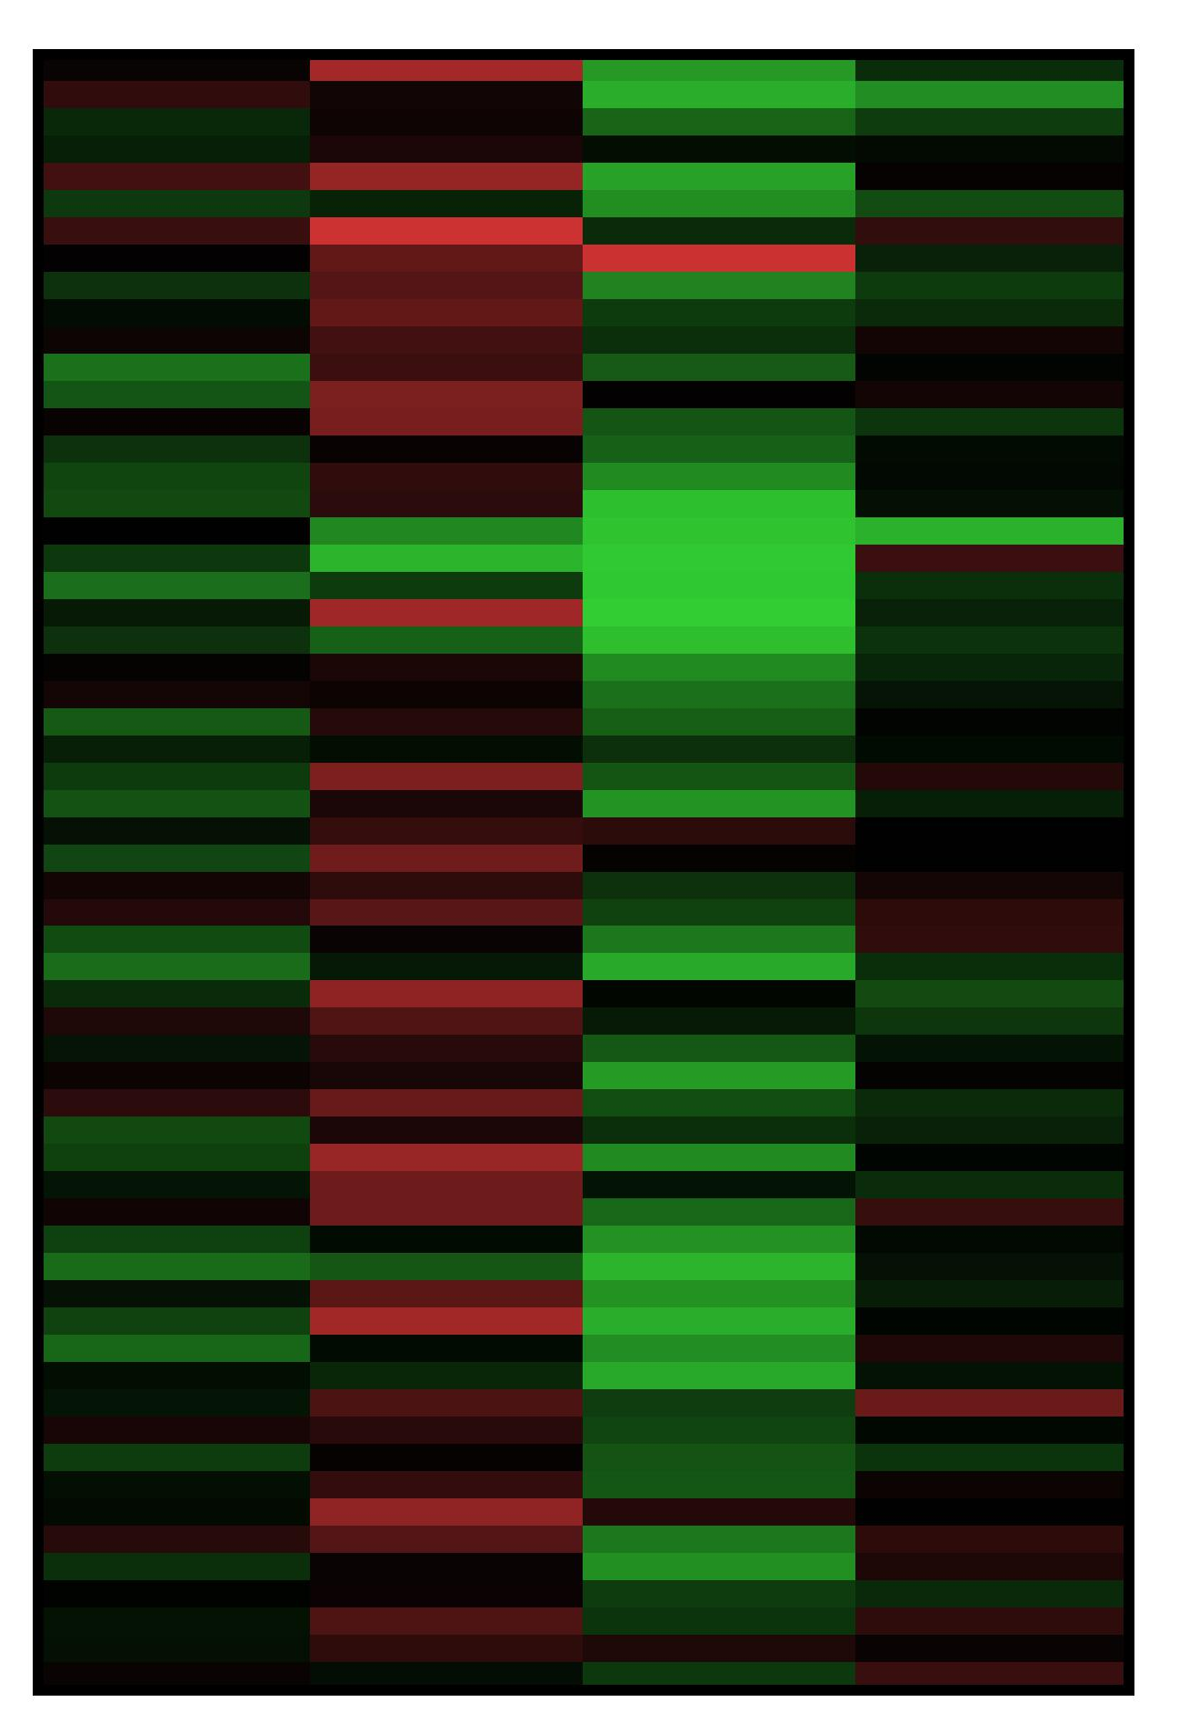
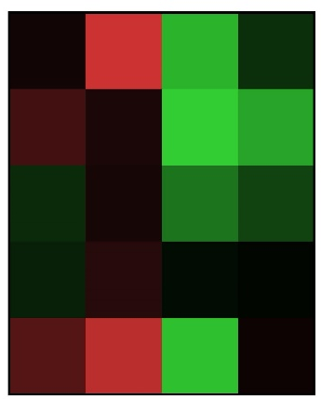
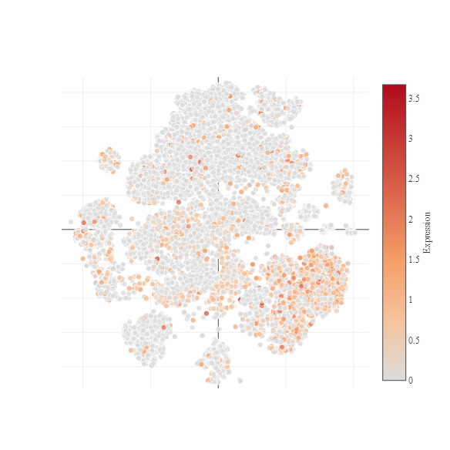

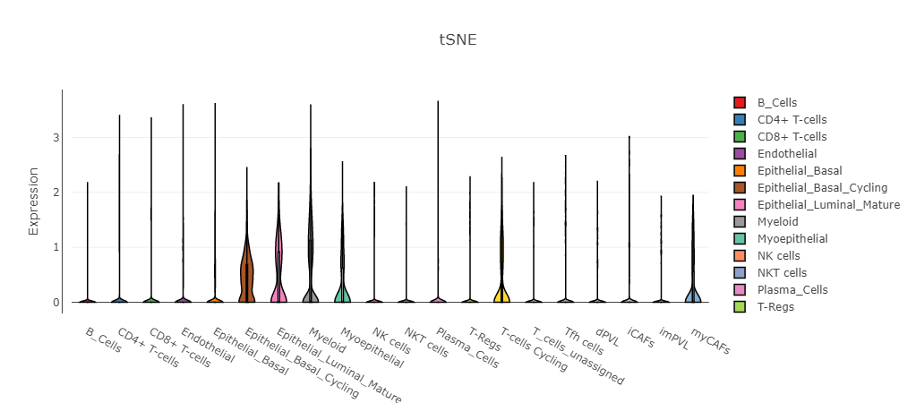
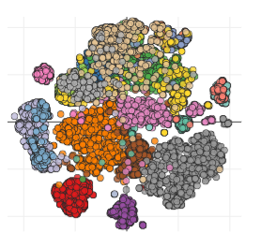
A.
B.
C.
BLVRB
BLVRB
BLVRA
BLVRB
HMOX1
HMOX2
HMOX1
BLVRA
HMOX2
BLVRB
Gene expression
MCF7
MDA-MB231
HS-578T
BT549
T47D
BLVRA
Breast cancer
BLVRA
Expression, Log₂
Gene expression
D.
Immune cells
Mature Epithelial luminal
iCAF
Myoepithelial
Epithelial basal
Myeloid
Marchenko et. al., Supplementary Figure 1
Epithelial basal
cycling

