Slide 1
Supplementary Figures

Slide 2
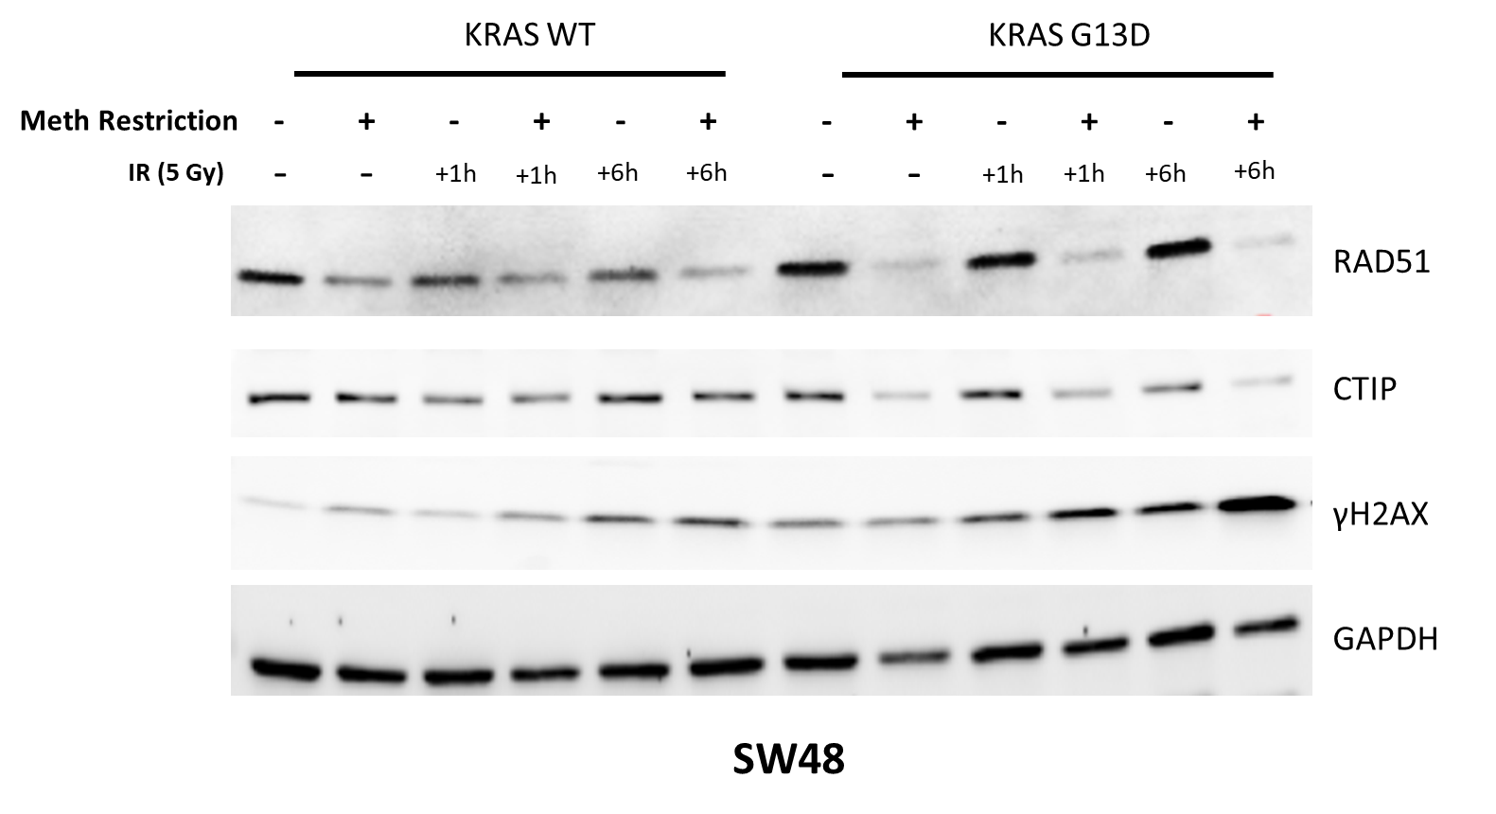
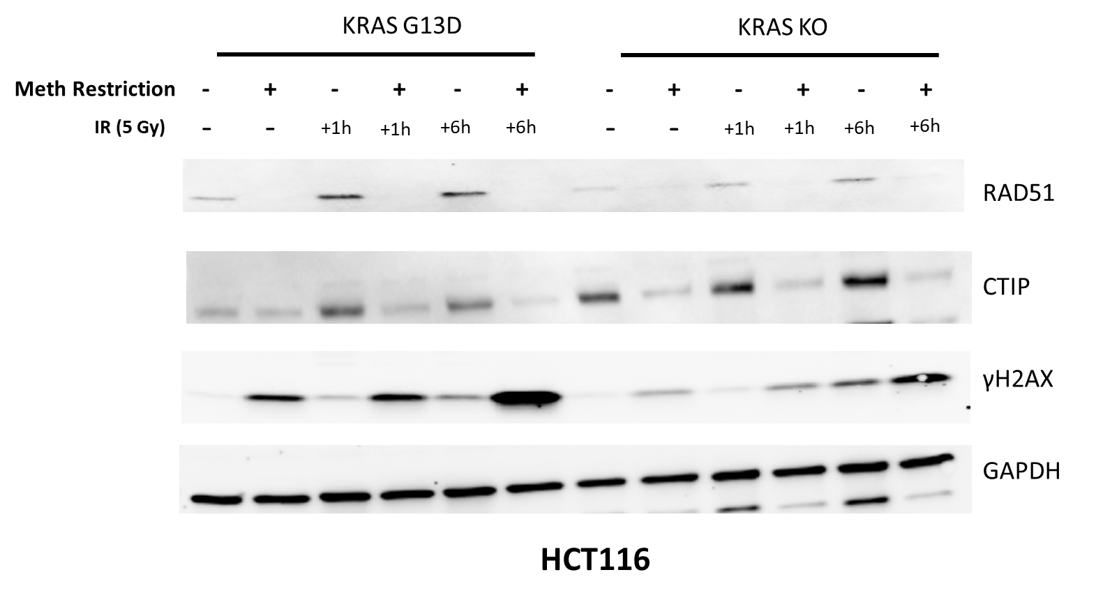
Supplementary Figure 1.

Slide 3
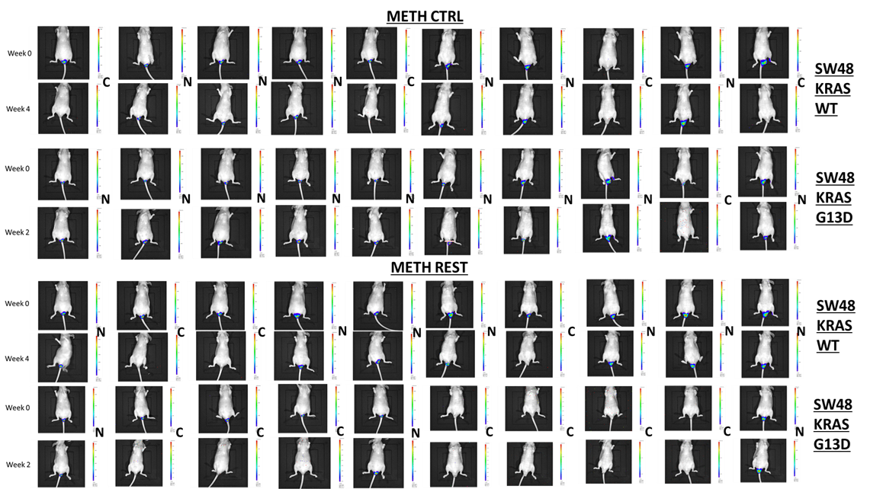
Supplementary Figure 2
Week 0
Week 4
Week 0
Week 4
Week 0
Week 4
Week 0
Week 4

