Slide 1
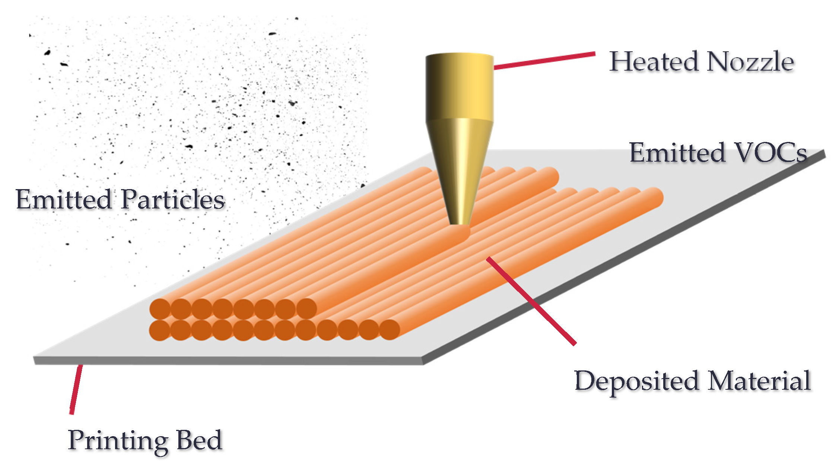
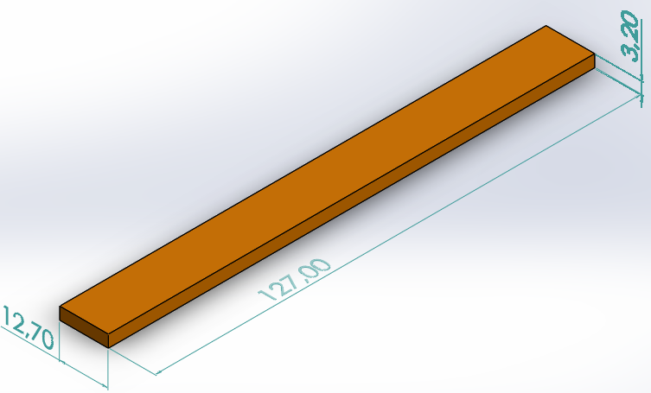
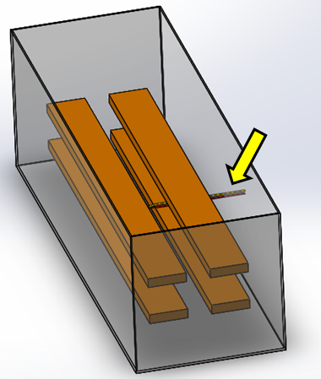
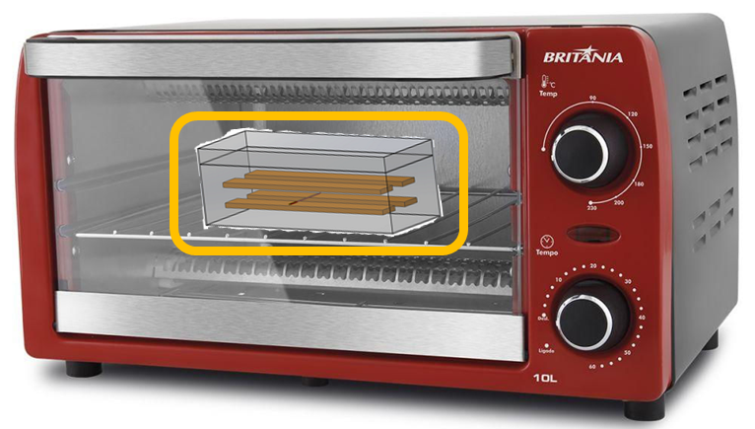
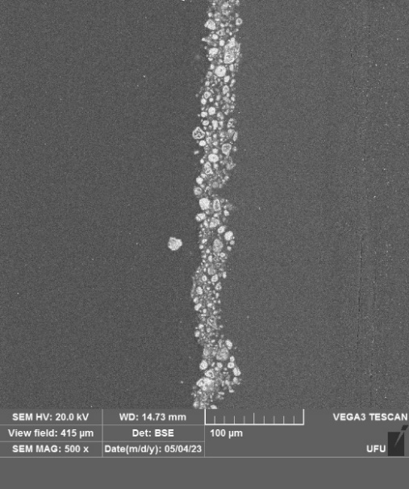
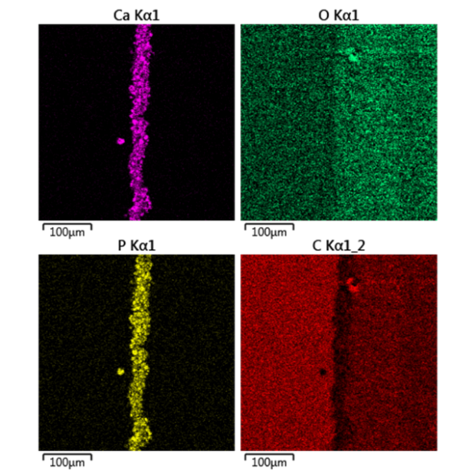
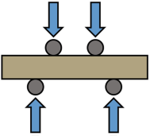
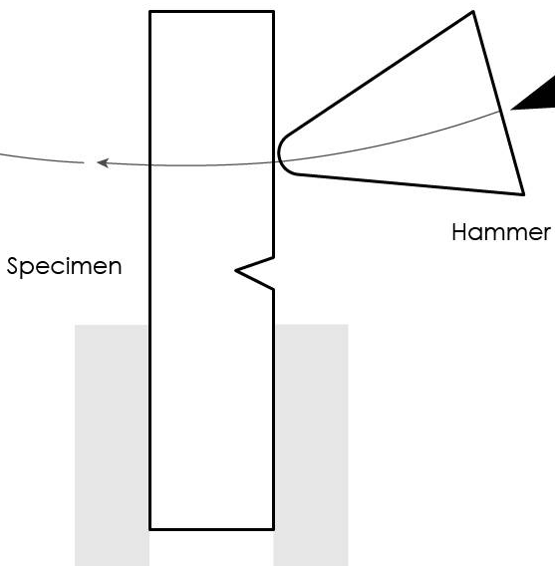
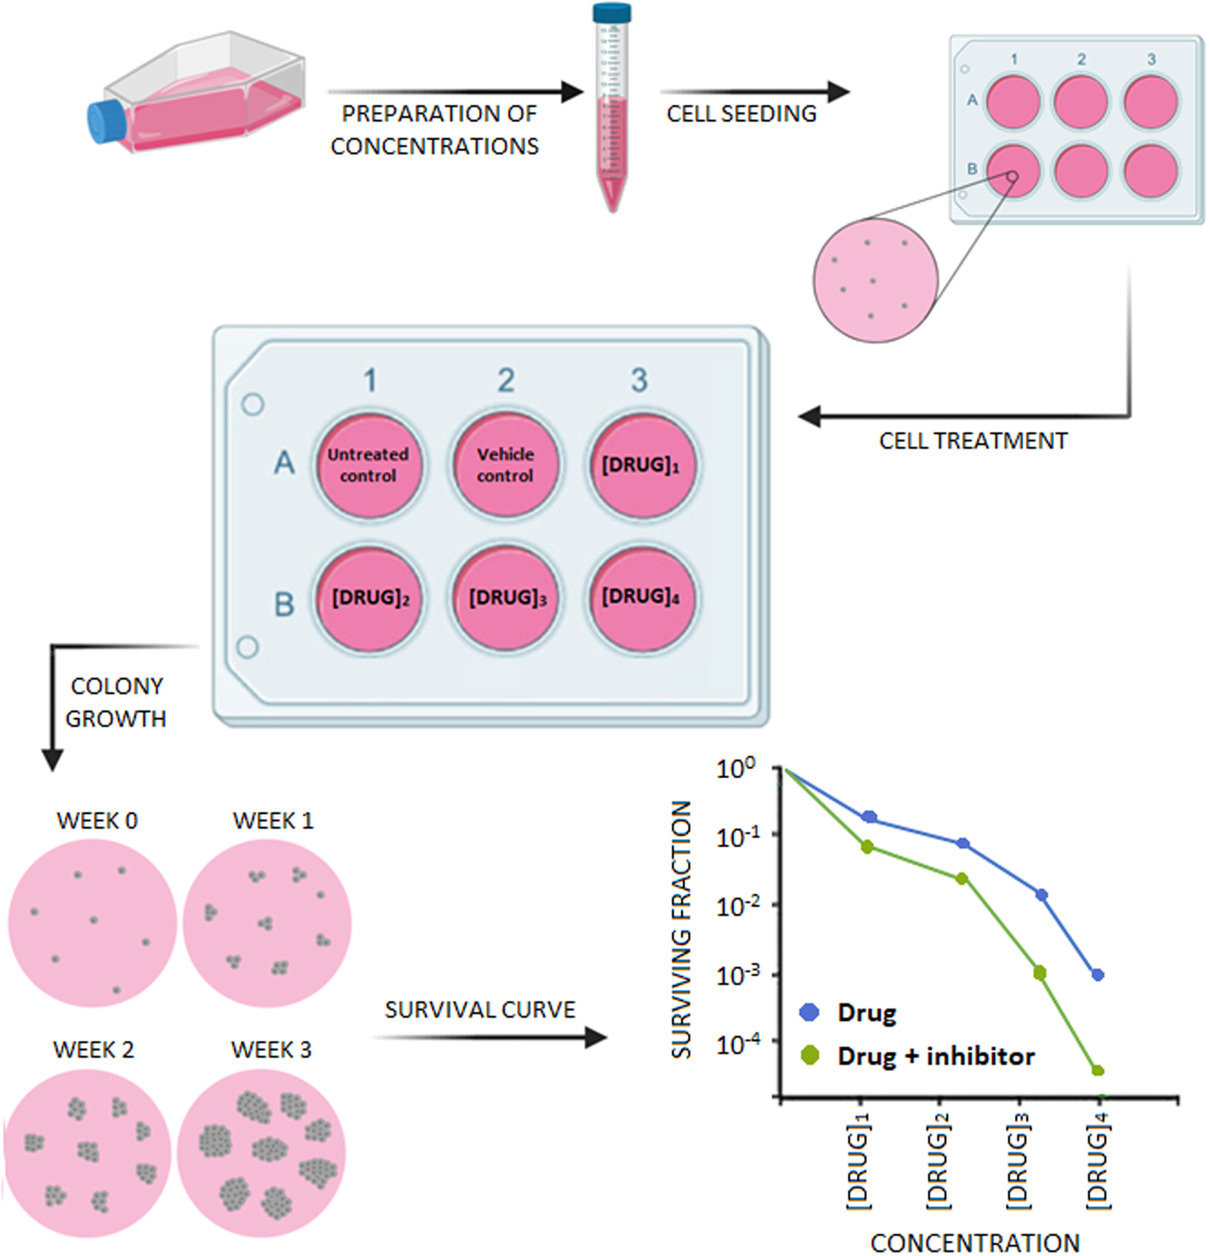
nozzle
3D printing of bend test samples by FFF
bend test samples of 127x12,7x3 mm
samples positioned in tray inside hydroxyapatite powder bed, with thermocouple (yellow arrow)
annealing in oven forms hydroxyapatite coating
deposited filament
coating characterization, mechanical tests and biological tests
+ control
- control
sample B
sample D
sample F

