Slide 1
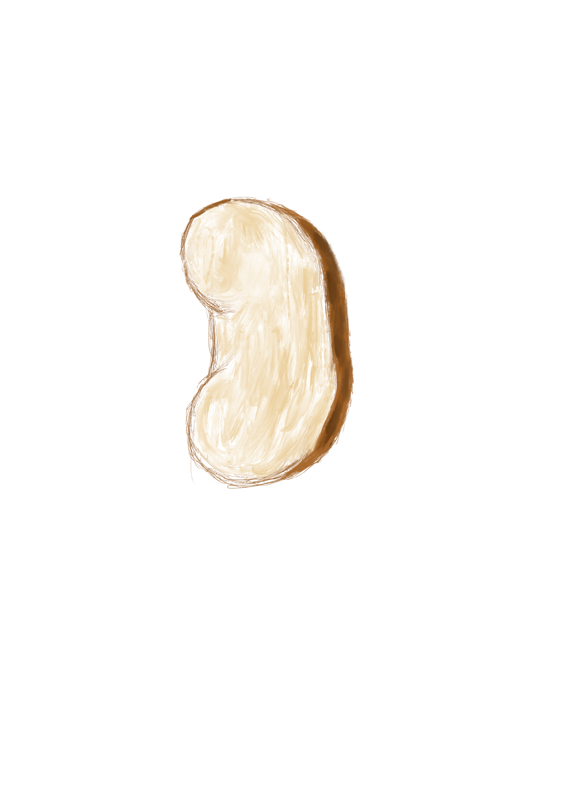
Macrophage
Activation
IL-1β，CXCL12
LRG1-bearing
EV
AAI injection
TEC
TGF-β1 receptor
NOX4
Apoptosis
Oxidative Stress
O₂
O₂
O₂
Macrophages derived EVs
O₂
O₂
O₂
ROS

