Slide 1
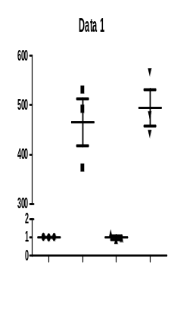
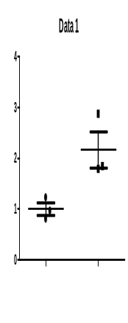
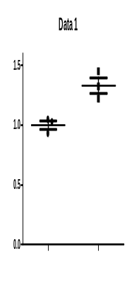



Supplemental Figure 1 Jiang et al.
mRNA levels,relative expression
A (BMDM) Real time-PCR
B (mTEC) Western blot
1.5
1.0
0.5
0
600
500
400
300
CXCL12
IL-1β
4
3
2
1
0
*
**
**
Ratio (KIM-1/β-actin)
Ratio
(Cle- caspase-3/β-actin)
*
KIM-1
43
Cle-caspase-3
26
2
1
0
β-actin
43
AAI
- + - +
CM - +
- +
- +
AAI + +
+ +
+ +
Supplemental Figure 1
(A) Real-time qPCR analysis showing the mRNA levels of CXCL12 and IL-1β in BMDM/mTEC conditioned media culture model. Dot plots show the corresponding quantification of band intensity and fold change.
(B) Western blot analysis showing the protein levels of KIM-1 and cleaved caspase-3 in BMDM/mTEC conditioned media culture model. Dot plots show the corresponding quantification of band intensity and fold change.
Similar results were obtained in triplicate culture assays. *P<0.05.

Slide 2
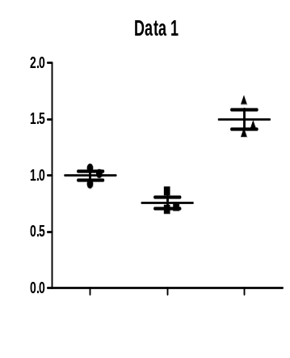
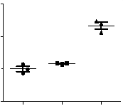
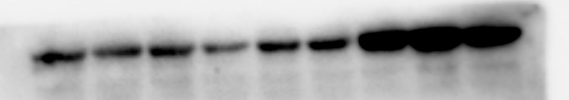
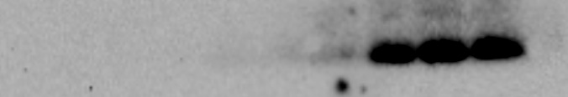
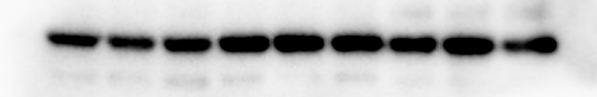
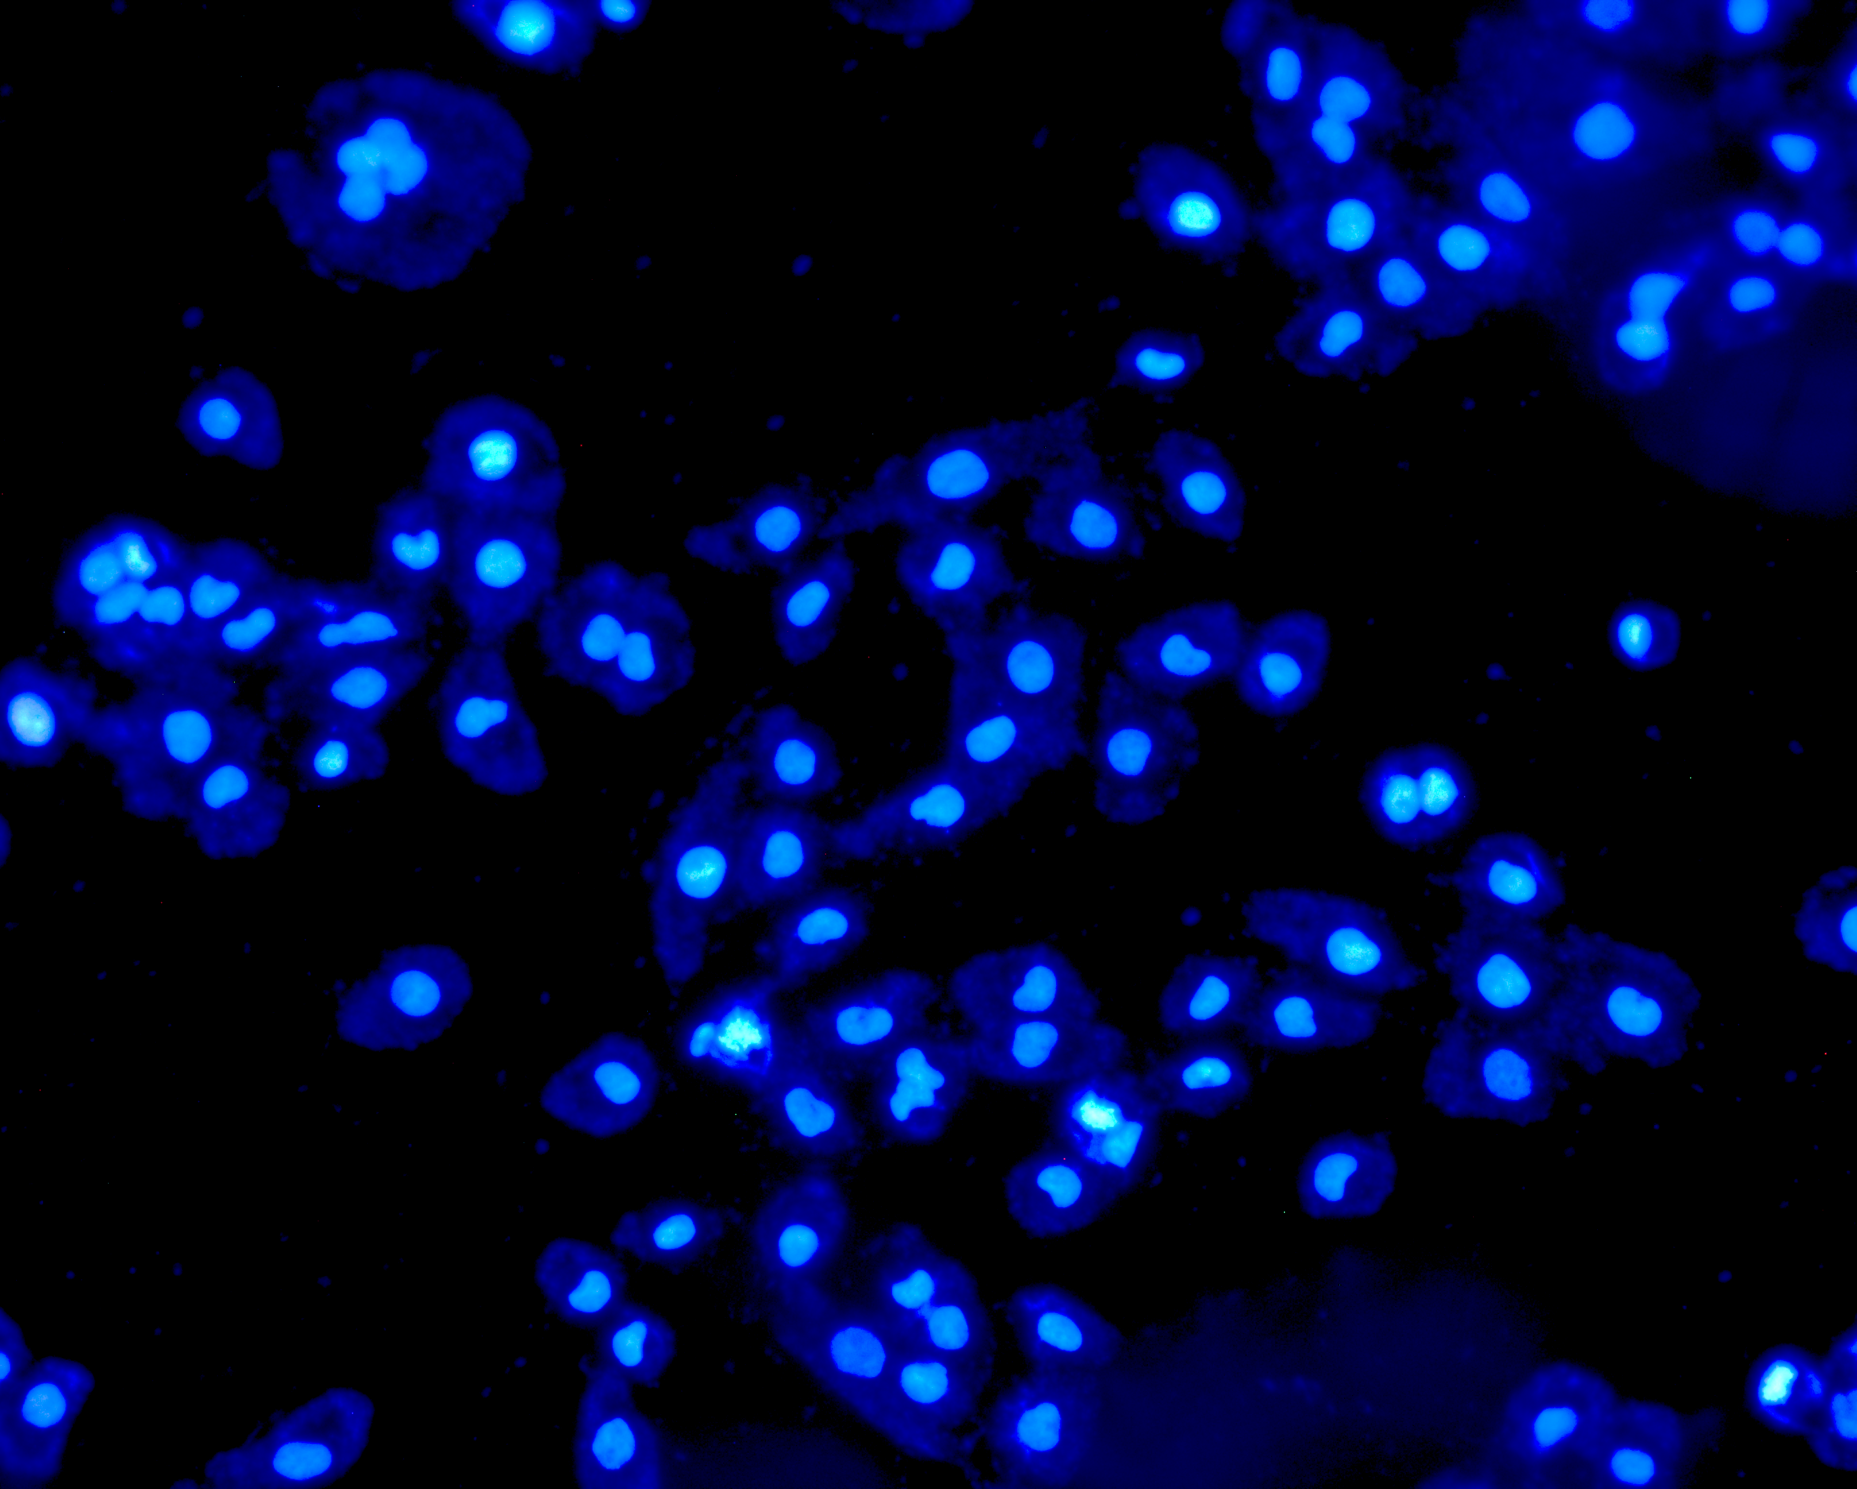
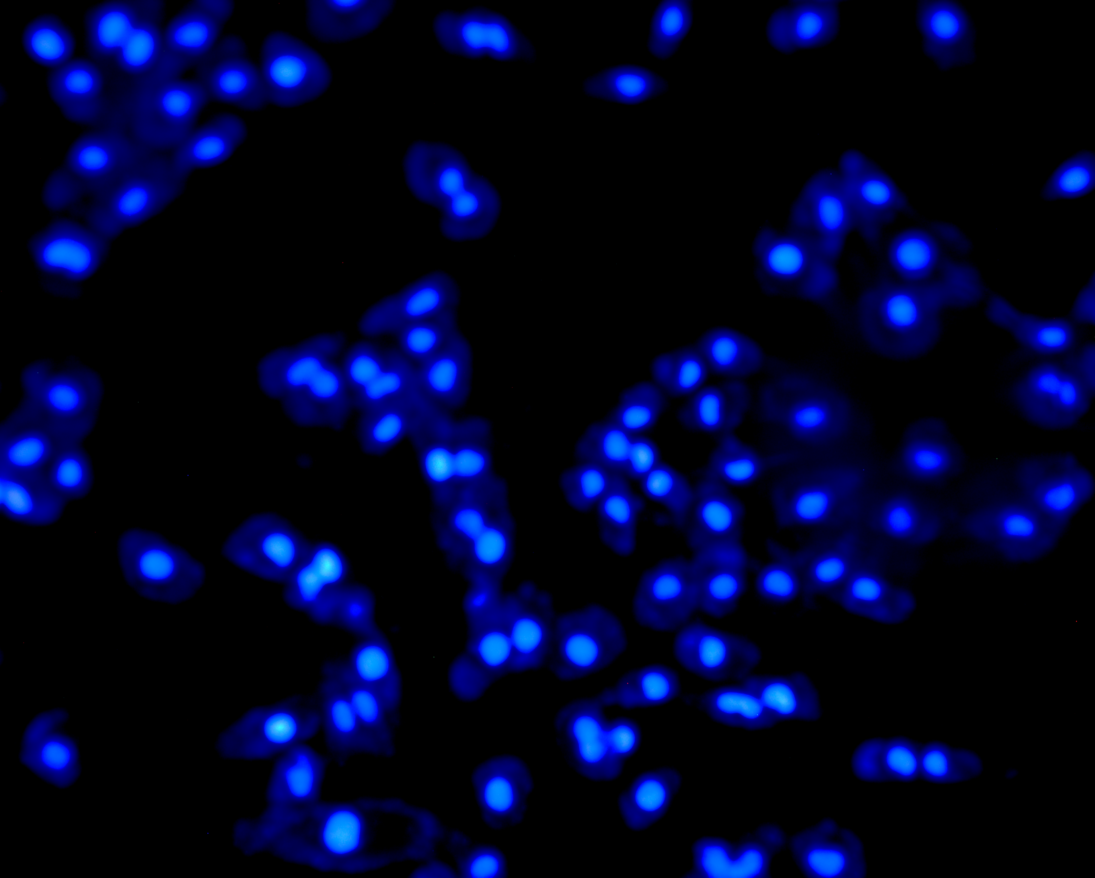
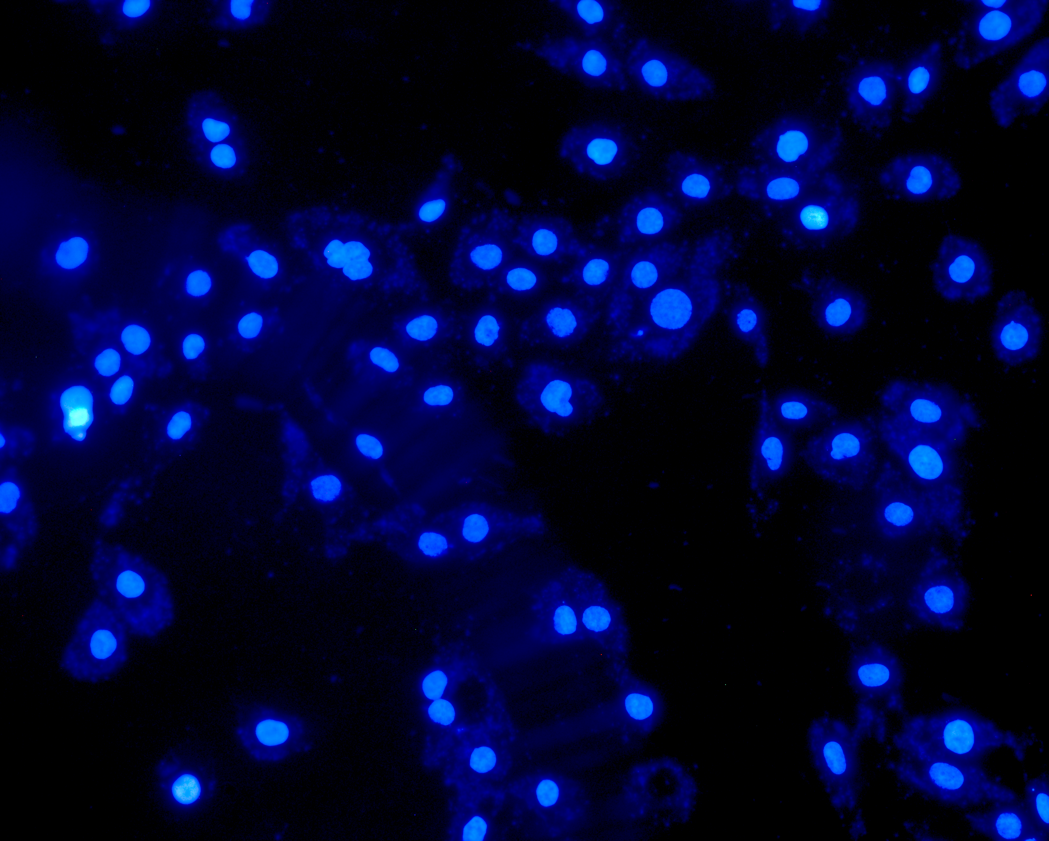

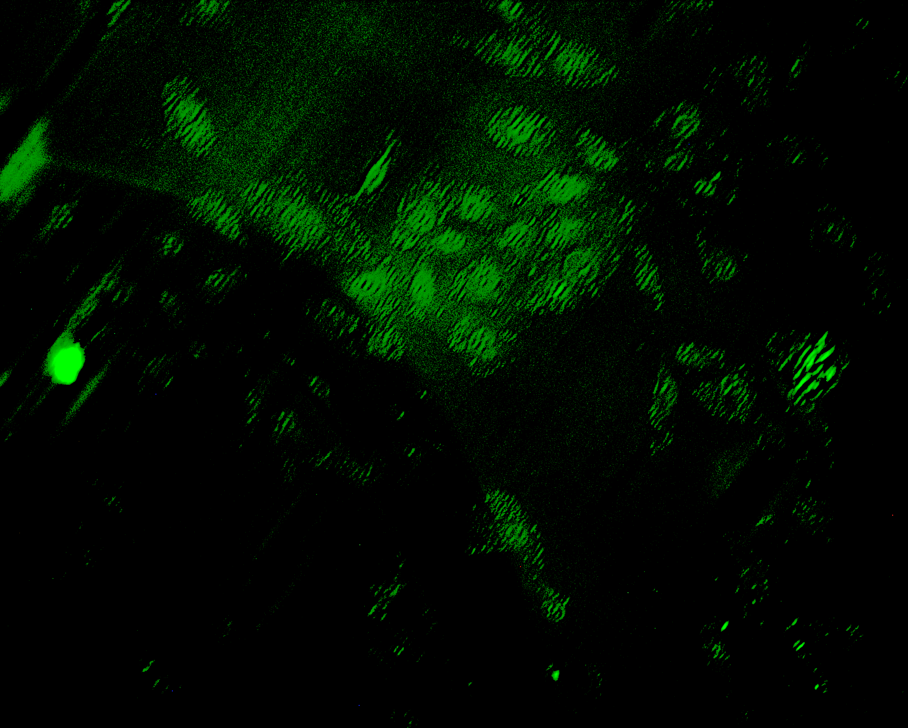
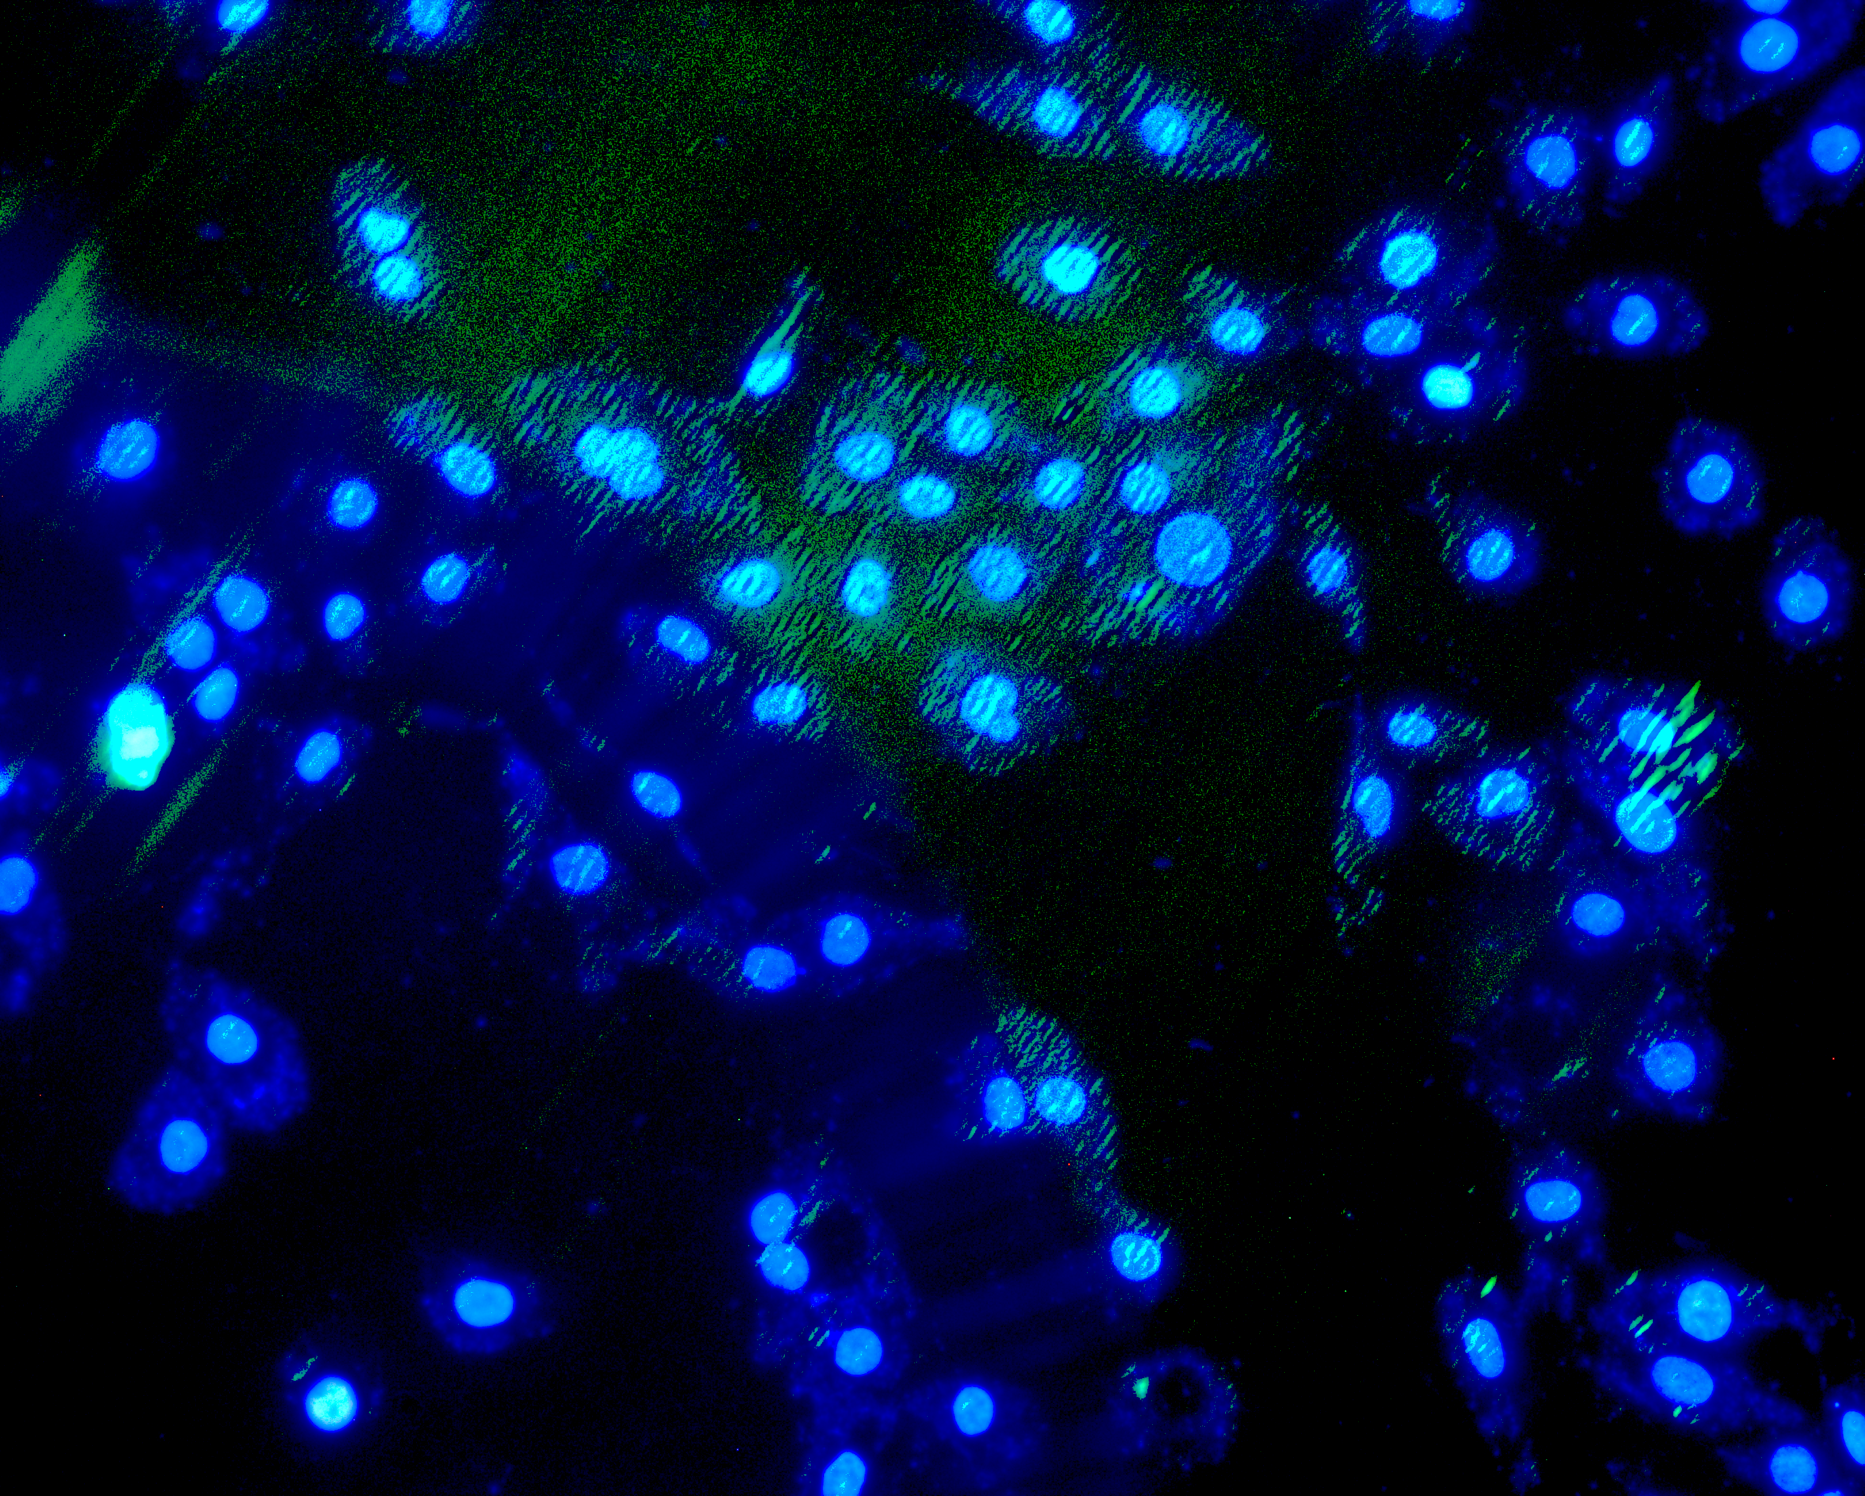
Supplemental Figure 2 Jiang et al.
A
EV_{v}
(10μM,24h)
(10μM,24h)
EV_{a}
(10μM,24h)
AAI
AAI
AAI
mTEC
BMDM
mTEC
BMDM
mTEC
24h Harvest
3
2
1
0
B (mTEC) Western blot
2.0
1.5
1.0
0.5
0.0
**
***
Ratio (KIM-1/β-actin)
##
Ratio
(Cle-caspase-3/β-actin)
##
KIM-1
43
Cle-
caspase-3
26
β-actin
43
AAI
EV_{v}
EV_{a}
-
-
-
+
+
-
+
-
+
-
-
-
+
+
-
+
-
+
-
-
-
+
+
-
+
-
+
C (mTEC) Immunofluorescence
DAPI
Cle capase-3
Merge
AAI
EV_{v}
EV_{a}
-
-
-
+
+
-
+
-
+
Supplemental Figure 2
(A) The cell model was established to investigate the role of EV. EVv was derived from BMDM and incubated with AAI-treated mTEC. EVa was derived from AAI-treated BMDM and incubated with AAI-treated mTEC.
(B) Western blot analysis showing the protein expression of KIM-1 and cleaved caspase-3 in different group. Dot plots show the corresponding quantification of band intensity and fold change.
(C) Representative images of cleaved caspase-3 immunofluorescence staining in different group. Scale bar, 50μm.

Slide 3
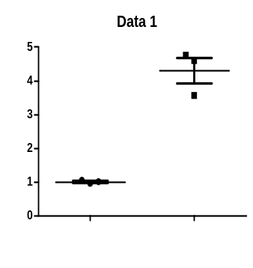


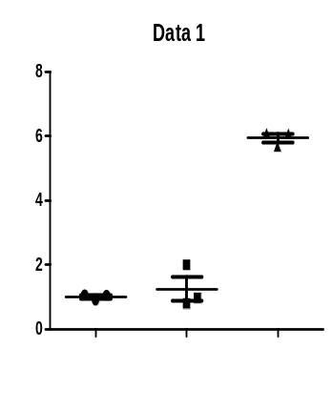
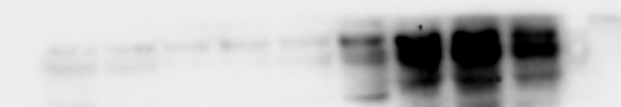
Supplemental Figure 3 Jiang et al.
A (mTEC) Western blot
Ratio
(NOX-4/β-actin)
5
4
3
2
1
0
***
NOX-4
72
β-actin
43
CM - +
AAI + +
8
6
4
2
0
***
B (mTEC) Western blot
Ratio (NOX-4/β-actin)
##
NOX-4
72
β-actin
43
AAI
EV_{v}
EV_{a}
-
-
-
+
+
-
+
-
+
-
-
-
+
+
-
+
-
+
Supplemental Figure 3
(A) Western blot analysis showing the protein levels of NOX4 in BMDN/mTEC co-culture system. Dot plots show the corresponding quantification of band intensity and fold change.
(B) Western blot analysis showing the protein levels of NOX4 in BMDN/mTEC conditioned media culture model. Dot plots show the corresponding quantification of band intensity and fold change.

