Slide 1
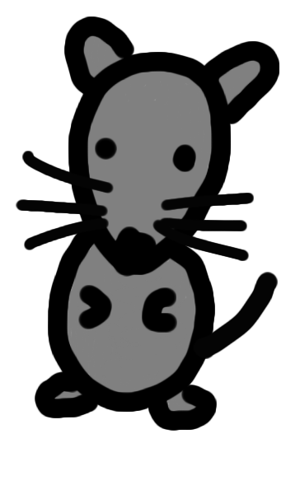
Fig.S1
A
B
Znf746
Flox Primer_Rv
KO Primer_Rv
M
w/w
f/f
Exon6
Exon7
Znf746 WT allele
Putative DNA Binding Site
Primer_Fw
Exon6
loxP
Exon7
loxP
Znf746 flox allele
Putative DNA Binding Site
Exon6
Znf746 flox (750 bp)
Znf746 WT (616 bp)
Znf746 KO allele
C
D
Znf746 KO/KO, CAG-Cre+
E
Znf746 KO/KO, CAG-Cre-
Znf746 KO/KO, CAG-Cre+
Znf746 KO/KO, CAG-Cre-
Znf746 WT/WT
Znf746 WT/WT
Znf746 flox/flox
CAG-Cre
Znf746 WT (2147 bp)
Znf746 KO (477 bp)
CAG-Cre (370 bp)
P.C. (300 bp)
Znf746 KO/KO
F
Supplementary Figure S1 Generation of mice with a Znf746 exon 7 knockout (P7KO).
(A) Schematic representation of the Znf746 genomic locus, showing the WT, floxed, and KO alleles. (B) Agarose gel electrophoresis of genotyping PCR products showing Znf746WT/WT and Znf746flox/flox band patterns. (C) Schematic representation of the mouse breeding strategy of crossing Znf746flox/flox mice with CAG-Cre mice to generate P7KO mice with germline deletion of Znf746. CAG-Cre was subsequently removed. (D, E) Agarose gel electrophoresis of genotyping PCR products showing Znf746WT/WT, Znf746KO/KO, and CAG-Cre +/- transgenic band patterns. (F) RT-PCR analysis of Znf746 expression in sWAT and eWAT of WT and P7KO mice.

Slide 2
Fig.S2
A
B
sWAT
eWAT
Kidney
Liver
Lung
Heart
PARIS(mAb)
W
K
W
K
W
K
W
K
W
K
W
K
PARIS(pAB)
Ponceau-S
C
Supplementary Figure S2 Validation of anti-PARIS antibodies
(A) Western blot analysis of PARIS expression in sWAT, eWAT, kidney, liver, lung, and heart tissues of WT and P7KO mice using monoclonal (mAb) and polyclonal (pAb) antibodies against PARIS. (B, C) Quantitative analysis of relative PARIS levels using the pAb (B) and mAb (C). Data expressed as means ± SD.

Slide 3
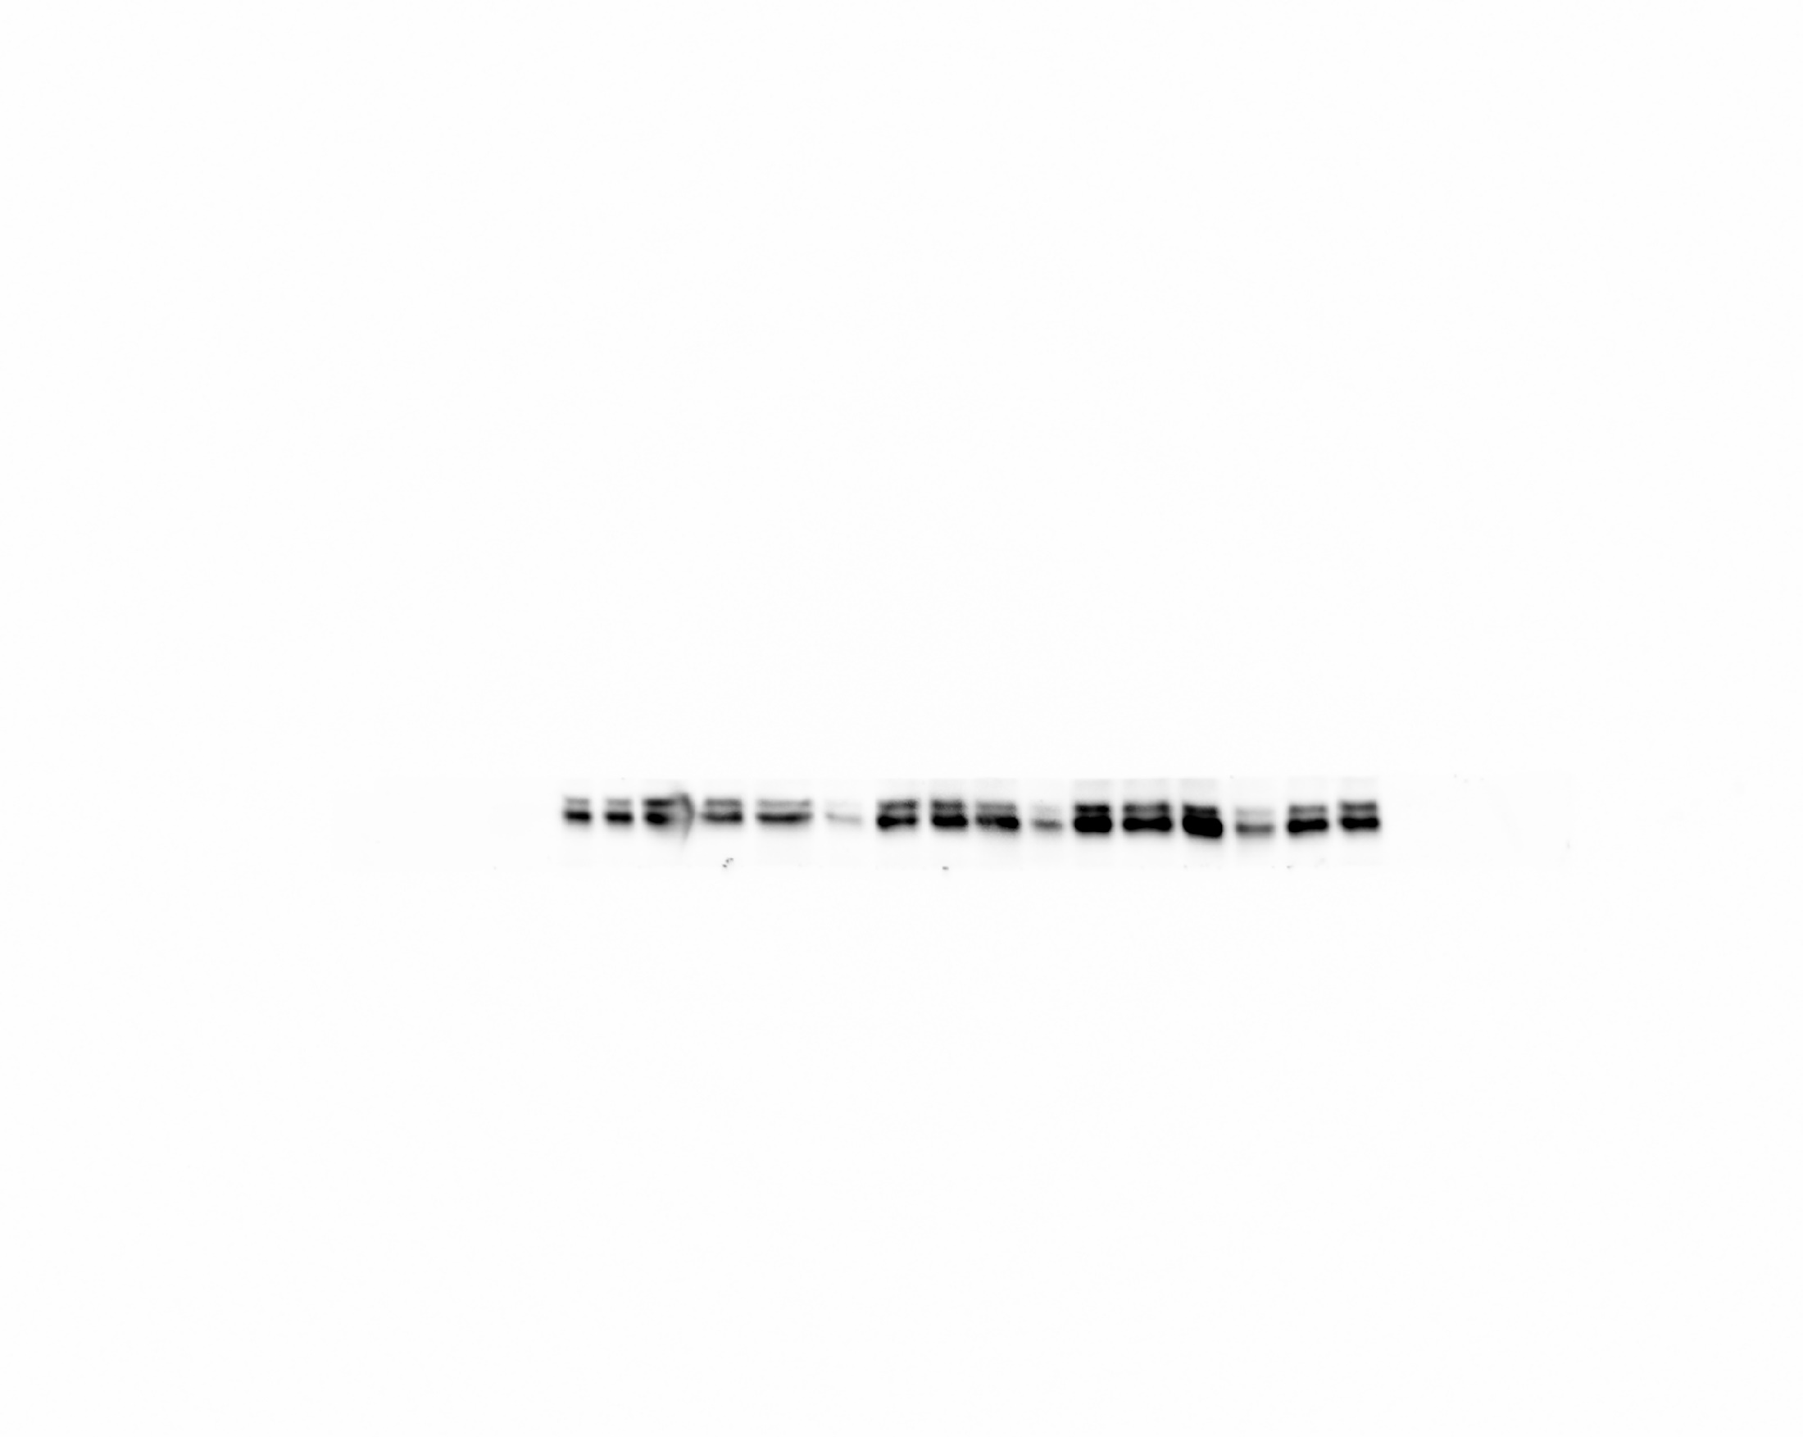
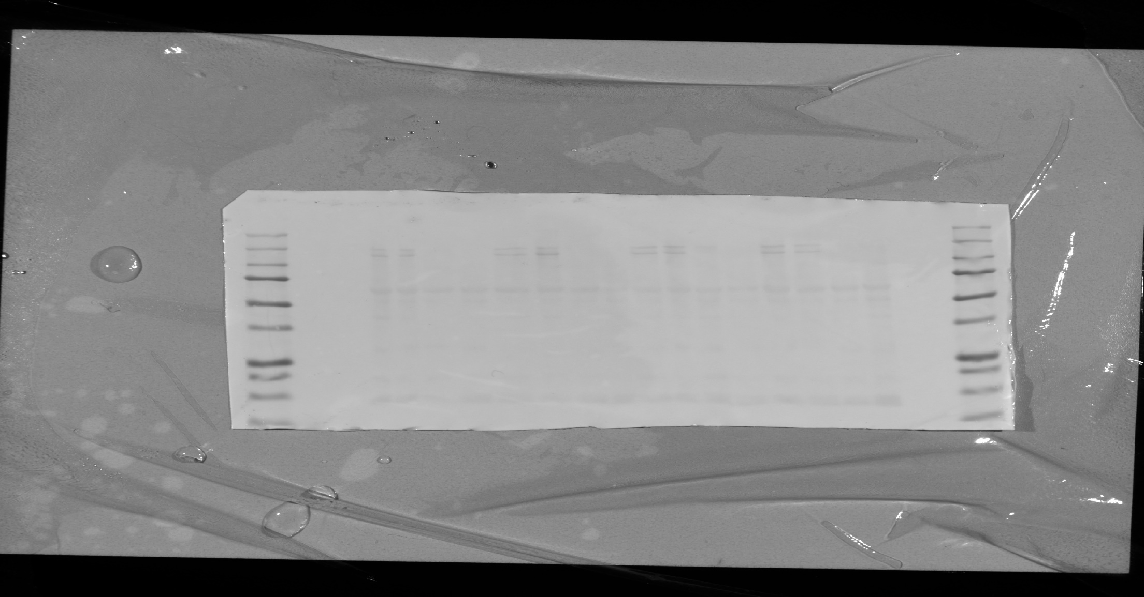
Fig.S3
A
eWAT
B
WT
PARIS KO
C
sWAT
D
WT
PARIS KO
E
eWAT
sWAT
F
WT
KO
WT
KO
PPARγ
◀︎2
◀︎1
Ponceau-S
G
Supplementary Figure S3 Analysis of WAT in ND-fed WT and P7KO mice.
(A–D) Representative microscopic images of H&E-stained eWAT (A) and sWAT (C) of WT and P7KO mice, with the corresponding distribution curves and box plots of adipocyte size in eWAT (B; WT, n = 535 cells from four mice; KO, n = 923 cells from four mice) and sWAT (D; WT, n = 654 cells from four mice; KO, n = 1,577 cells from four mice). Scale bars: 200 µm. (E) Western blotting and (F) quantitative analysis of PPARγ expression in sWAT and eWAT of WT and P7KO mice (n = 4). Ponceau-S staining was used for normalization. (G) RT-PCR analysis of mRNA expression of Ppargc1a, Adipoq, Fasn, Acaca, Srebf1, Cebpa, Pparg1, and Pparg2 expression in sWAT and eWAT of WT and P7KO mice. Data expressed as means ± SD, analyzed by Student’s t-test; *P < 0.05, **P < 0.01, ***P < 0.001.

Slide 4
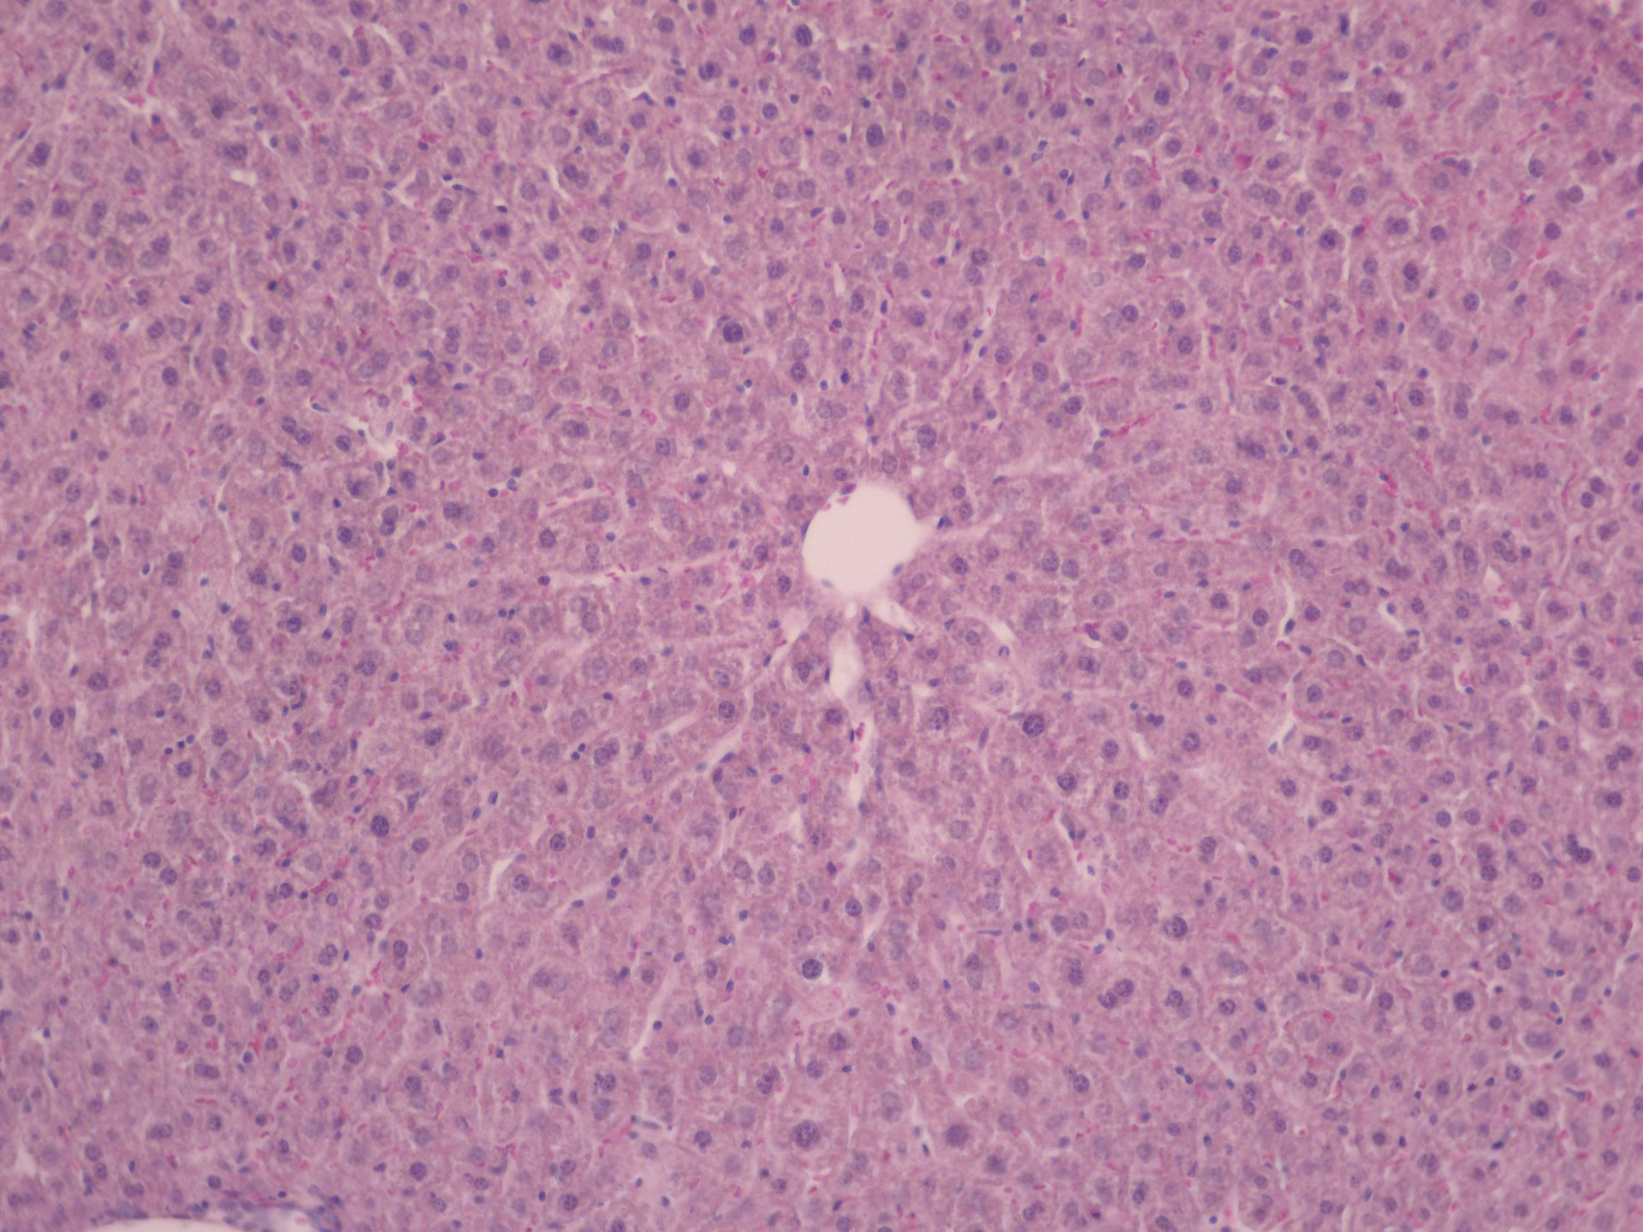
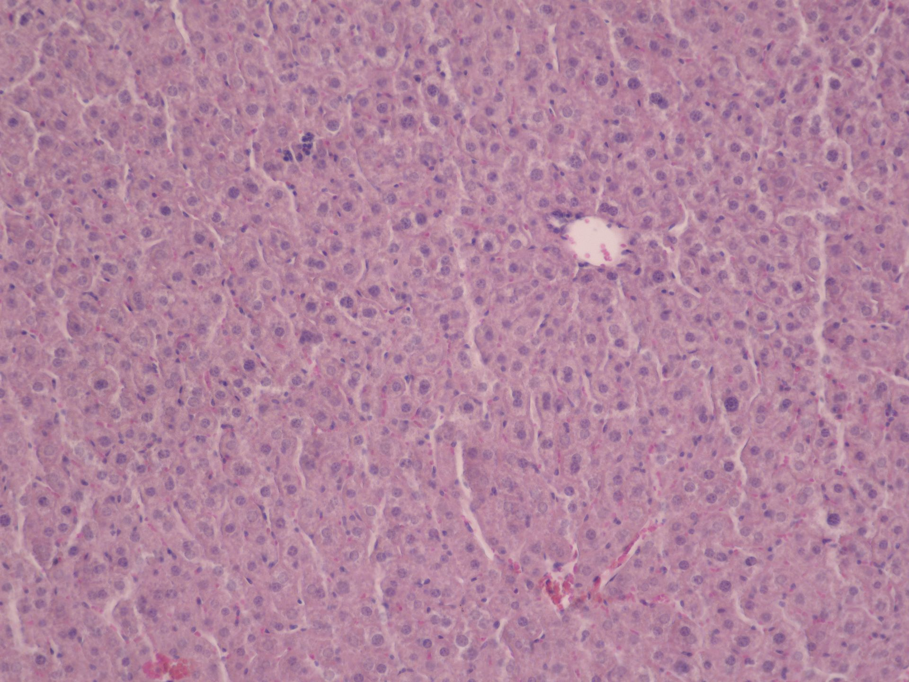
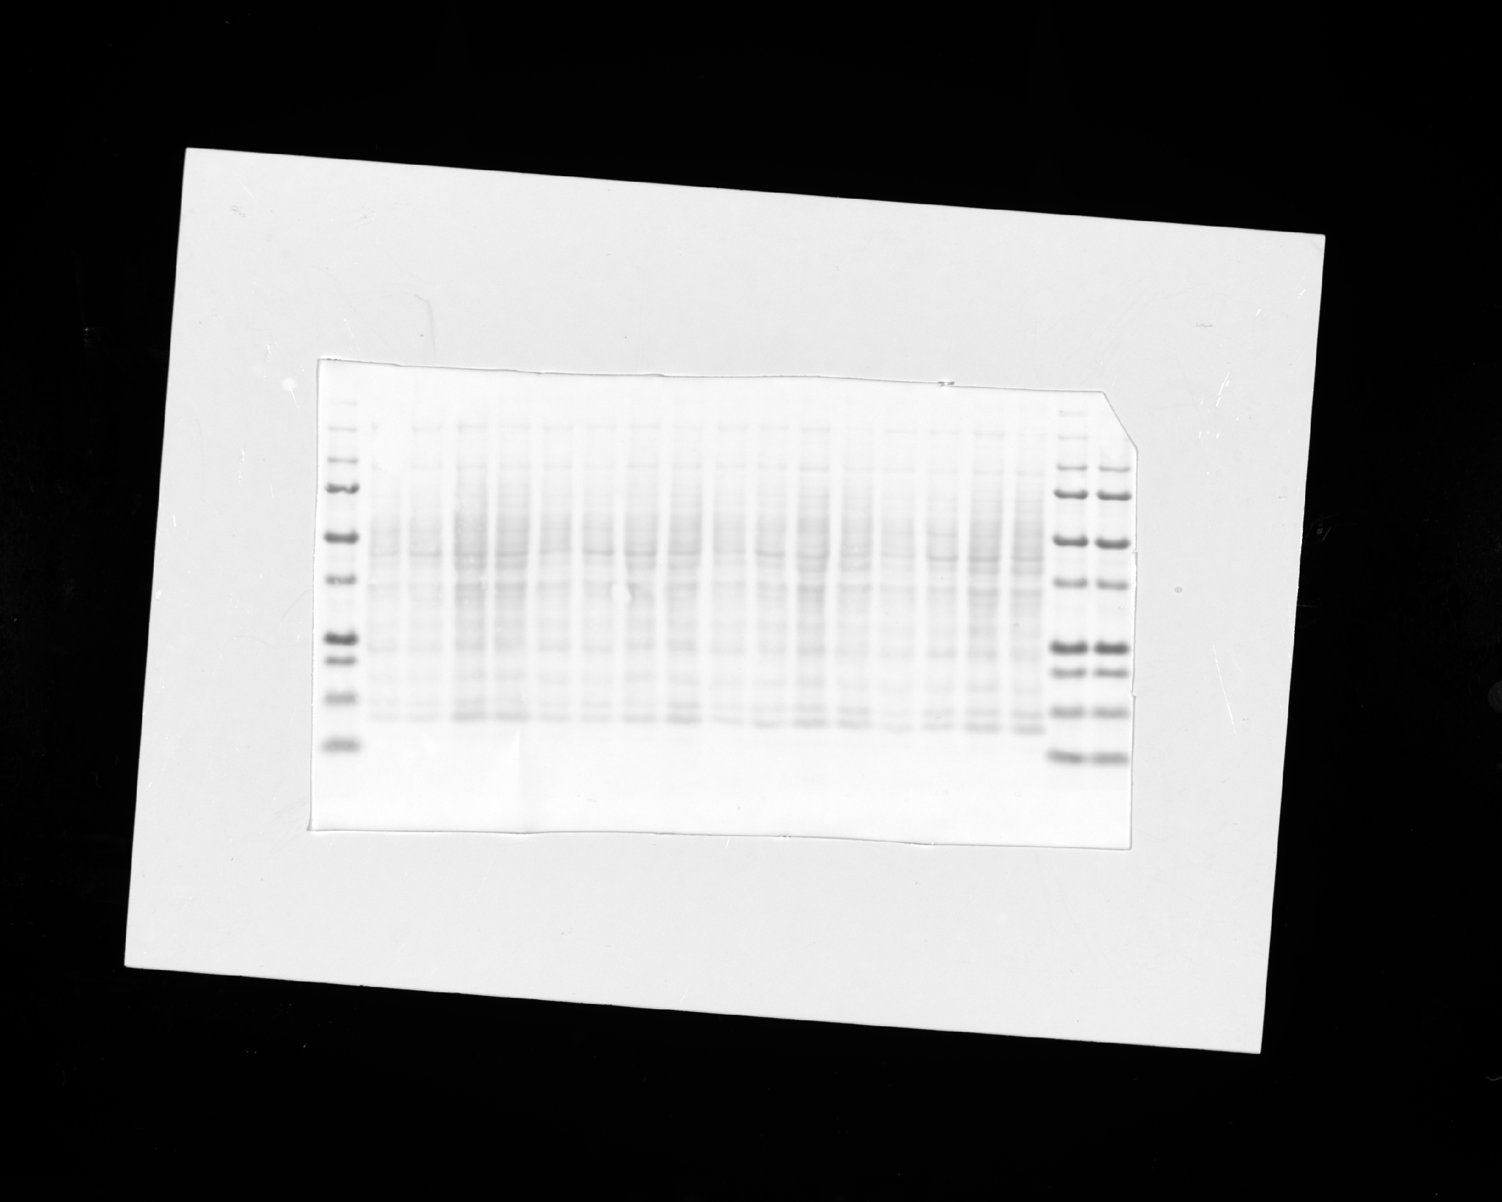
Fig.S4
A
WT
KO
B
C
D
PPARγ
WT
KO
Supplementary Figure S4 Liver analysis of ND-fed WT and P7KO mice.
(A) Representative microscopic images of H&E-stained liver sections of WT and P7KO (KO) mice. Scale bars: 200 µm (B) Western blotting and (C) quantitative analysis of PPARγ expression in the liver of WT and P7KO mice (n = 4). Ponceau-S staining was used for normalization. (D) RT-PCR analysis of mRNA expression of Znf746, Ppargc1a, Slc2a2, Cd36, Srebf1, Fasn, and Acly in the liver of WT and P7KO mice (n = 4). Data expressed as means ± SD, analyzed by Student’s t-test; *P < 0.05, **P < 0.01.

