Slide 1
Original blots are listed by figure numbers.
Highlighted regions correspond to the figures in manuscript.

Slide 2
Fig.4A
Fig.5A
Replicate 1
Replicate 2
Replicate 3
Replicate 4
Replicate 1
Replicate 2
Replicate 3
Replicate 4
ND
HFD
ND
HFD
ND
HFD
ND
HFD
ND
HFD
ND
HFD
ND
HFD
ND
HFD
W
K
W
K
W
K
W
K
W
K
W
K
W
K
W
K
W
K
W
K
W
K
W
K
W
K
W
K
W
K
W
K
PARIS
PARIS
Ponceau-S
Ponceau-S

Slide 3
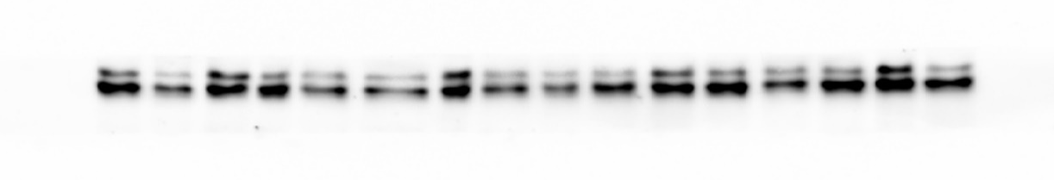
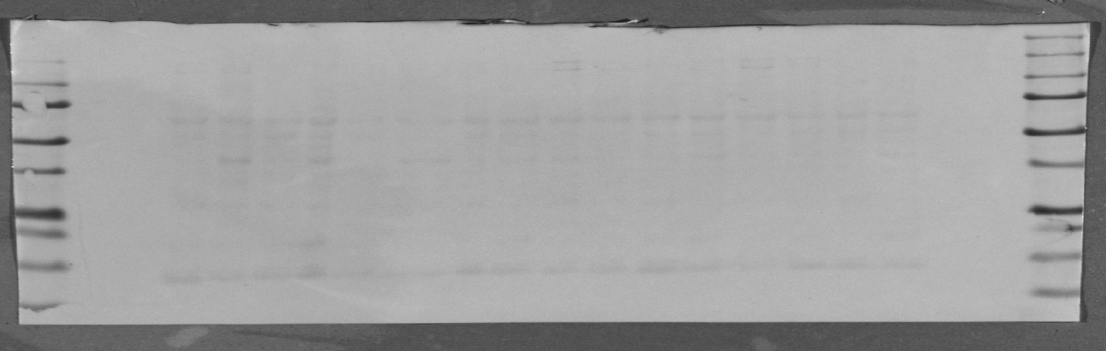
Fig.4F, 5F
Replicate 1
Replicate 2
Replicate 3
Replicate 4
sWAT
eWAT
sWAT
eWAT
sWAT
eWAT
sWAT
eWAT
W
K
W
K
W
K
W
K
W
K
W
K
W
K
W
K
PPARγ
◀︎2
◀︎1
Ponceau-S
Fig.5F
Fig.4F

Slide 4
Fig.6A
Replicate 1
Replicate 2
Replicate 3
Replicate 4
ND
HFD
ND
HFD
ND
HFD
ND
HFD
W
K
W
K
W
K
W
K
W
K
W
K
W
K
W
K
PARIS
Ponceau-S

Slide 5
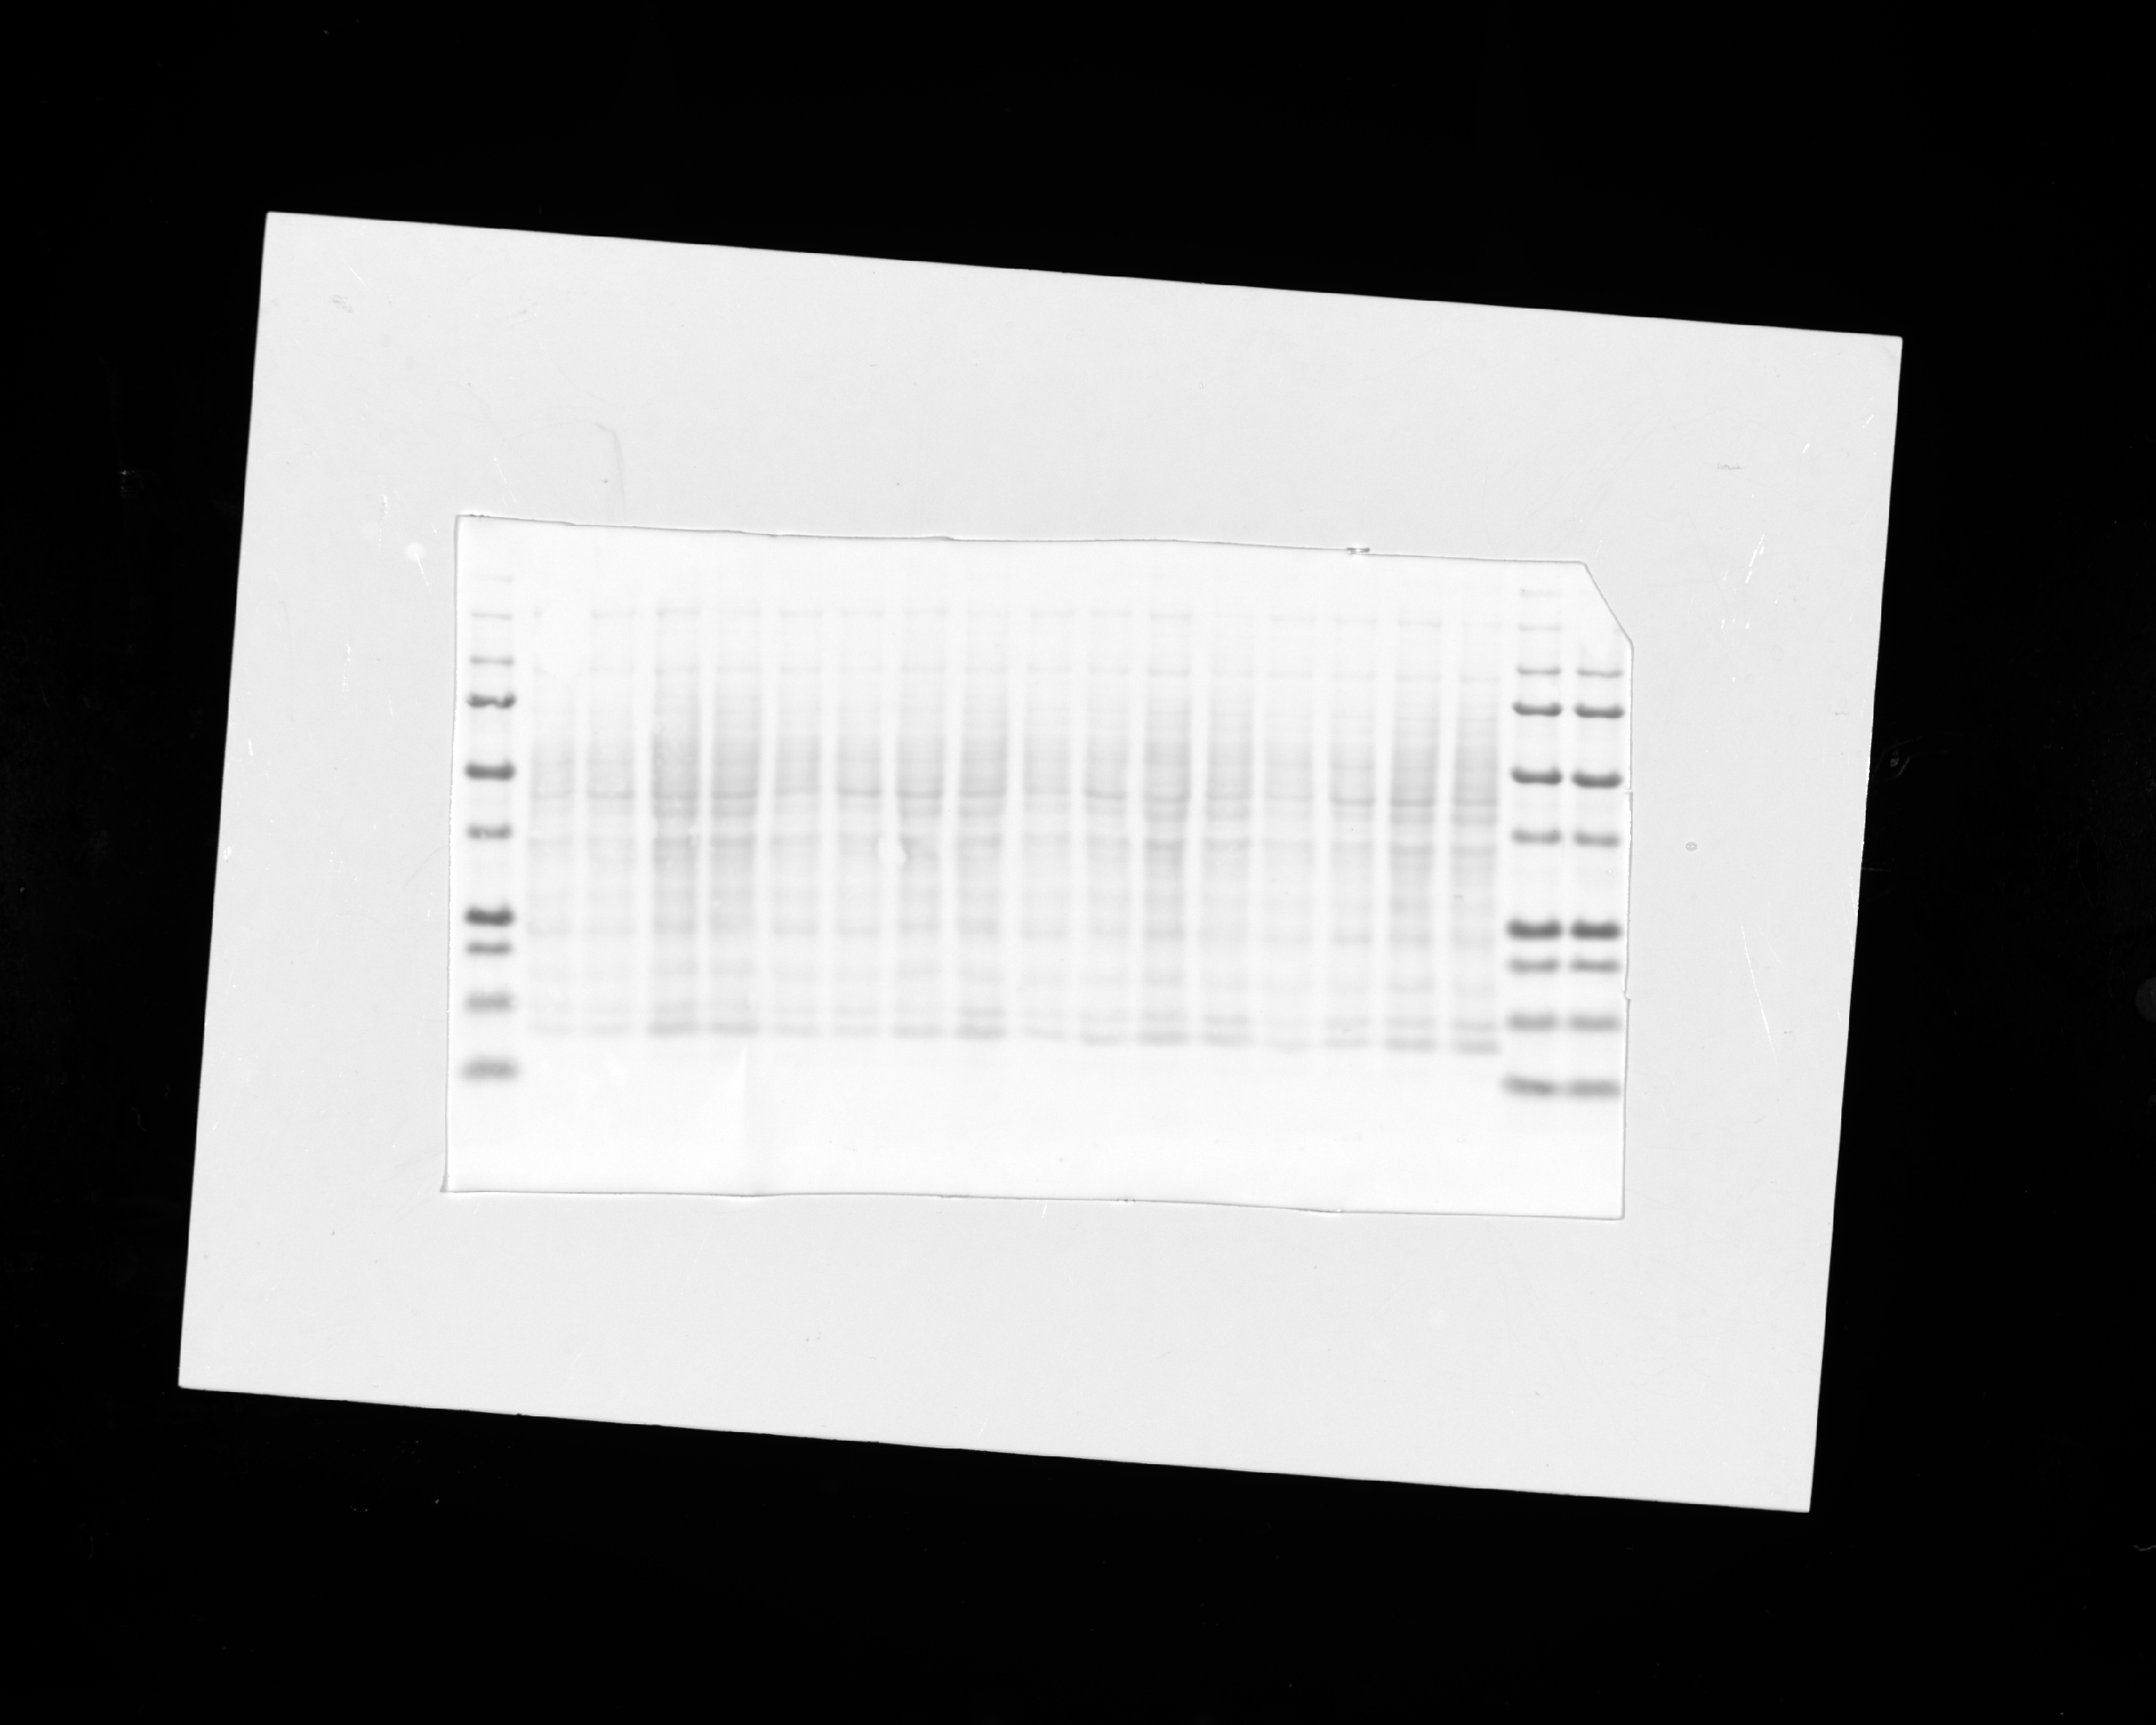
Fig.6F
Replicate 1
Replicate 2
Replicate 3
Replicate 4
ND
HFD
ND
HFD
ND
HFD
ND
HFD
W
K
W
K
W
K
W
K
W
K
W
K
W
K
W
K
PPARγ
Ponceau-S

Slide 6
Supplementary Fig.2A
Replicate 1
Replicate 2
sWAT
eWAT
Kidney
Liver
Lung
Heart
sWAT
eWAT
Kidney
Liver
Lung
Heart
W
K
W
K
W
K
W
K
W
K
W
K
W
K
W
K
W
K
W
K
W
K
W
K
PARIS(mAb)
PARIS(mAb)
PARIS(pAB)
PARIS(pAB)
Ponceau-S
Ponceau-S

Slide 7
Supplementary Fig.2A
Replicate 3
Replicate 4
sWAT
eWAT
Kidney
Liver
Lung
Heart
sWAT
eWAT
Kidney
Liver
Lung
Heart
W
K
W
K
W
K
W
K
W
K
W
K
W
K
W
K
W
K
W
K
W
K
W
K
PARIS(mAb)
PARIS(mAb)
PARIS(pAB)
PARIS(pAB)
Ponceau-S
Ponceau-S

Slide 8
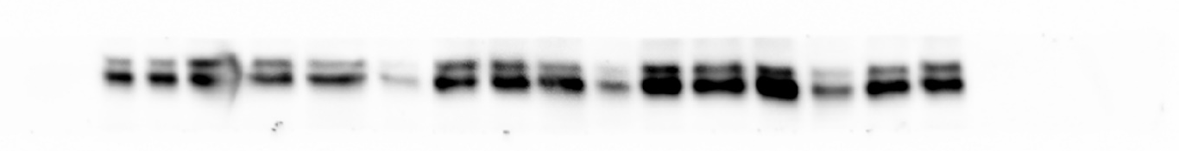
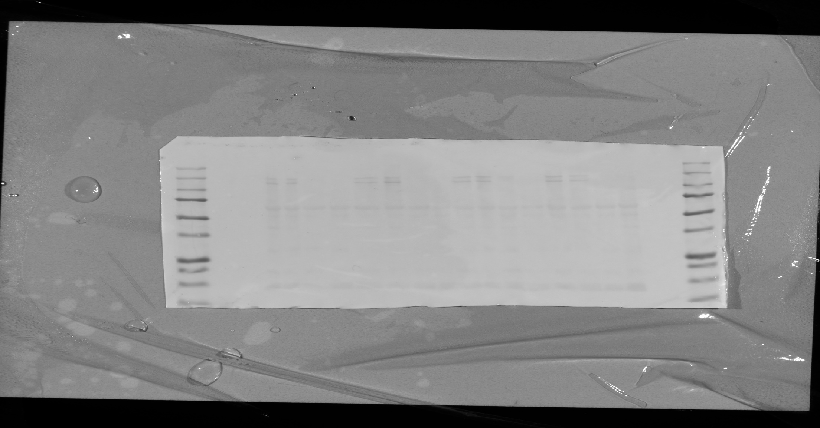
Supplementary Fig.3E
Replicate 1
Replicate 2
Replicate 3
Replicate 4
sWAT
eWAT
sWAT
eWAT
sWAT
eWAT
sWAT
eWAT
W
K
W
K
W
K
W
K
W
K
W
K
W
K
W
K
Ponceau-S

Slide 9
Supplementary Fig.4B
Replicate 1
Replicate 2
Replicate 3
Replicate 4
ND
HFD
ND
HFD
ND
HFD
ND
HFD
W
K
W
K
W
K
W
K
W
K
W
K
W
K
W
K
PPARγ
Ponceau-S

