Slide 1
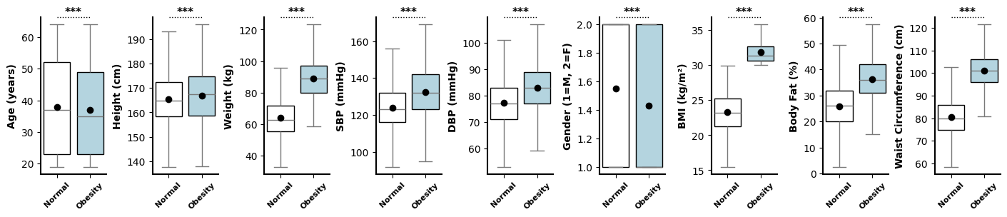
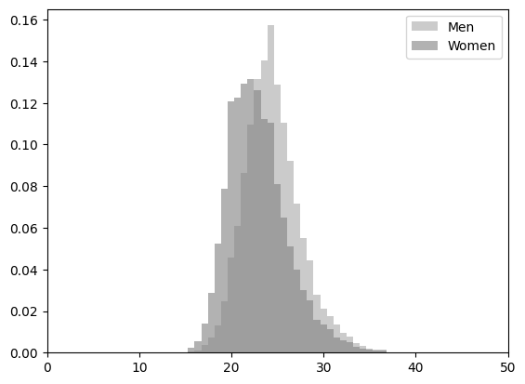
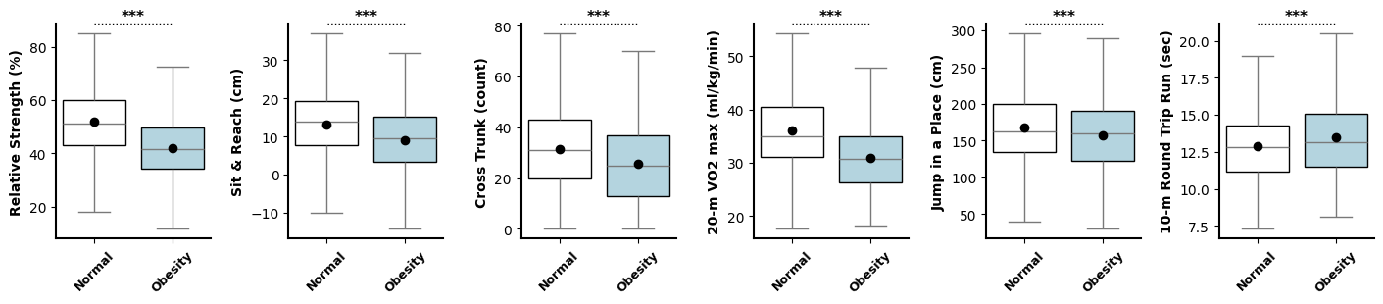
Supplement 1.
(a) Basic Characteristics of Normal and Obese Subjects
(b) Physical Fitness Factors of Normal and Obese Subjects

Slide 2
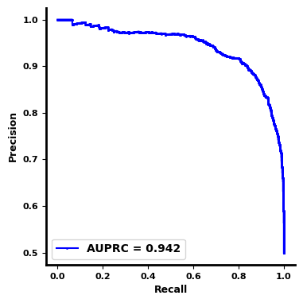
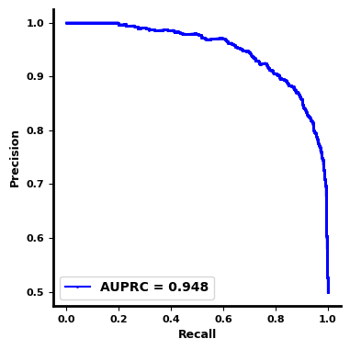

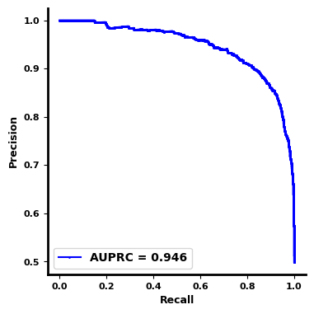
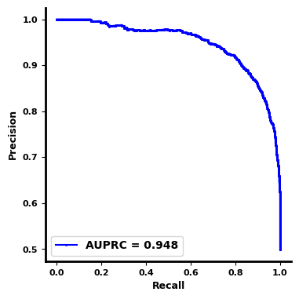
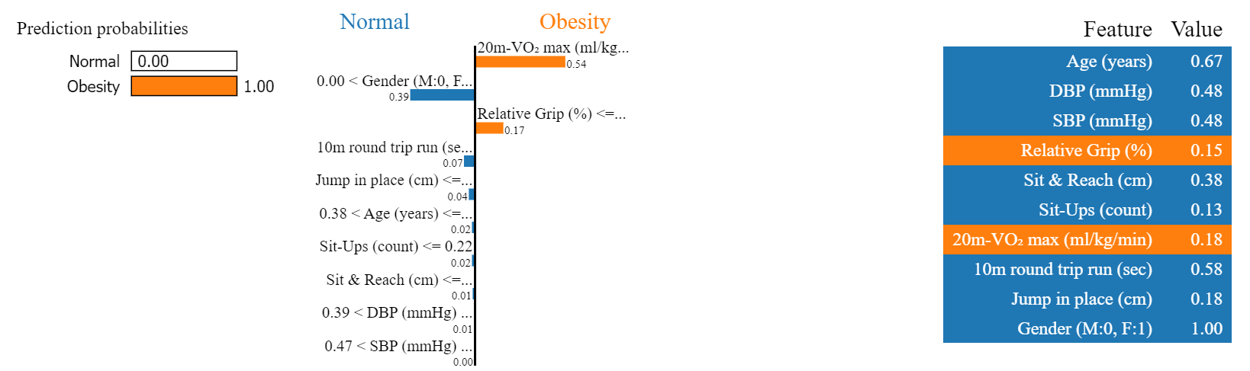
Supplement 2.
(a) Precision-recall Curves of the Five Stratified K-fold Analysis
Fold 1
Fold 2
Fold 3
Fold 4
Fold 5
(b) Results of LIME Analysis Obtained Using the Optimized Neural Network Model

