Slide 1
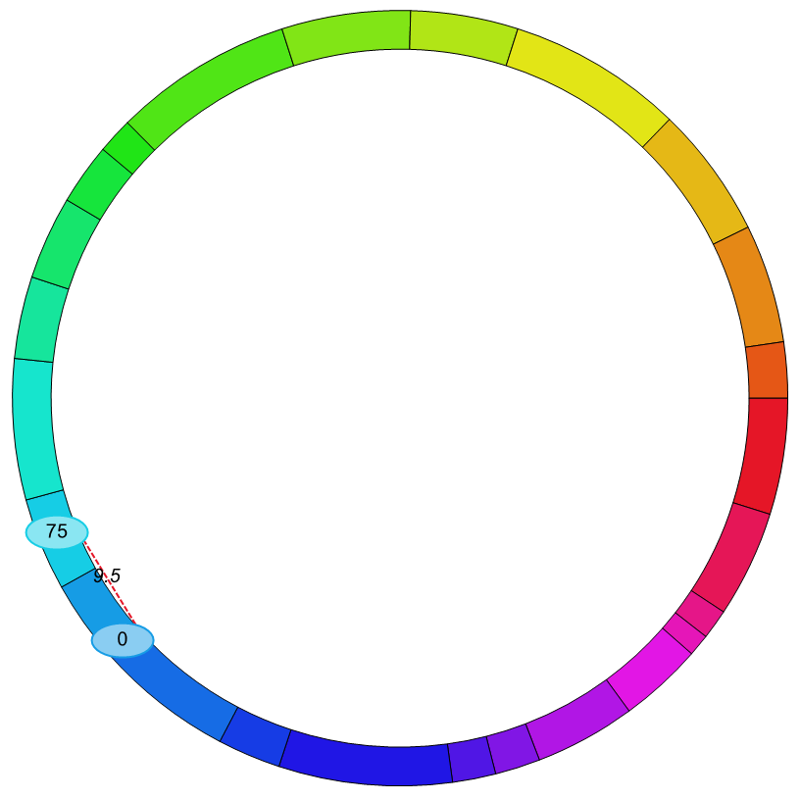
Fig. S1
Linkage group 2
(PbcFDC-chr4B)
Linkage group 1
(Pbc1-chr3B)
The epistasis mapping for PBC using the function of ICIM-EPI in Icimapping 4.1

