Slide 1
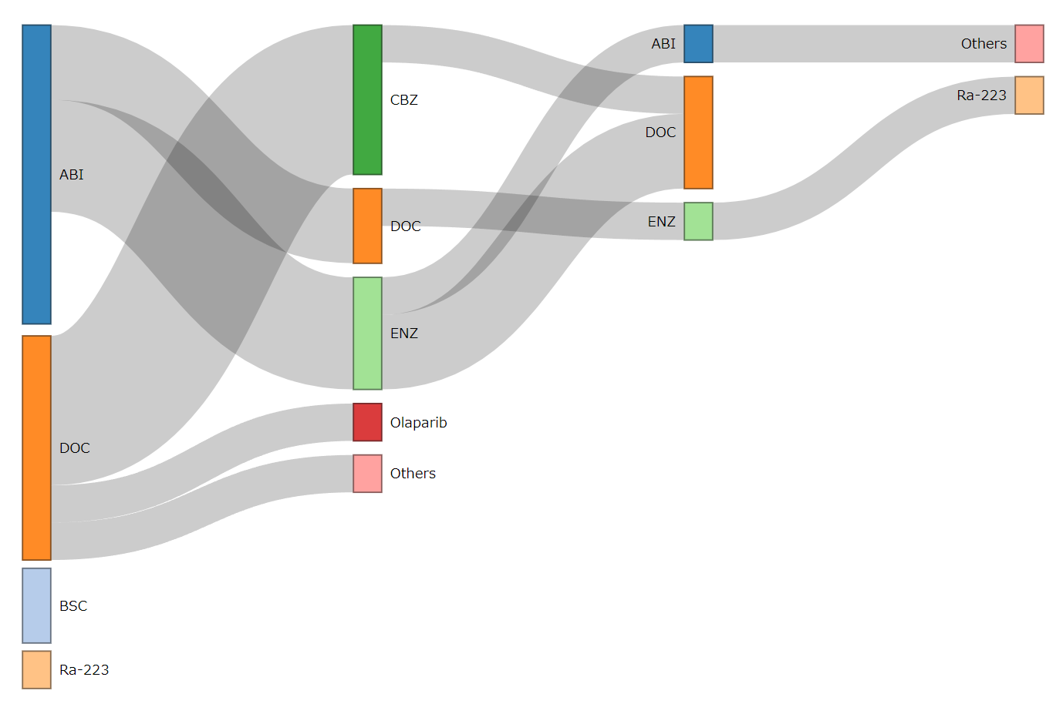
Additional file1.
n=16
n=10
n=5
n=2
1
ABI
1
Others
Ra-223
3
1
3
DOC
8
ENZ
2
1
3
1
5
1
2
1

Slide 2
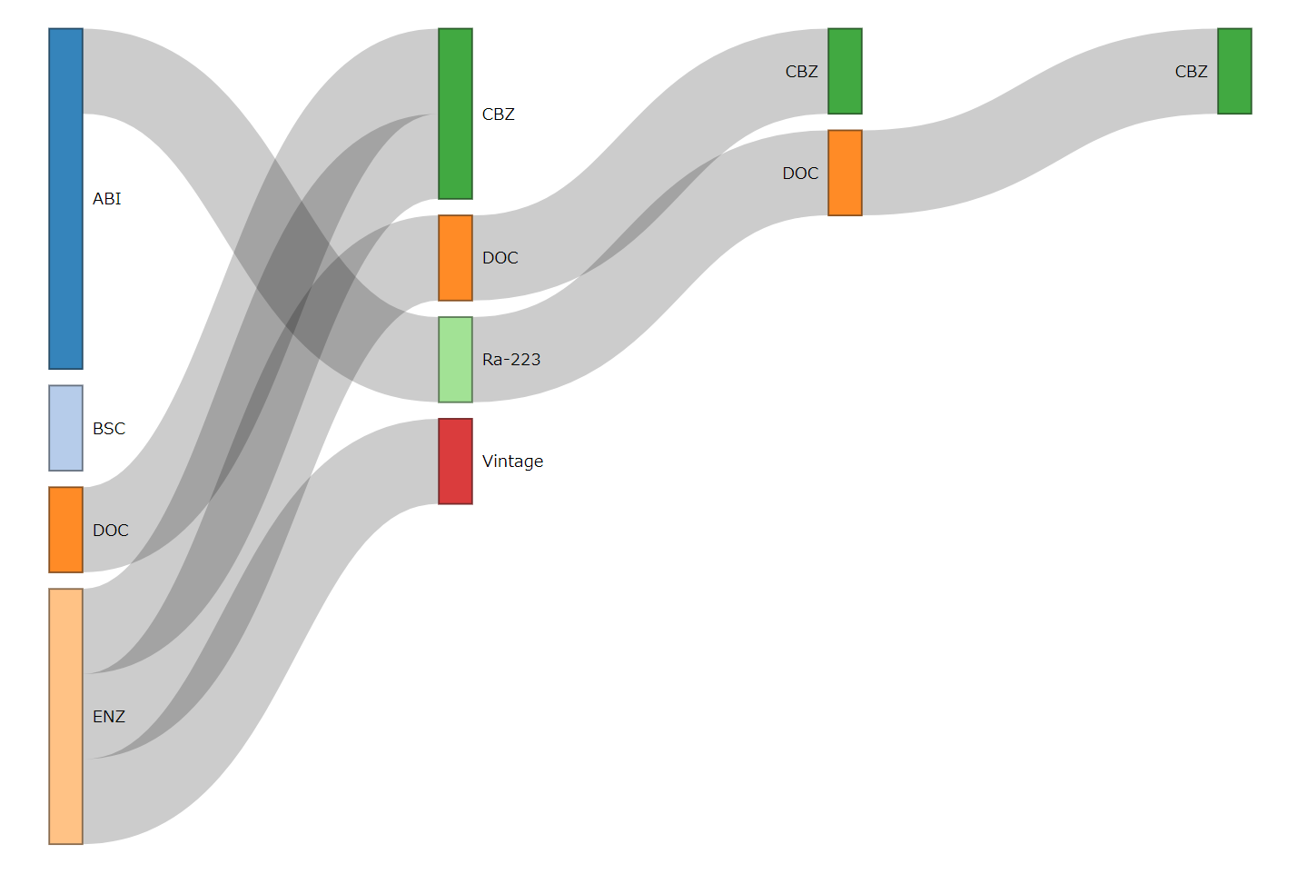
Additional file2.
n=10
n=5
n=2
n=1
CBZ
CBZ
1
1
2
1
4
DOC
1
1
1
1
1
3
1

