Slide 1
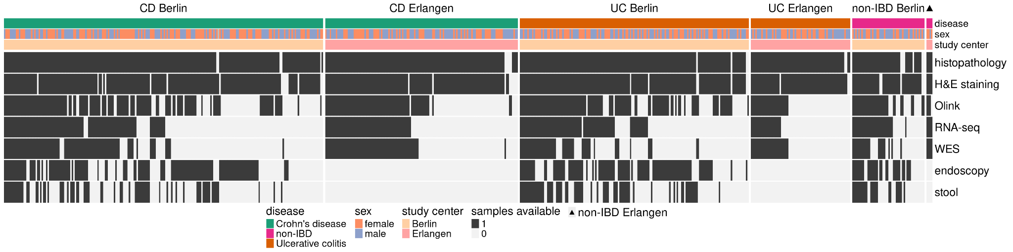
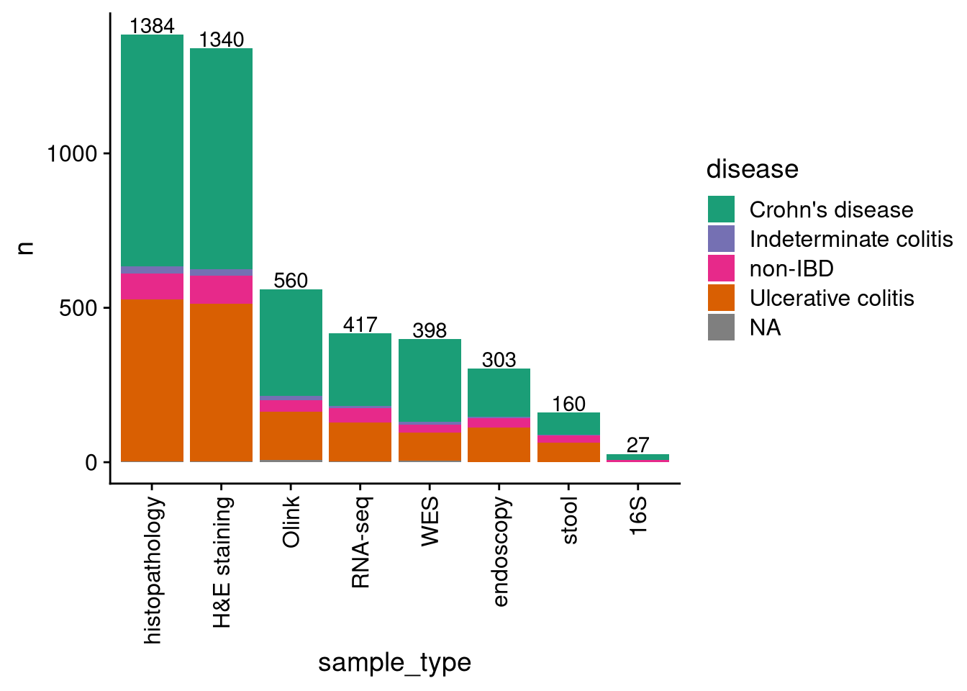
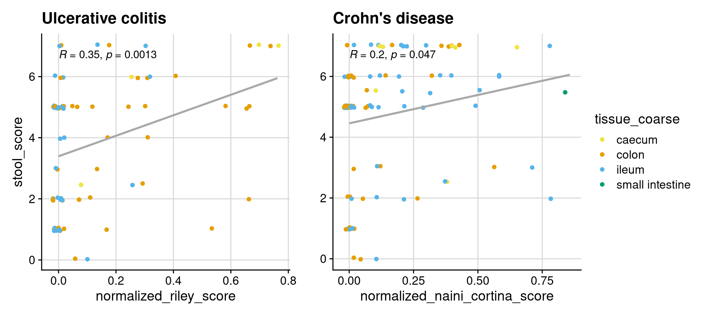
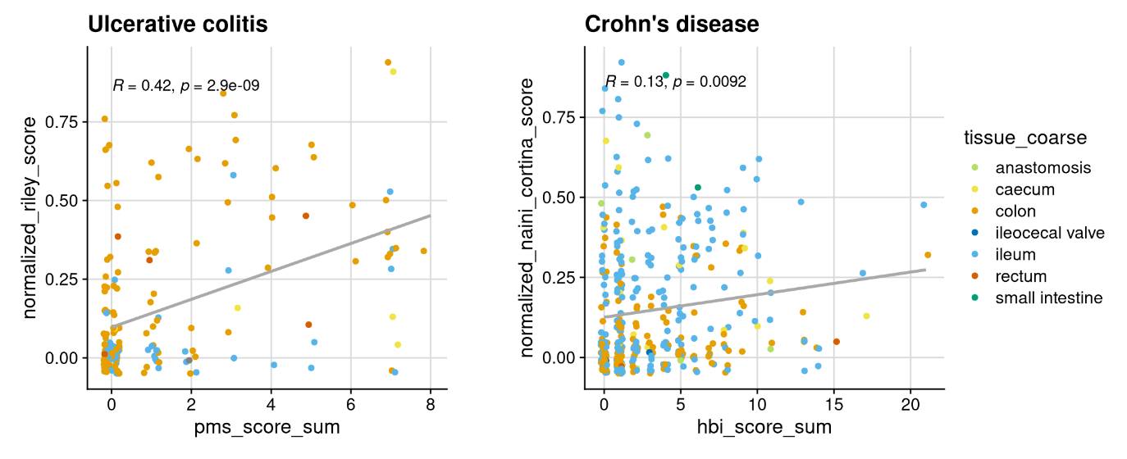
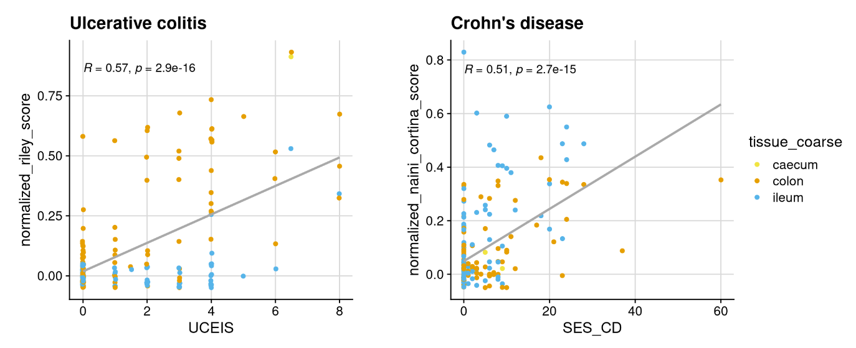
a
b
c
d
e
Extended Data Fig. 1| IBDome overview. a, Cohort distribution illustrated in a heatmap showing the available samples per patient. The heatmap is split by disease and study center and ordered according to the amount of different sample types available per patient. b, Number of samples per sample type; colors are representing the different diseases and number on top of the graphs are depicting the total sample numbers c, Correlation between histopathology (normalized Riley score and normalized Naini-Cortina score) and the Bristol stool score. d, Correlation between histopathology (normalized Riley score and normalized Naini-Cortina score) and clinical activity scores (PMS= Partial Mayo Score, HBI=Harvey-Bradshaw Index) for UC and CD, respectively. e, Correlation between endoscopic (UCEIS = Ulcerative Colitis Endoscopic Index of Severity, SES-CD = Simple Endoscopic Score for Crohn’s Disease) and histopathology scores for UC and CD, respectively.

Slide 2
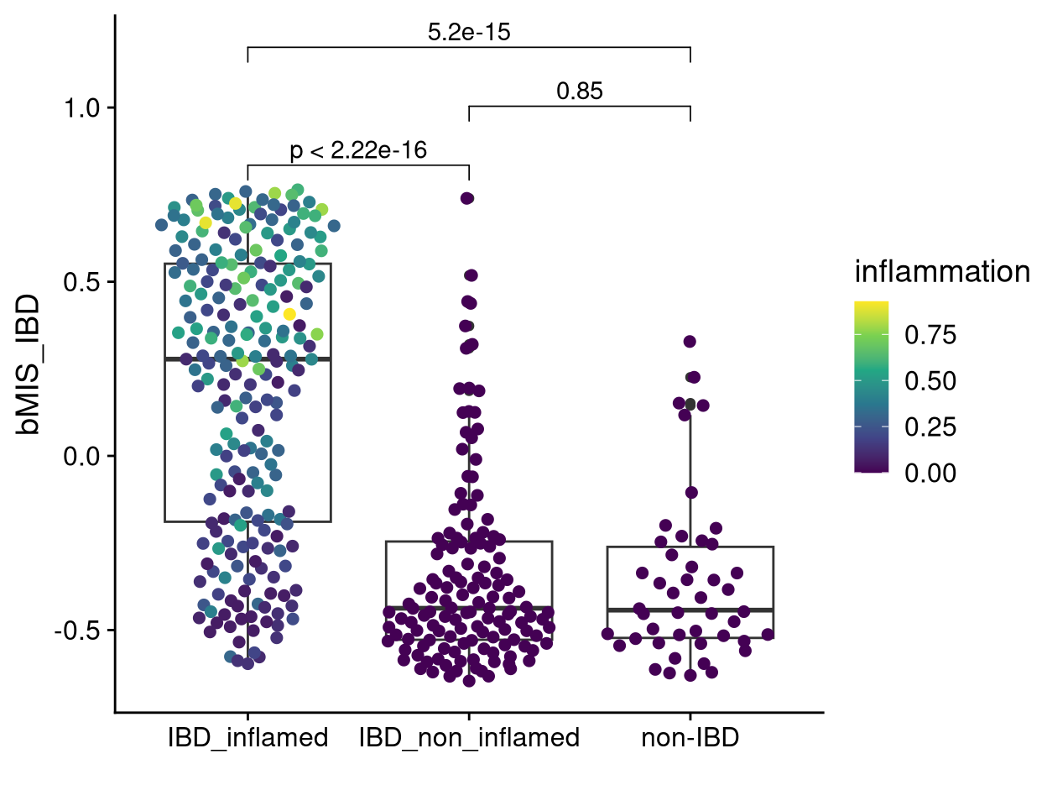
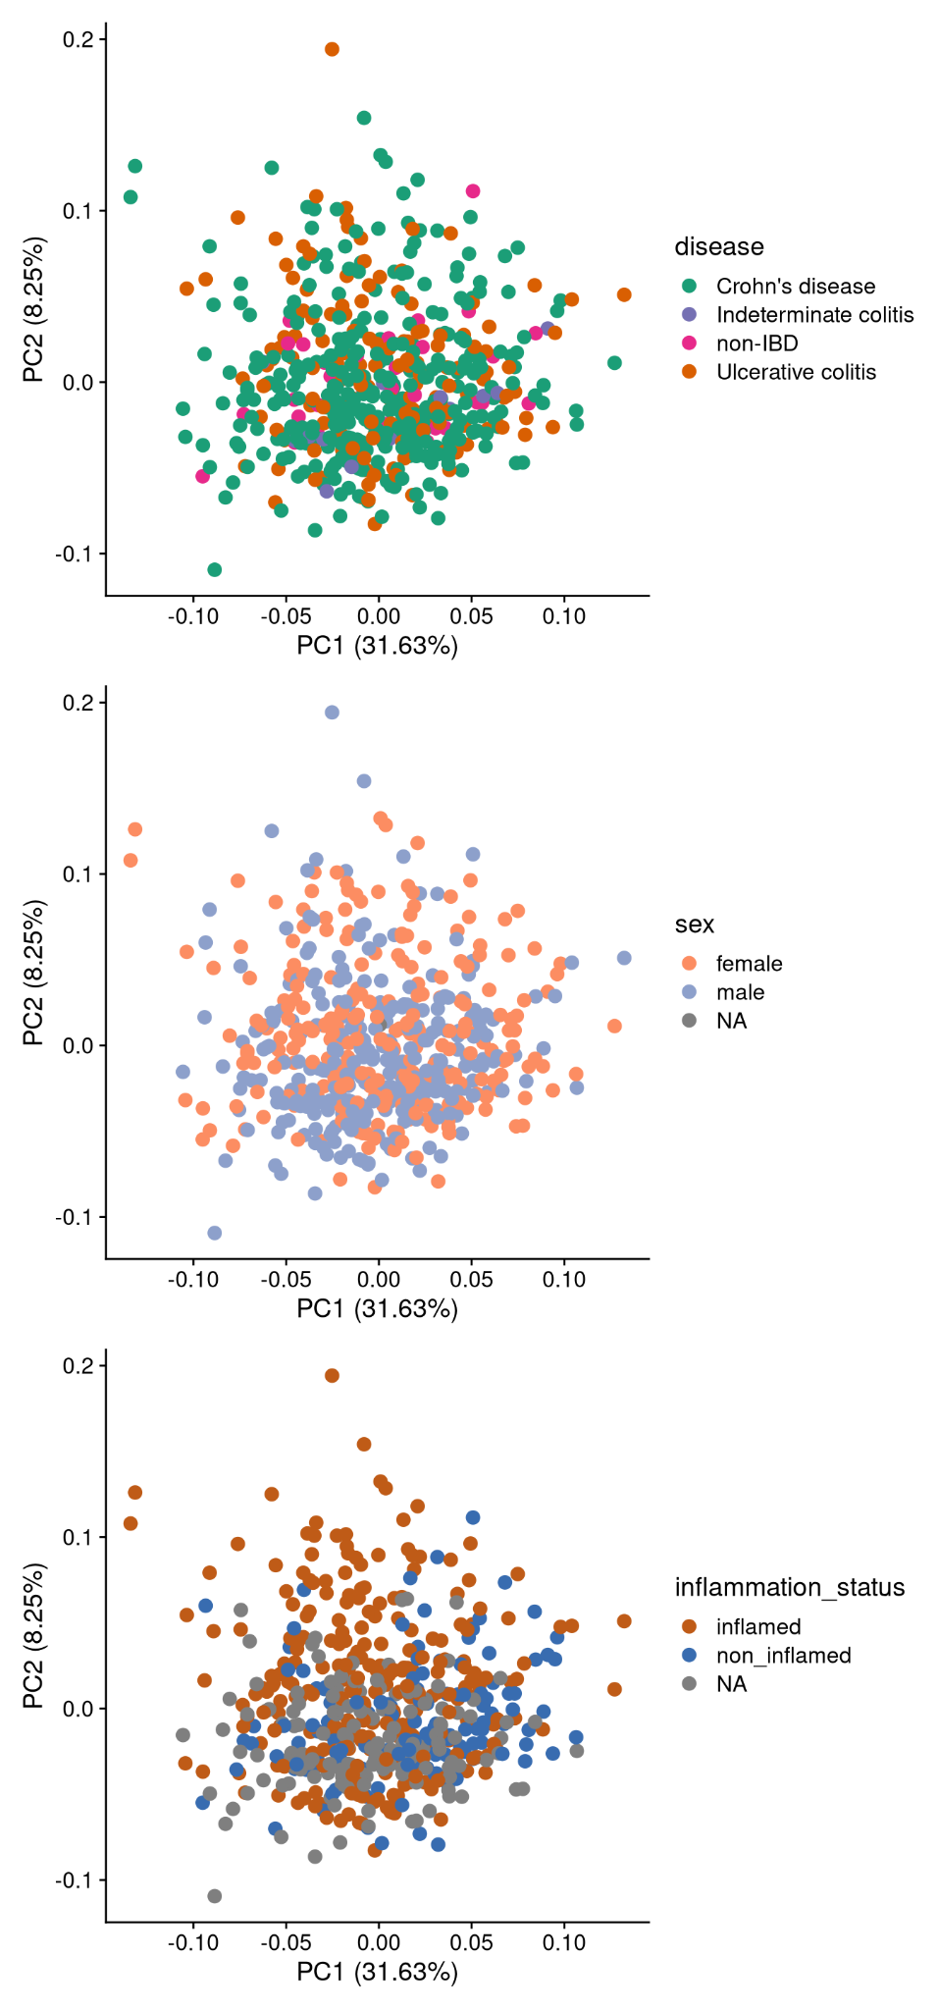
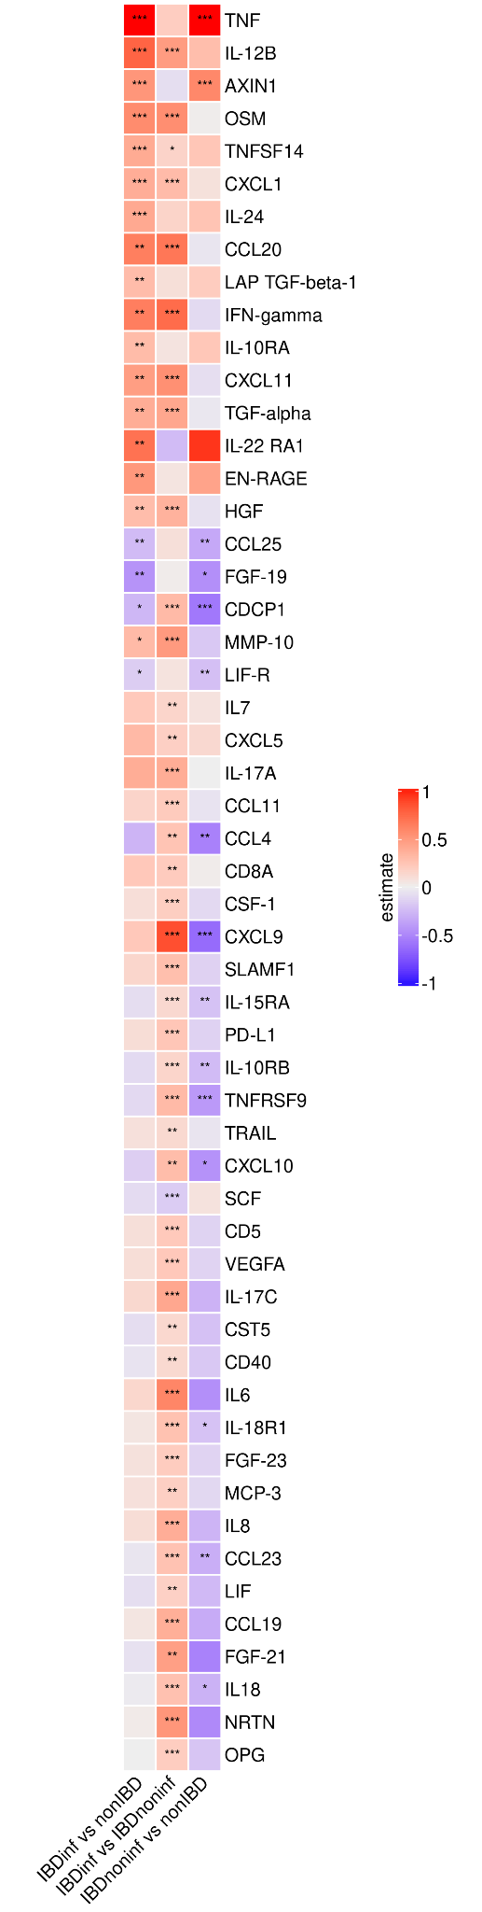
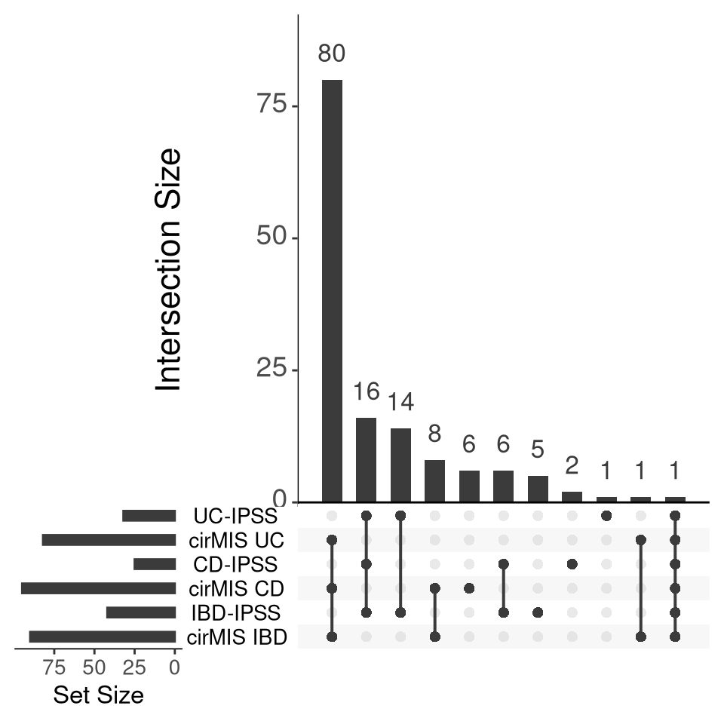
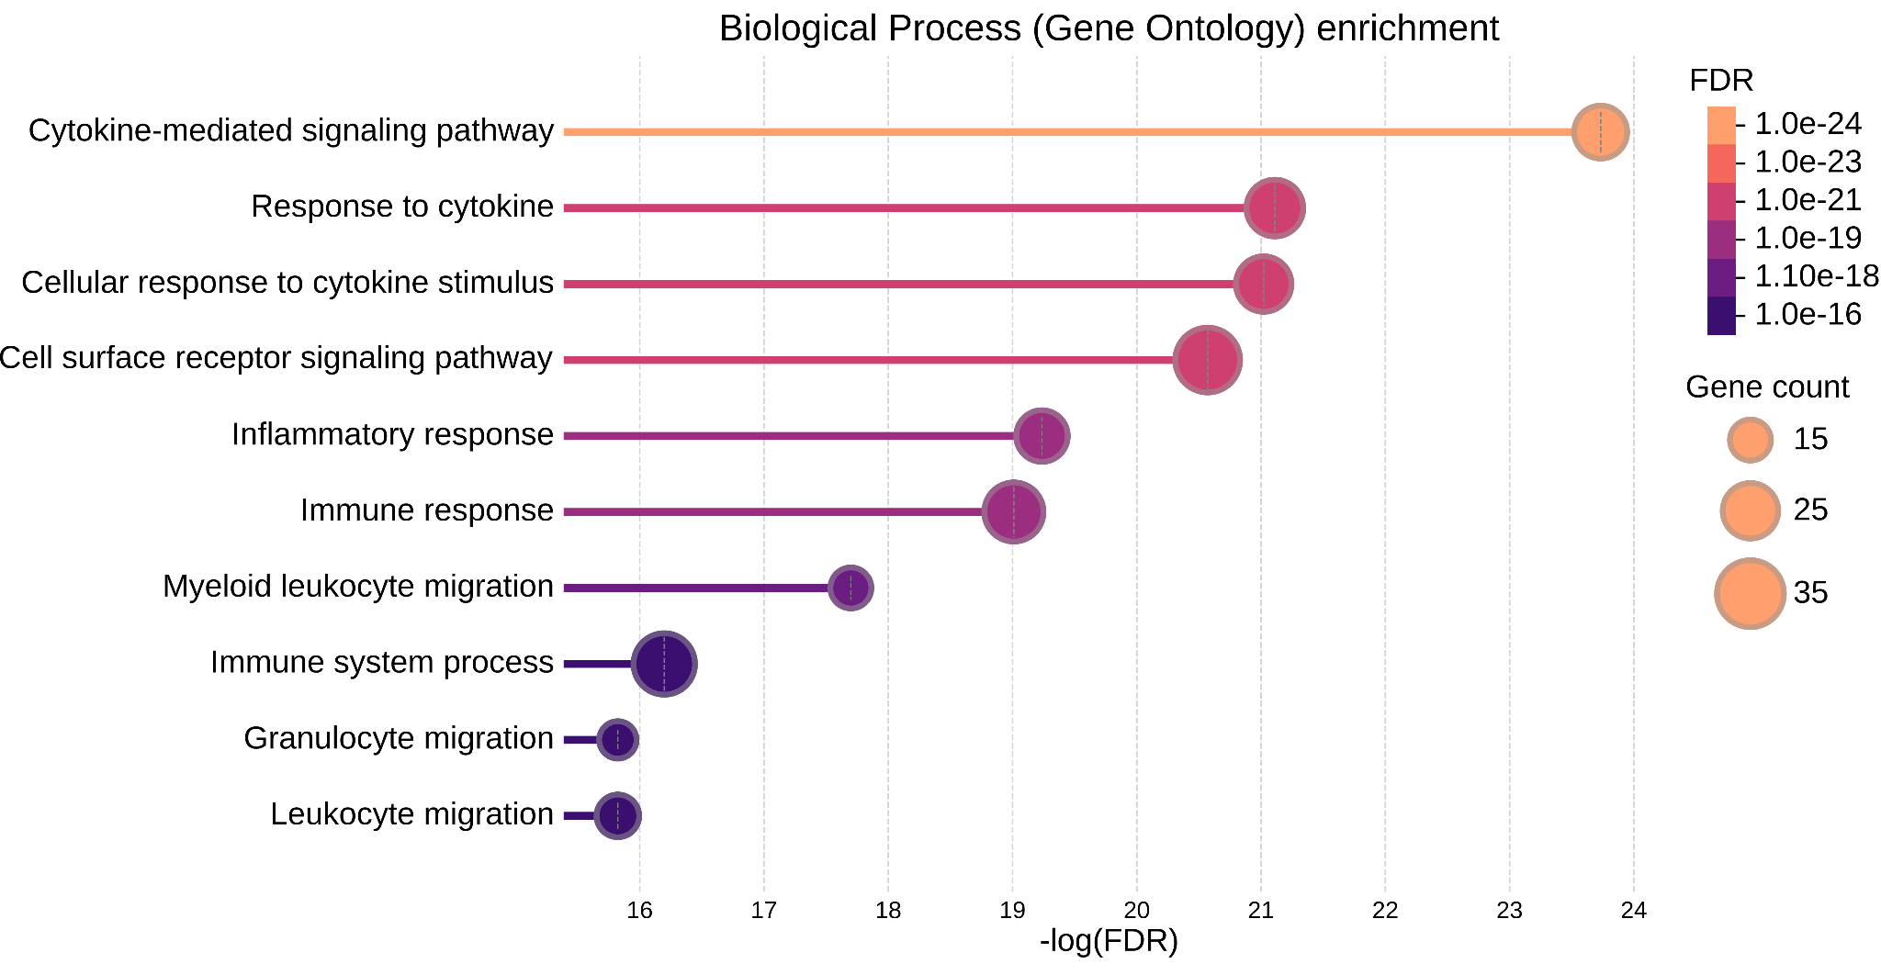
a
b
e
c
OSM
d
Extended Data Fig. 2| Protein abundance in the serum. a, Biopsy-based molecular inflammation scores (bMIS-IBD) across different groups, calculated using Gene Set Variation Analysis (GSVA); p-values were assessed using the Wilcoxon test. The color depicts the normalized inflammation score assessed by histopathology (modified Riley score for UC and modified Naini Cortina score for CD). b, Principal Component Analysis (PCA) of serum protein abundances, colored by disease type, sex, and inflammation status c, UpSet plot showing the intersection of different blood-based scores (cirMIS = circulating molecular inflammation score from RNA-seq from the blood, IPSS = inflammatory protein severity signature from serum proteins) highlighting OSM as the only protein shared across all signatures. d, Significantly enriched Gene Ontology - Biological Processes (GO-BP) terms (FDR < 0.05) from over representation analysis (ORA) in the IBD-IPSS. e, Heatmap of the differentially abundant proteins with significance levels determined by t-test: *** = adj.p<0.01, ** = adj.p < 0.05, * = adj.p < 0.1; “estimate” represent the numeric difference in mean NPX (normalized protein expression; Olink’s arbitrary unit) between groups.

Slide 3
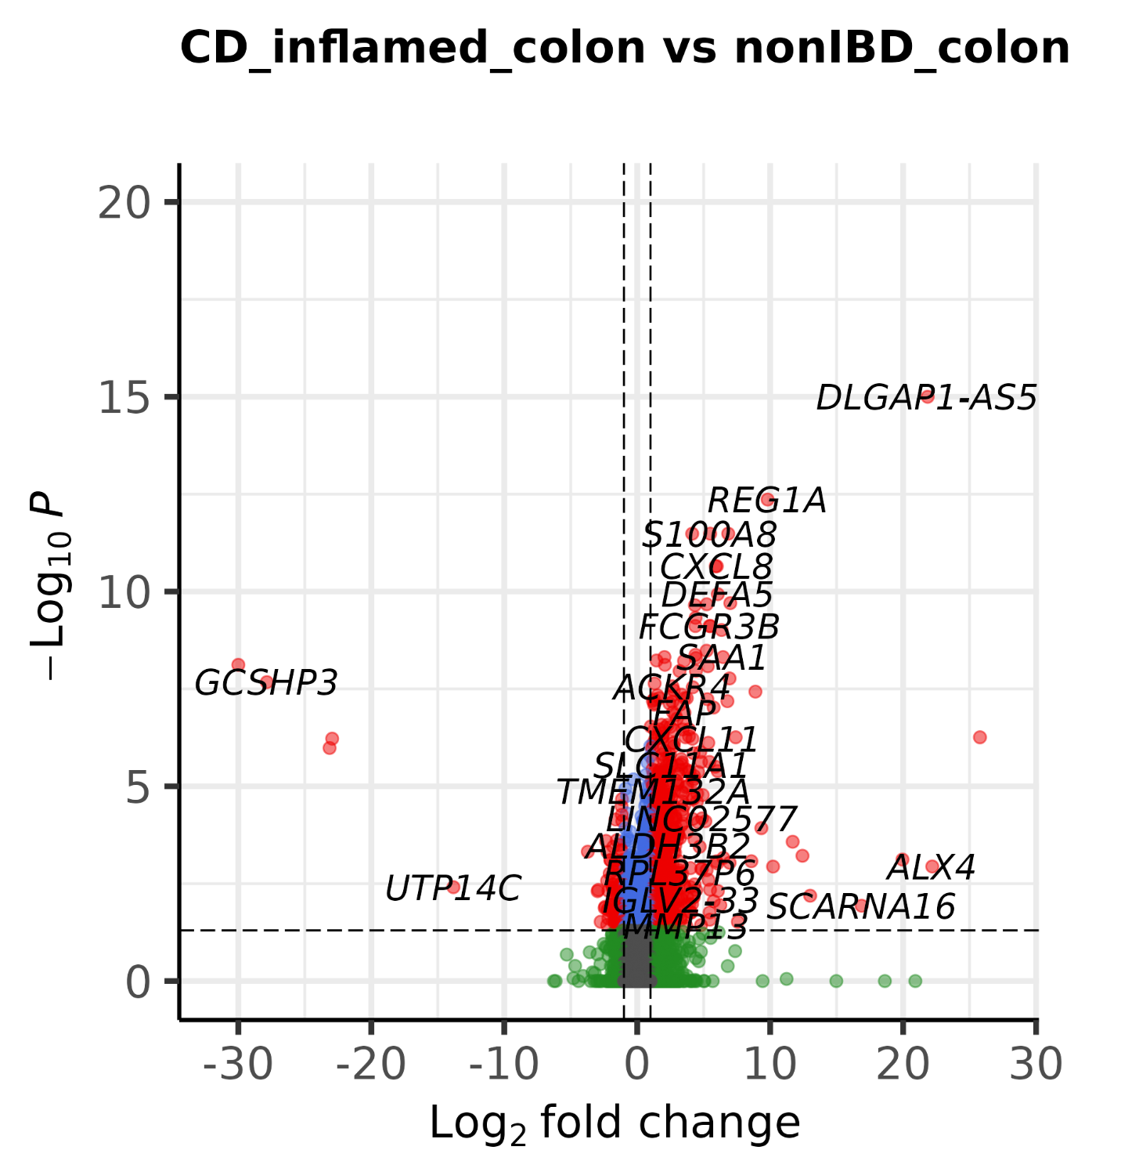
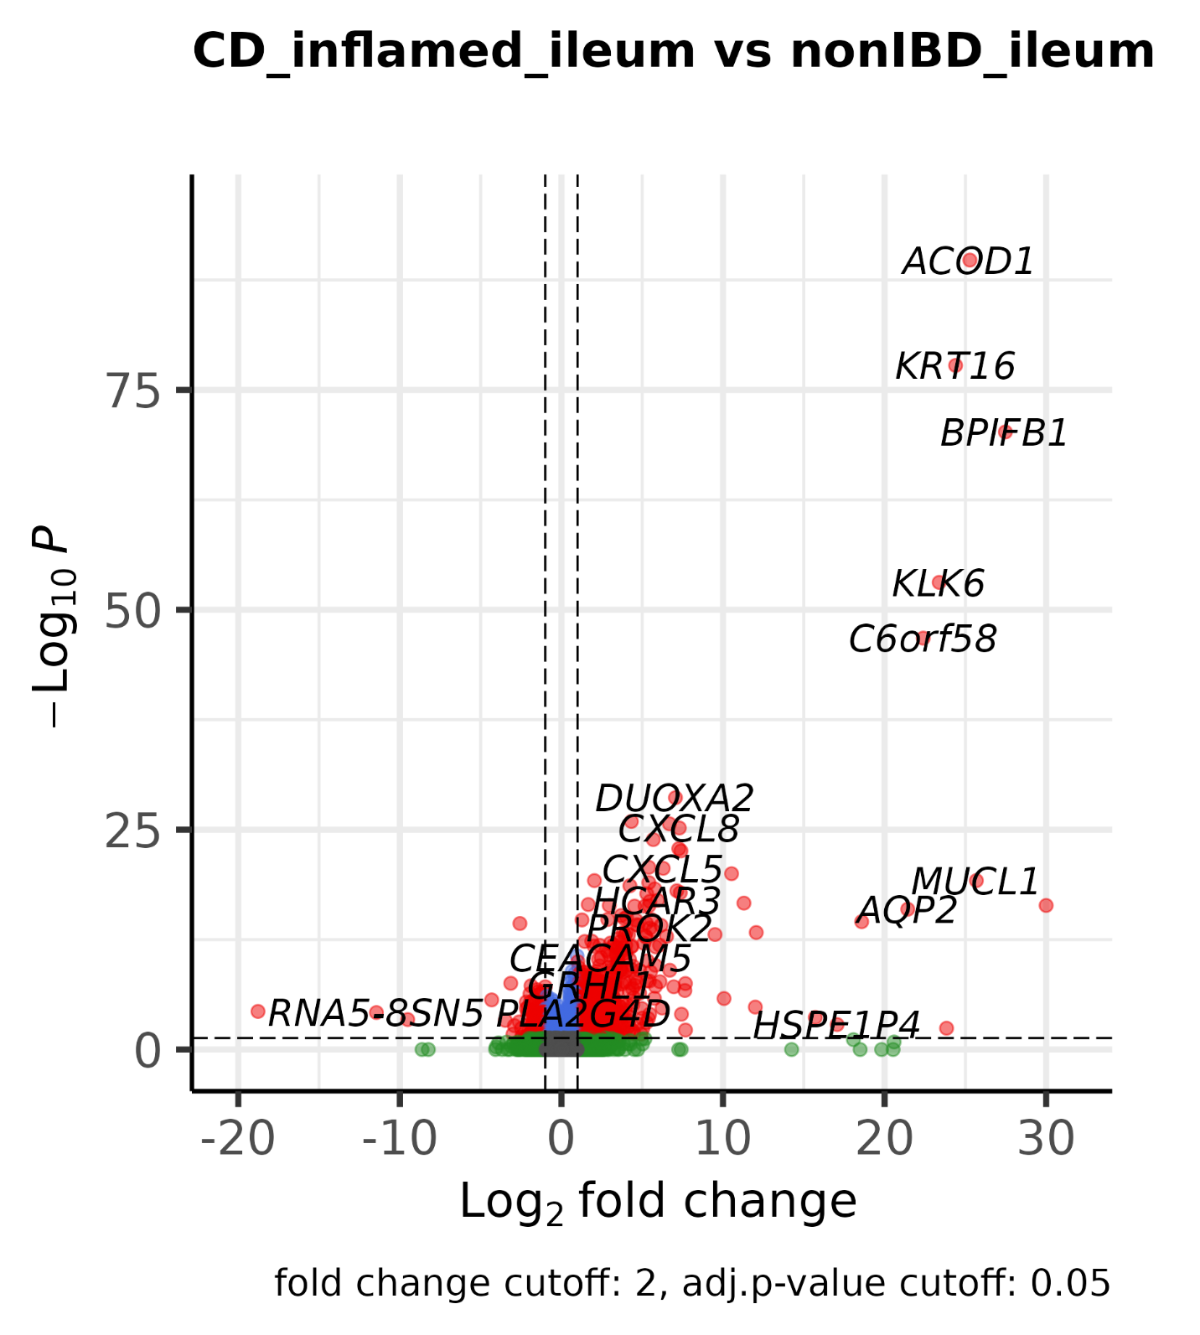
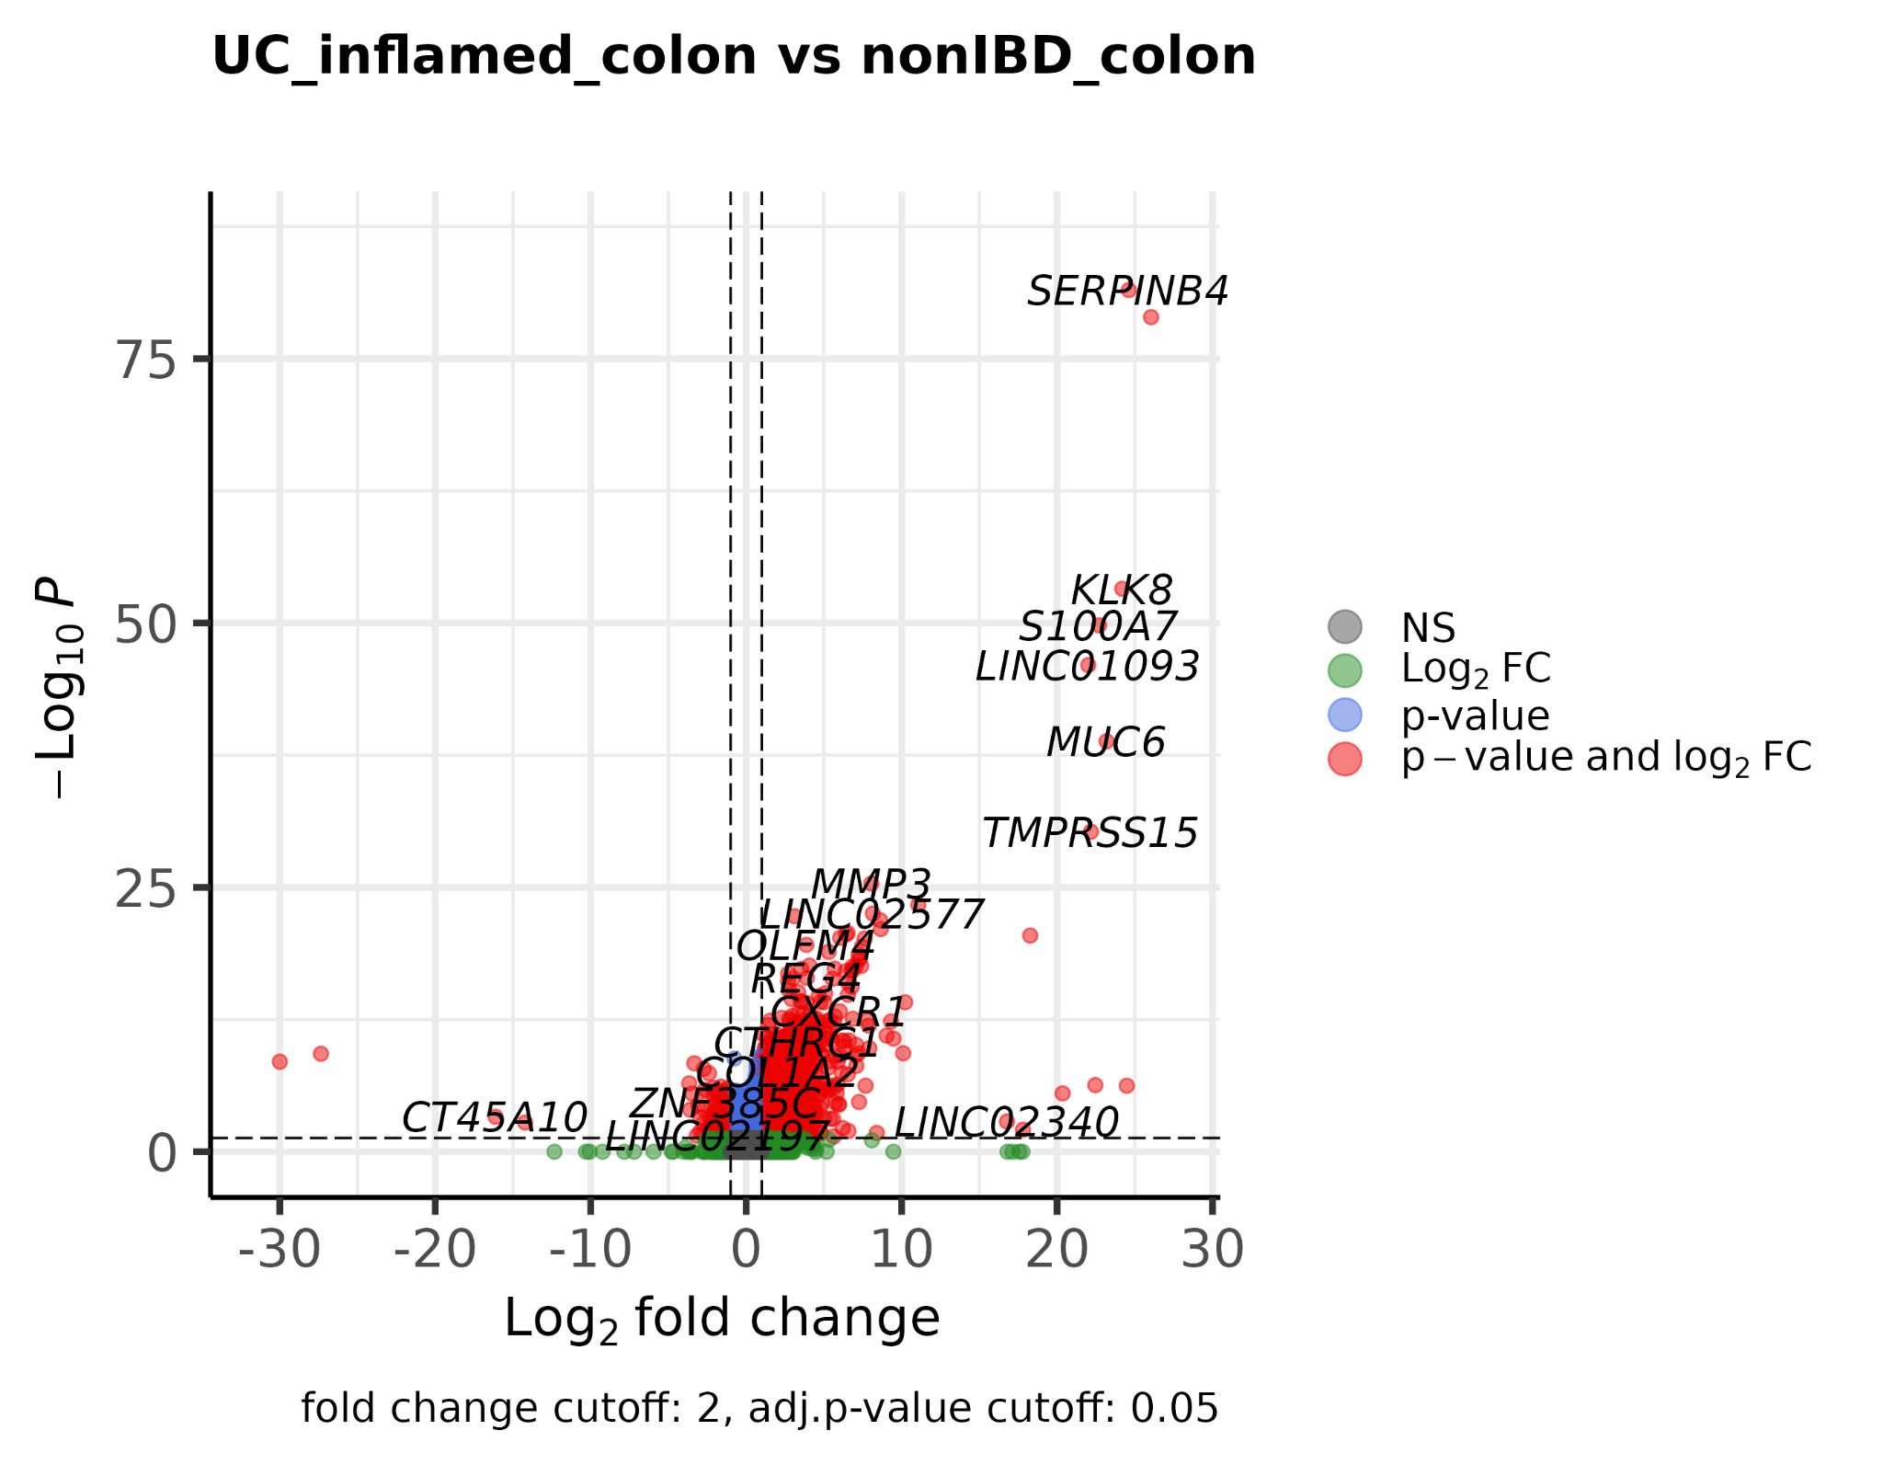
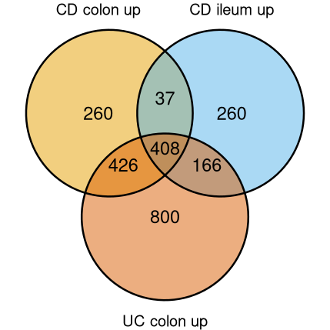
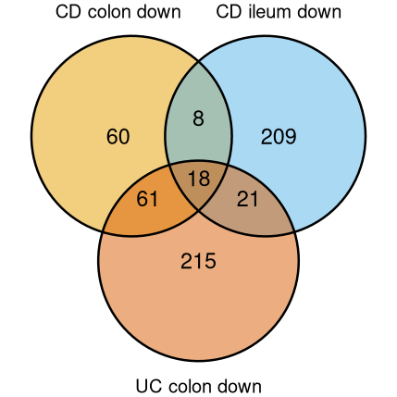
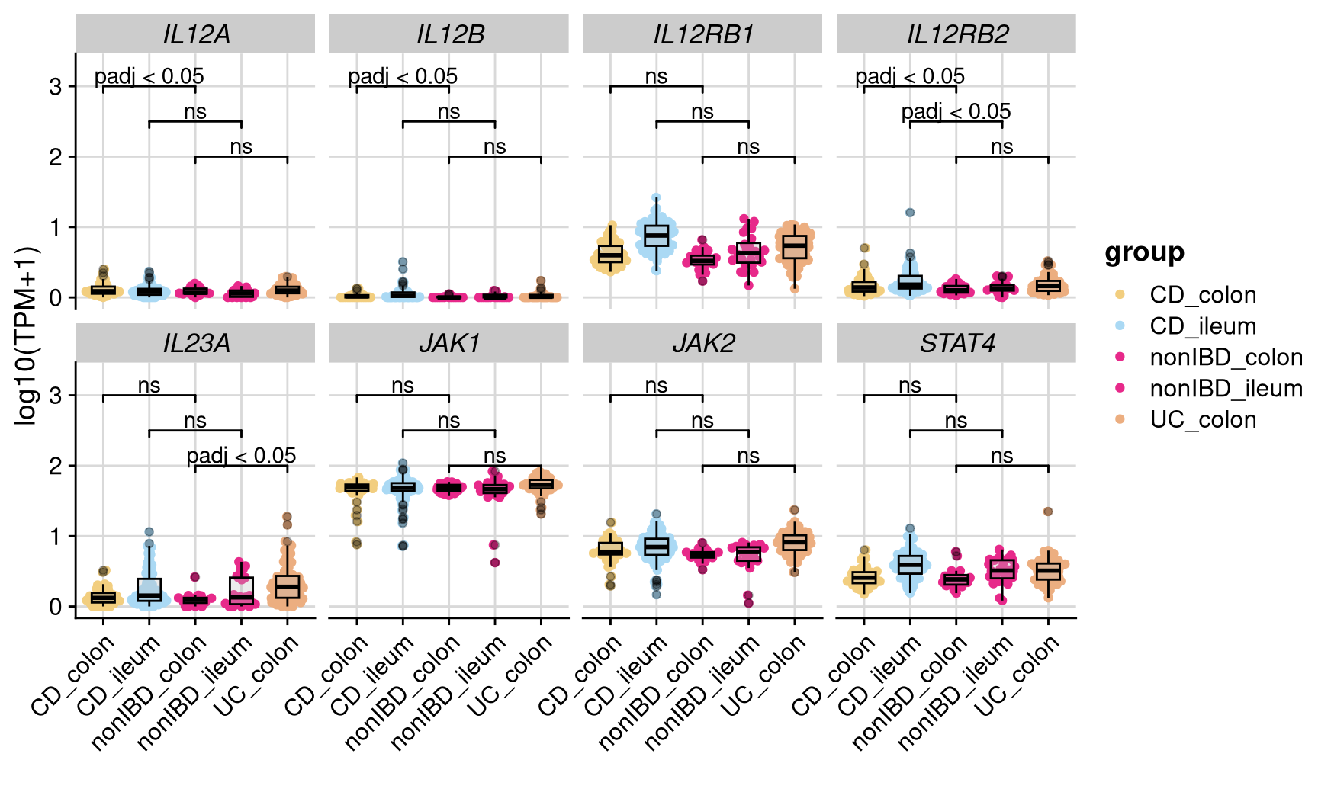
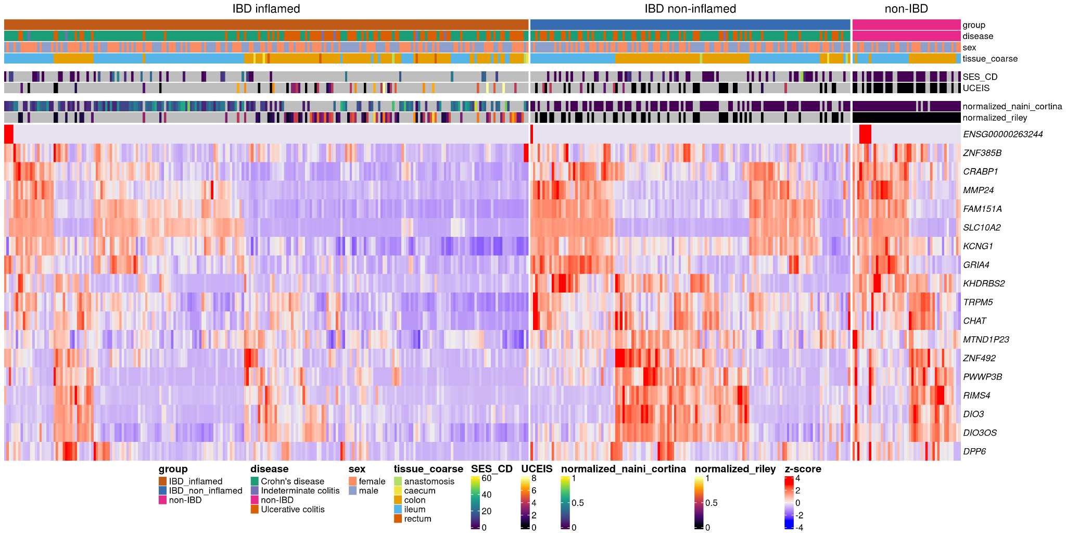
a
b
d
c
Extended Data Fig. 3| Transcriptional characterization. a, Volcano plots displaying the DE analysis results of inflamed CD vs. non-IBD colon samples, inflamed CD vs. non-IBD ileum samples and inflamed UC colon vs. non-IBD colon samples with thresholds: |log2FC| > 1 and adjusted p-value < 0.05. b) Overlap of significantly upregulated and downregulated genes in the different comparisons. c, Heatmap displaying the gene expression of the commonly downregulated genes (n=18) across the different groups (inflamed IBD, non-inflamed IBD and non-IBD) clustered by euclidean distance and complete linkage. d, Gene expression of genes involved in the IL12 signaling pathway with adjusted p-values retrieved from the differential expression analysis with DESeq2.

Slide 4
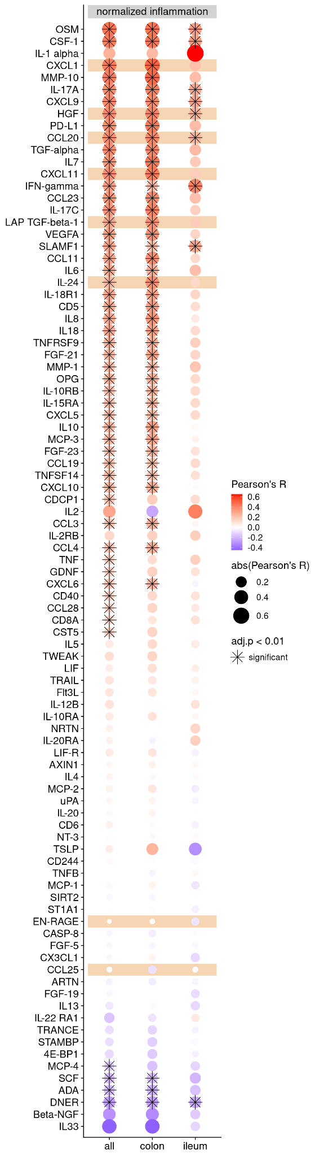
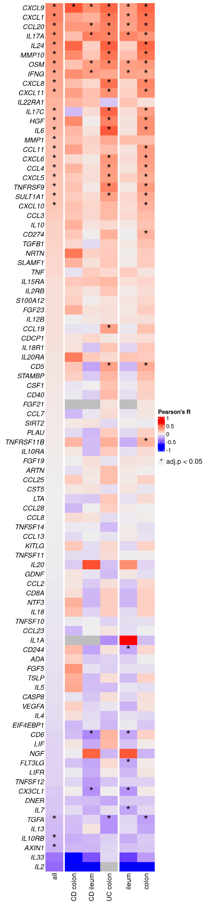
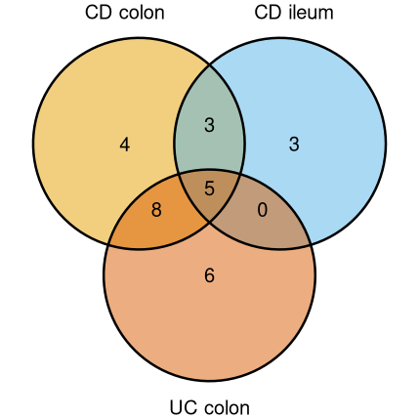
a
b
c
↑IFN-gamma
↓FGF-19
↓CCL4
↑CCL20
↑CXCL1
↑CXCL11
↑EN-RAGE
↑HGF
↑IL-24
↑LAP TGF-beta-1
↓CCL25
Extended Data Fig. 4| Correlation of serum proteins. a, Venn diagram depicting the intersections of differential abundant proteins in the different comparisons. b, Dot plot of Pearson correlation coefficients (R) between serum protein abundance and histopathology scores (normalized inflammation = normalized modified Riley or normalized modified Naini Cortina score) across all samples and the tissue groups; adjusted p-value cutoff: 0.01; c, Heatmap of Pearson correlation coefficients between serum protein abundance and tissue gene expression across all samples (n=335) and splitted by group and tissue; * adjusted p-value <0.05.

Slide 5
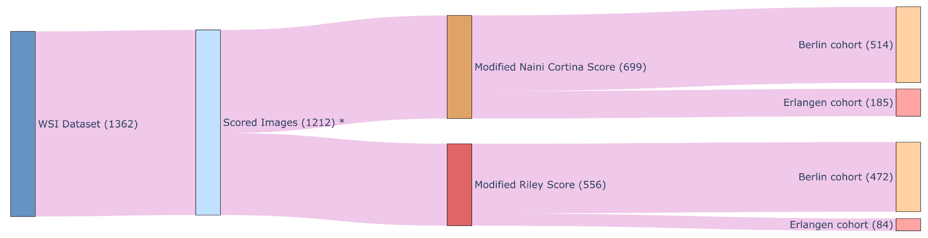
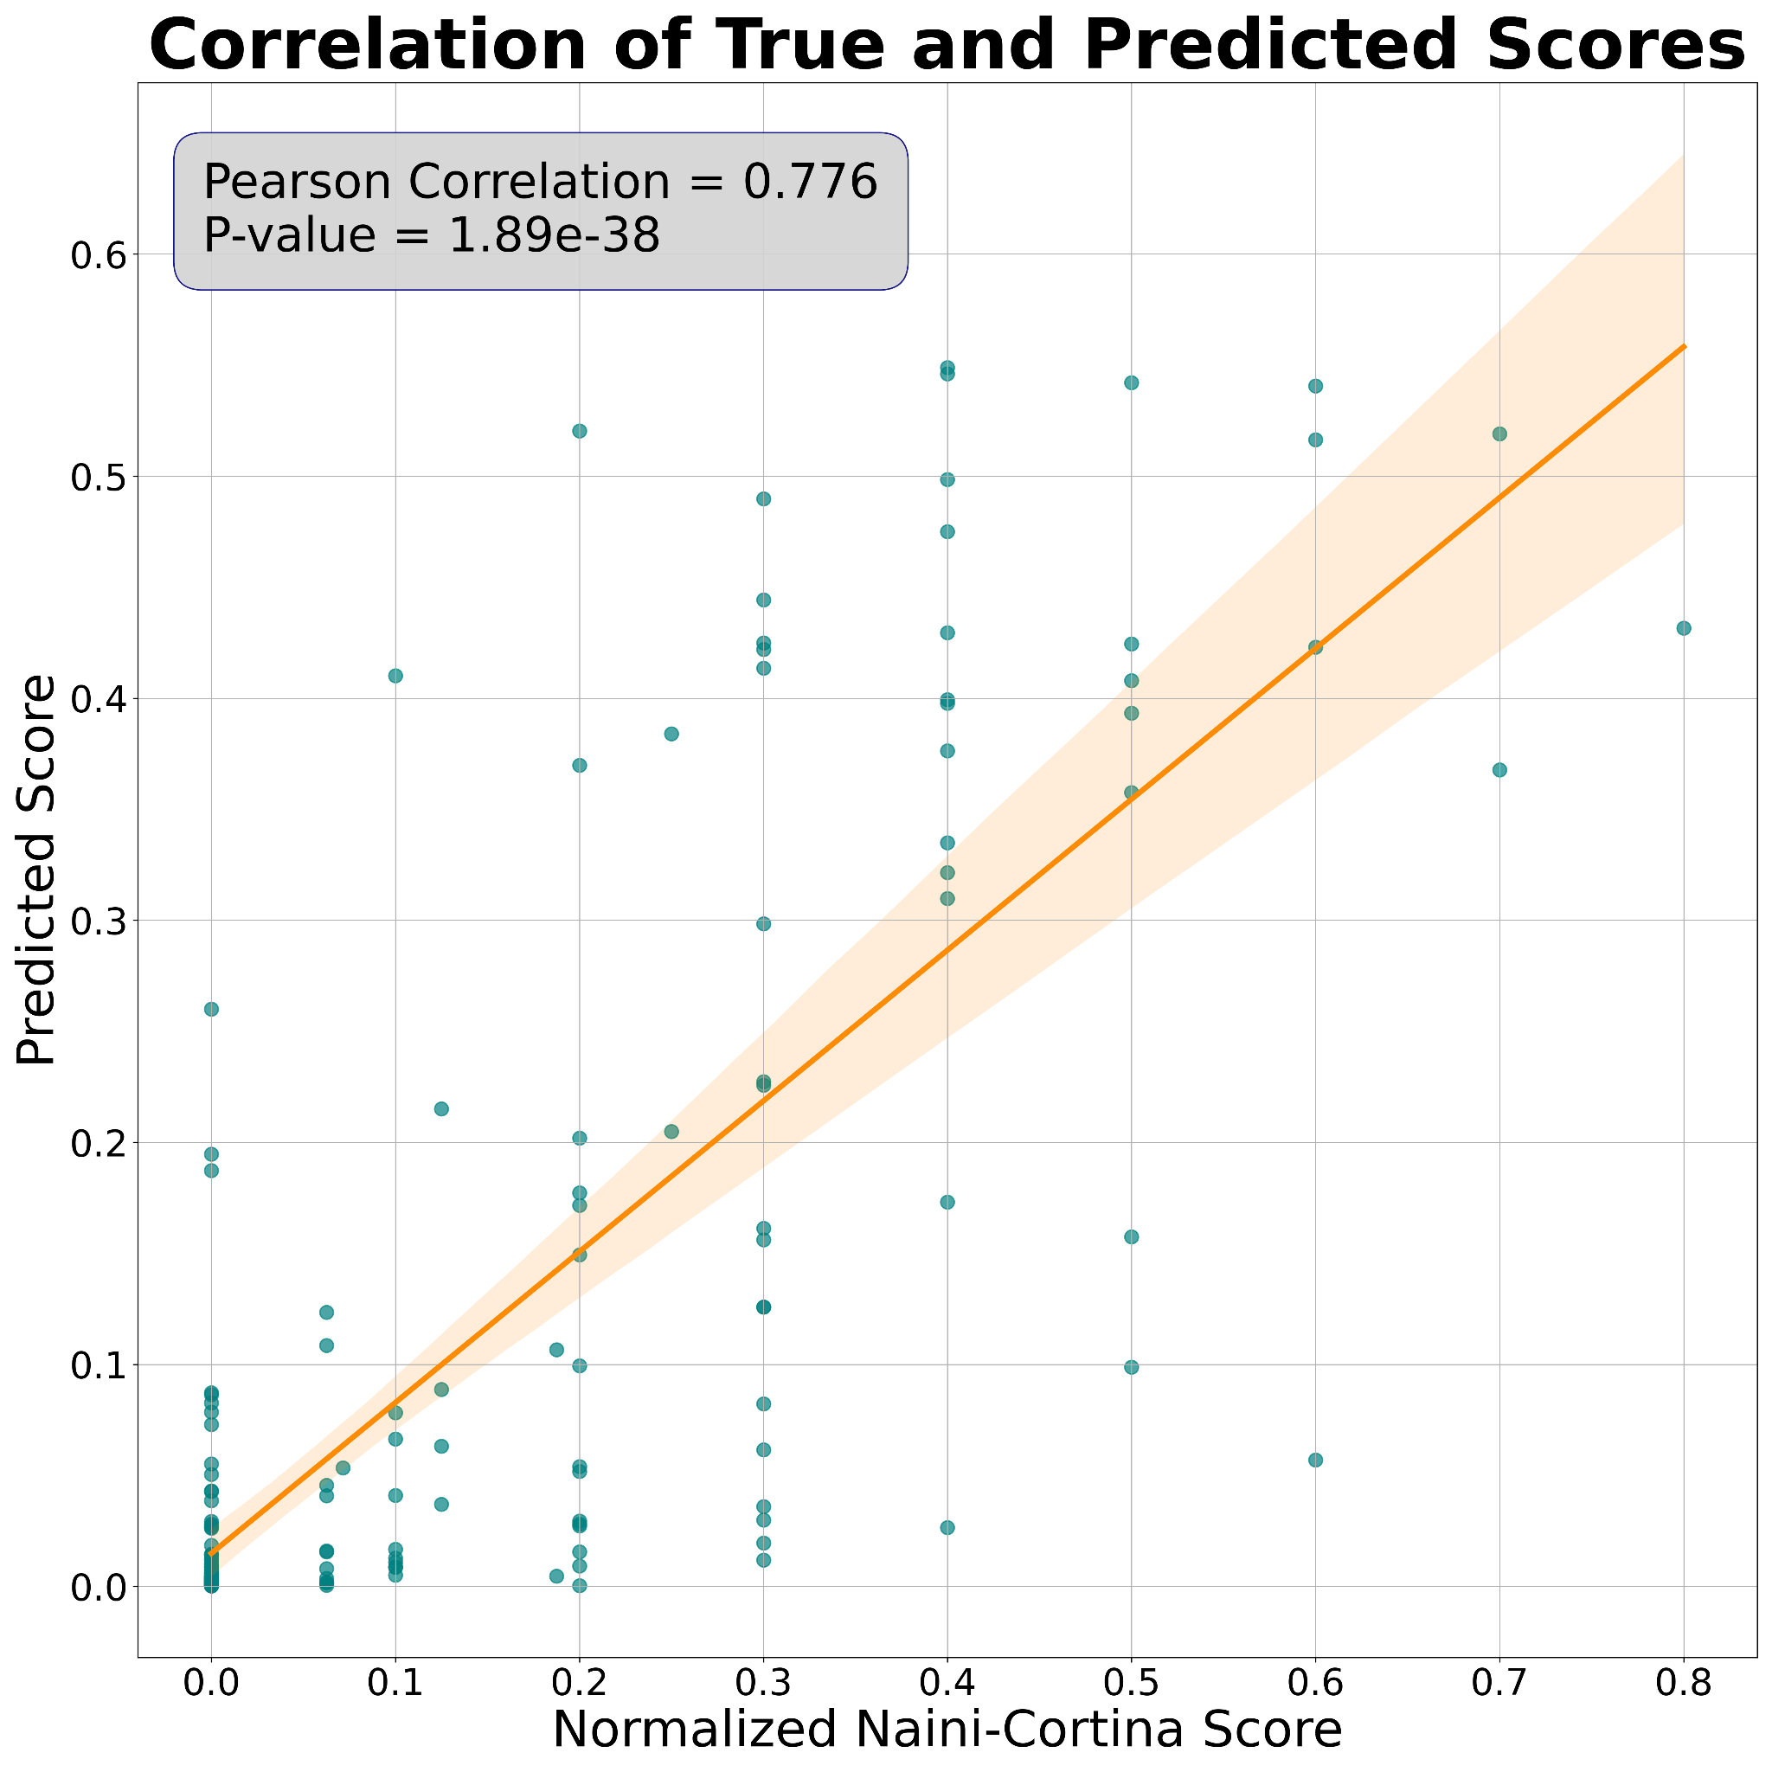
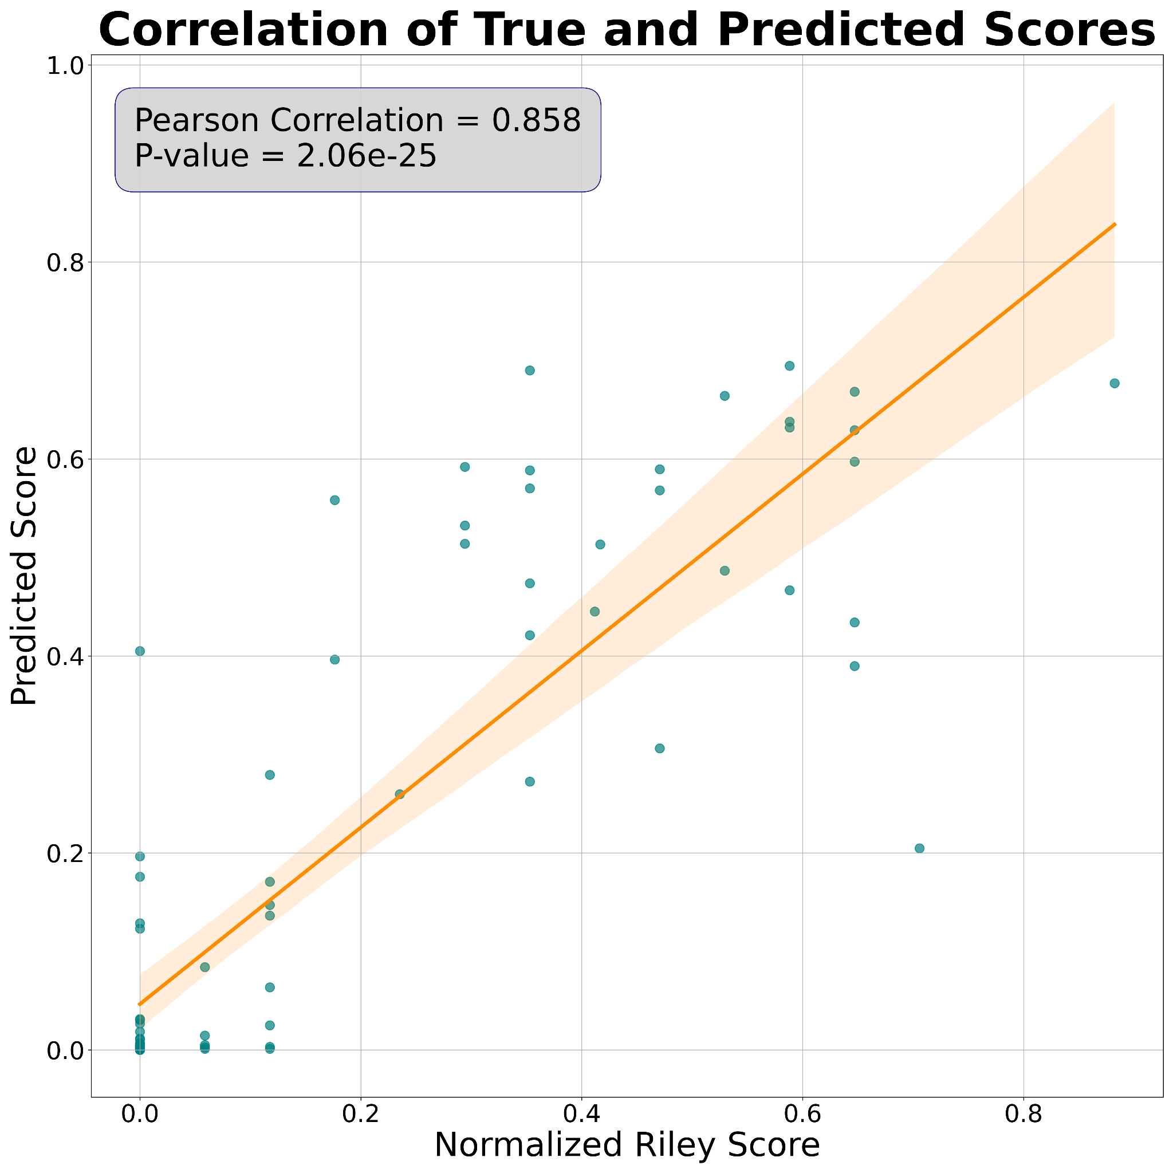
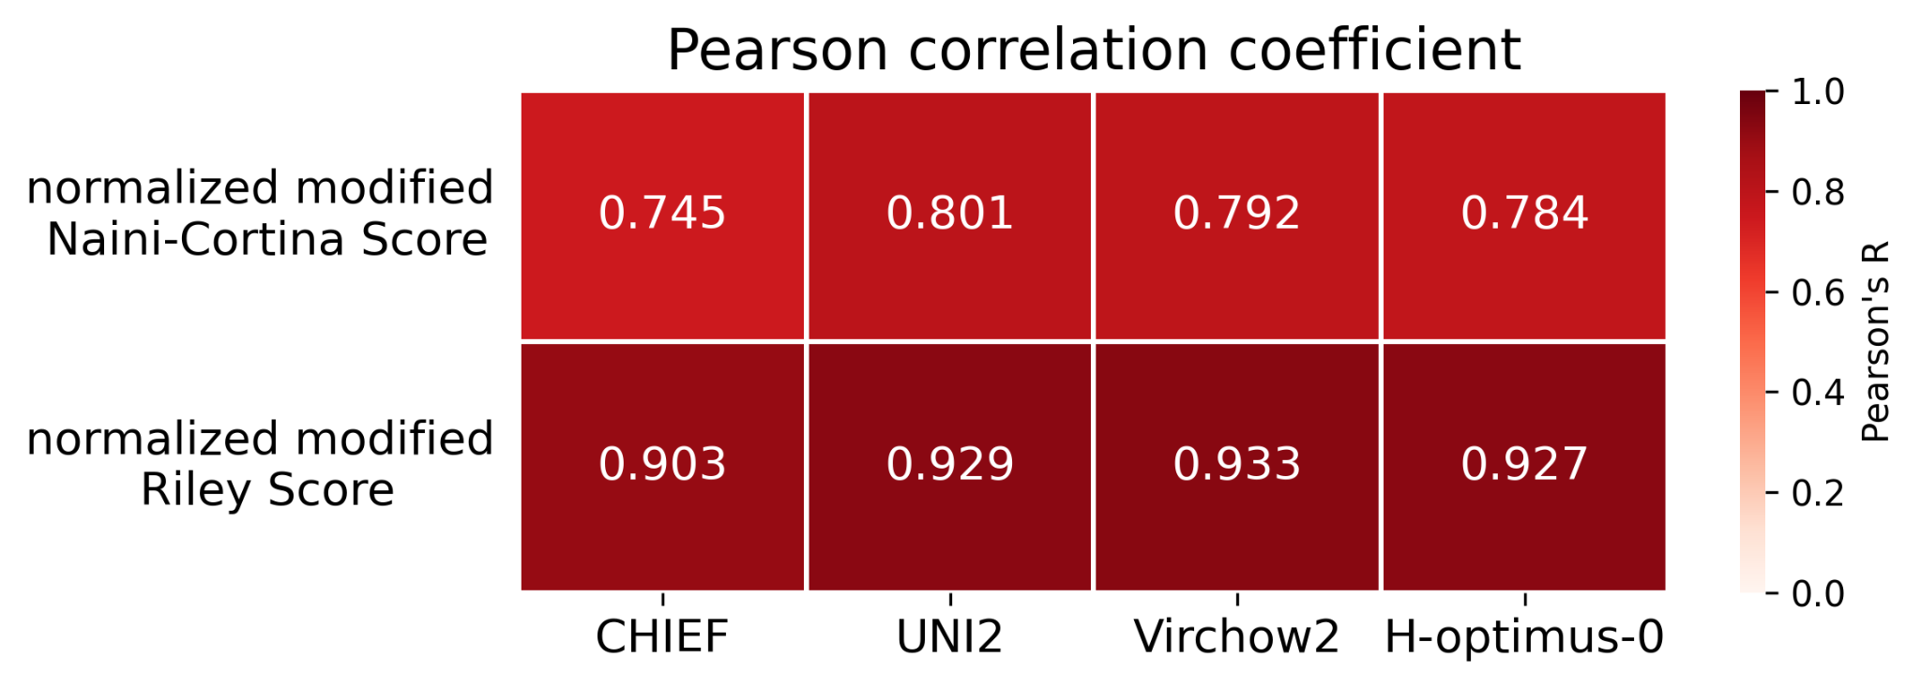
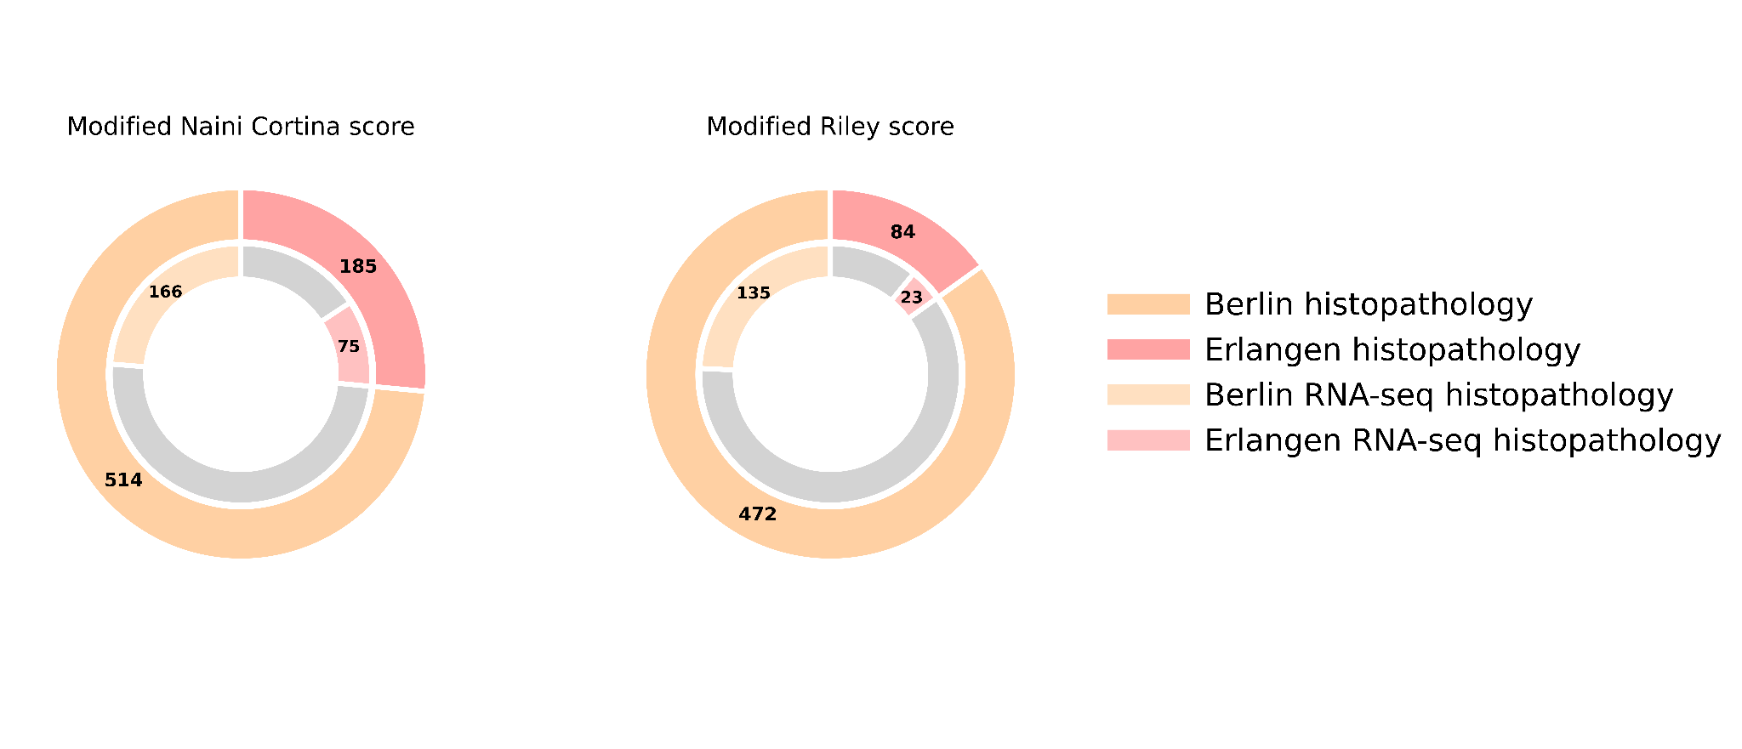
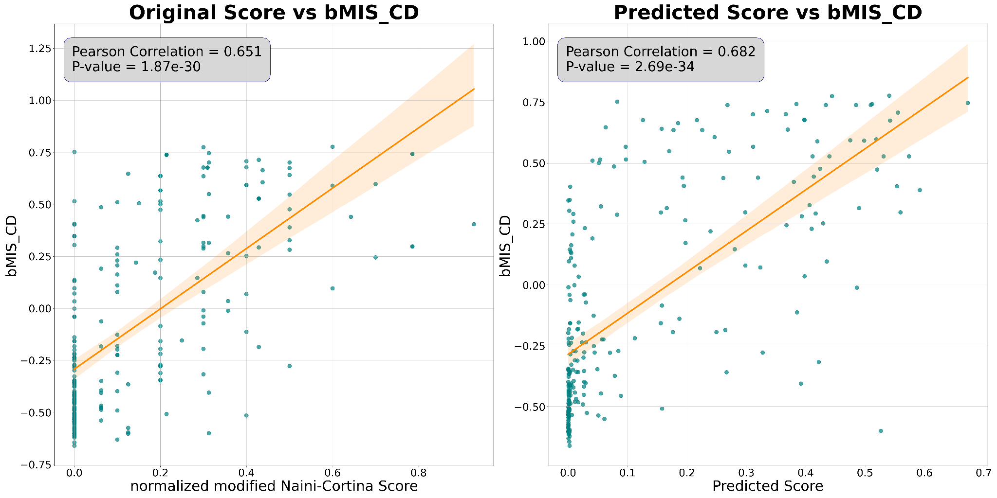
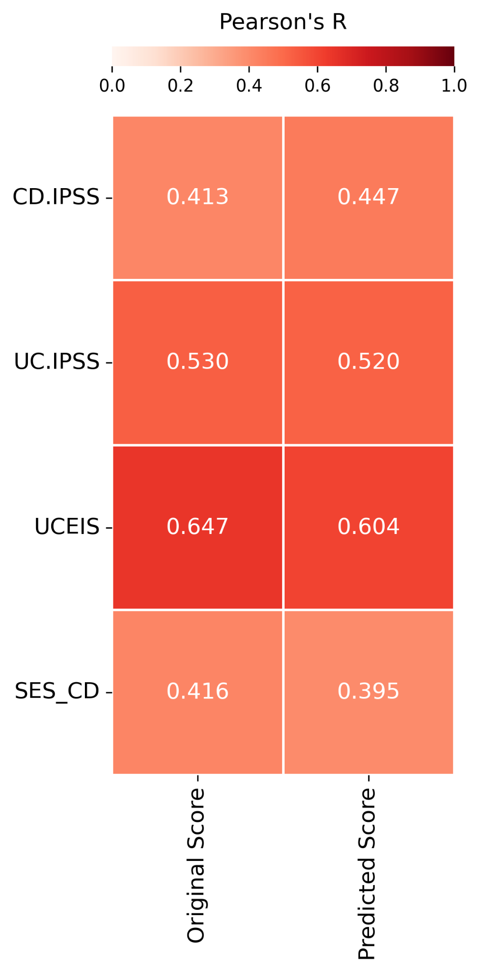
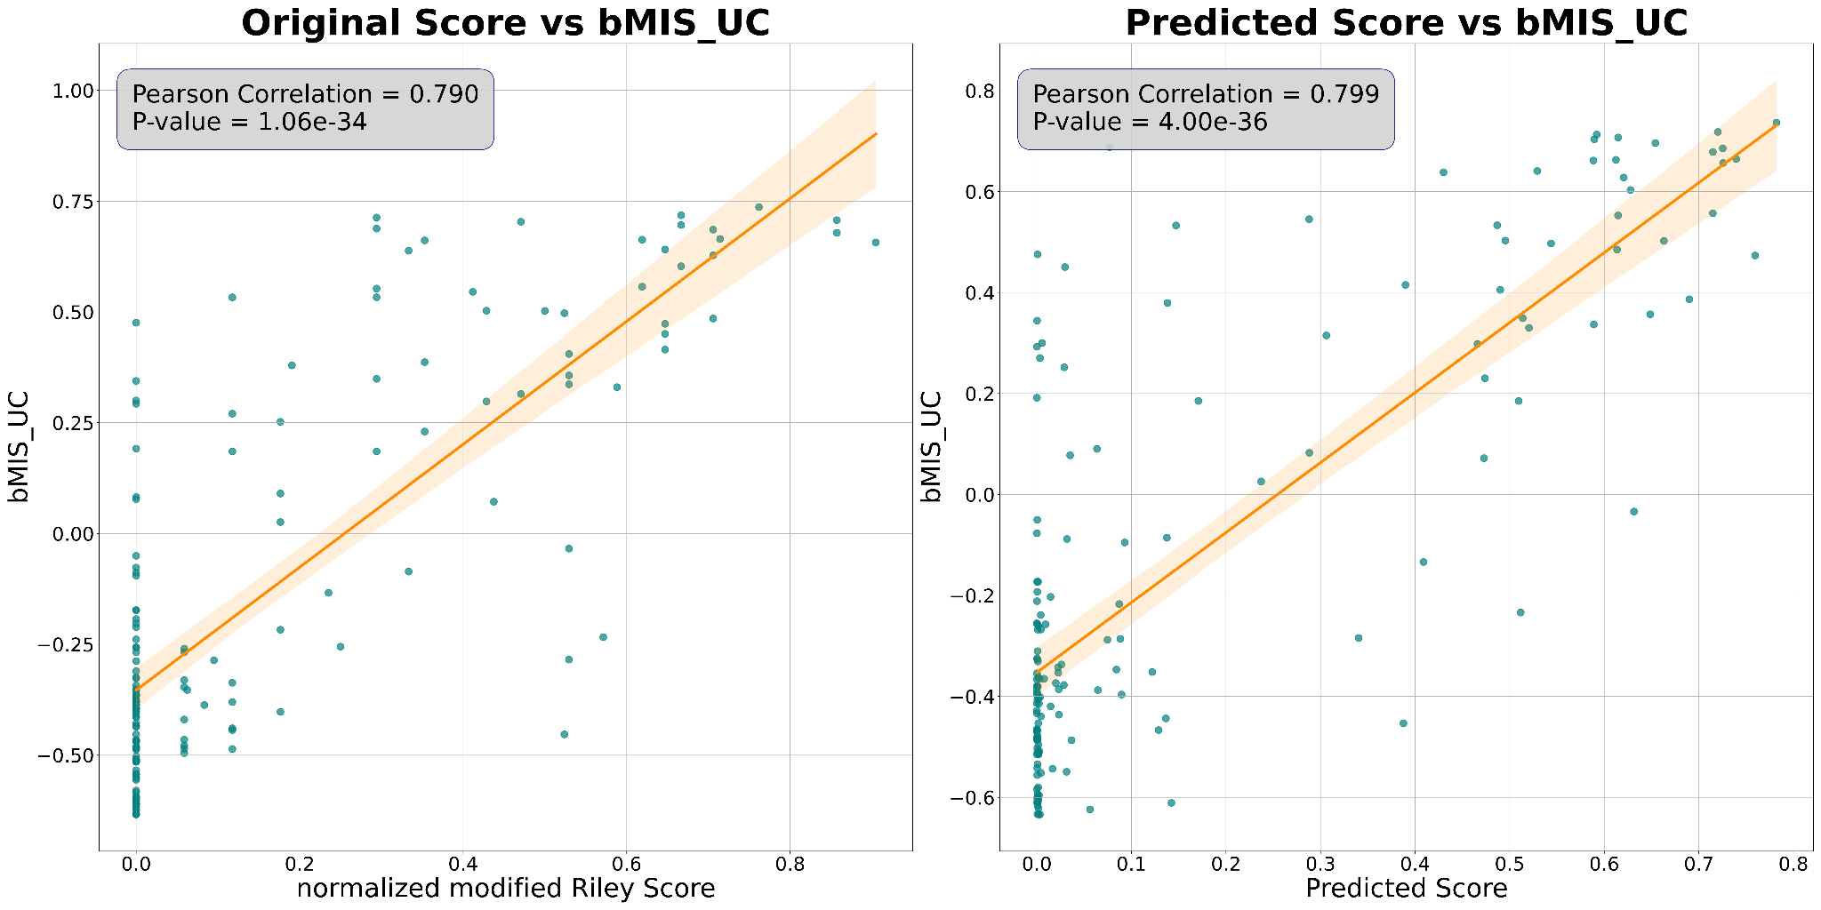
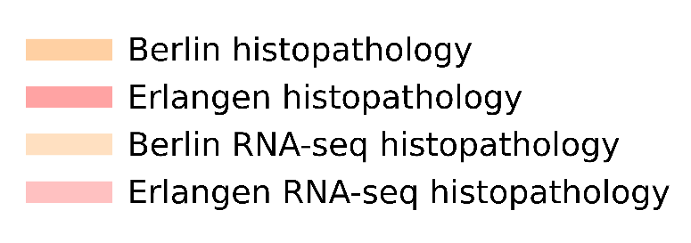
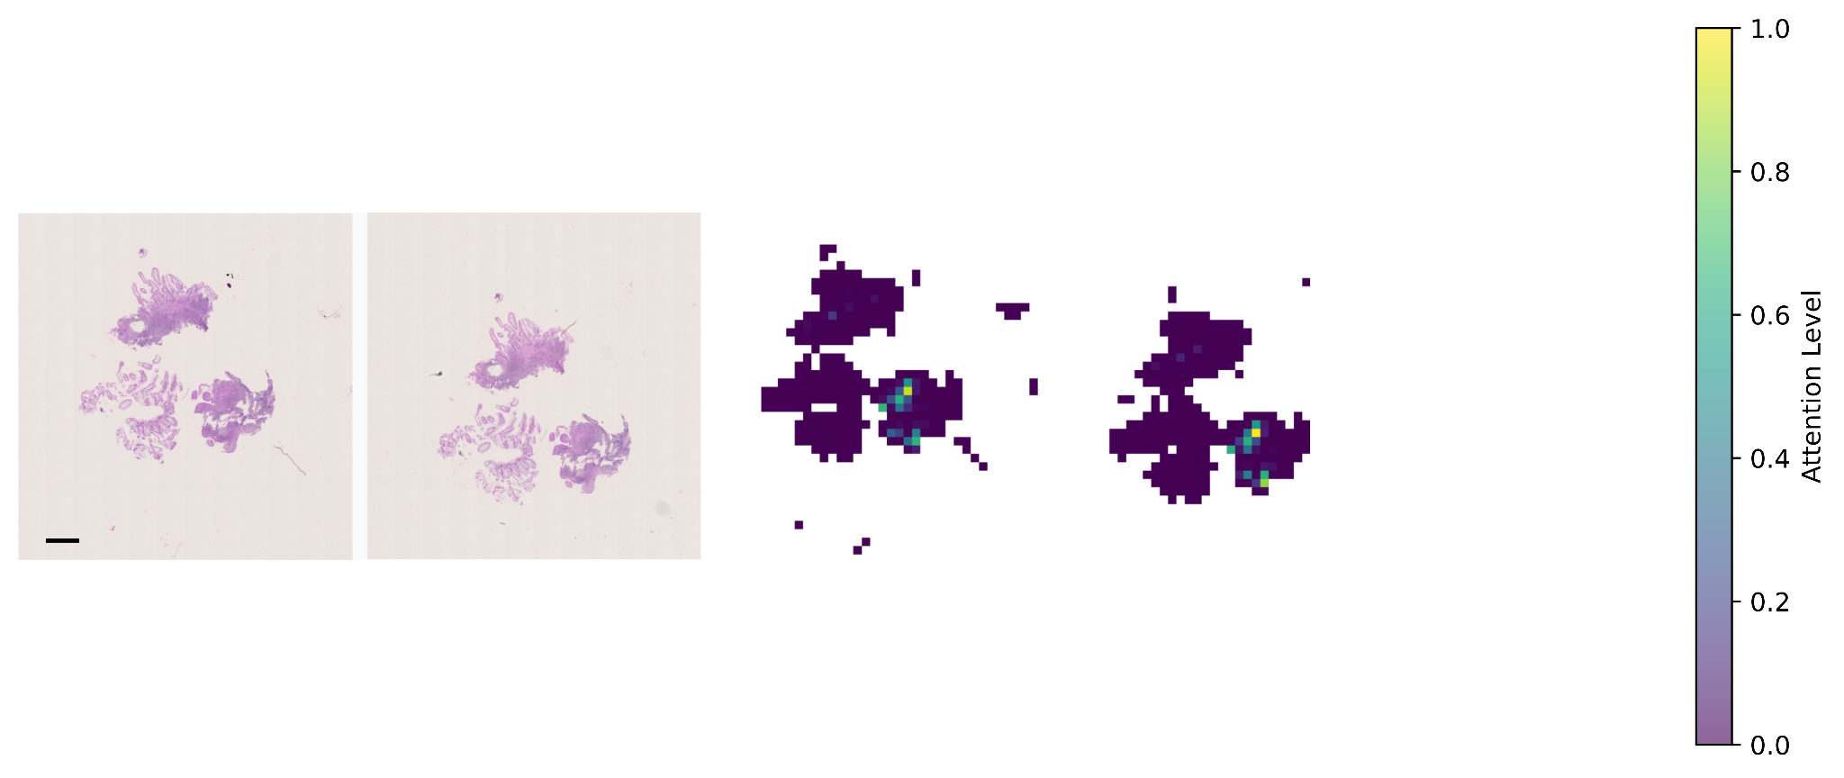
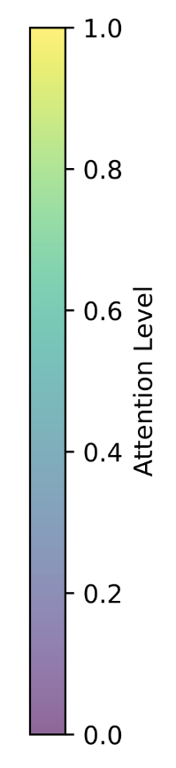

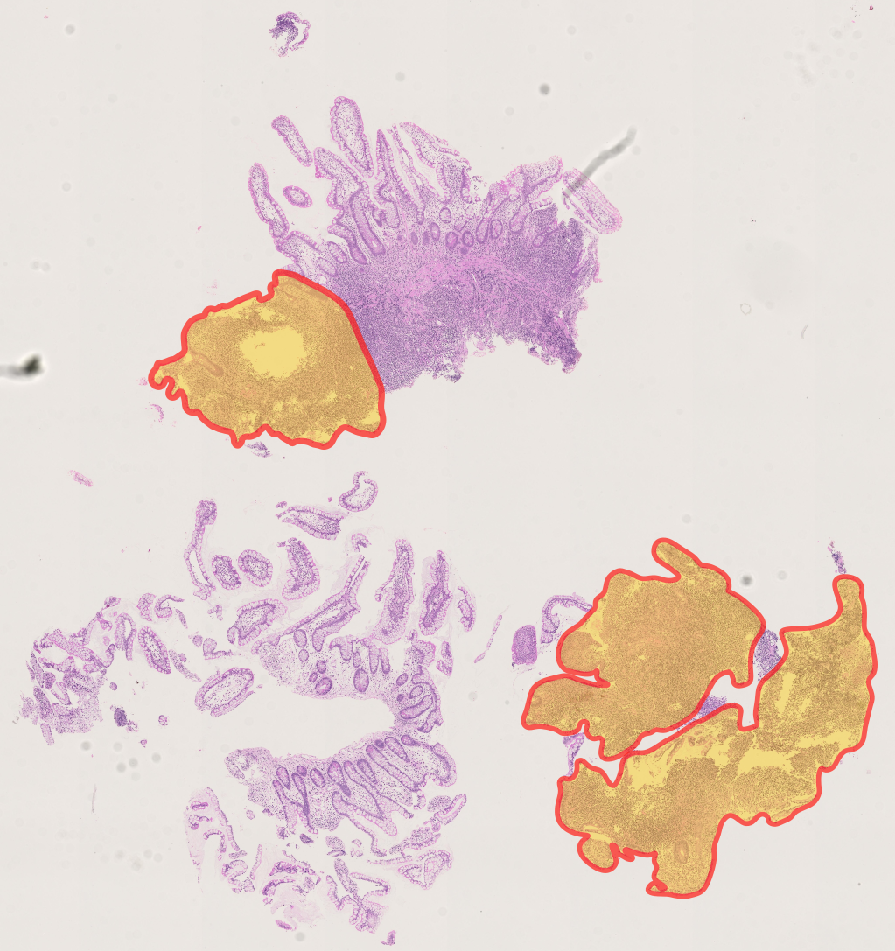
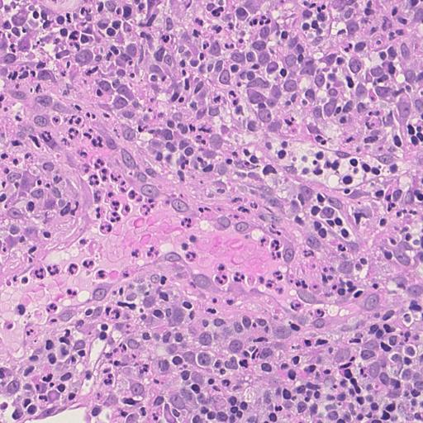
a
b
c
d
e
f
g
Original WSI
Attention heatmap of the AI model
Pathologist annotation
1mm
Extended Data Fig. 5| See next page for caption

Slide 6
Extended Data Fig. 5| Prediction of histopathologic scores from H&E images. a, Distribution of all H&E images (n = 1362). After preprocessing, the number of images is reduced to 1212*, which are then categorized with two scoring systems: the modified Naini Cortina score (n = 699) and the modified Riley score (n = 556). Each scoring category is further divided in the two center subsets: Berlin (n = 514 for modified Naini Cortina, n = 472 for modified Riley) and Erlangen (n = 185 for modified Naini Cortina, n = 84 for modified Riley). *Some indeterminate colitis and non-IBD samples were scored with both scoring systems. b, Performance of different Foundation Models (CHIEF, UNI2, Virchow2 and H-optimus-0) on the 5 folds cross-validation regression task on the Berlin cohort, shown by Pearson correlation (R) coefficients. c, Correlation plots between the original histologic disease activity scores (x-axis) and AI-predicted scores (y-axis) for both modified Naini Cortina and modified Riley scoring systems. Predictions are based on the ensemble of 5 cross-validation models trained on the Berlin cohort and evaluated on the Erlangen cohort. d, Cohort distribution: the outer circles represent the Berlin and Erlangen histopathology cohorts, and the inner circles indicating the proportion of available RNA-seq data within each cohort. e, Correlation plots between the bMIS score for UC and CD with the original score (normalized Naini Cortina and Riley score) on the left and the model’s predicted scores on the right. f, Comparison of Pearson correlation (R) coefficients between original and predicted histologic disease activity scores against CD-IPSS, UC-IPSS, UCEIS, and SES-CD. g, On the left side, a representative attention heatmap of a biopsy slide image from a CD patient with high histologic disease activity. The heatmap shows the model’s attention levels. Higher scores (yellow) mark regions that strongly influence the model’s prediction, while lower scores (green) indicate less critical regions. In the middle, a zoomed-in view of the highest-attention region showing the top attention tile and on the right side the pathologist annotation highlighting the important areas to consider for disease activity scoring.

