Slide 1
Fig 4
SlC6A1
GAPDH

Slide 2
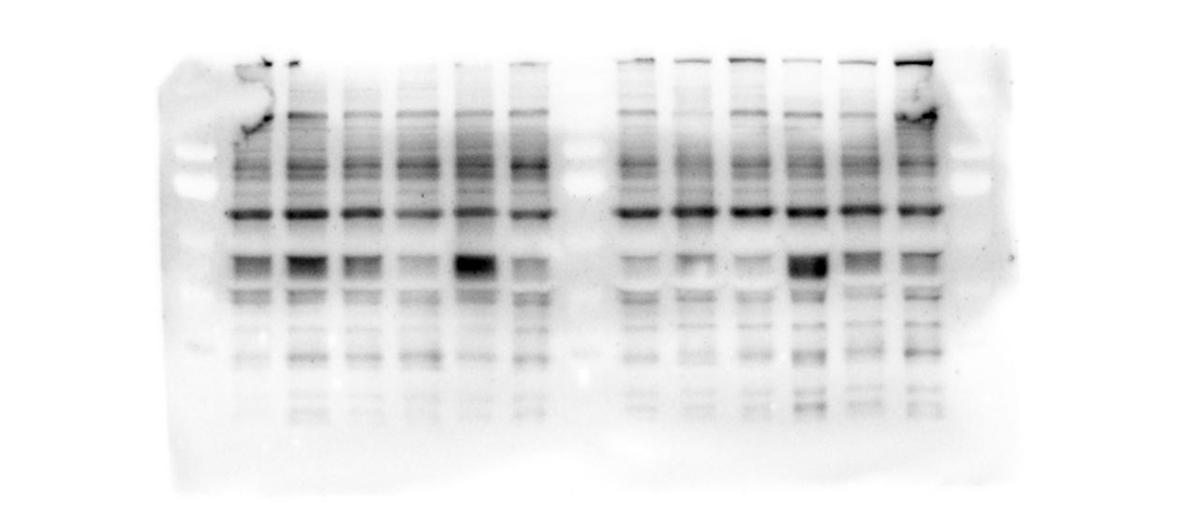
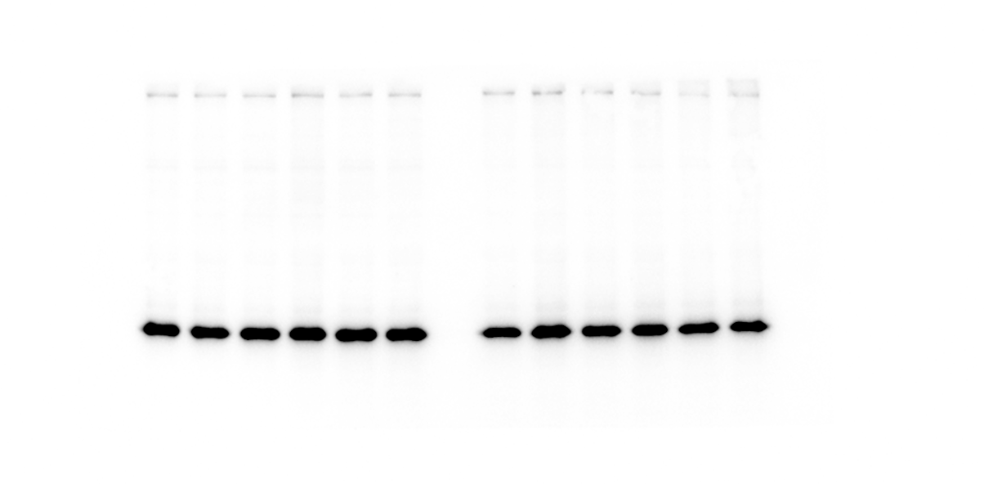
Fig 5
SlC6A1
GAPDH

