Slide 1
Suppl. Fig. 1
A
B
40
p=0.001
38
p=0.9222
Body Temperature (C)
Body Weight (g)
30
36
20
34
10
32
0
30
C
D
1.2
1
60
Grip Strength(N)
p=0.9891
p=0.9105
Wire Hang(s)
0.8
0.6
0.4
0.2
40
20
0
0
Controls (n=9)
Mutants (n=12)

Slide 2
Suppl. Fig. 2
160
120
A
Latency to 1st (sec)
p=0.7617
Controls (n=9)
Mutants (n=12)
80
40
0
1
3
5
7
9
11
13
15
Trials
B
Errors to 1st (times)
12
10
8
6
4
2
0
p=0.3215
1
3
5
7
9
11
13
15
500
400
Trials
C
p=0.4425
Distance to 1st (cm)
300
200
100
0
1
3
5
7
9
11
13
15
Trials

Slide 3
Suppl. Fig. 3
A
Time Spent around Each Hole(sec)
Probe test (day1)
p=0.4733
Controls (n=9)
Mutants (n=12)
50
40
p=0.1141
p=0.1088
p=0.1597
40
Error to 1st (times)
8
Distance to 1st (cm)
300
30
Latency to 1st (sec)
6
30
200
20
20
4
10
10
2
100
0
0
0
0
180
150
120
90
60
30
target
-30
-60
-90
-120
-150
Distance(angle) from Target (cm)
Time Spent around Each Hole(sec)
B
Probe test (day8)
p=0.6641
50
40
40
p=0.6734
8
p=0.4352
300
p=0.3788
30
Latency to 1st (sec)
Error to 1st (times)
Distance to 1st (cm)
30
6
200
20
20
4
10
10
2
100
0
180
150
120
90
60
30
target
-30
-60
-90
-120
-150
0
0
0
Distance(angle) from Target (cm)

Slide 4
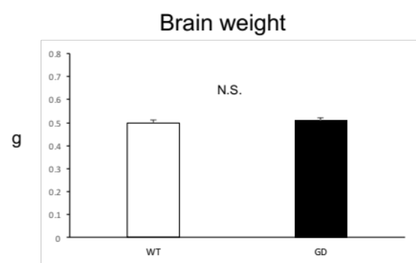
Suppl. Fig. 4
A
WT
GD
B
WT
GD

Slide 5
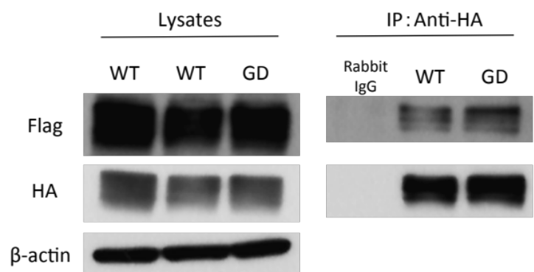
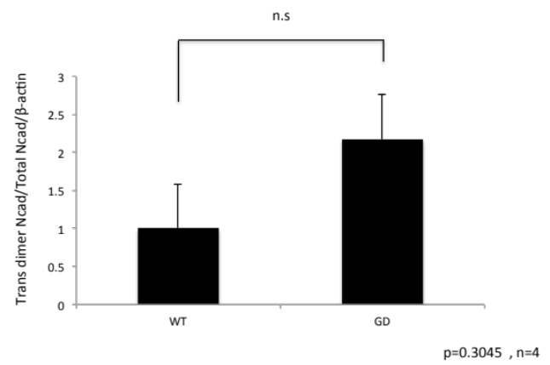
Suppl. Fig. 5
A
B
C

Slide 6
Suppl. Fig. 6

