Slide 1
Table S1
Table S1. Primers for quantitative real-time PCR (qRT-PCR) analysis.
Gene Names | Sense primers (5′-3′) | Antisense primers (5′-3′) | Article
AMY1 | CAACCACAGAACGGCTGAGA | GGGGTTAAGGTGGTCGATGT
AMY2 | AGTCAGAGCTATGGCTGACATC | CGAAGTGACAGCGTGTTCATC
GAPDH | GCTGGAGCTGACTACGTTGTTG | CTTCAAGTGAGCTGCAGCCTTG | Park & Hasenstein, 2016

Slide 2
Figure S1
271nm
Absorbance (a.u.)
271nm
520 nm
560 nm
Wave length (nm)
Figure S1. Absorbance of PNC and Dil-PNC. A 271 nm peak was observed in PNC, while extra 520 and 560 nm peaks were observed in DiI-PNC.

Slide 3
Figure S2
a
Germination rate (%)
Salt stress
Seedling fresh weight (mg seedling⁻¹)
Days
b
a
a
a
a
b
c
c
c
200 mM NaCl
Figure S2. Screening of PNC concentration for rapeseed nanopriming. Effect of different PNC concentrations on a, rapeseed germination rate at different days and b, seedling fresh weight at Day7 under salt stress and non-saline condition. Different lowercase alphabets on the vertical bars indicates significant difference at P < 0.05. Error bars are the representative of standard error of three biological replicates (one batch as one biological replicates) (n = 3).

Slide 4

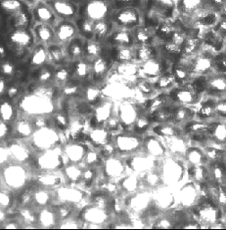
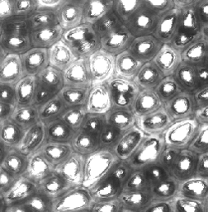

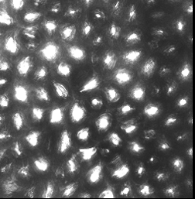
Figure S3
DiI-PNC
Seed coat
Overlay
1 h
TES priming
3 h
8 h
10μm
Figure S3. Confocal imaging of Dil-PNC distribution in seed coat of the control group. DiI-PNC signal in seed coat of rapeseed with TES priming at 1h, 3h, and 8h of priming. Scale bar: 10 µm.

Slide 5

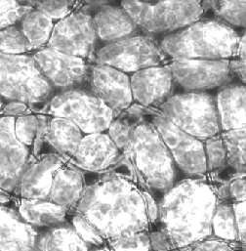

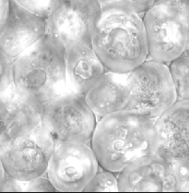

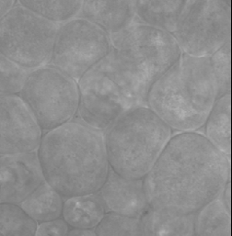
Figure S4
DiI-PNC
Cotyledon
Overlay
1 h
TES priming
3 h
8 h
10μm
Figure S4. Confocal imaging of Dil-PNC distribution in seed cotyledon of the control group. DiI-PNC signal in seed cotyledon of rapeseed with TES priming at 1h, 3h, and 8h of priming. Scale bar: 10 µm.

Slide 6
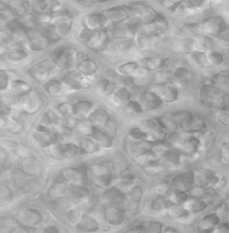

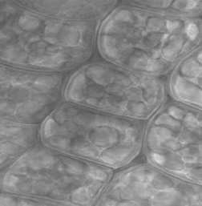
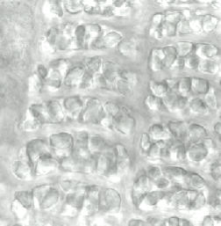
Figure S5
DiI-PNC
Radical
Overlay
1 h
TES priming
3 h
8 h
Figure S5. Confocal imaging of Dil-PNC distribution in seed radical of the control group. DiI-PNC signal in seed radical of rapeseed with TES priming at 1h, 3h, and 8h of priming. Scale bar: 10 µm.
10μm

Slide 7
Figure S6
a
K⁺ content (mg g⁻¹ DW)
b
a
Na⁺ content (mg g⁻¹ DW)
a
a
b
b
c
c
c
200 mM NaCl
200 mM NaCl
Na⁺/K⁺ ratio
c
a
b
c
c
200 mM NaCl
Figure S6. PNC nanopriming modulates Na⁺ and K⁺ content and Na⁺/K⁺ ratio in rapeseeds under salt stress. PNC priming decreased Na⁺ accumulation (a), improved K⁺ retention ability (b), and reduced Na⁺/K⁺ ratio (c) in seedlings under 200 mM NaCl stress (7 days). Different lowercase alphabets on the vertical bars indicates significant difference at P < 0.05. Error bars are the representative of standard error of three biological replicates (one batch as one biological replicates) (n = 3).

