Slide 1
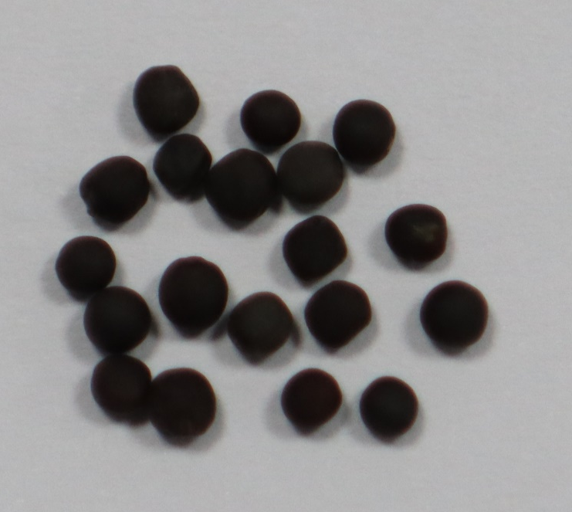
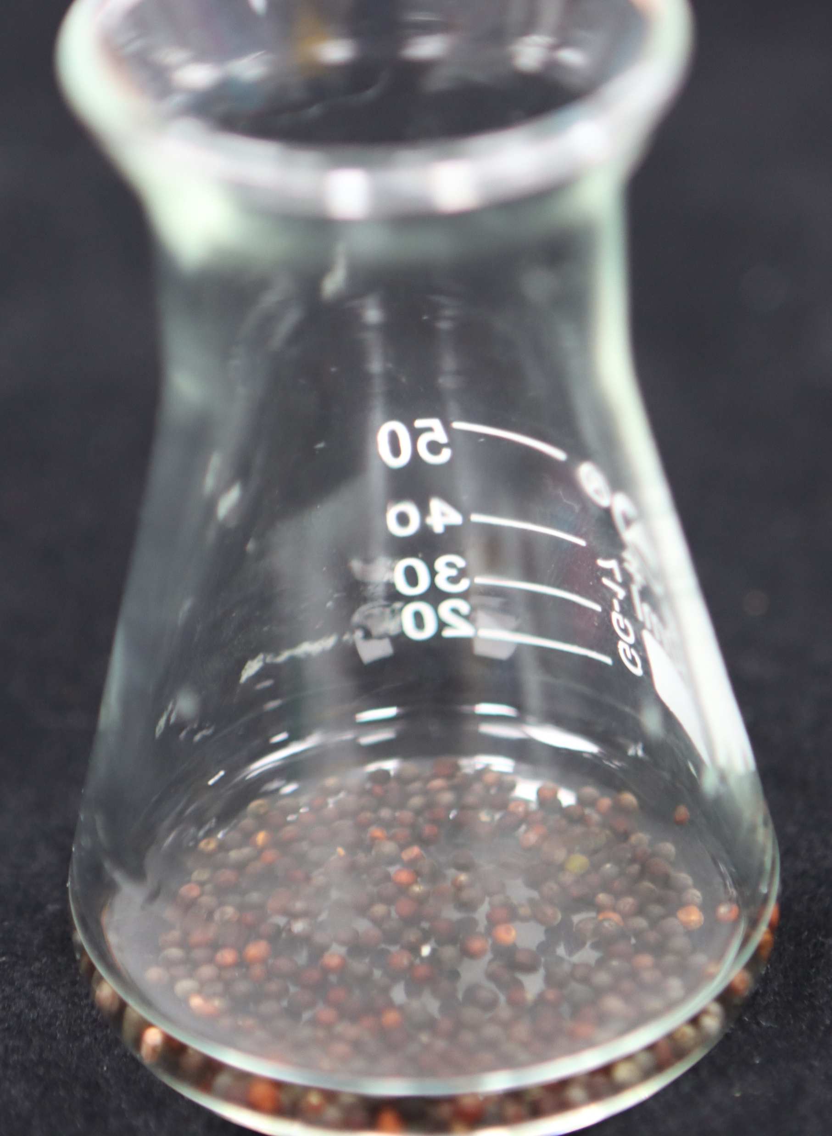
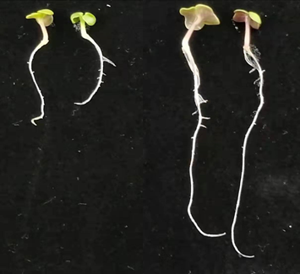
Graphical abstract
Fresh weight (mg seedling⁻¹)
a
a
Rapeseed seeds
b
c
PNC nanopriming
200 mM NaCl
Increased α-amylase activities
Improved ROS scavenging ability
Better maintained Na⁺/K⁺ ratio
200 mM NaCl
Control
PNC priming
1 cm

