Slide 1
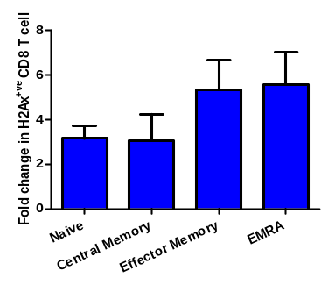
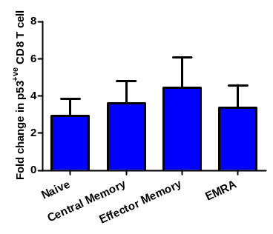
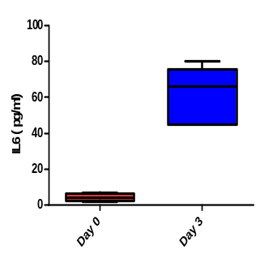
B
C
A
C
Supplementary Figure 1: Replicative senescence model

Slide 2
 | Control | Butyrate | P value
CD4 T cells (%) | 57.77 (±17.07) | 62.24 (±14.82) | 0.49
Naïve CD4 T cells (%) | 47.82 (±14.55) | 44.40 (± 16.33) | 0.81
CM CD4 T cells (%) | 24.08 (±12.38) | 26.32 (±18.21) | 0.87
EM CD4 T cells (%) | 20.64 (±16.51) | 21.92 (±20.44) | 0.96
EMRA CD4 T cells (%) | 8.25 (±11.49) | 6.97 (±13.94) | 0.66
CD57^{+ve} CD4 T cells (%) | 4.23 (±2.07) | 3.35 (±2.17) | 0.34
CD8 T cells (%) | 38.74 (±16.16) | 38.90 (±13.70) | 0.79
Naïve CD8 T cells (%) | 26.03 (±13.39) | 27.39 (±12.34) | 0.62
CM CD8 T cells (%) | 19.24 (±17.35) | 19.91 (±22.47) | 0.97
EM CD8 T cells (%) | 29.44 (±23.64) | 31.37 (±11.28) | 0.58
EMRA CD8 T cells (%) | 11.09 (±8.23) | 10.21 (±11.9) | 0.90
CD57^{+ve} CD8 T cells (%) | 3.50 (±1.89) | 4.34 (1.97) | 0.71
Supplementary Table 1 . T cell subset distribution post 3 day cell culture with Butyrate

Slide 3
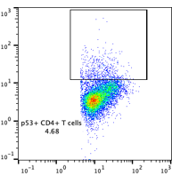
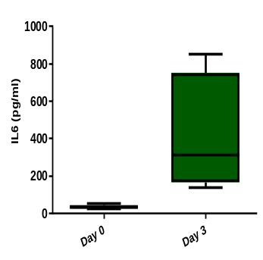
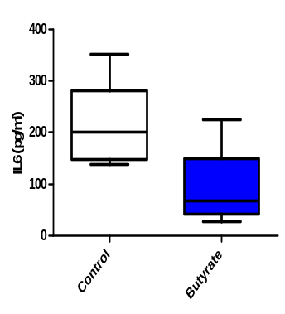
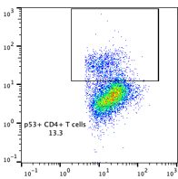
A
B
0.54
3.68
H₂Ax
P 53
C
***
D
***
7.32
13.3
SASP
CD 4
Supplementary Figure 1. A cellular model of proliferation-induced T cell senescence.
In-vitro culture of T cells in CD3-coated wells for 3 days representative flow cytometry images for (A) DNA damage (H2Ax) marker (B) replicative arrest mediated by upregulation of tumor-suppressor pathway p53. (C) Senescent cells secrete products (SASP) that are important contributors to aging and an upregulation of SASP factor IL-6 has been observed in cell-culture supernatant at day3 indicative of three independent experiments. (D) The secretion of IL6 from CD3-treated young T cells from 6 healthy young participants in the presence of 1 M butyrate. Statistical analysis was performed by two-tailed paired student’s t-test *P <0.05, **p < 0.01, ***p < 0.001.

Slide 4
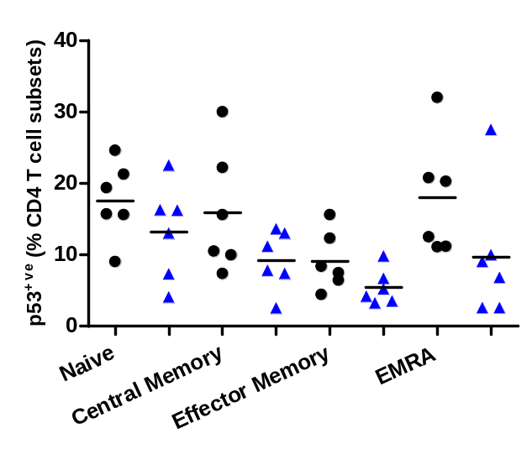
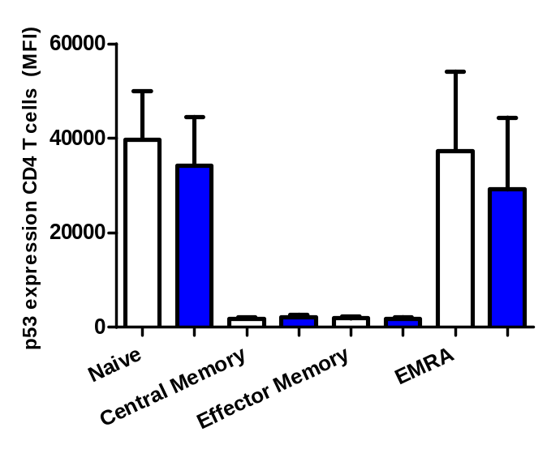
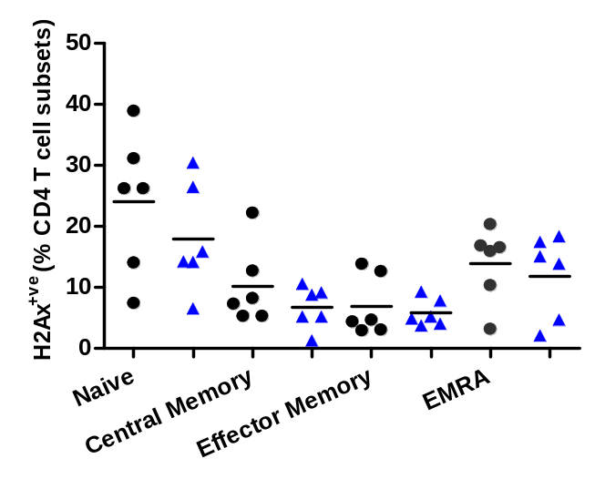
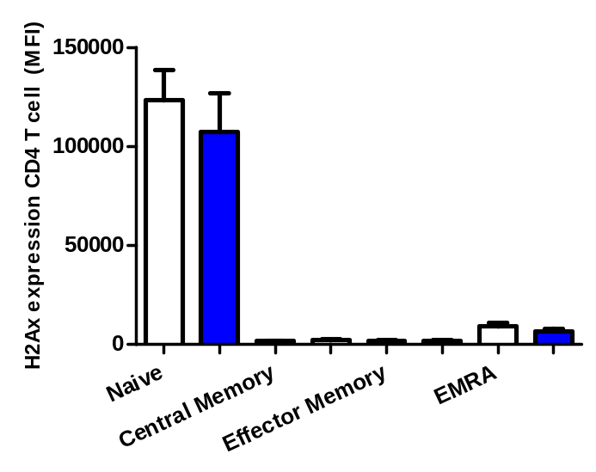
A
B
*
*
C
D
*
Supplementary Figure 2. Regulation of senescence phenotype by butyrate in aged CD 4 T cells
In-vitro culture of PBMCs in CD3-coated wells for 3 days in the presence/absence of SCFA butyrate for (A) frequency of phosphorylated p53 expressing CD4 T cell subsets (B) p 53 expression levels in CD 4 T cell subsets (C) frequency of γH2AX expressing CD4 T cell subsets (D) γH2AX expression levels (MFI) in CD4 T cell subsets. A two-tailed paired Student’s t-test was used to perform the statistical analysis. Data are shown as the mean ± SD ***p < 0.001. n =6 healthy old donors per experiment.

Slide 5
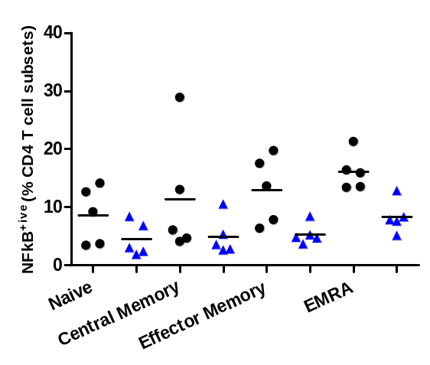
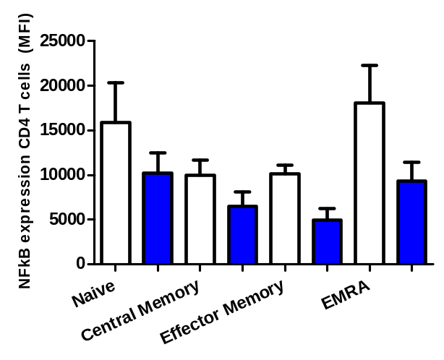
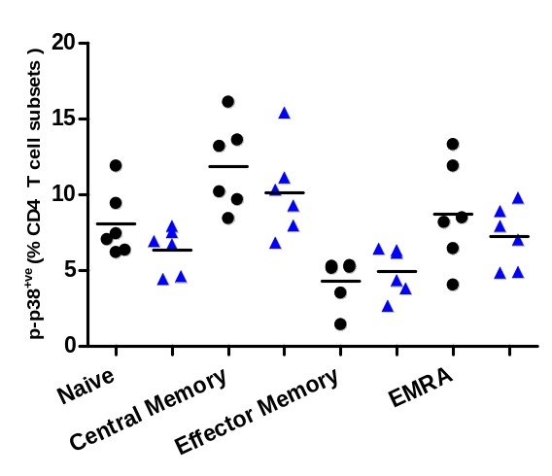
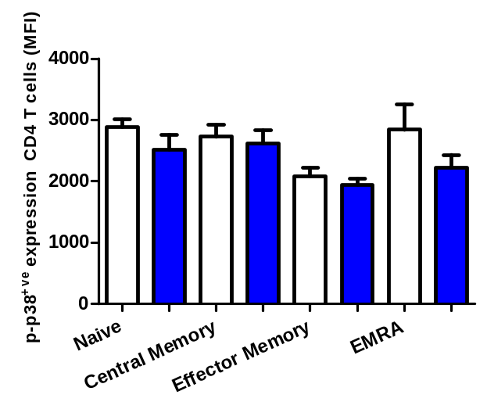
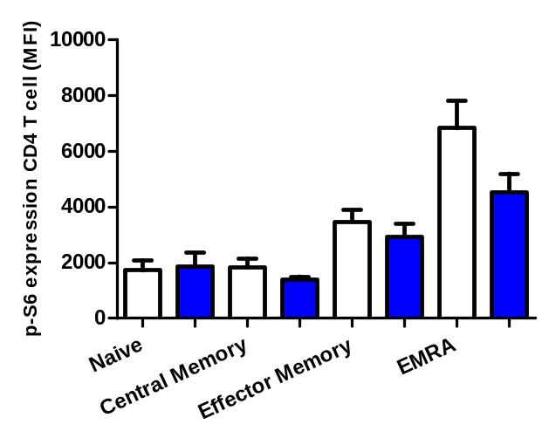
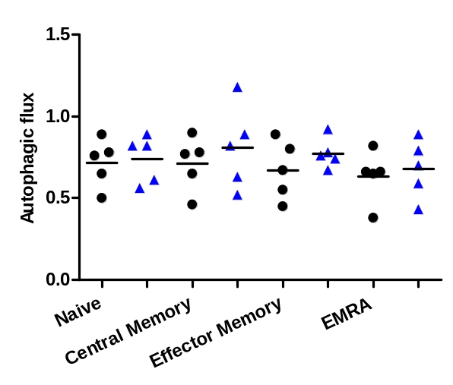
A
B
*
*
*
*
C
D
E
F
Supplementary Figure 3. Effect of butyrate on nuclear factor kappa B (NFκB), p-38 MAPK and m TOR signalling in aged CD4 T cells. In-vitro culture of T cells in CD3-coated wells for 3 days in the presence/absence of SCFA butyrate for (A) frequency of phosphorylated NF-kB expressing CD4 T cell subsets. (B) NF-kB expression levels in CD4 T cell subsets (C) frequency of phosphorylated p38 expressing CD4 T cell subsets. (D) p-p38 expression levels in CD4 T cell subsets (E) p S6 mean fluorescence intensity (MFI) in CD4 T cell subsets (naïve, central memory, effector memory, EMRA). (F) Autophagic flux in CD4 T cell subsets (naïve, central memory, effector memory, EMRA). A two-tailed paired Student’s t-test was used to perform the statistical analysis. Data are shown as the mean ± SD *p = 0.05, **p < 0.01. n =6 healthy old donors per experiment.

Slide 6
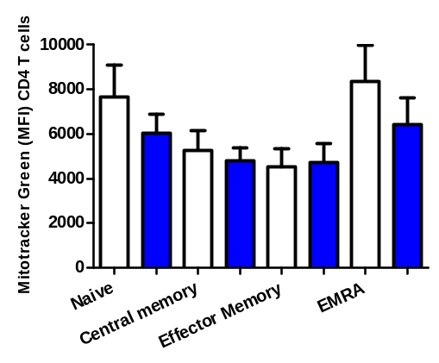
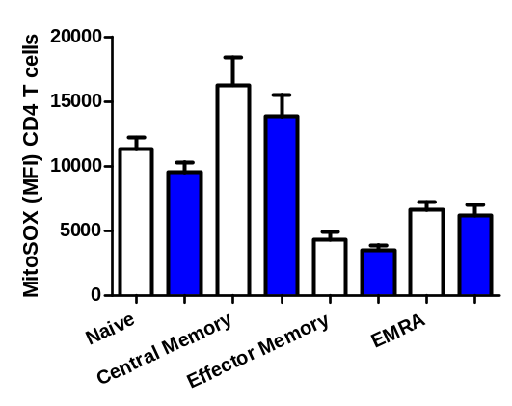
A
*
B
Supplementary Figure 4. Effect of butyrate on mitochondrial mass and ROS production in CD4 T cells.
In vitro culture of T cells in CD3-coated wells for 3 days in the presence/absence of SCFA butyrate and stimulation. (A) MitoTracker™ green expression levels in aged CD4 T cell subsets (B) MitoSOX™ red expression levels in aged CD4 T cell subsets. Statistical analysis was performed by a two-tailed paired Student’s t-test. Data are shown as the mean ± SD *p <0.05, **p < 0.01.

