Slide 1


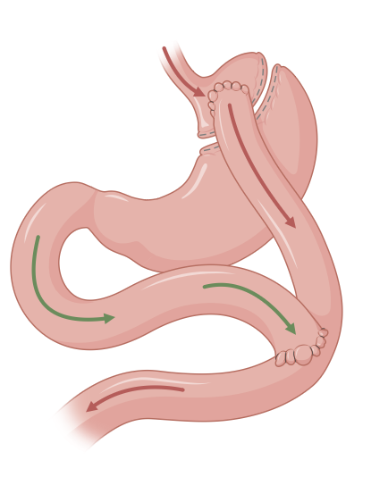
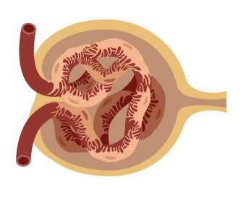


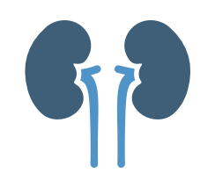



Determinants of Obesity-Related Kidney Dysfunction Remission after Bariatric Surgery
👥
Patients with
Obesity related
Kidney Disease (ORKD)
obesity + proteinuria
(n=39)
Methods
📉 Before and 21.3± 4.6 months after surgery
🧪 Assessments
  BMI, %EBMIL, %TWL
  24h proteinuria & albuminuria
  CKD-EPI GFR
METHODS
RESULTS
CONCLUSIONS
🚫
Excluded:
Diabetes, Inflammation, Neoplasia
✅ Weight Loss
↓BMI 41.0 → 26.5 kg/m²
%EBMIL: 99.5%
%TWL: 38.5%
Bariatric surgery leads to significant improvement of ORKD-associated proteinuria and albuminuria.
Persistent proteinuria occurs in ~25% 2 years after surgery, occurring predominantly in males and patients with higher pre-surgery eGFR.
This suggests non-weight related factors or structural kidney damage.
✅ Proteinuria
↓ 43.0% (from 352 → 144 mg/24h)
Type of Surgery:
RYGB: 26 (66.7%)
SADI-S: 10 (25.6%)
Gastric Sleeve: 2 (5.1%)
Duodenal Switch: 1 (2.6%)
Bariatric Surgery
✅ Albuminuria
↓ 14.3 ± 81.8 % (from 137 → 43 mg/24h)
✅ Higher pre-op %Albuminuria pre-op ➝ greater post-op Albuminuria reduction
Blood Tests
24h Urine
Collection
❗ Persistent Proteinuria >150 mg/24h
25.6% (n=10)
Associated with:
  Male sex
  Higher CKD-EPI
Notes:
LU Biter, MMA Van Buuren, GHH Mannaerts
JA Apers, M Dunkelgrun, GHEJ Vikgen, May 2017

