Slide 1
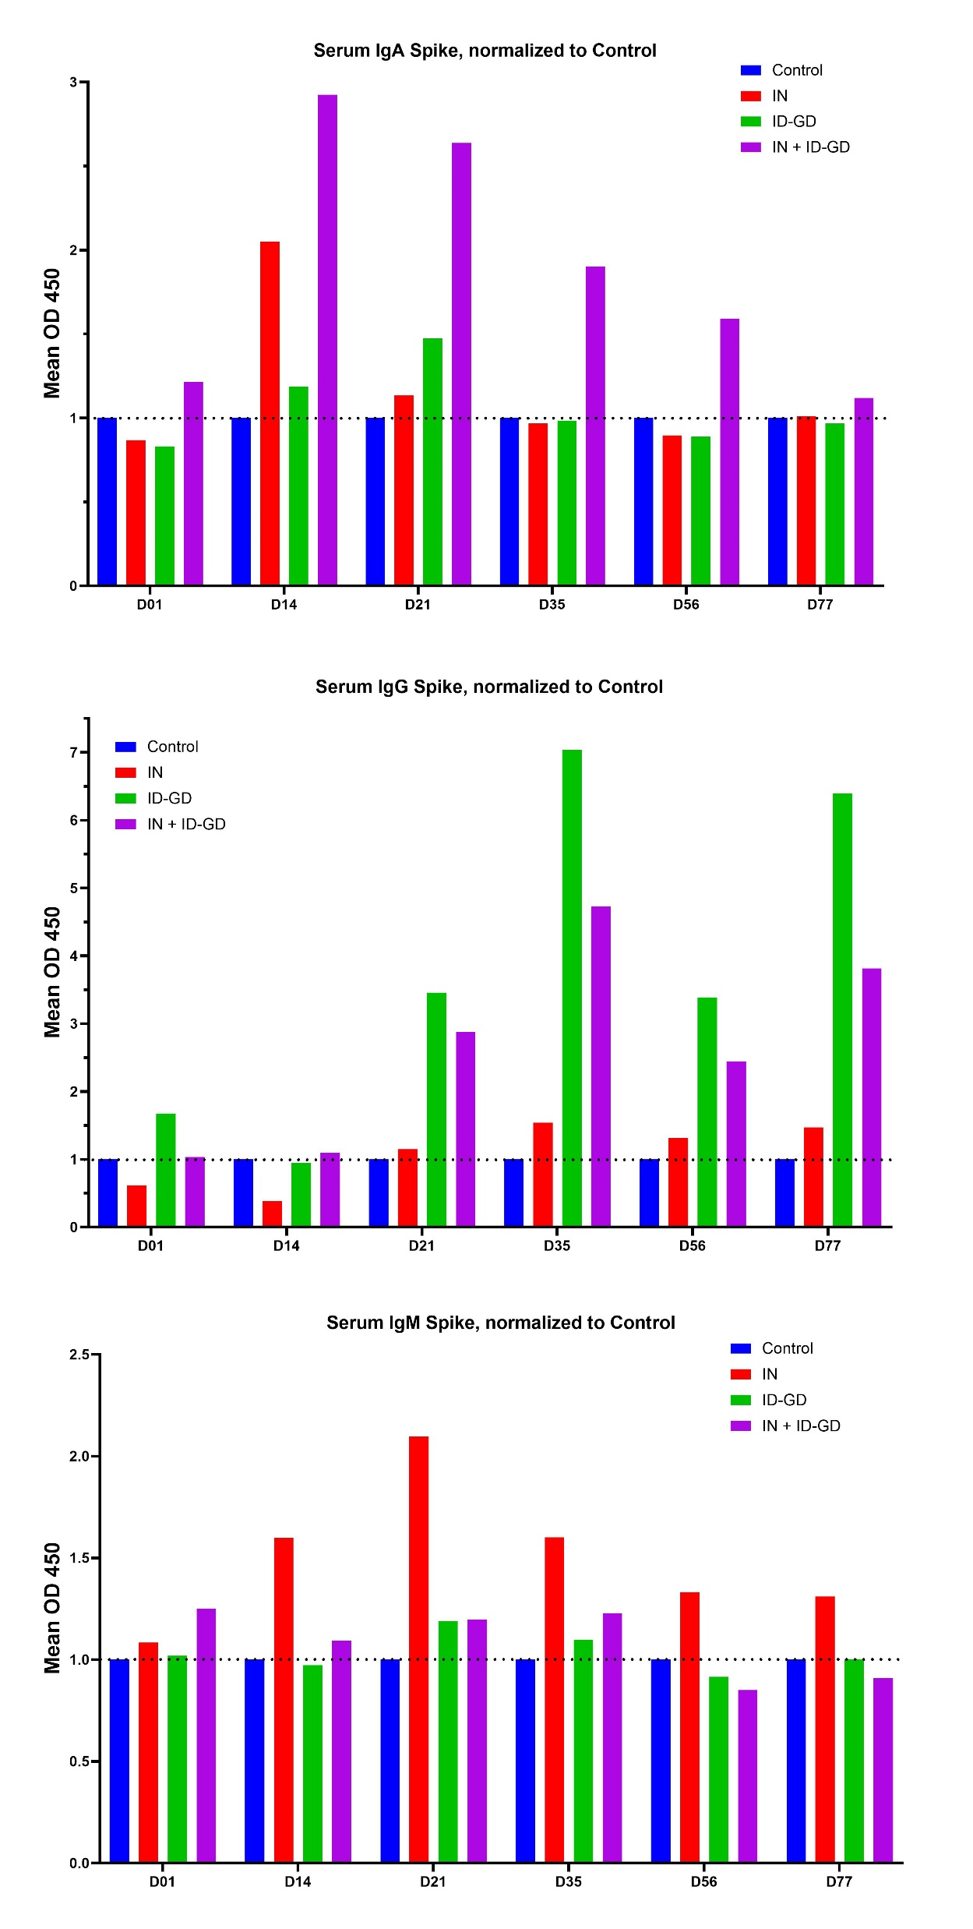
Fig S1: Rabbit Spike IgA, IgG
Fig S1a
Fig S1b

