Slide 1
a
b
Sph
PC 15:0_20:3
5
S1P
7
dhCer
PC 17:0_18:2
Ceramide [Cer] | FA 20:0
11
Cer
Ceramide [Cer] | d17:1
18
deoxyCer
SM 18:2; O2/17:0
C1P
deoxyCeramide [deoxyCer]
27
HexCer
SM 18:2; O2/18:1)
Sphingolipids | FA 16:0
Hex2Cer
10
Hex3Cer
Sphingolipids | d18:2
GM3
9
GM1
PC 16:0_18:1
Sphingolipids | d17:1
SHexCer
37
SM
Sphingomyelin [SM] | d18:2
29
Sphingomyelin [SM]
PC
d18:2
8
PC O
Glycerophospholipids | FA 20:5
11
13
PC P
PC 33:2
PC 32:1
Glycerophospholipids | FA 17:0Acyl
10
LPC
Glycerophospholipids | FA 17:0
33
LPC O
Glycerophospholipids | FA 16:1
4
LPC P
Glycerophospholipids | FA 16:0
4
PE
PE O
Phosphatidylcholine [PC] | FA 17:0Acyl
5
12
PE P
Phosphatidylcholine [PC] | FA 17:0
4
LPE
Phosphatidylcholine [PC] | FA 16:0
LPE P
Phosphatidylinositol [PI] | FA 16:0
10
PI
CE 16:1
Phosphatidylglycerol [PG]
12
LPI
PS
18
PG
Neutral lipids | FA 16:1
CE
Phosphatidylethanolamine [PE] | FA 16:0
8
COH
Neutral lipids | FA 16:0
DE
TG 50:0 [SIM]
8
AC
Diacylglycerol [DG] | FA 16:0
4
DG
Triacylglycerol [TG] | FA 16:1
16
TG [SIM]
TG 50:0 [NL-18:0]
FA 20:5
TG [NL]
Triacylglycerol [TG] | FA 16:0
16
FA 17:0Acyl
18
TG O [SIM]
FA 17:0
22
TG O [NL]
FA 16:1
69
Ubiquinone
FA 16:0
-20
-10
0
10
20
-0.4
-0.2
0.0
0.2
LSEA Statistic
Standardized Coefficient (95% CI)
Corrected p > 0.05
Corrected p < 0.05
Top 10 lipids with lowest p-values
-log10(BH)
40
60
80
100
Supplementary Fig. 1 Alcohol intake associated lipidome profile in the discovery cohort, AusDiab (n=9,340). Panels a and b respectively show the associations with lipid species and lipid sets. Both linear regression and LSEA were performed between alcohol intake (as a predictor) after an inverse normal transformation and each circulating lipid species concentration or lipid set (as an outcome) after scaling the data to unit SD. The covariates included age, sex, BMI, energy, clinical lipids (total cholesterol, HDL-C and triglycerides), exercise, diabetes, smoking. p values for each lipid species with open circles (p > 0.05), dark green circles (p < 0.05) are presented after correction for multiple comparisons using the method of Benjamini and Hochberg. Brown coloured circles represent top 10 lipid species ranked based on p-values. Each data point represents a beta coefficient (per 1-SD) and the error bars represent 95% confidence intervals (CI). AC acylcarnitine, CE cholesteryl ester, Cer ceramide, COH cholesterol, DE dehydrocholesterol, dhCer dihydroceramide, DG diacylglycerol, GM1 GM1 ganglioside, GM3 GM3 ganglioside, HexCer monohexosylceramide, Hex2Cer dihexosylceramide, Hex3Cer trihexosylceramide, LPC lysophosphatidylcholine, LPC(O) lysoalkylphosphatidylcholine, LPC(P) lysoalkenylphosphatidylcholine, LPE lysophosphatidylethanolamine, LPE(P) lysoalkenylphosphatidylethanolamine, LPI lysophosphatidylinositol, PC phosphatidylcholine, PC(O) alkylphosphatidylcholine, PC(P) alkenylphosphatidylcholine, PE phosphatidylethanolamine, PE(O) alkylphosphatidylethanolamine, PE(P) alkenylphosphatidylethanolamine, PG phosphatidylglycerol, PI phosphatidylinositol, PS phosphatidylserine, SHexCer sulfatide, SM sphingomyelin, TG triacylglycerol, TG(O) alkyl-diacylglycerol. NL, neutral loss; SIM, single ion monitoring. The (a), (b), and (c) denote the elution order from chromatographic column. PE (P-17:0/22:6) (a), e.g., refers to the species that elutes prior to PE (P-17:0/22:6) (b).

Slide 2
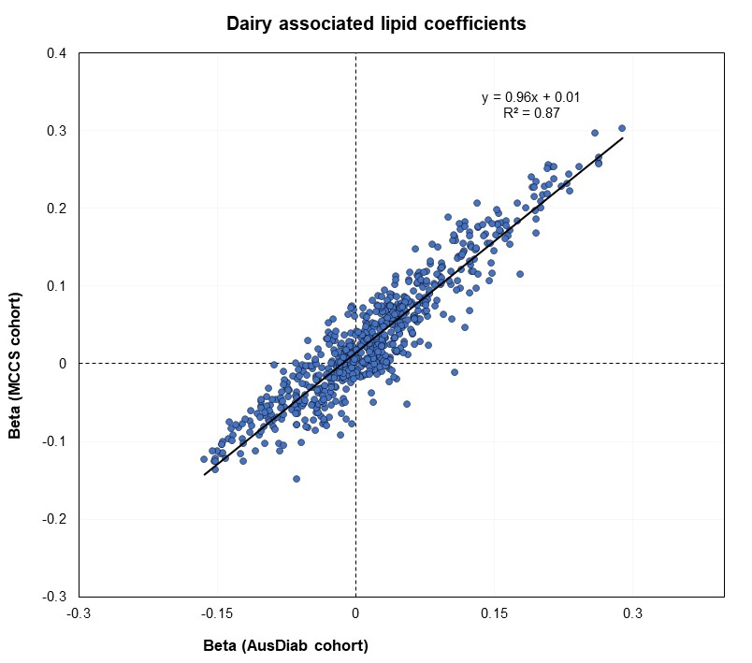
Supplementary Fig. 2 Validation of the dairy-lipidome associations. The correlation between beta coefficients from AusDiab (x-axis) and MCCS (y-axis). AusDiab, Australian Diabetes, Obesity and Lifestyle Study; Melbourne Collaborative Cohort Study (MCCS).

Slide 3
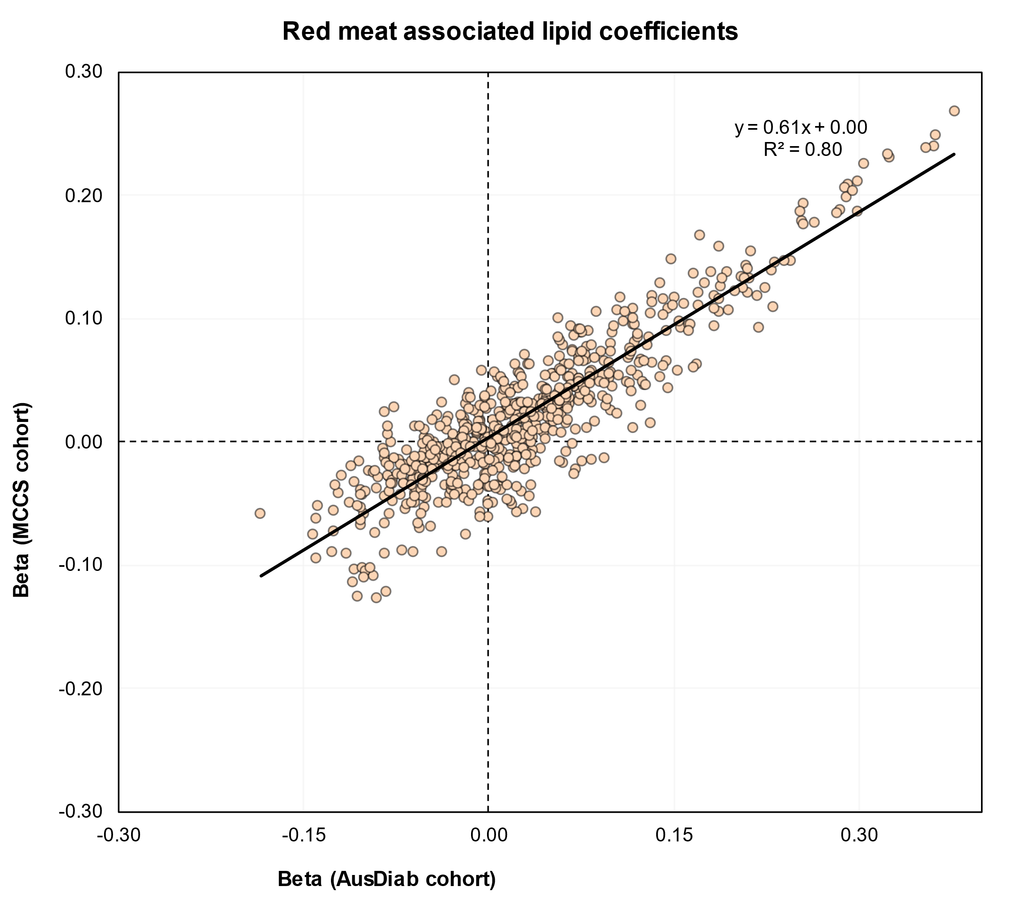
Supplementary Fig. 3 Validation of the red meat intake-lipidome associations. The correlation between beta coefficients from AusDiab (x-axis) and MCCS (y-axis). AusDiab, Australian Diabetes, Obesity and Lifestyle Study; Melbourne Collaborative Cohort Study (MCCS).

Slide 4
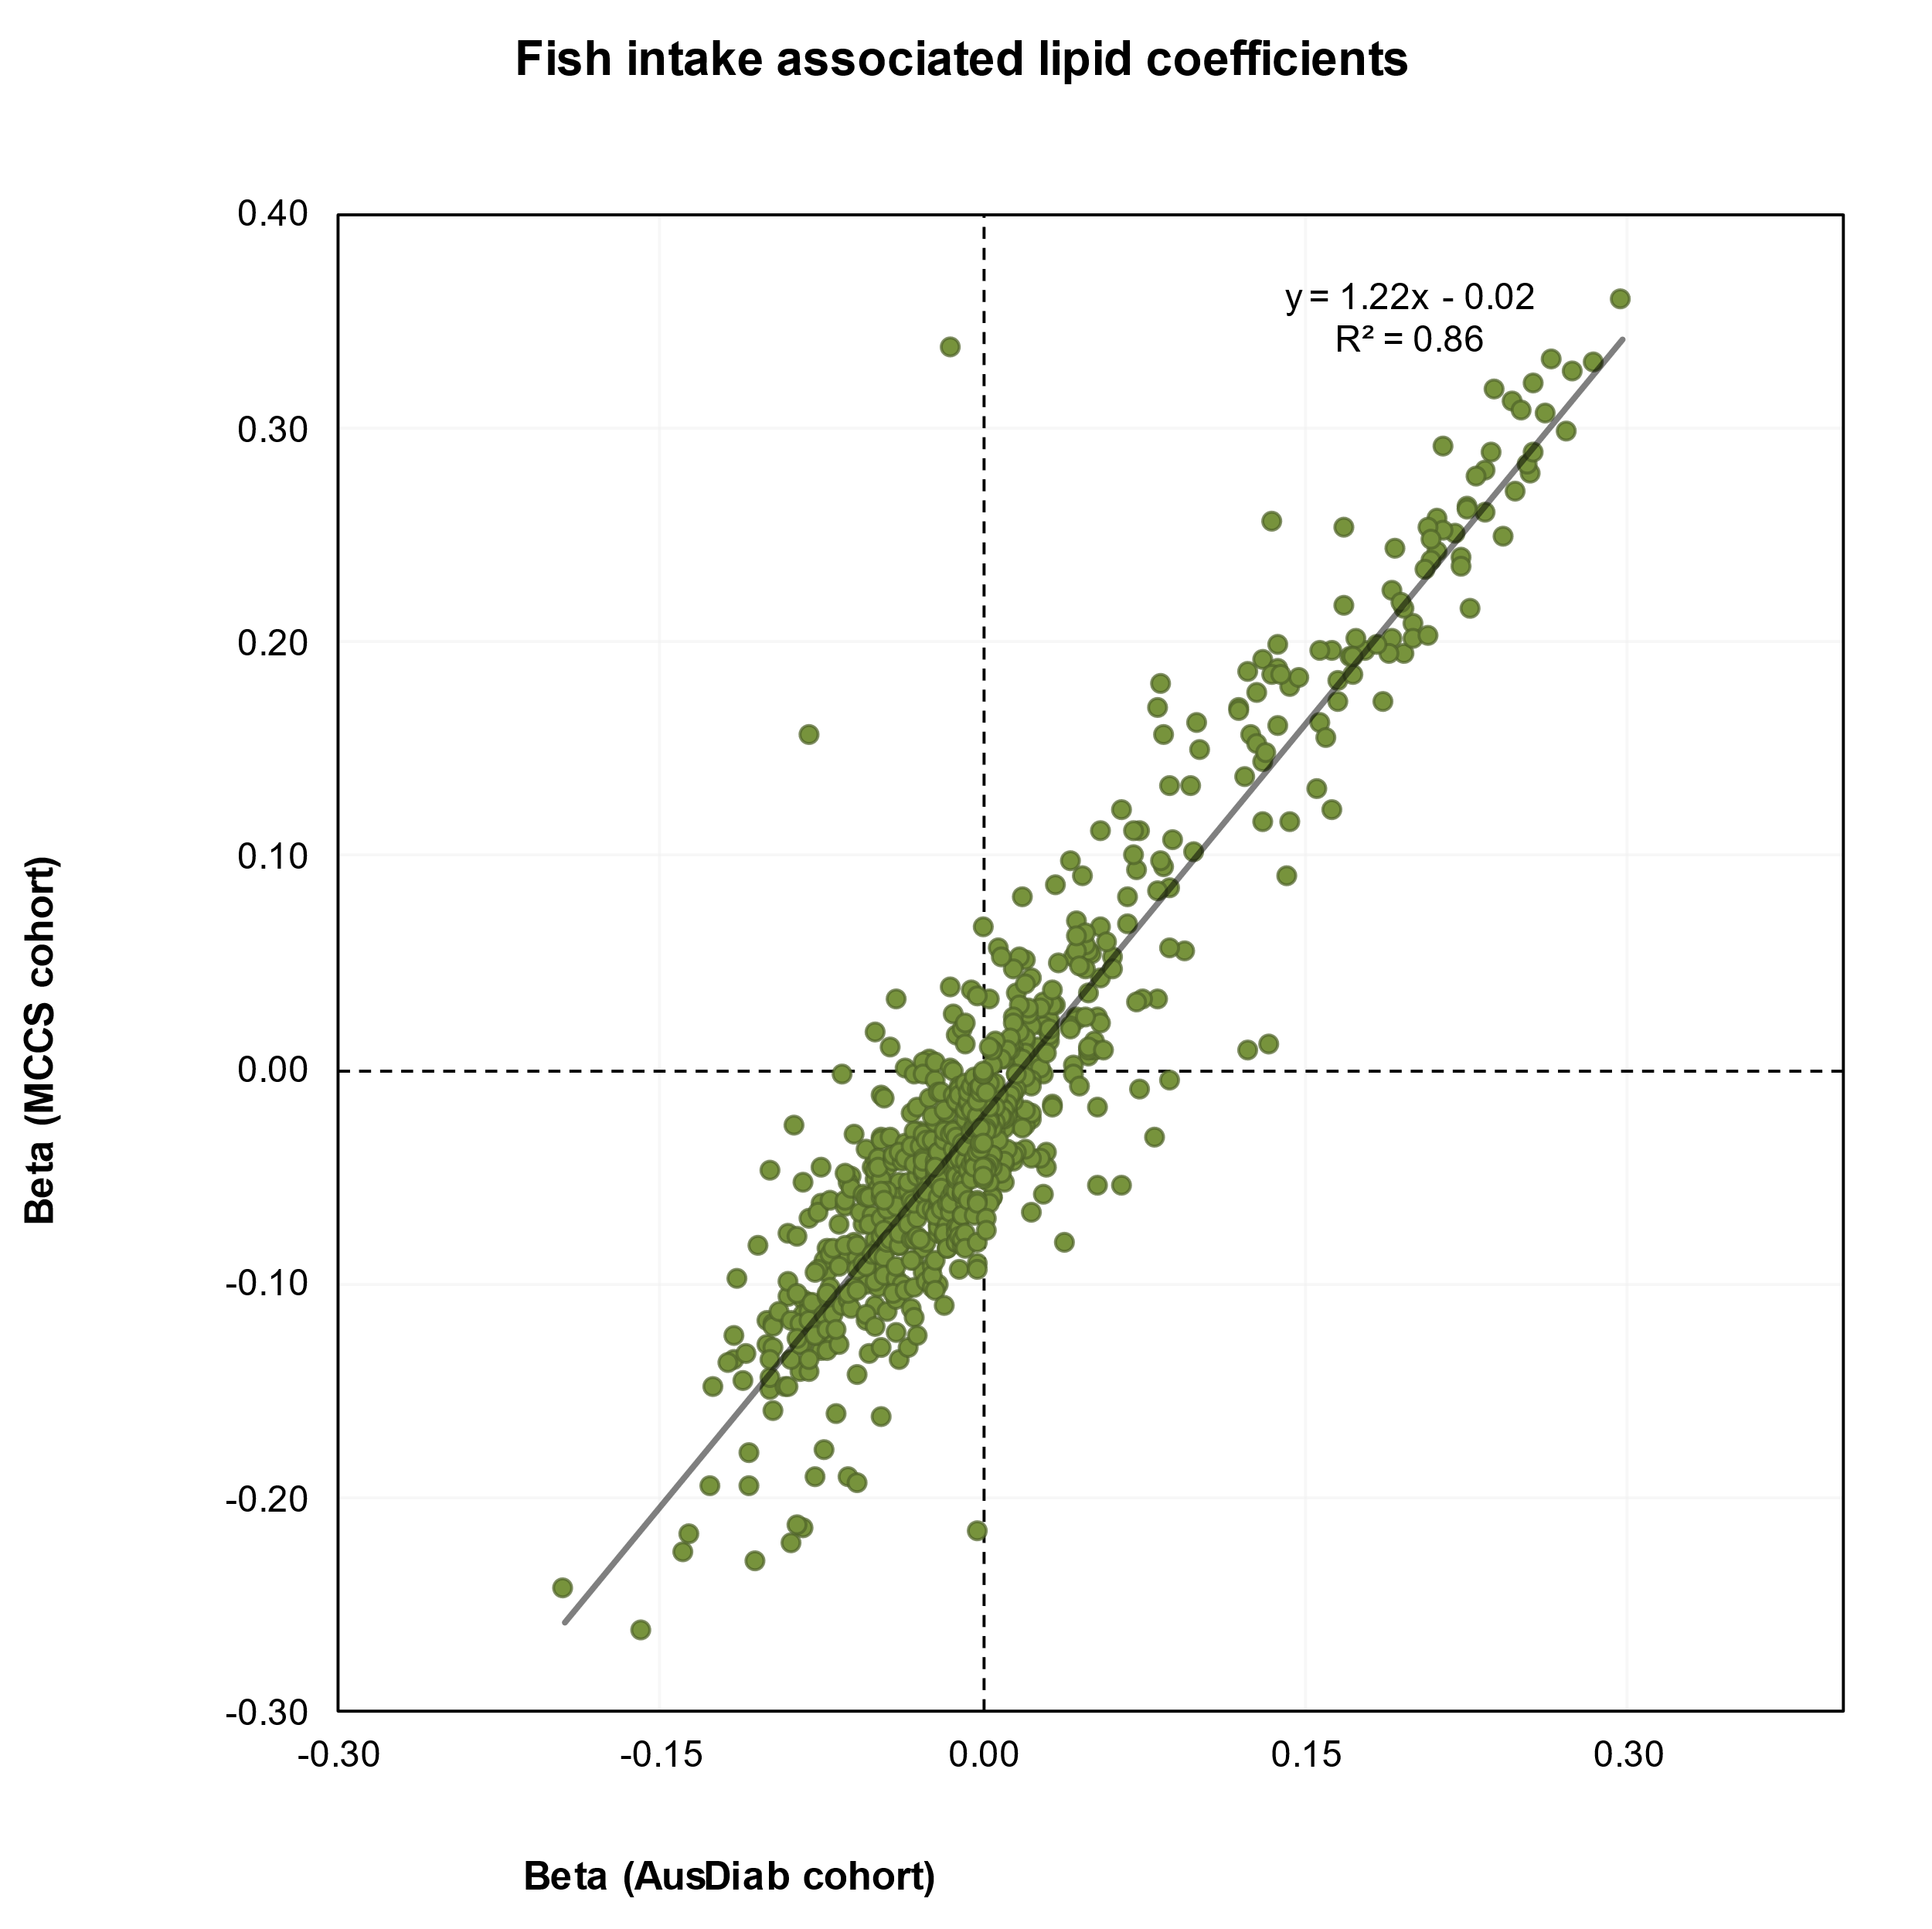
Supplementary Fig. 4 Validation of fish intake-lipidome associations. The correlation between beta coefficients from AusDiab (x-axis) and MCCS (y-axis). AusDiab, Australian Diabetes, Obesity and Lifestyle Study; Melbourne Collaborative Cohort Study (MCCS).

Slide 5
Supplementary Fig. 5 correlation among FFQ derived diet quality scores. DGI, Australian Dietary Guideline Index; GDQS, Global Diet Quality Score; HSR, Health Star Rating-Dietary Index; LCD, Low Carbohydrate Diet; Med Diet, Mediterranean diet score; MIND, Mediterranean-DASH (Dietary Approaches to Stop Hypertension) Intervention for Neurodegenerative Delay; PCR, Protein to carbohydrate ratio.

Slide 6
Supplementary Fig 6: The lipidome based prediction of dietary quality scores. The correlation (R²) between the lipidome predicted diet quality score and the FFQ derived diet quality score (x axis) (n = 8,000 biologically independent samples in the AusDiab and 2700 in the MCCS). DGI, Australian Dietary Guideline Index; GDQS, Global Diet Quality Score; HSR, Health Star Rating-Dietary Index; LCD, Low Carbohydrate Diet; Med Diet, Mediterranean diet score; MIND, Mediterranean-DASH (Dietary Approaches to Stop Hypertension) Intervention for Neurodegenerative Delay; PCR, Protein to carbohydrate ratio.

Slide 7
HSR-DI
pHSR-DI
GDQS
pGDQS
MIND
pMIND
LCD score
pLCD score
Standardized beta coefficient (95% CI)
p>0.05
p<0.05
Supplementary Fig. 7 Associations of FFQ calculated and lipidome predicted diet quality scores with conventional cardiometabolic health biomarkers. The forest plots show standardized coefficients (95% CIs) (x-axis) in a multiple linear regression analysis of between metabolic risk scores and diet groups after adjusting for age, sex, energy intake, smoking, physical activity level and diabetes status. Beta coefficients are per 1-SD increment.

Slide 8
Supplementary Fig. 8 Associations of lipidome defined diet quality scores with metabolic health: (a) metabolic BMI, (b) plasmalogen score and (c) LRS. The forest plots show standardized coefficients (95% CIs) (x-axis) in a multiple linear regression analysis of between metabolic risk scores and diet groups after adjusting for age, sex, BMI, clinical lipids (total cholesterol, HDL-C, triglycerides), smoking, physical activity level and diabetes status. Beta coefficients are per 1-SD increment. LRS, lipidomic risk score for CVD risk.

