Slide 1
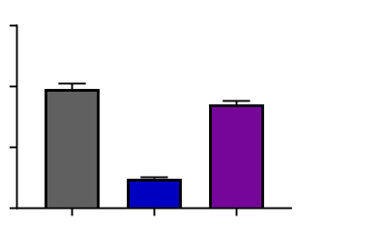
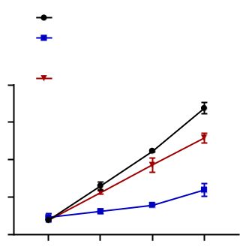
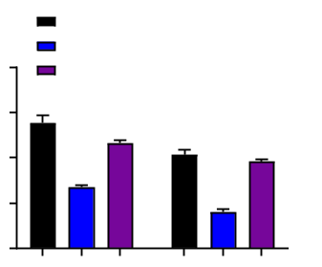
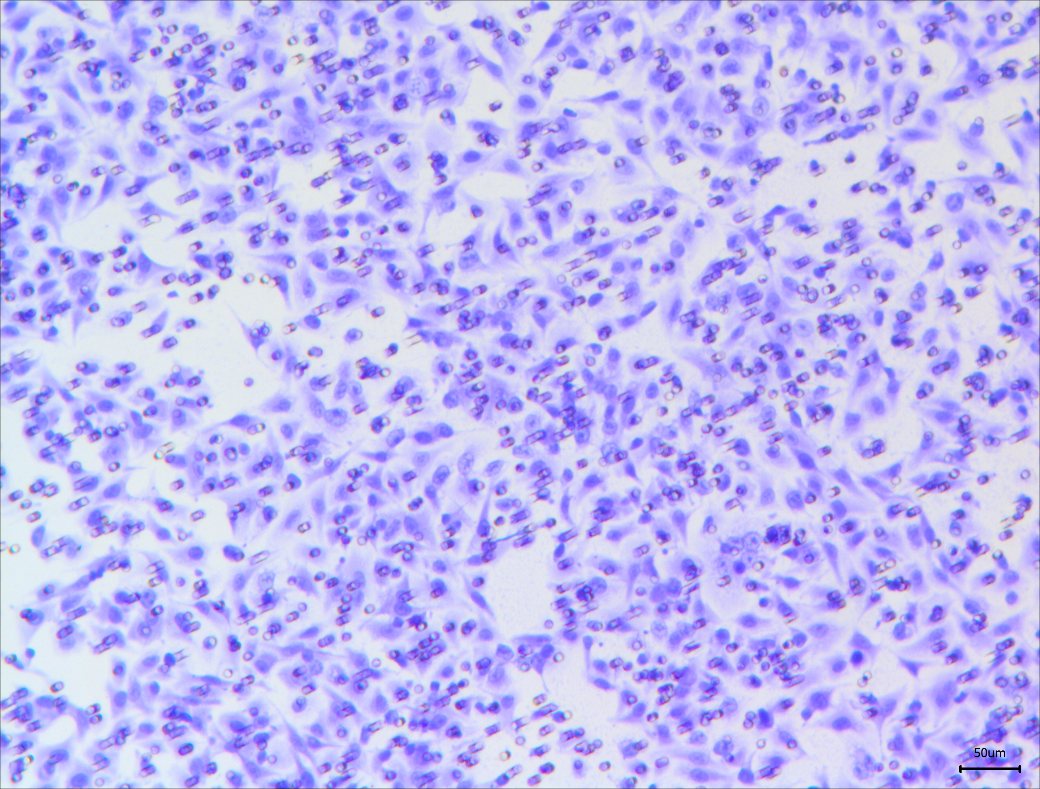
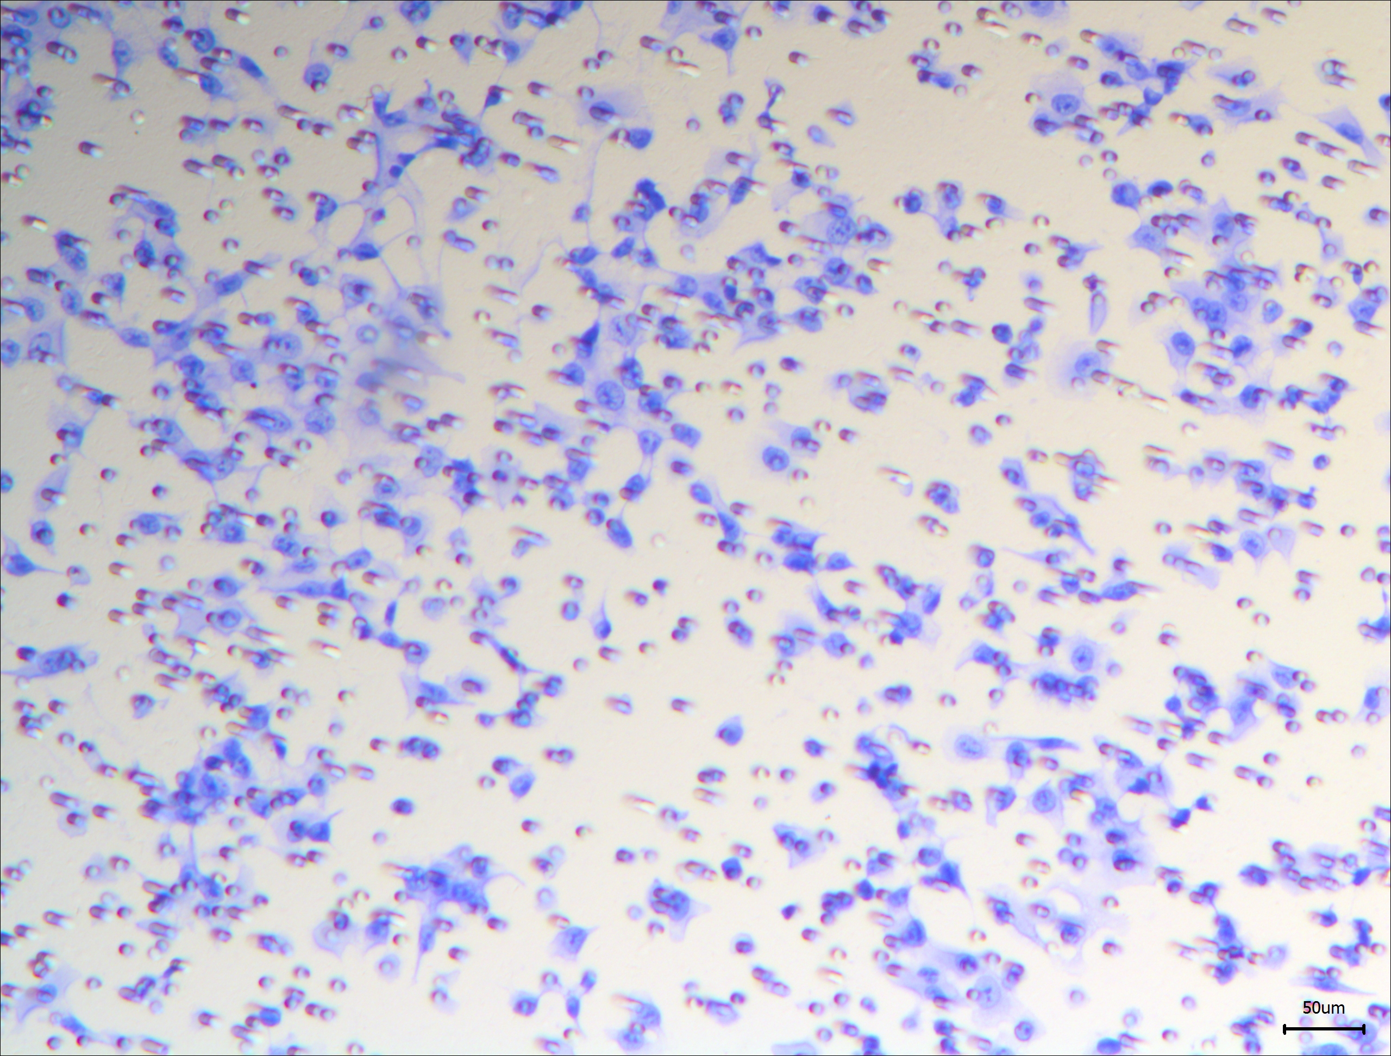
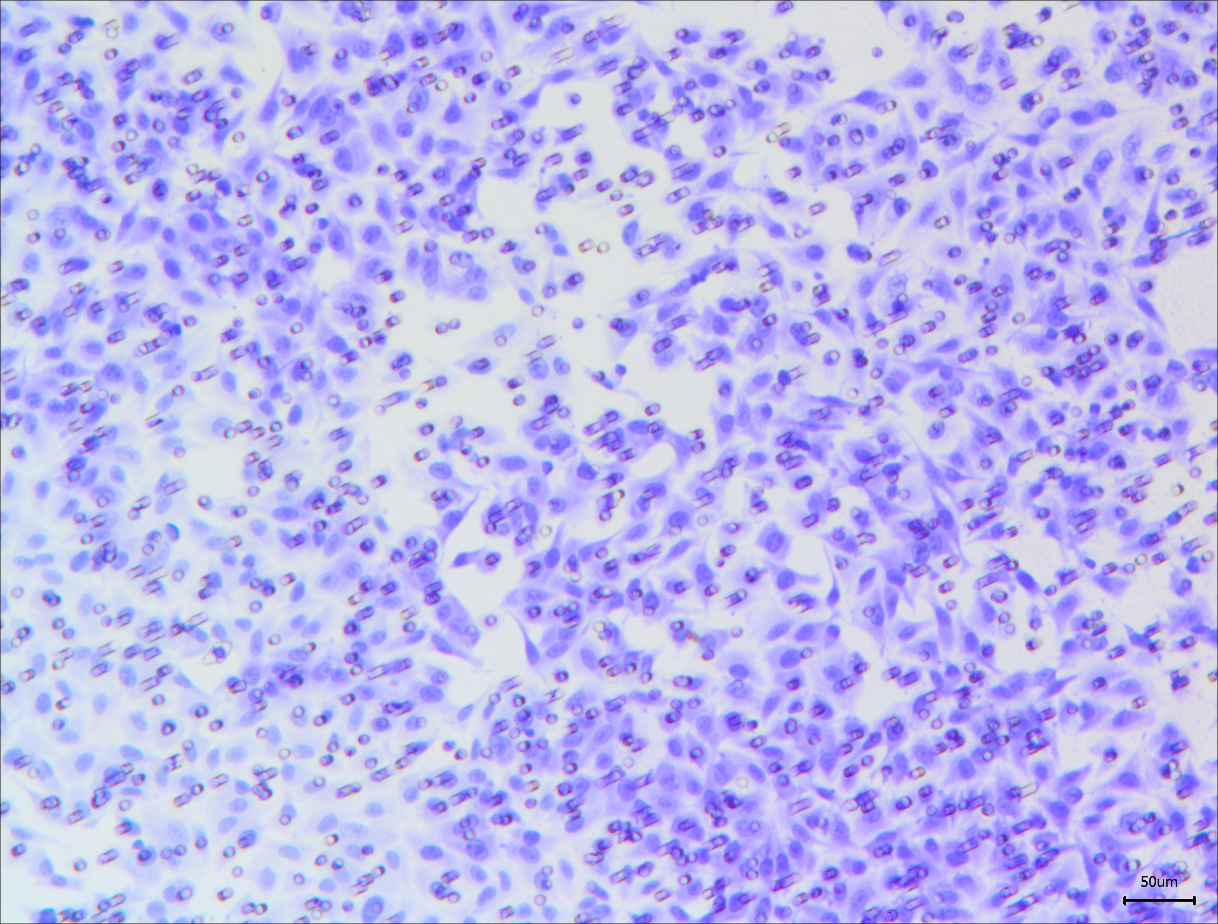
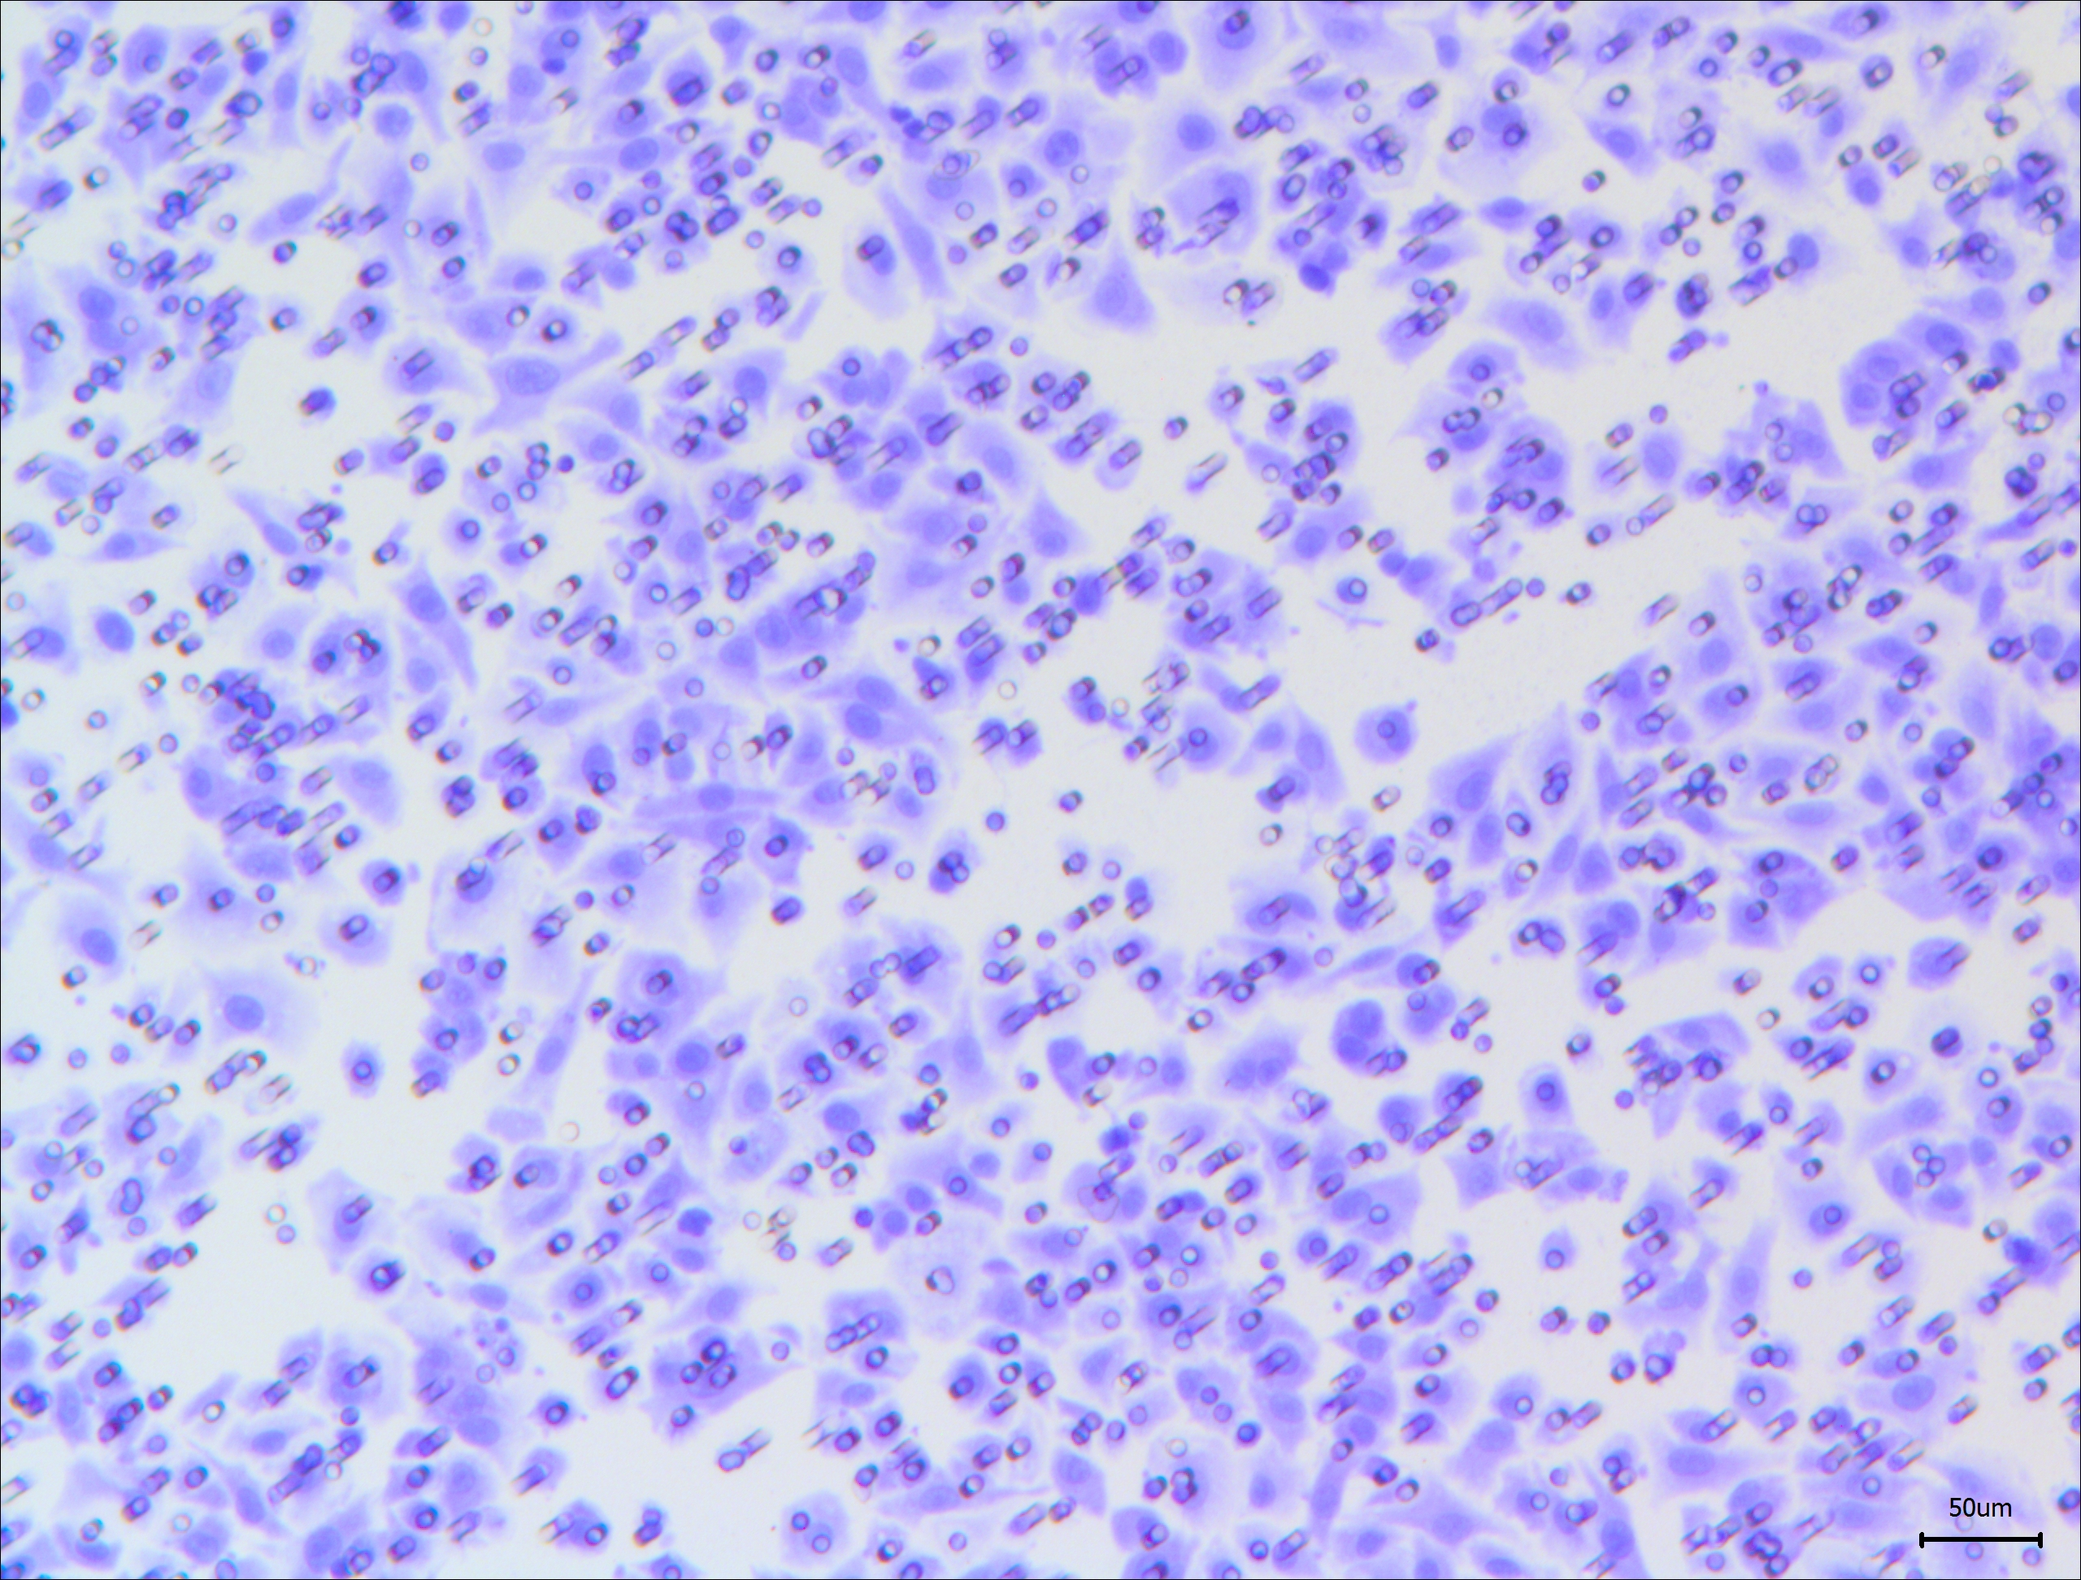
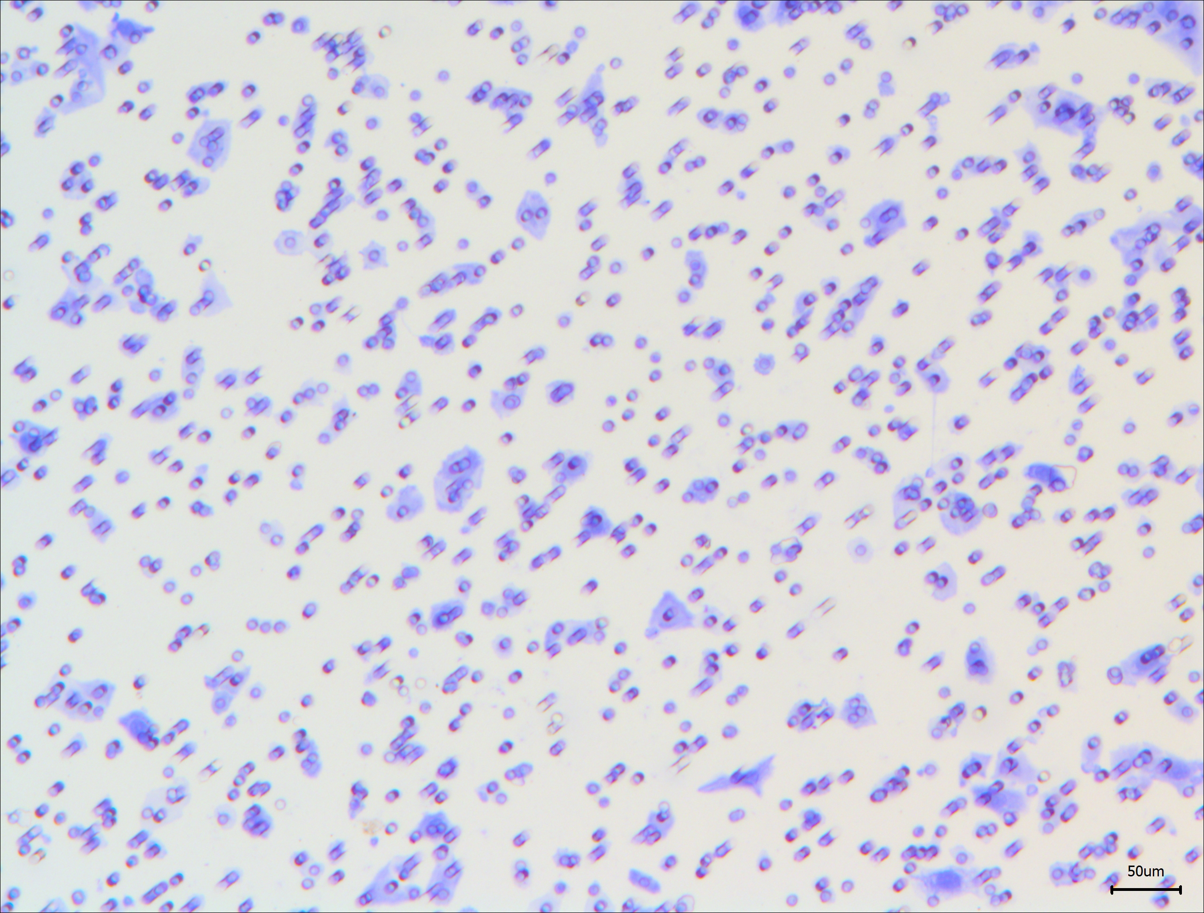
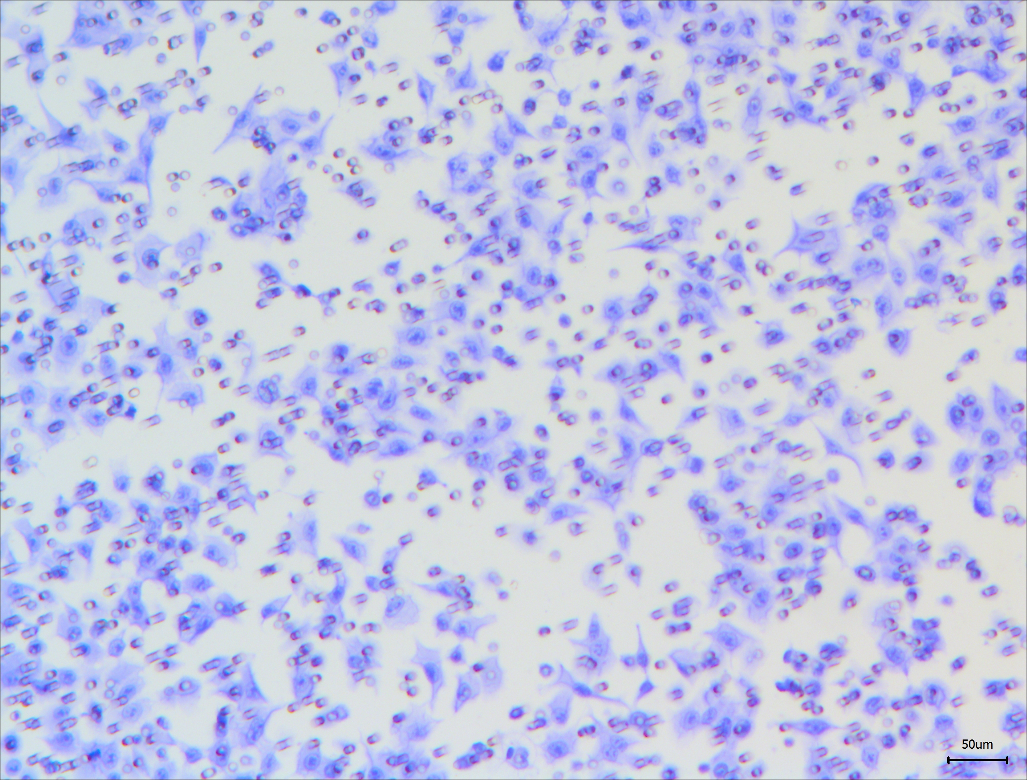
A
SK-hep1
B
SK-hep1
si-NC
1.5
si-circTP63#1
si-circTP63#1+miR-155-5p inhibitor
1.0
##
2.0
si-circTP63#1+ZBTB18
##
Relative ZBTB18 expression
1.5
0.5
**
1.0
##
0
Cells viability(OD 450nm)
**
si-NC
0.5
si-circTP63#2
si-circTP63#2+
ZBTB18
0
0h
24h
48h
72h
C
si-NC
si-circTP63#2
si-circTP63#2+
ZBTB18
si-NC
400
si-circTP63#2
Migration
300
si-circTP63#2+
ZBTB18
SK-hep1
200
##
##
Colony number
**
Invasion
100
**
0
Migration
Invasion
circTP63
Sponge
miR-155-5p
Target
ZBTB18
Promotes
Tumor Progression

