Slide 1
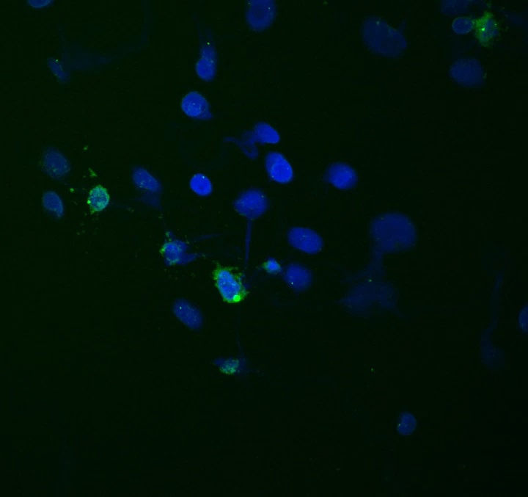
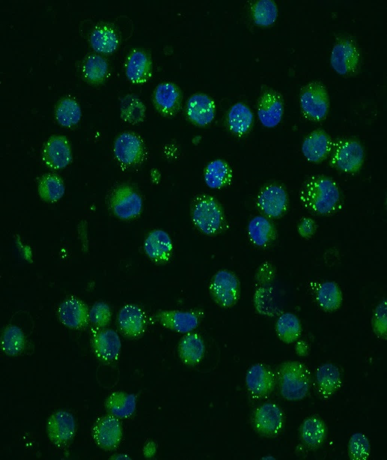
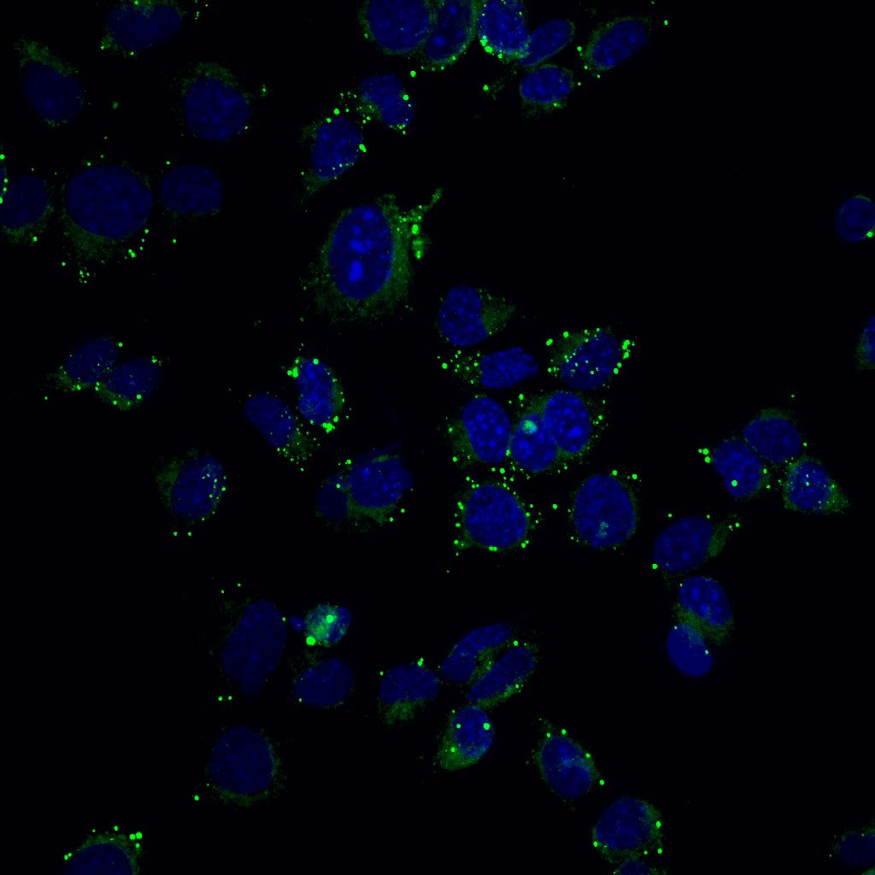
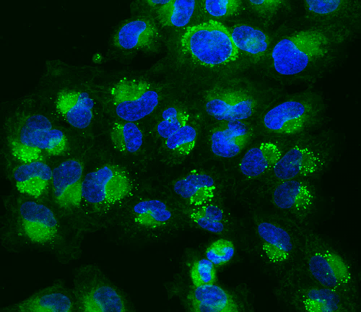
PN19
MES83
TRP
U251
Unedited images for Figure 3B

Slide 2
U251
75
75
50
50
pATGL
ATGL
Full unedited blot/gel for Figure 4J

Slide 3
TRP
75
75
50
50
pATGL
ATGL
Full unedited blot/gel for Figure 4K

Slide 4
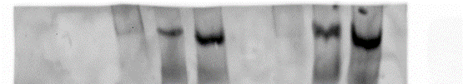
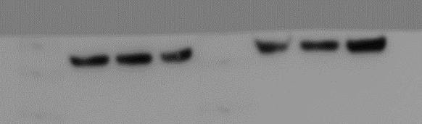
C LA Er
C LA Er
C LA Er
C LA Er
Transferin Receptor
(84kDa)
Actin (42kDa)
U251
TRP
U251
TRP
Full unedited blot/gel for Figure 5D

Slide 5
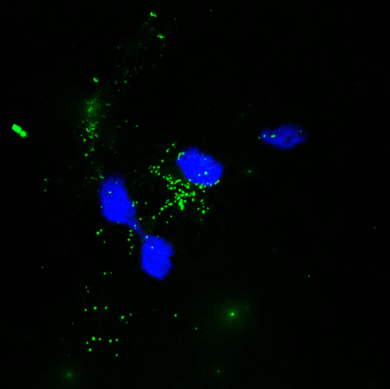
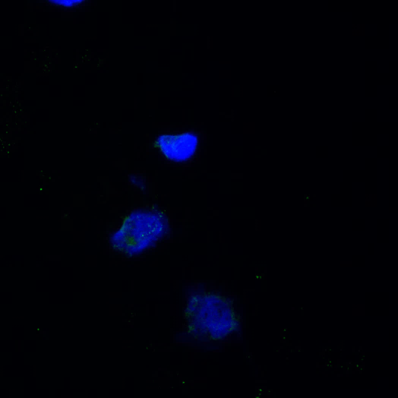
6B
6C
Unedited images for Figures 6B and 6

Slide 6
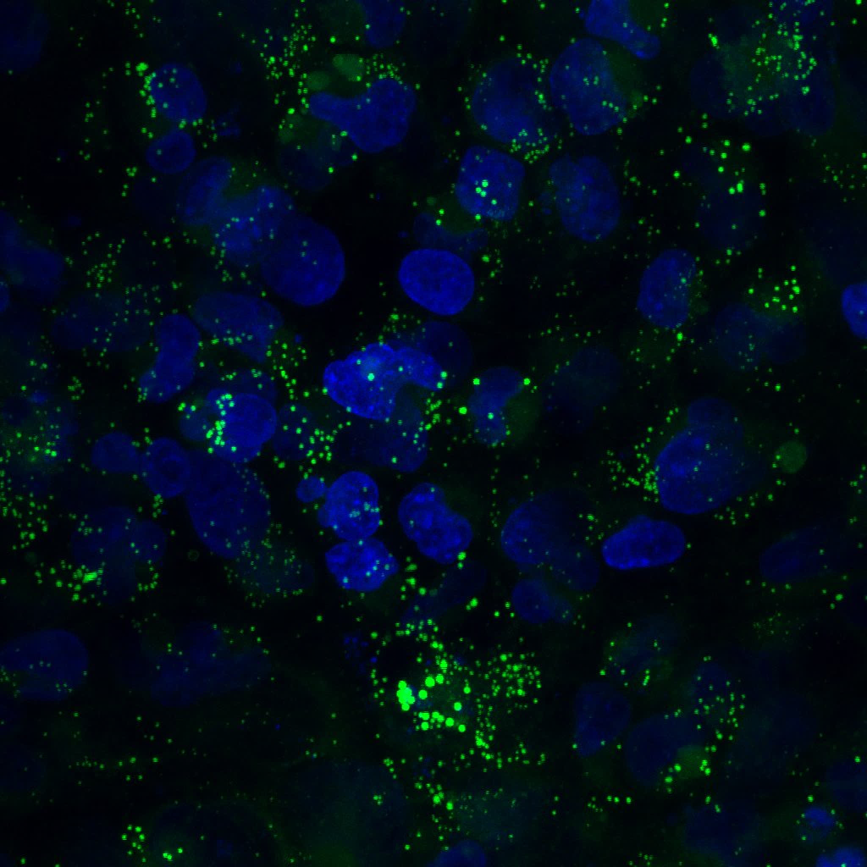
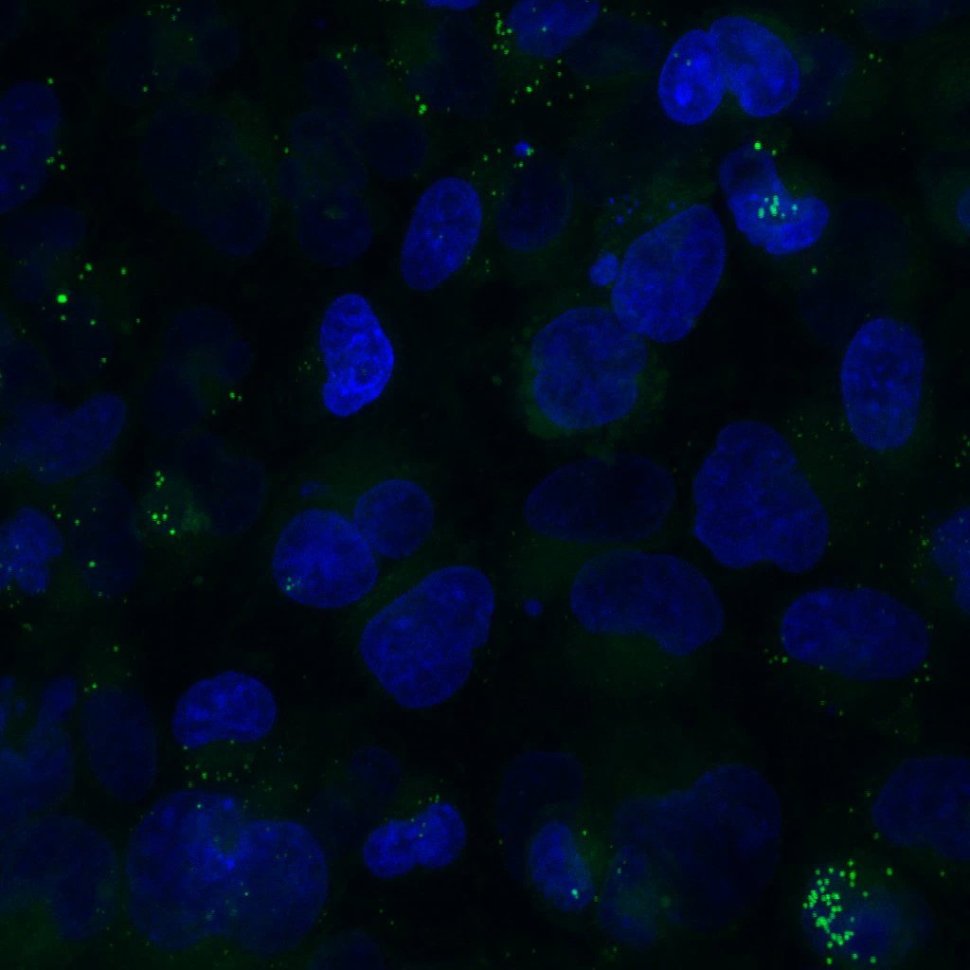
Unedited images for Figure 7E

