Slide 1
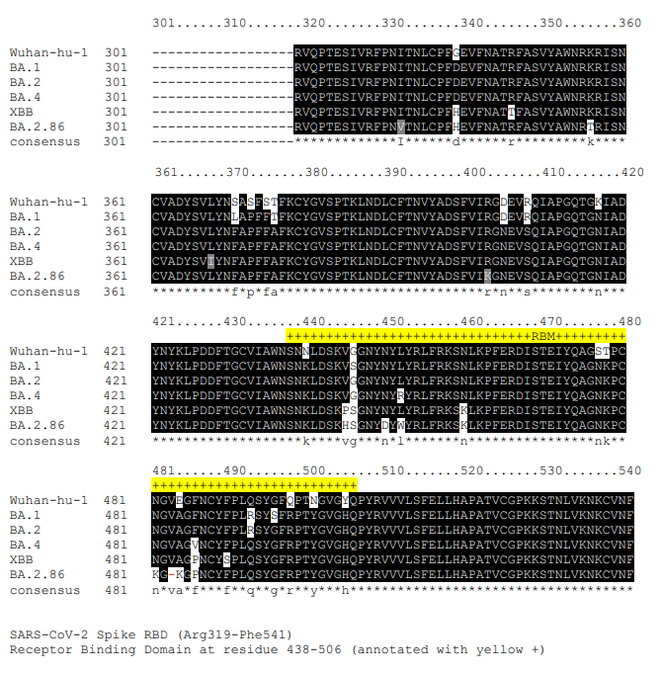
a
b
Supplementary Figure 1: Spike Receptor Binding Domain alignment in variants of concern and population SARS-CoV-2 variant prevalence between 2020 and 2024.
a) Multiple sequence alignment of SARS-CoV-2 Spike receptor binding domain (RBD). The sequence of SARS-CoV-2 Spike RBD from Wuhan-hu-1, BA.1, BA.2, BA.4, XBB, and BA2.86 were aligned by MAFFT, generated by boxshade, and annotated manually. Residue indexes are based on Wuhan-Hu-1, starting at Arg319. Residues different from consensus are in black on white background. Asterisks indicate completely conserved columns in the alignment. The receptor binding motif (RBM) residues are marked yellow plus signs (+). NCBI protein accession numbers are as follows: Wuhan-Hu-1 (NC_045512.2); BA.1 (OL672836.1); BA.2 (OM371884.1); BA.4 (ON373214.1); BA.2.86 (OR775659.1); XBB (XBB 1.5 OP790748.1 with S: P486S). b) SARS-CoV-2 epidemiological dynamics in Nigeria between 2020 and 2024. (top) The WHO reported weekly new cases (black) and new deaths (red) in Nigeria attributed to COVID-19. (bottom left) The weekly prevalence of each major variant on GISAID retrieved via the Outbreak.info API reported as a percentage. The stacked bar charts represented aggregated total proportion of sequences attributed to each variant based on sequence count (bottom middle) and based on sequence count weighted by the weekly number of new cases (bottom right).

Slide 2
a
b
Supplementary Figure 2: Pre-vaccination antibody response in participants from a 2023 vaccine trial in Nigeria with Omicron exposure defined by IgG anti-RBD-Omicron status (Cohort 2, n = 58). a) Participants recruited with neutralisation response data prior to vaccination (T0) who were tested for total IgG antibodies against SARS-CoV-2 Wildtype (Wu-1) anti-Nucleocapsid (anti-N), anti-Spike (S), anti-Wu-1 Receptor Binding Domain (anti-RBD-Wu-1), and anti-Omicron BA.1 RBD (anti-RBD-Omicron). b) Pseudotyped virus neutralisation titres of Wu-1, BA.1, BA.2 and XBB viruses in (n = 58) participants in cohort 2. Data are representative of two independent experiments comprised of two technical replicates. Geometric mean titre (GMT) of neutralising antibody responses are shown numerically above each timepoint and as horizontal black lines. Data points were compared and assessed for significance using two-tailed Wilcoxon signed-rank tests. *P < 0.05; **P < 0.01; ***P < 0.001; ****P < 0.0001; no * = not significant. Dashed lines indicate limit of neutralisation response detection. Fold changes are represented above the corresponding horizontal comparative lines

Slide 3
a
Total IgG anti-RBD-Omicron (n = 45)
IgG anti-RBD-Omicron
≥ 2-fold increase (n = 23)
Supplementary Figure 3: Kinetics of IgG binding antibody responses against SARS-CoV-2 Omicron RBD. a) Total IgG of anti-Receptor Binding Domain (RBD) Omicron-specific antibodies before and after one dose of the Ad26.COV2.S vaccine in (n = 45) participants (left panel). Participants who had ≥ 2-fold increase in anti-RBD-Omicron titres from pre-vaccination to 1-month post-dose 1 (n = 23) are shown (right panel). Geometric mean of the Mean Fluorescence Intensity (MFI) from the Luminex binding antibody assay is shown numerically above each timepoint and as black horizontal lines.

Slide 4
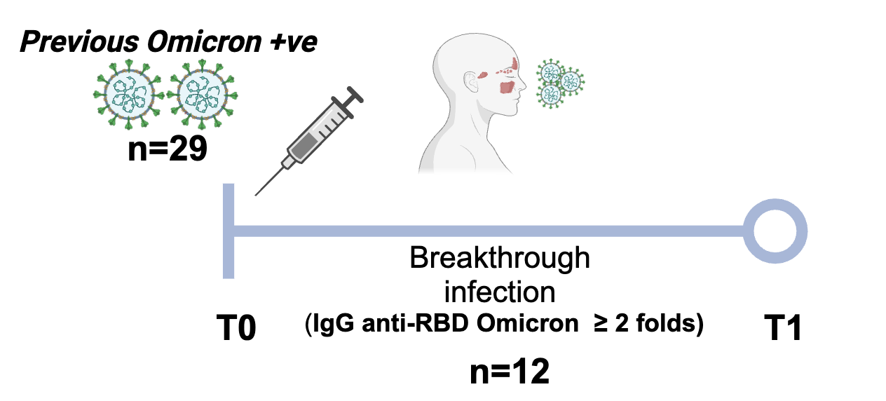
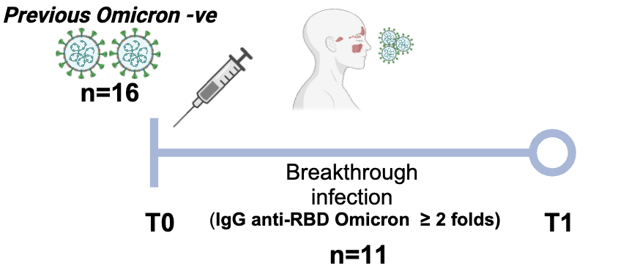
a
Wu-1
BA.1
BA.2
BA.4
XBB
b
Wu-1
BA.1
BA.2
BA.4
XBB
Supplementary Figure 4: Plasma neutralisation responses stratified by pre-vaccination Omicron exposure status with or without breakthrough infection after one dose of Ad26.COV2.S vaccine. Pseudotyped virus neutralisation titres against Wild type (Wu-1), BA.1, BA.2, BA.4 and XBB across two consecutive time points: T0 (prior to first-dose vaccination) and T1 (1 month after first-dose vaccination). Titres in a) pre-vaccination Omicron-exposed participants (n = 29) stratified by Omicron breakthrough infection (BTI, n = 12) and without BTI (n = 17), and in b) pre-vaccination Omicron-unexposed participants (n = 16) stratified by Omicron BTI (n = 11) and without BTI (n = 5). Data are representative of two independent experiments comprised of two technical replicates. Geometric mean titres (GMT) of antibodies are shown numerically above each timepoint. Data points were compared using two-tailed Wilcoxon signed-rank tests and shown as GMT with 95% CI. *P < 0.05; **P < 0.01; ***P < 0.001; ****P < 0.0001; ns = not significant.

Slide 5
a
b
Supplementary Figure 5: Validation of Luminex assay for quantification of binding antibodies using pre-pandemic sera from (n = 93) participants. a) Binding antibodies against Wu-1 anti-Nucleocapsid (anti-N) and b) binding antibodies against Omicron Receptor Binding Domain (anti-RBD-Omicron) in (n = 93) pre-pandemic control sera samples. Data are represented as Mean Fluorescence Intensity (MFI). Cut-offs were determined using Mean + 3 standard deviations of the mean.

