Slide 1
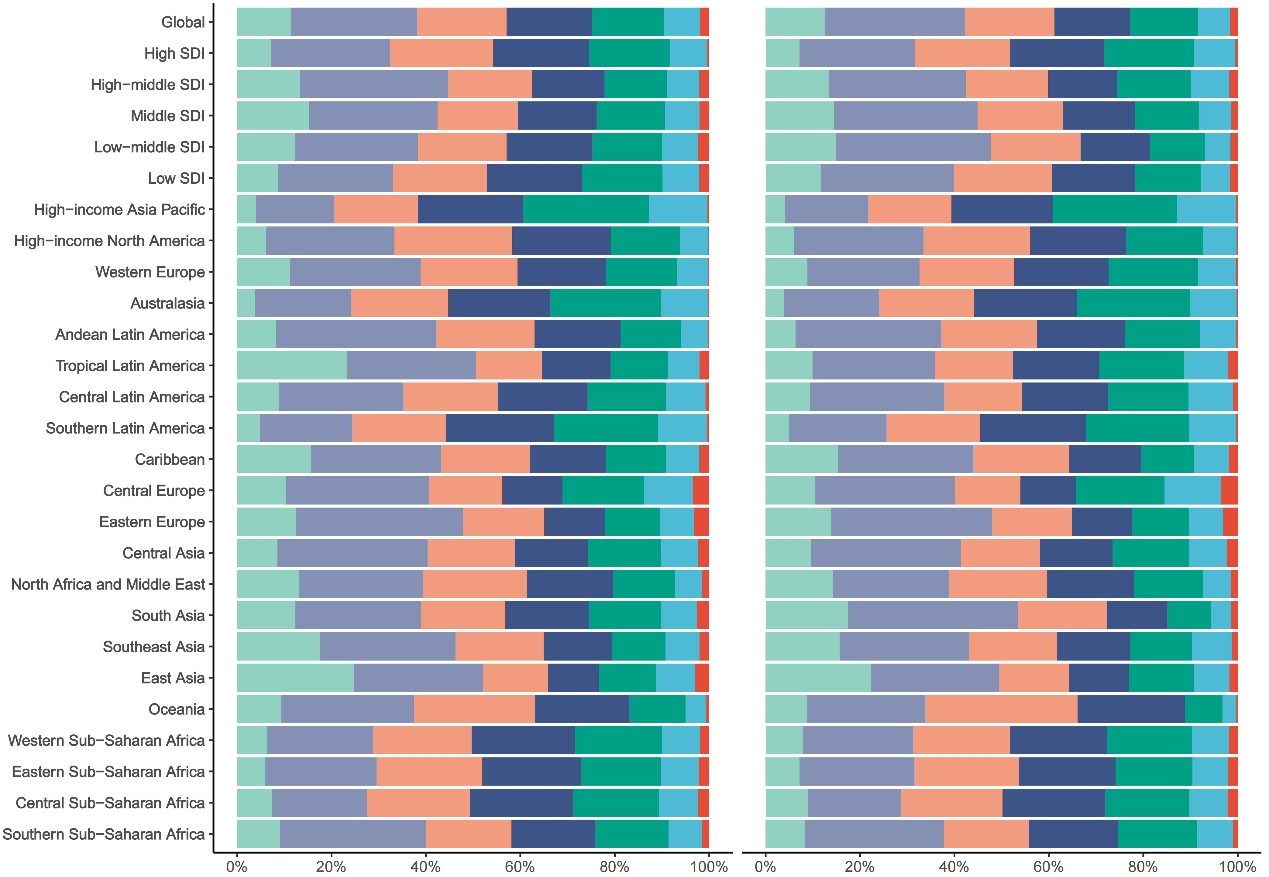
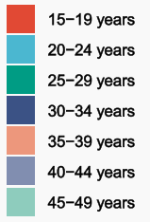
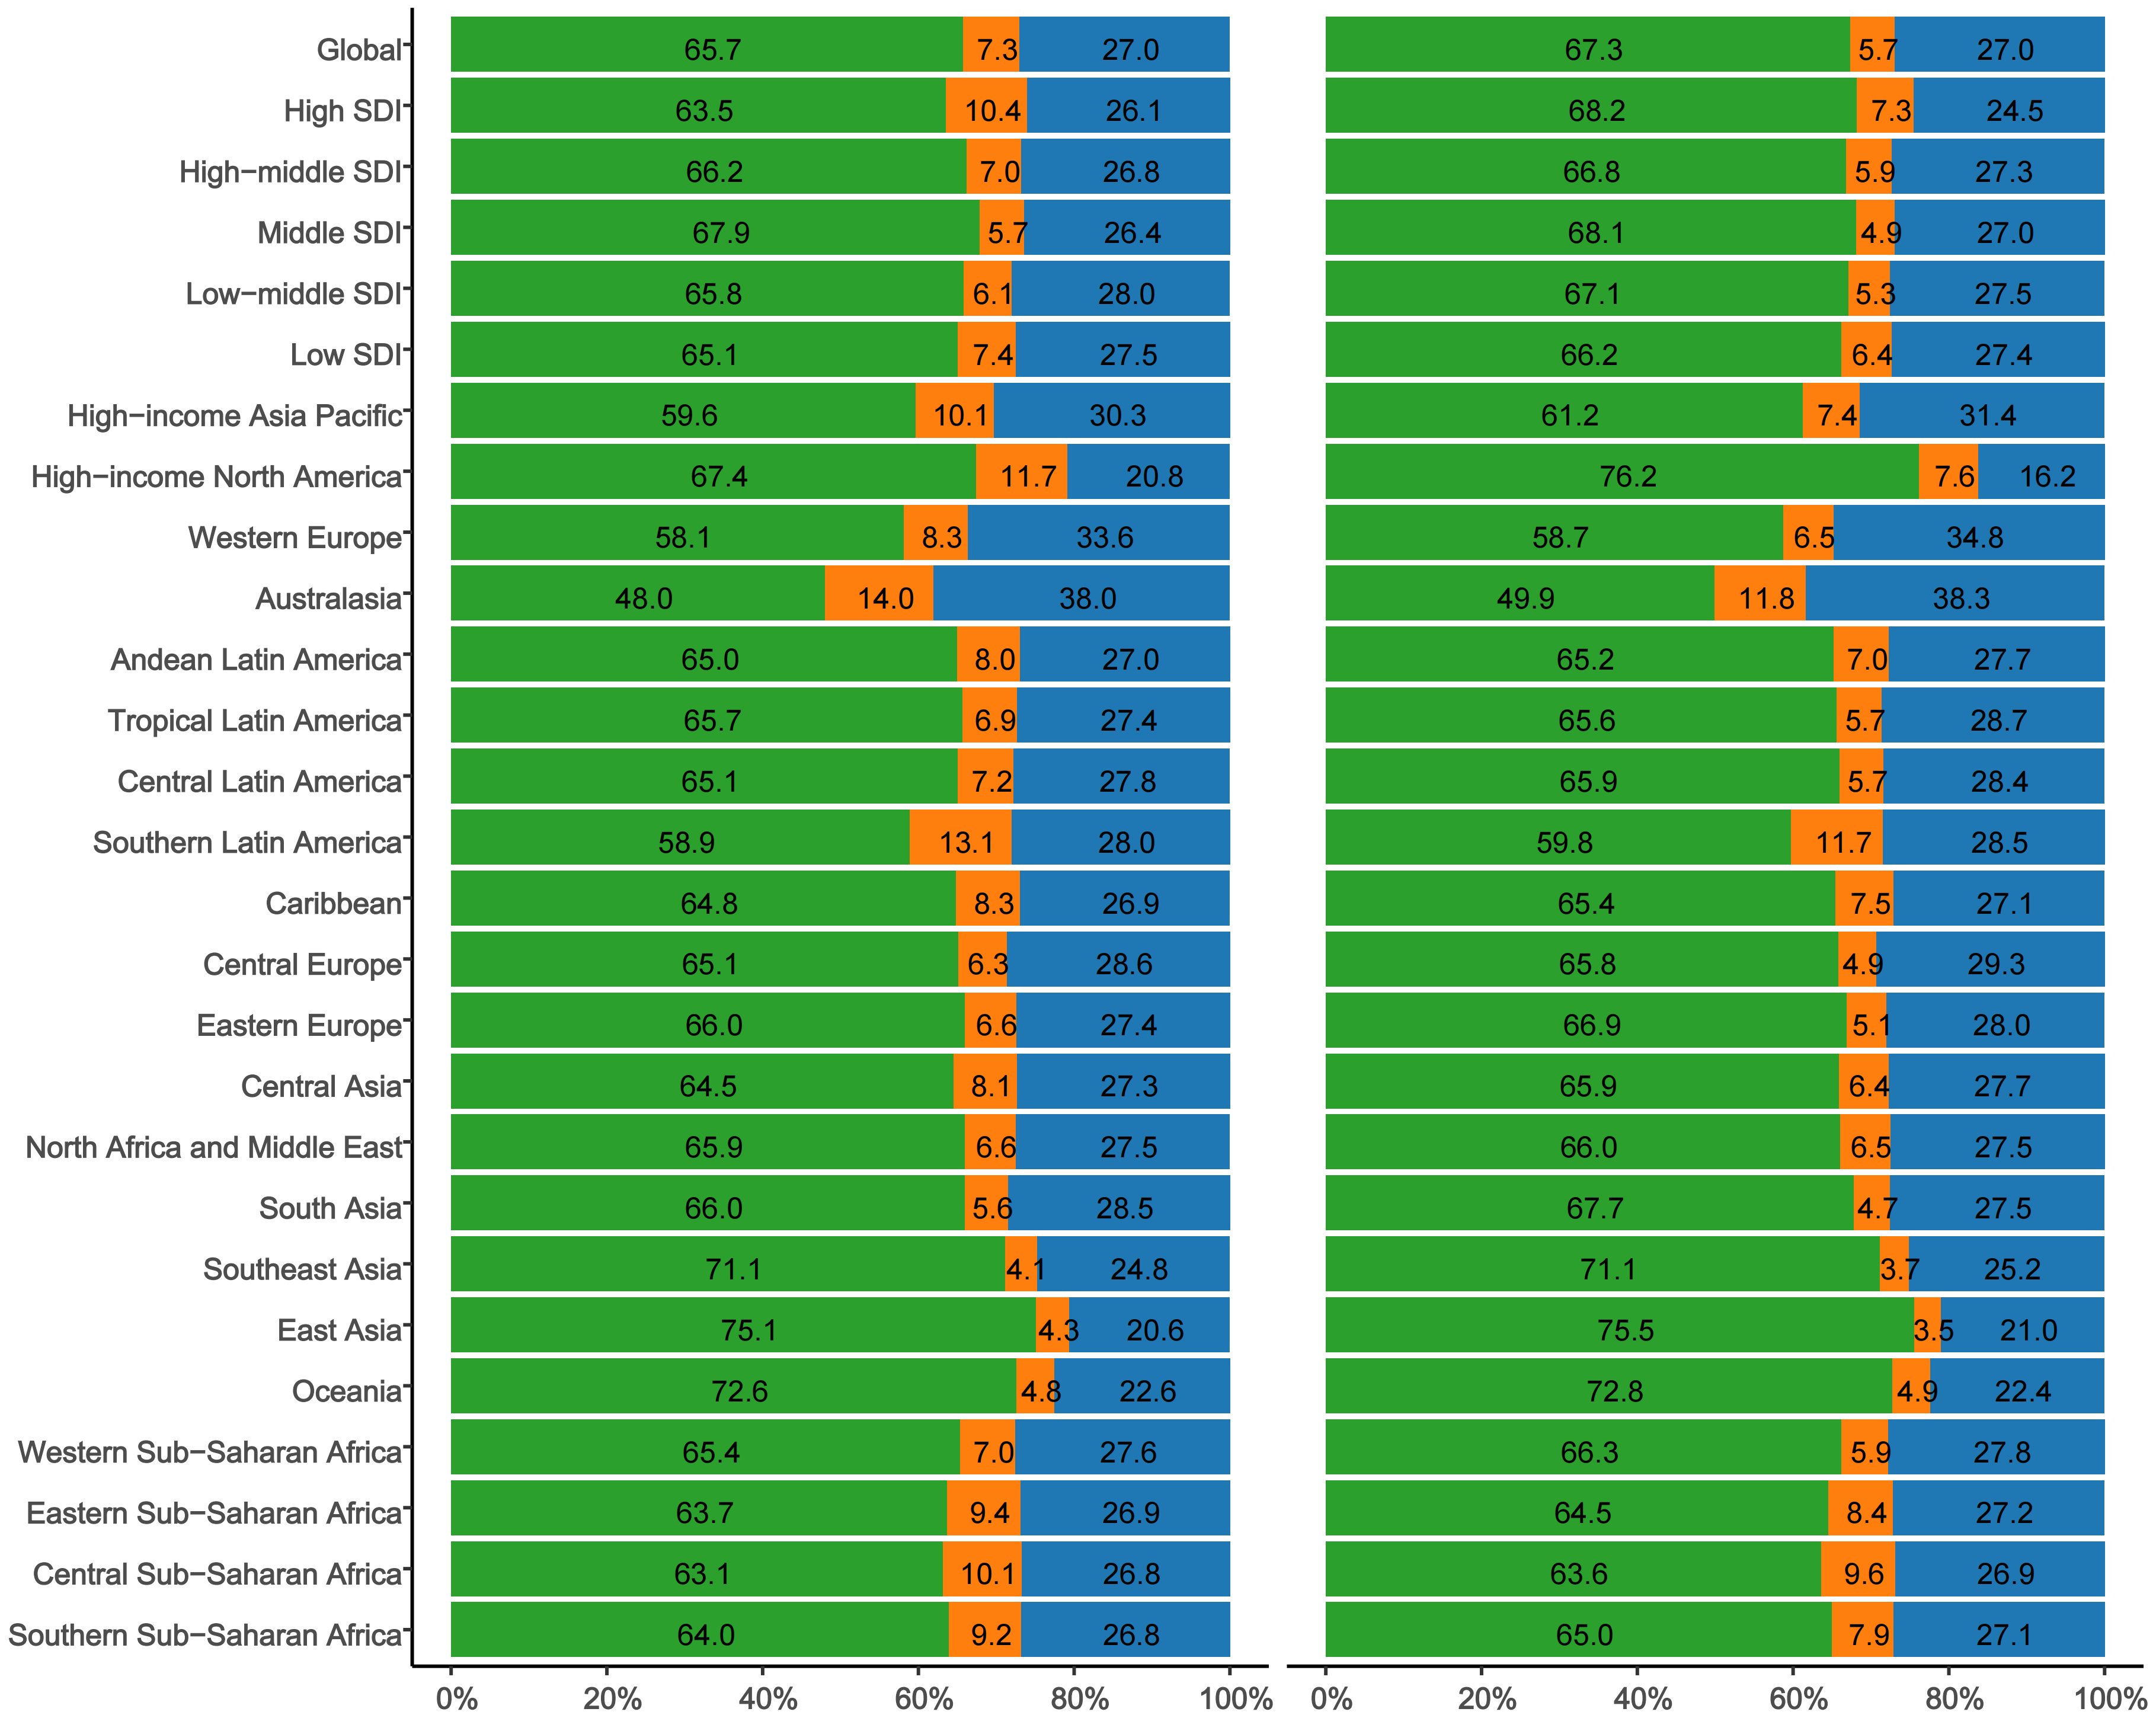
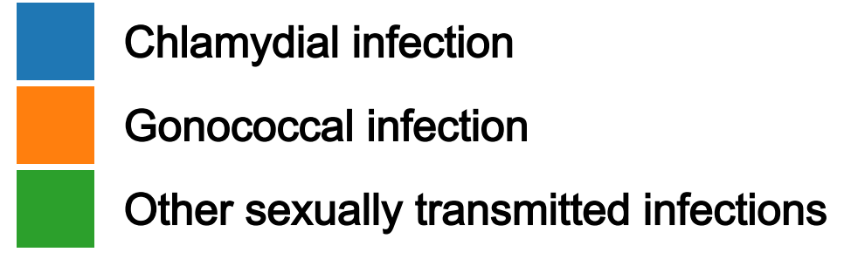
Figure S1 Primary Infertility
A Prevalence
Proportion
B The types of illnesses
Proportion

Slide 2
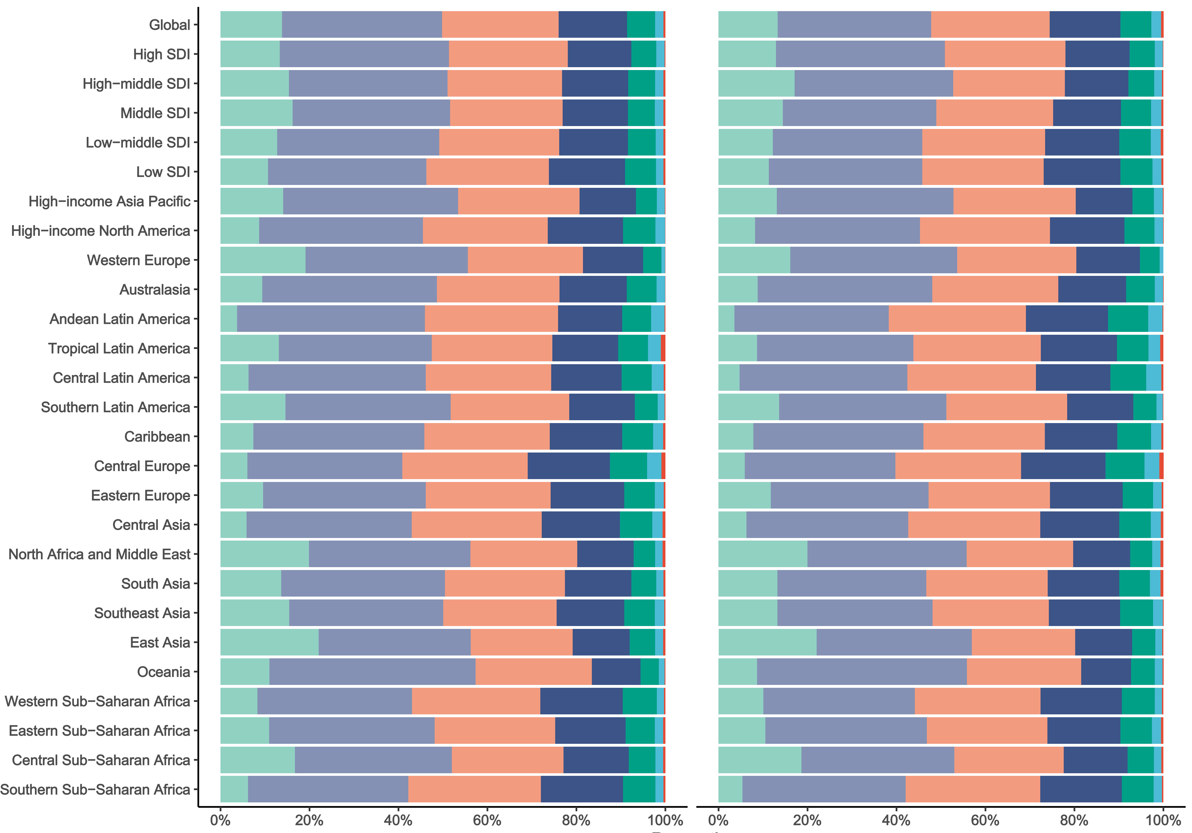
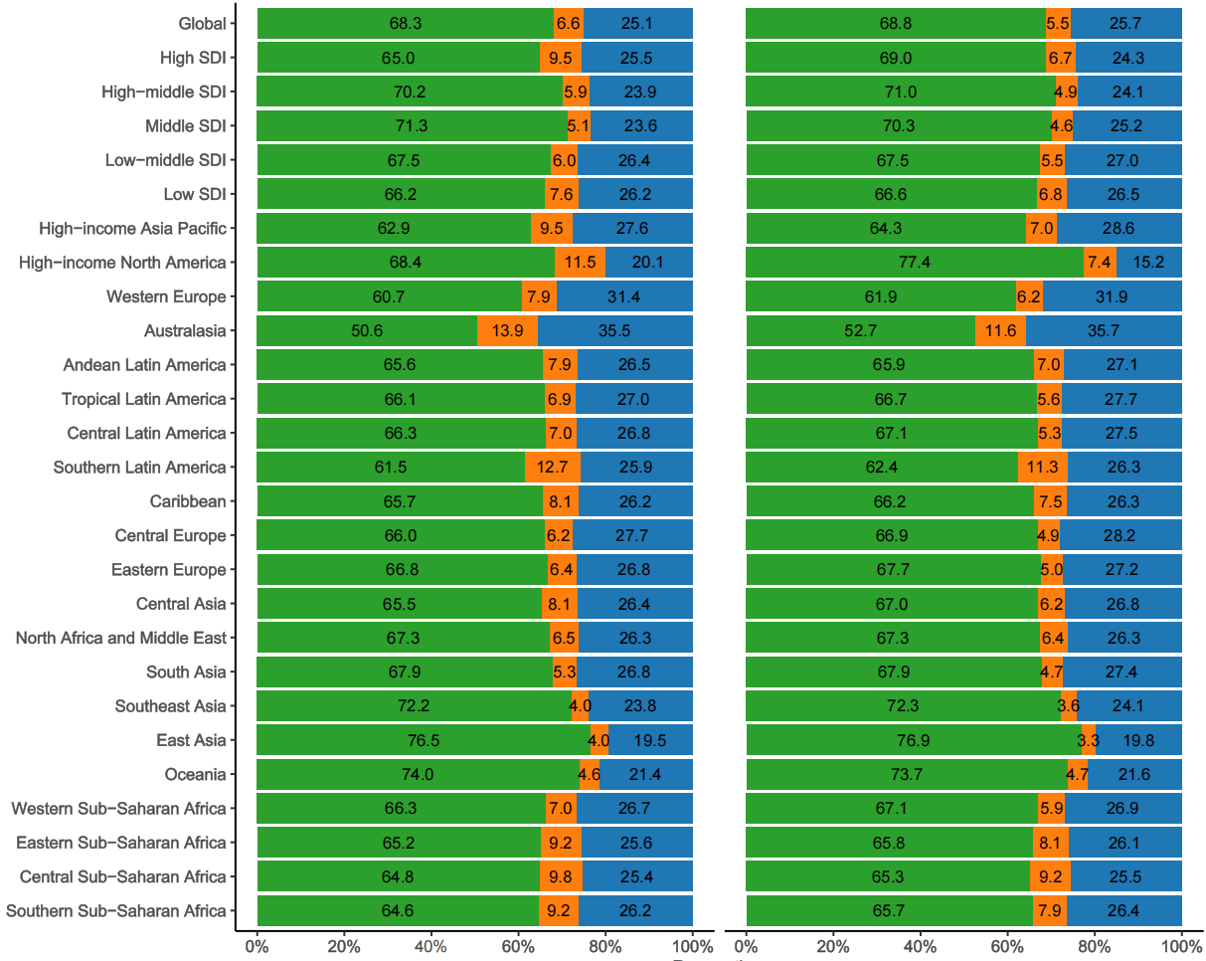
Figure S2 Secondary Infertility
2021
1990
A Prevalence
Proportion
B The types of illnesses
Proportion

