Slide 1
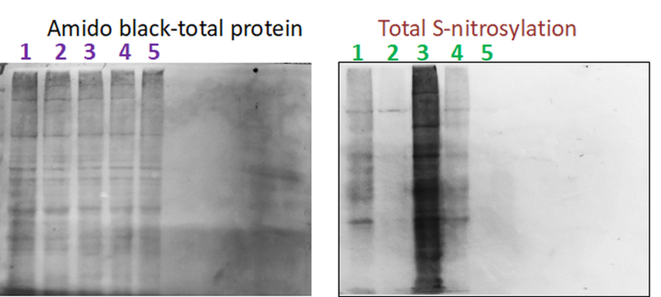
Sup.1. A control experiment demonstrating the specificity of the method for detecting s-nitrosylated proteins was performed. Control frontal cortex samples (2 mg/mL protein) were treated with the nitrosylating agent GSNO at a concentration of 200 μM for 60 minutes (line 3), GSNO but without ascorbate (line 4), or without HDP-biotin. Line:1. Control 2.Control without Asc 80mM 3.GSNO 200uM; 60 min 4.GSNO without Asc 80mM 5.GSNO without HDP biotin

Slide 2
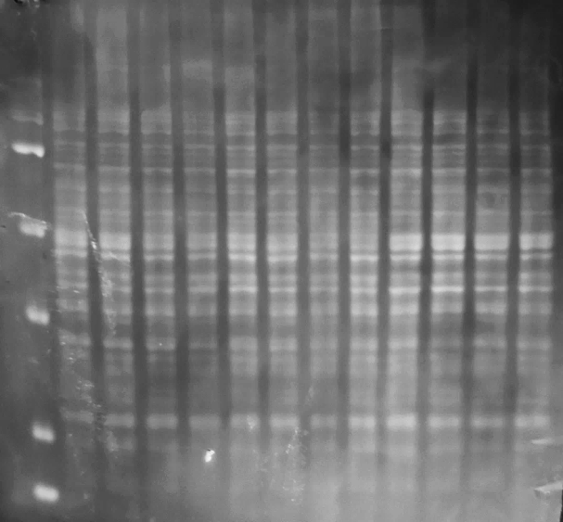
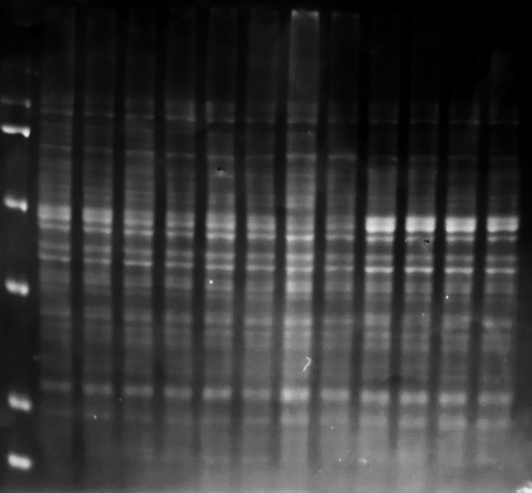
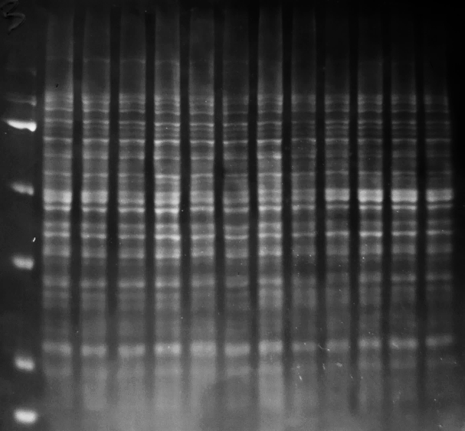
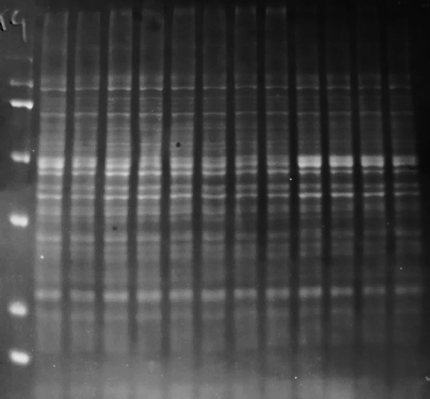
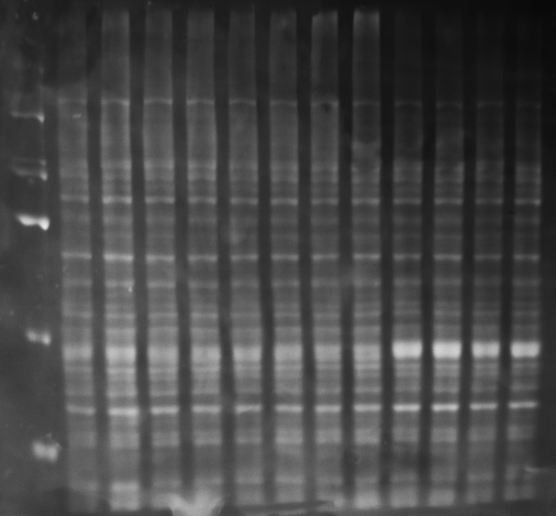
Total-protein amido black staining- scopolamine
Blot A
Blot B
Blot C
M 1 2 3 4 5 6 7 8 9 10 11 12
M 1 2 3 4 5 6 7 8 9 10 11 12
M 1 2 3 4 5 6 7 8 9 10 11 12
Blot D
Blot E
M 1 2 3 4 5 6 7 8 9 10 11 12
M 1 2 3 4 5 6 7 8 9 10 11 12
M-size marker
1,2-control
3,4- Scopolamine
5,6-Scop.+VU0152100
7,8-Scop.+VU0357017
9,10-Scop.+LY487379
11,12-Scop.+CDPPB

Slide 3
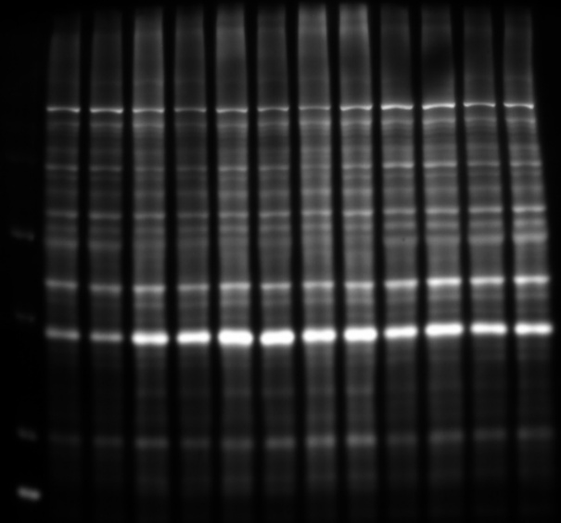
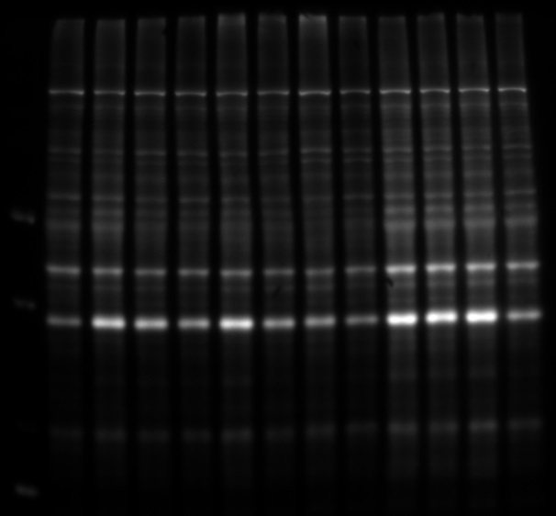
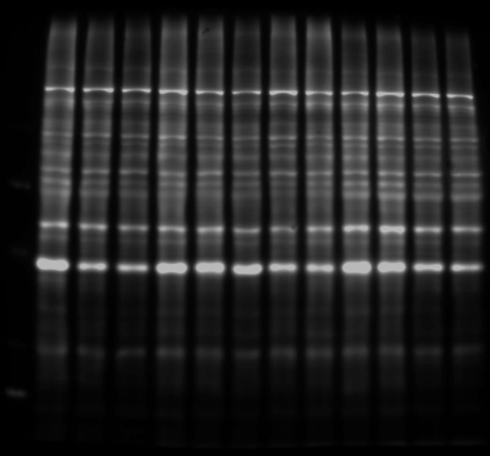
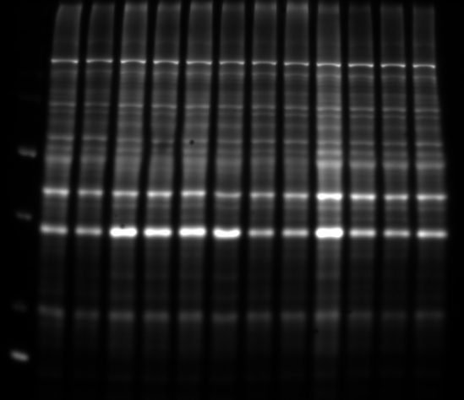
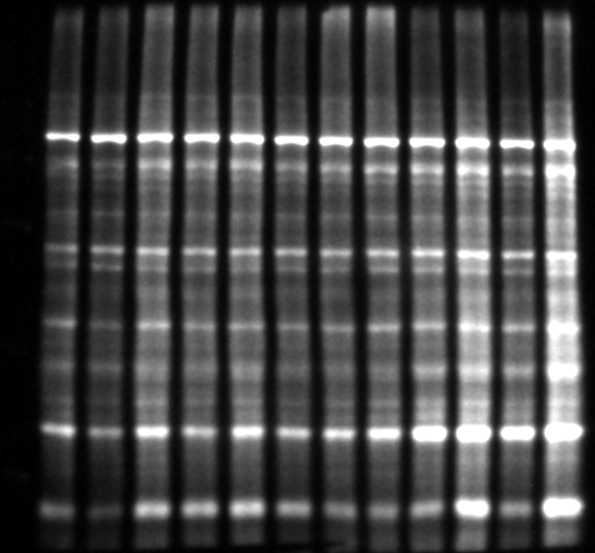
Total S-nitrosylation -scopolamine
Blot A
Blot B
Blot C
M 1 2 3 4 5 6 7 8 9 10 11 12
M 1 2 3 4 5 6 7 8 9 10 11 12
M 1 2 3 4 5 6 7 8 9 10 11 12
Blot D
Blot E
M 1 2 3 4 5 6 7 8 9 10 11 12
M 1 2 3 4 5 6 7 8 9 10 11 12
M-size marker
1,2-control
3,4- Scopolamine
5,6-Scop.+VU0152100
7,8-Scop.+VU0357017
9,10-Scop.+LY487379
11,12-Scop.+CDPPB

Slide 4
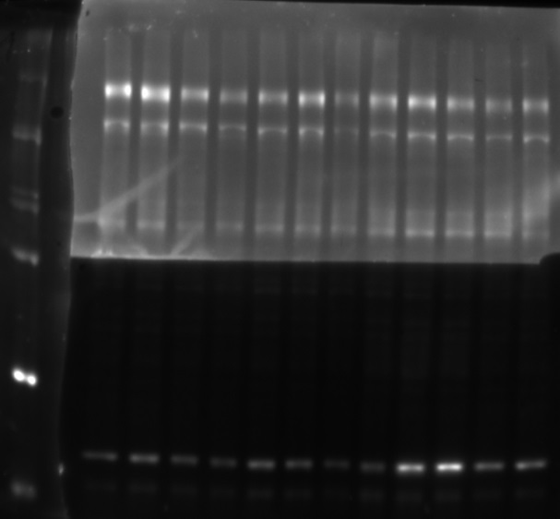
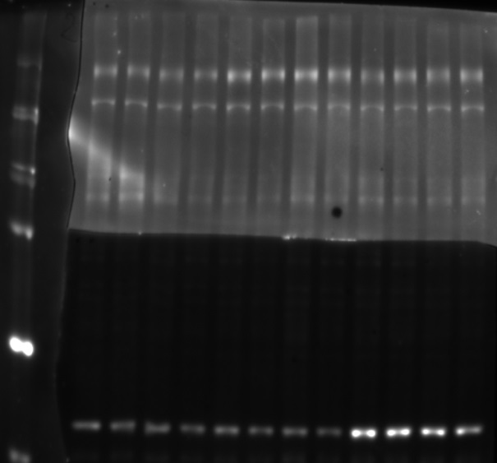
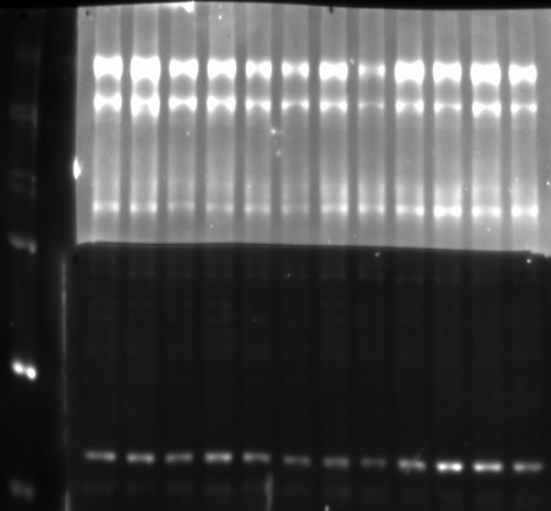

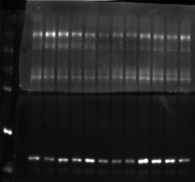
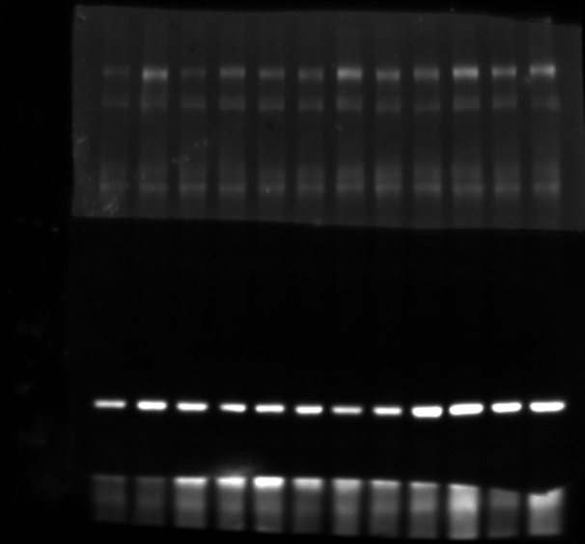
Total protein Actin (42kDa) and APP (103kDa)
Blot A
Blot B
Blot C
M 1 2 3 4 5 6 7 8 9 10 11 12
M 1 2 3 4 5 6 7 8 9 10 11 12
M 1 2 3 4 5 6 7 8 9 10 11 12
Blot D
Blot E
M 1 2 3 4 5 6 7 8 9 10 11 12
M 1 2 3 4 5 6 7 8 9 10 11 12
M-size marker
1,2-control
3,4- Scopolamine
5,6-Scop.+VU0152100
7,8-Scop.+VU0357017
9,10-Scop.+LY487379
11,12-Scop.+CDPPB

Slide 5
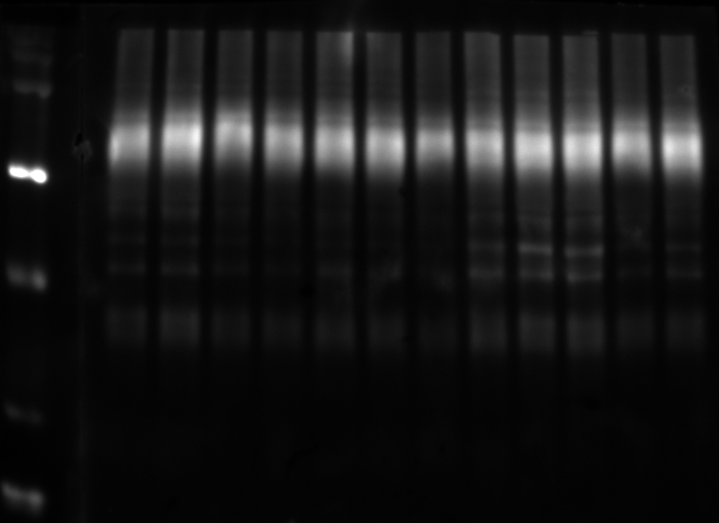
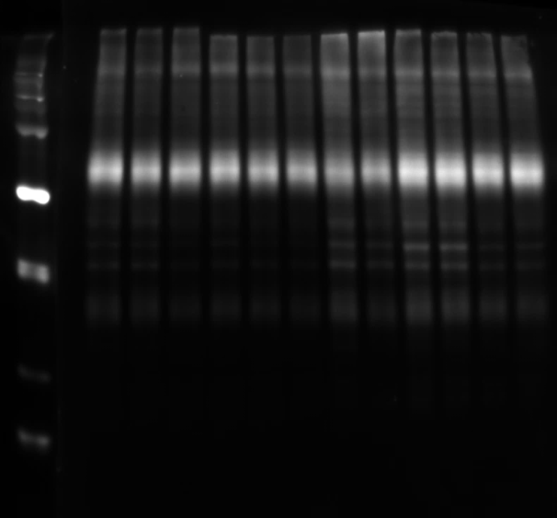
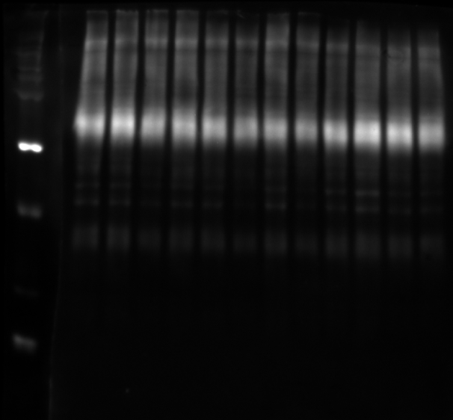
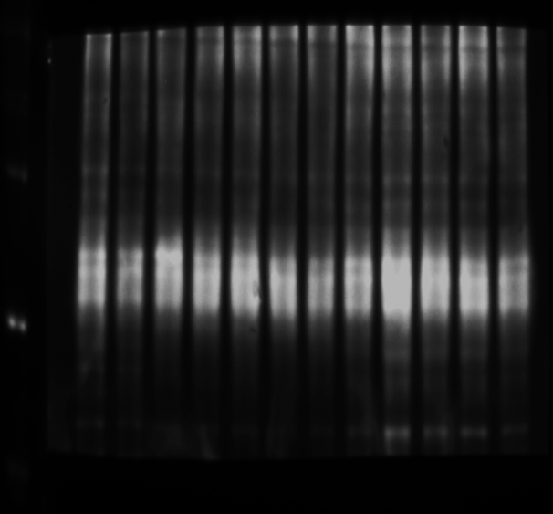
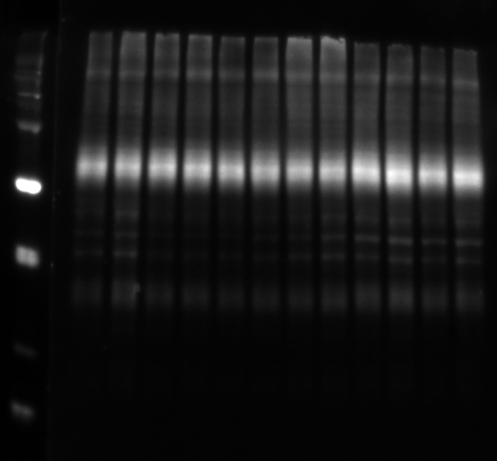
Total protrin Glt-1 (62kDa)
Blot A
Blot B
Blot C
M 1 2 3 4 5 6 7 8 9 10 11 12
M 1 2 3 4 5 6 7 8 9 10 11 12
M 1 2 3 4 5 6 7 8 9 10 11 12
Blot D
Blot E
M 1 2 3 4 5 6 7 8 9 10 11 12
M 1 2 3 4 5 6 7 8 9 10 11 12
M-size marker
1,2-control
3,4- Scopolamine
5,6-Scop.+VU0152100
7,8-Scop.+VU0357017
9,10-Scop.+LY487379
11,12-Scop.+CDPPB

Slide 6
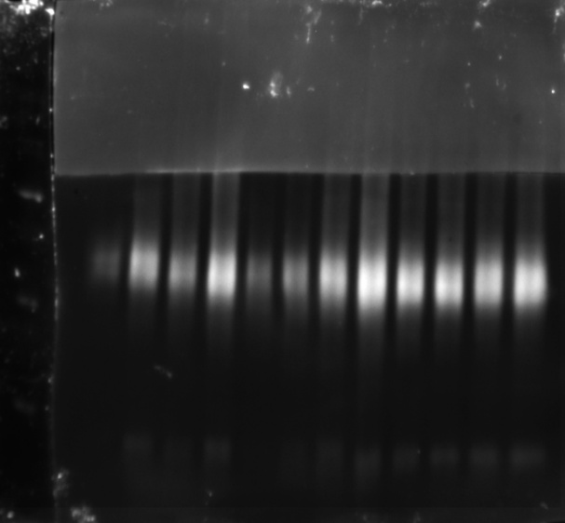
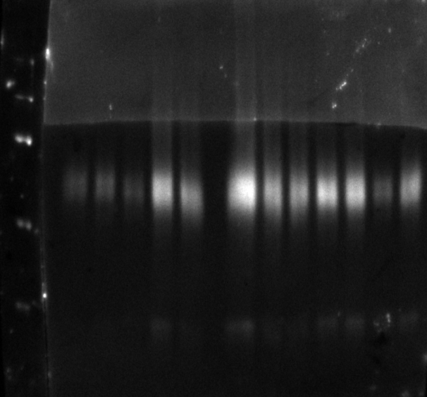
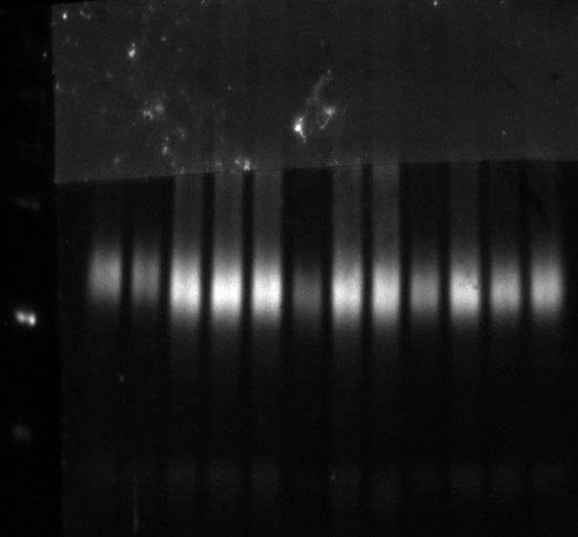
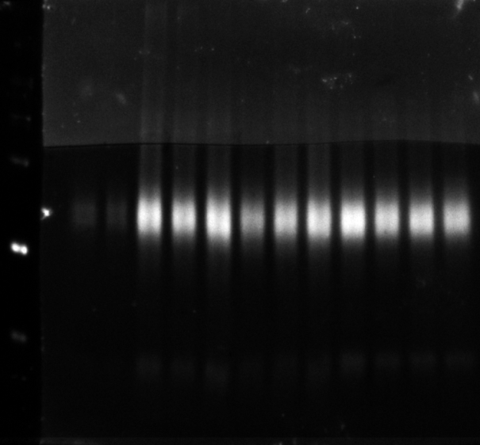
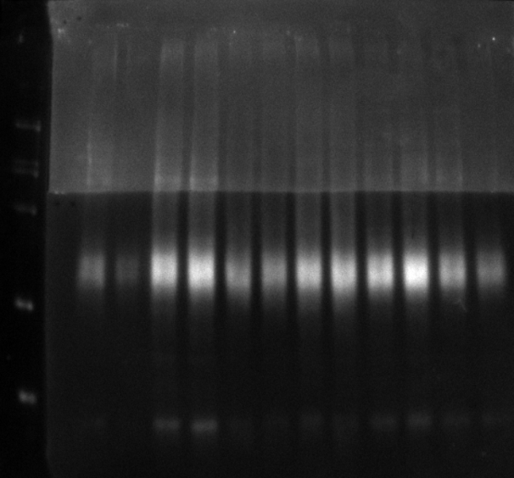
SNO-GLT-1 (62kDa)
Blot A
Blot B
Blot C
M 1 2 3 4 5 6 7 8 9 10 11 12
M 1 2 3 4 5 6 7 8 9 10 11 12
M 1 2 3 4 5 6 7 8 9 10 11 12
Blot D
Blot E
M 1 2 3 4 5 6 7 8 9 10 11 12
M 1 2 3 4 5 6 7 8 9 10 11 12
M-size marker
1,2-control
3,4- Scopolamine
5,6-Scop.+VU0152100
7,8-Scop.+VU0357017
9,10-Scop.+LY487379
11,12-Scop.+CDPPB

