Slide 1
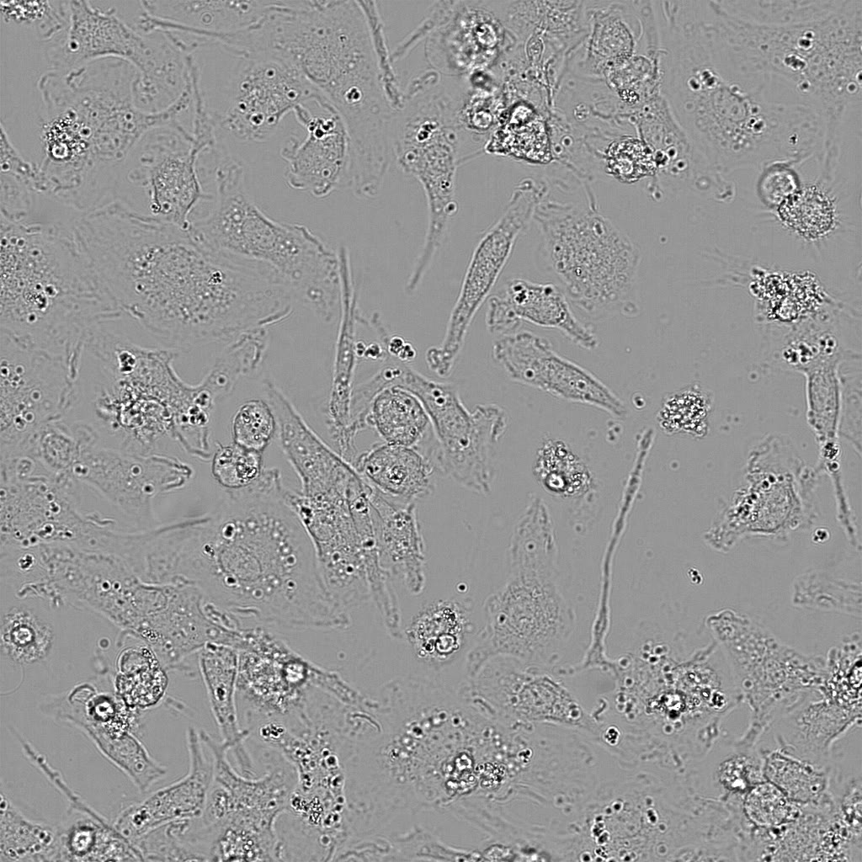
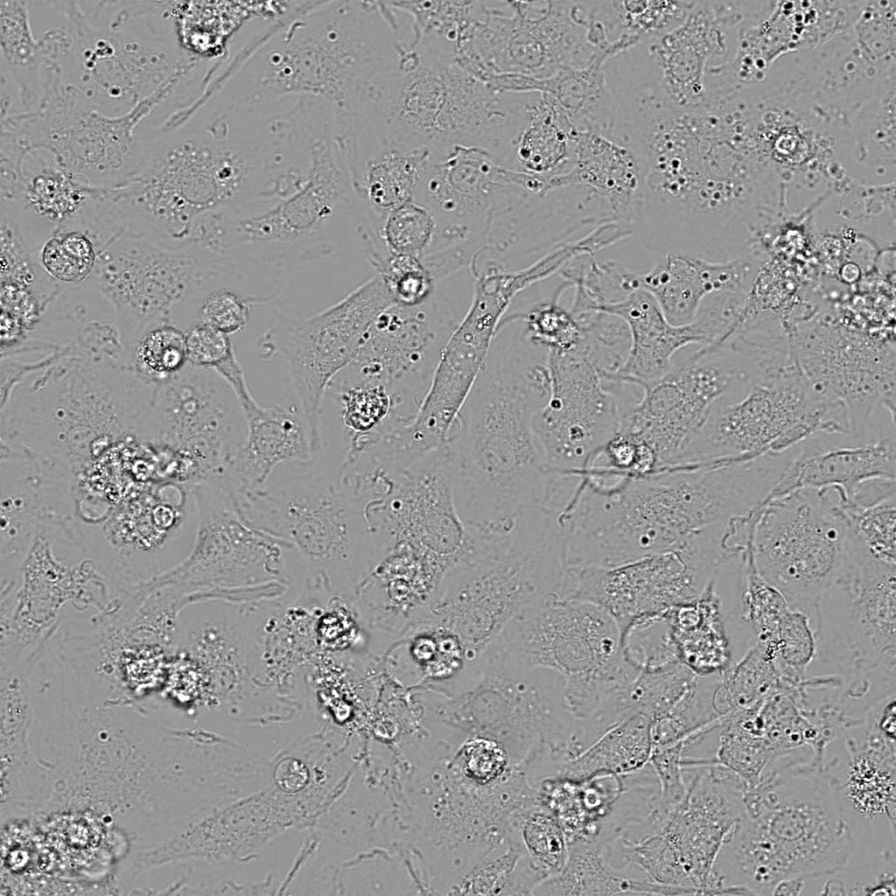
venetoclax
Wt
Ninj1–/–
Kayagaki et al., Supplementary Video 3

