Slide 1
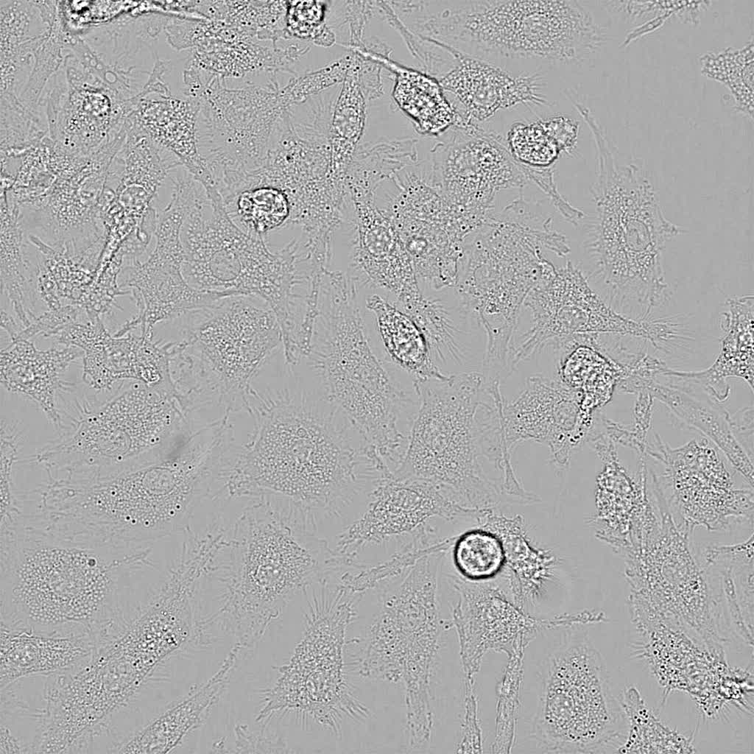
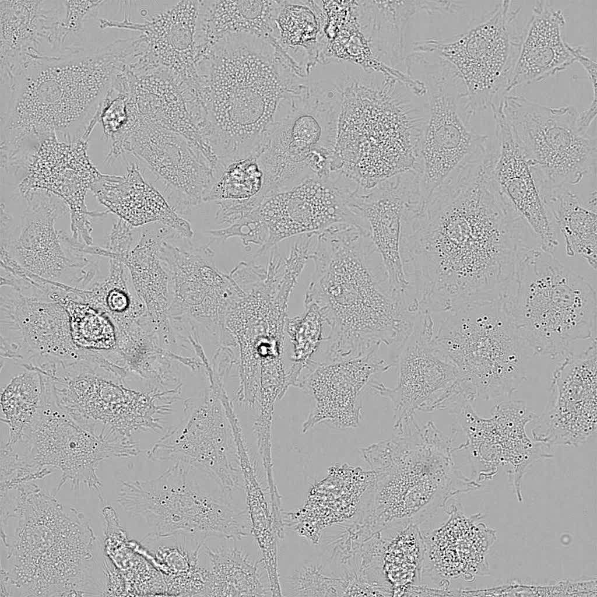
LPS
Wt
Ninj1–/–
Kayagaki et al., Supplementary Video 2

